Slide 1
Eco System of Lake Pétervására and Tarna Stream, Hungary

Slide 2
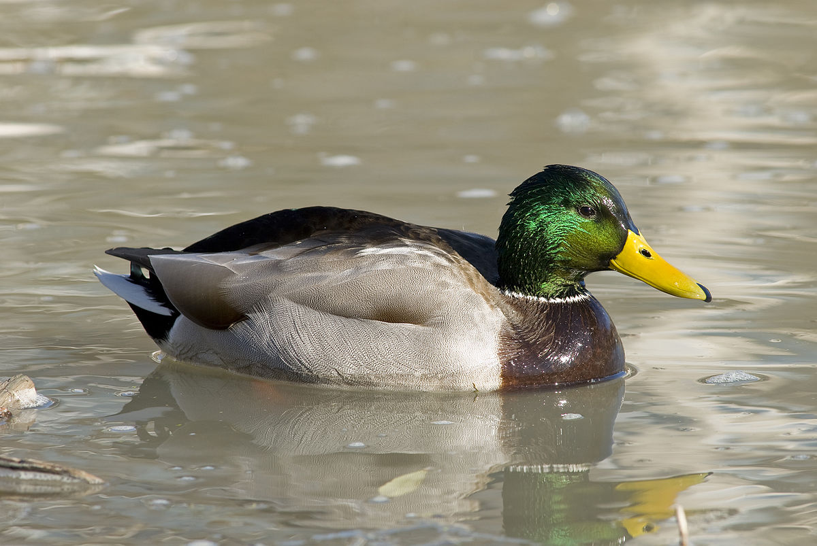
Duck

Slide 3
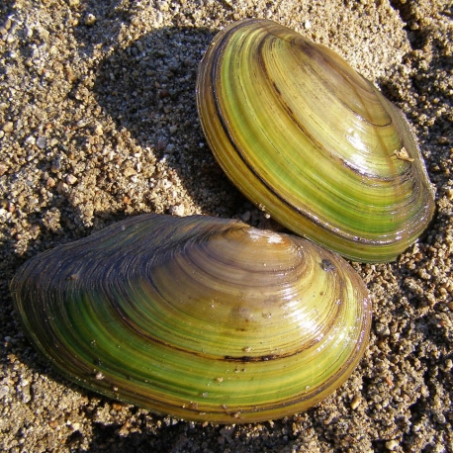
Lake shell

Slide 4
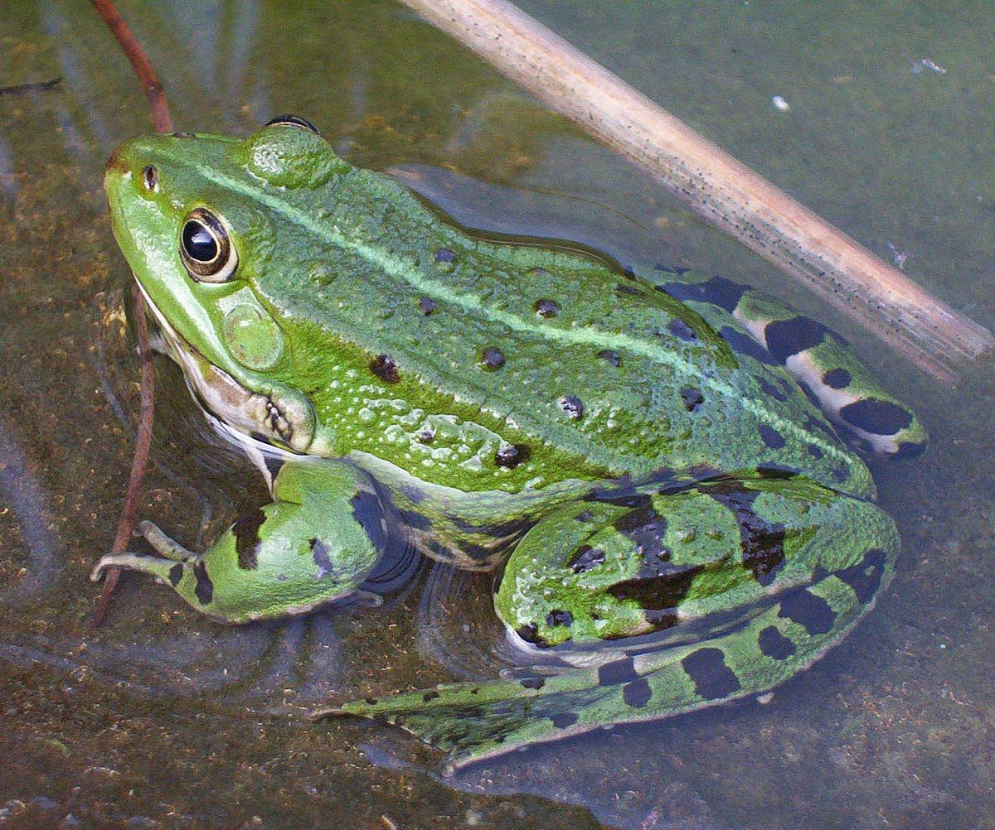
Frog

Slide 5
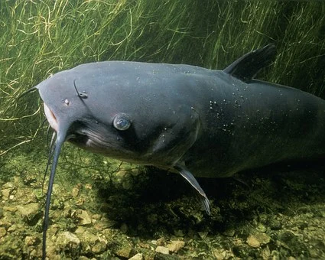
Catfish

Slide 6
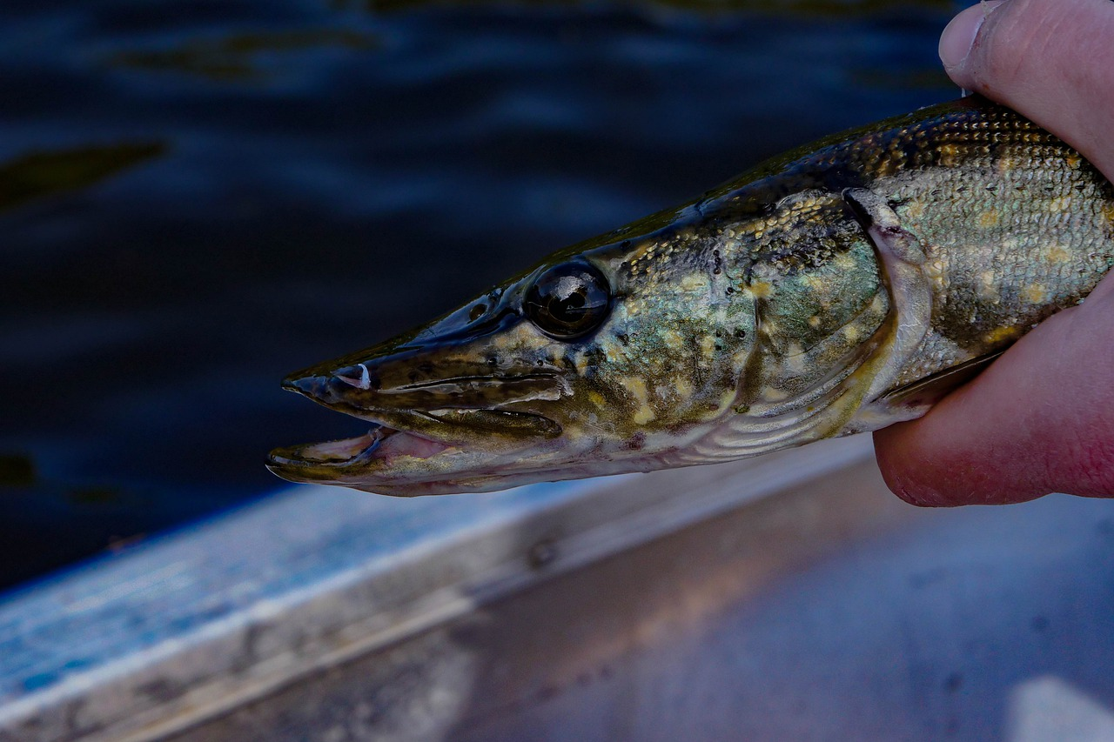
Pike

Slide 7
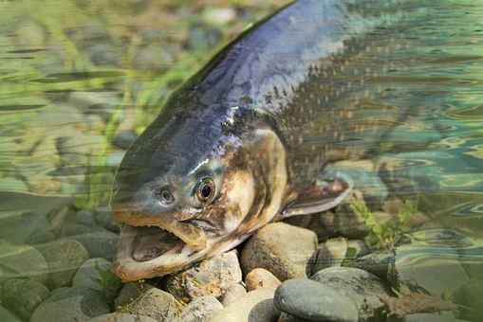
Trout

Slide 8
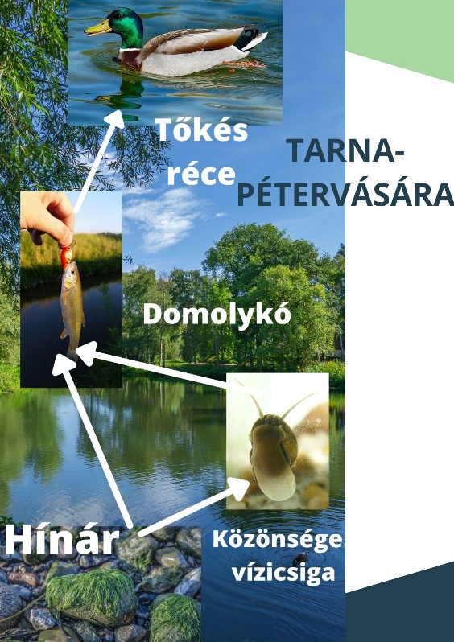
Eco-System of Tarna

