Slide 1
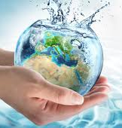
WATER AND LİFE
Defne KAÇMAZ

Slide 2
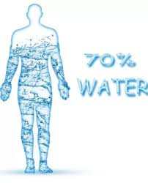
The importance of water in human life
Water is very important for living things to survive
We can only last 3 days without drinking water
Water is foundation of life
İf there was no water , it wouldn’t be alive
2/3 of the human body consists of water

Slide 3
Every systems in the human body require water to function
Water is also very important in hygiene
Water adjusts body temperature
Water is essential for the skin
İn short, WATER İS LİFE

Slide 4
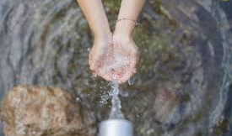
WHY İS WATER IMPORTANT
Saliva
Body Temparature
Toxins
Digestion
Nutrients
Physical activity
Energy
Immunity
Anti-aging
Dehydration
Circulation
Bowel movements

