Slide 1
Fish and aquatic creatures
Derecik Eylül
Derecik Sehit Yasin Boy Ortaokulu
eylulsngl@outlook.com

Slide 2
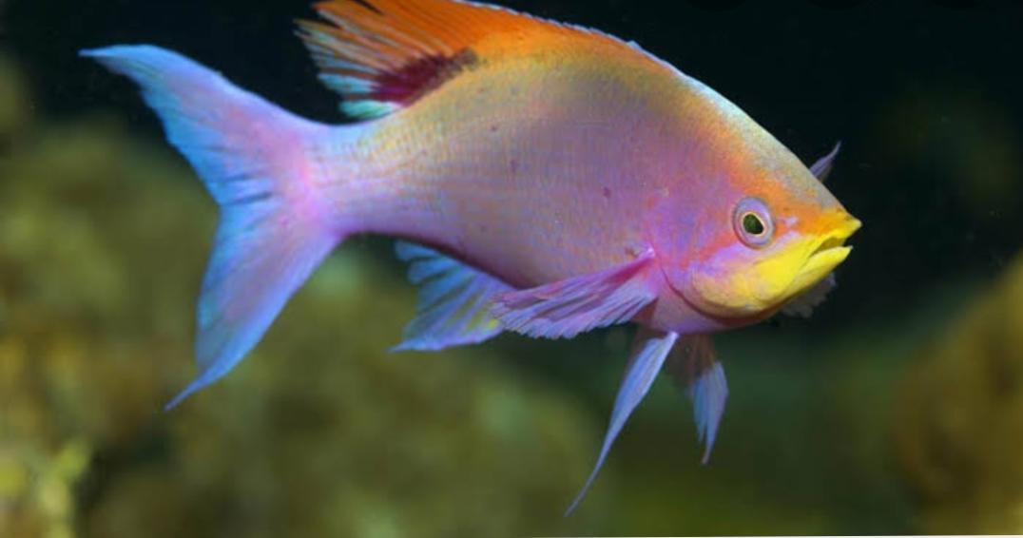
The Importance of Water for Fish
Water is very important for fish. Without water, fish and other aquatic creatures cannot.

Slide 3
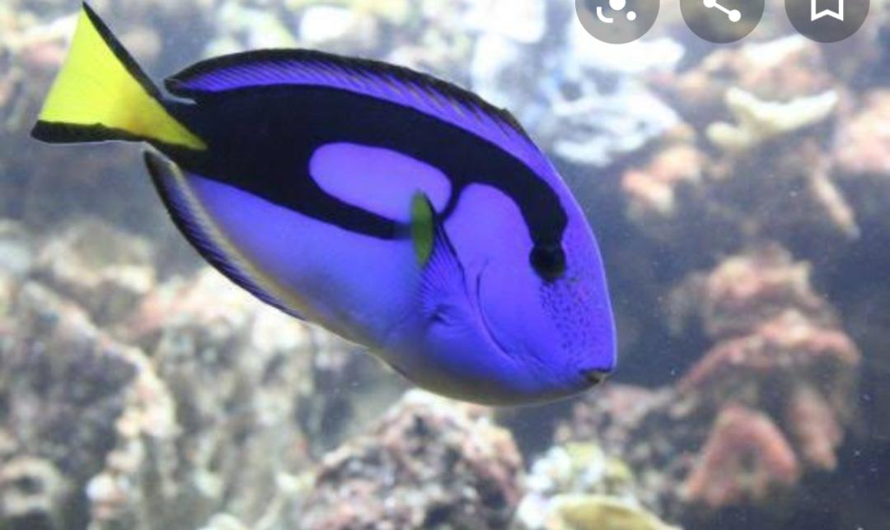
Water is the source of life for fish. Without water, they cannot. Some fish are about to become extinct. So let's not fish for nothing.

Slide 4
