Slide 1
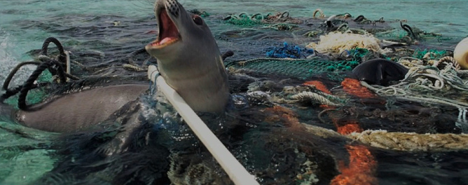
Water pollution
This Photo by Unknown Author is licensed under CC BY-ND
Evan Antonio Ottomano – 1c Silvia Viterbo

Slide 2
What creates water pollution ?
The World Health Organisation (WHO) defines water pollution as water that has been changed to the point it becomes unusable, in other words this water become impossible to consume and can cause diseases such as diarrhoea, typhoid and polio that kills over 500,000 people around the world every year.
Causes of water pollution are global warming, deforestation, industries, livestock farming and oil spillages.
One of the main causes of water pollution happens when people throw plastic, paper, chemicals and other stuff in the ocean. As a result, fish consume the plastic which effect what we eat.

Slide 3
What could we do to prevent water pollution?
First of all, we could minimize the consumption of carbon dioxide to prevent global warming as well as the waste from industrial factories.
We should also invest in substituting plastic with biodegradable plastic so in that way the fish that we eat aren’t contaminated.
Reduce the use of chemical pesticides and invest in organic farming.
Investing in sustainable fishing to help survival of species and the ocean will be more populated.
This Photo by Unknown Author is licensed under CC BY

