Slide 1
Human Body, Plants and Water
DERECİK ELİF
Derecik Şehit Yasin Boy OrtaOkulu
Notes:
1

Slide 2
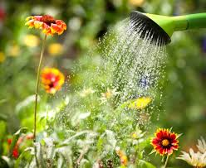
Water dissolves the nutrients required by the plant, so that it is absorbed by the roots and the absorbed nutrients are carried within the plant.
Notes:
2

Slide 3
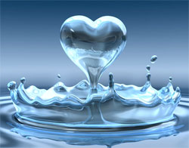
1. The Importance of Water for Humans
2/3 of our body
is water
Protect the hearts
Notes:
3

Slide 4
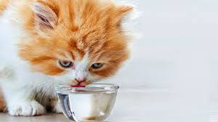
2. The Importance of Water to Animals
Animals cannot survive more than 3-4 days without water
In general, 60% of the body of an adult animal is water, this rate is even higher in offspring
Notes:
4

Slide 5
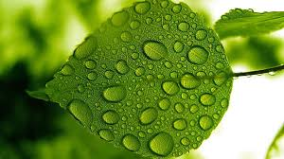
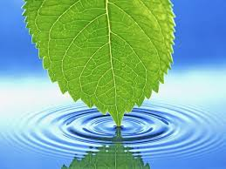
3. The Importance of Water for Plants
Water dissolves the nutrients required by the plant, so that it is absorbed by the roots and the absorbed nutrients are carried within the plant.
Water provides the germination of the plant and the vitality of the organs such as cells, stems, branches and leaves.
Notes:
5

