Slide 1
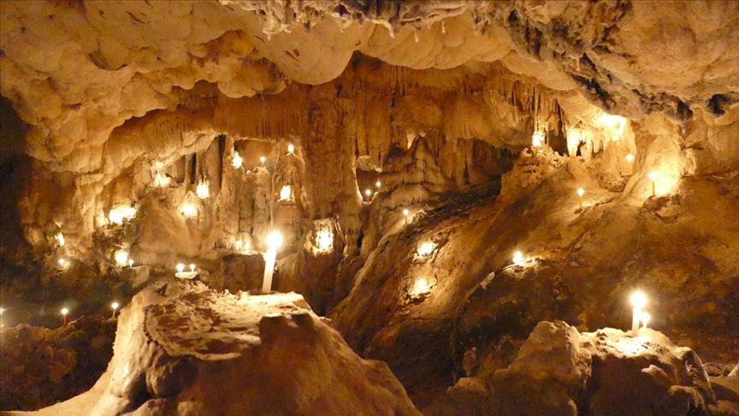
Caves
Caves are natural places

Slide 2
Caves formation
Caves can be formed many diffrent ways. The basic condition for the formation of a cave is the presence of crack or rift system trought this water.

Slide 3
This is water cave

Slide 4
This is ice cave

Slide 5
This is lava cave

Slide 6
They are stalacites

Slide 7
They are stalagmites

