Slide 1
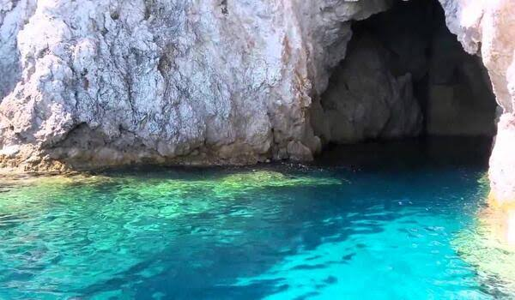
Water and Caves
Derecik Esmanur
Derecik Şehit Yasin Boy Secondary School

Slide 2
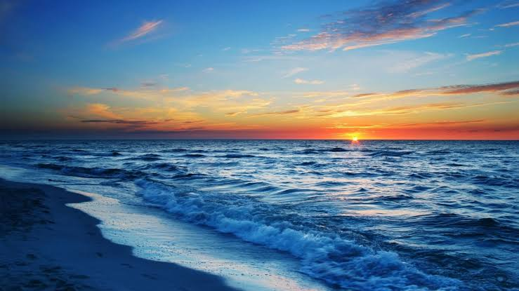
water is very important to us.

Slide 3
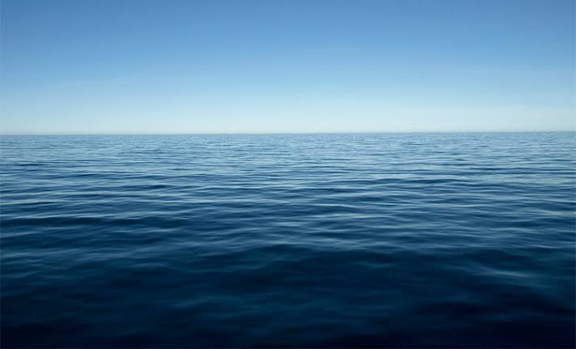
Water use doubled between 1940 and 1980. 4/3 of our body is covered with water

Slide 4
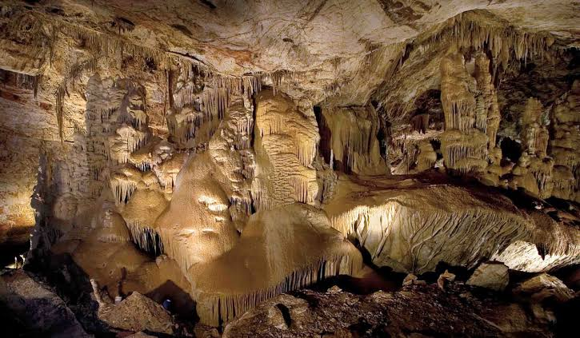
The basic condition for the formation of a cave is the presence of a system of cracks or crevices through which water can move.

Slide 5
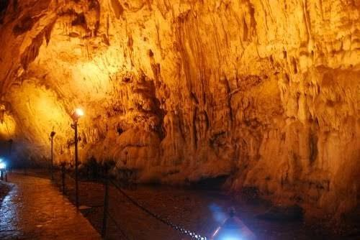
Caves in Turkey,
an estimated 30-35 thousand.

Slide 6
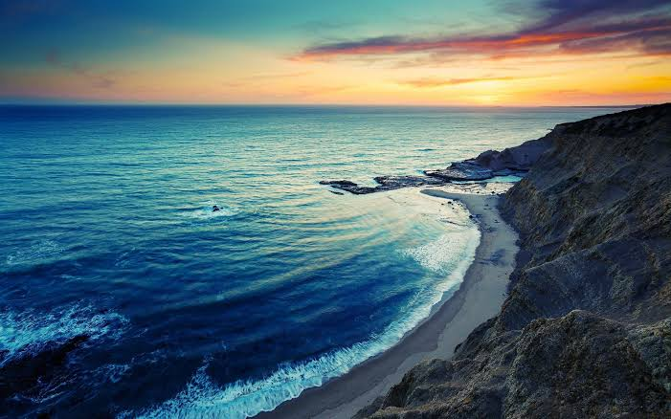
Water is vital for living things to live. It is water that sustains all biological life and all human activities, from the smallest living organism to the largest creature.

