Slide 1
FISH LIVING IN MY AREA
THE MEDITERRANEAN SEA IS RICH IN SPECIES DIVERSITY.
IT CONTAINS AROUND 7% OF ALL SPECIES IN THE WORLD.
MEDITERRANEAN FISH SPECIES ARE 712, FROM THE SHARK TO THE SHRIMP OR ANCHOVY.

Slide 2
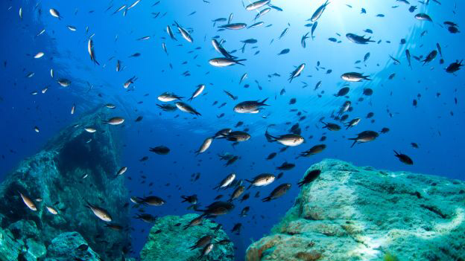
I LIVE IN PUGLIA AND ON OUR COAST WE FISH ANCHOVIES, SHRIMPS, MUSSELS.

Slide 3
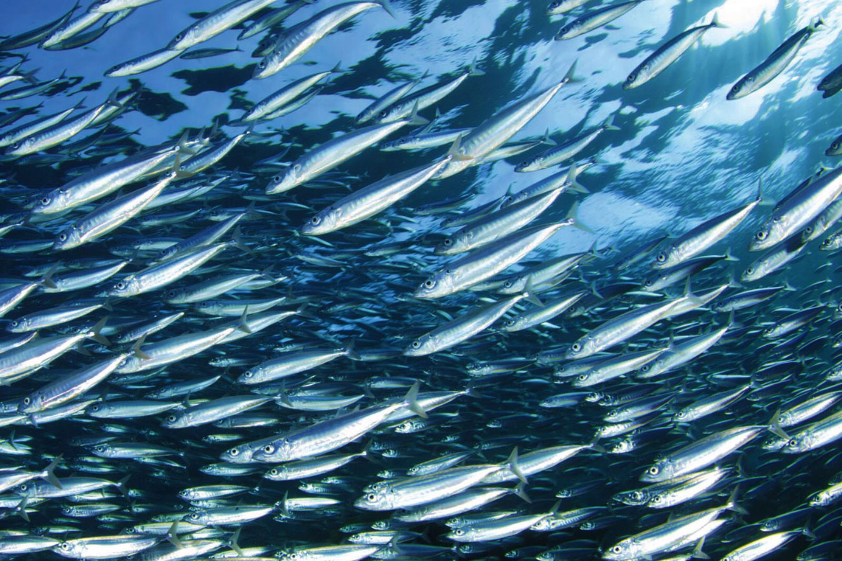
ANCHOVIES
In spring and summer anchovies come back to the coast to reproduce.
They are long and sharp, green or light blue on the back and silver on their side.
They live in big groups.
They are the most fished in the world.

Slide 4
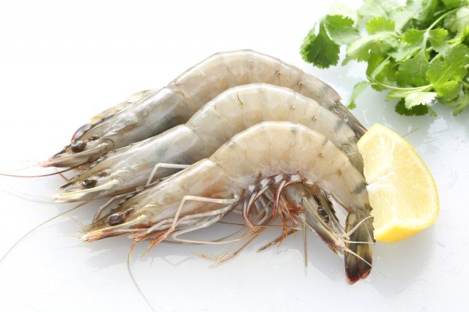
MAZZANCOLLA ( ITALIAN BIG SHRIMP )
IT IS A MEDIUM SIZE CRUSTACEAN.
IT IS A NATIVE MARINE FISH SPECIES, IT IS CHARACTERIZED BY A WHITE AND COMPACT MEAT.
IT HAS BLUE SHADOWS ON THE CARAPACE.

Slide 5
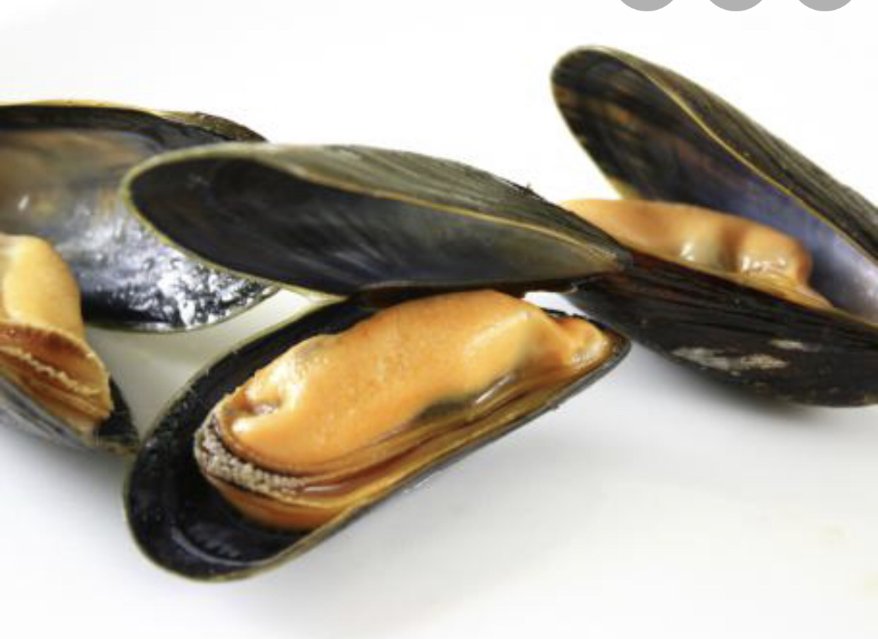
MUSSELS
THEY ARE LIKE A BLACK DROP OUTSIDE AND SOFT AND ORANGE INSIDE.
THEY LIVE CLINGING IN GROUPS ON THE ROCKS.

Slide 6
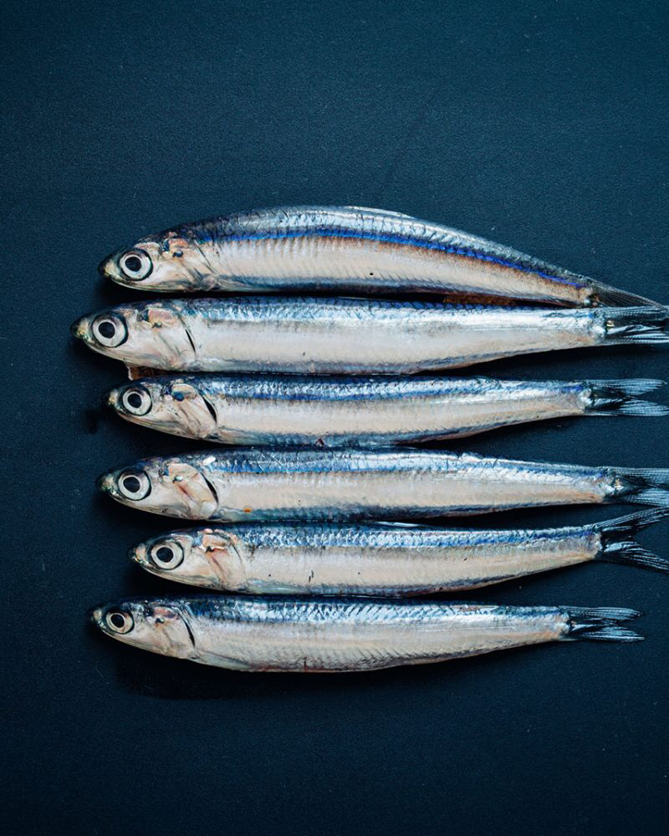
OUR SEA IS ALSO RICH OF BLUE FISH
Blue fish are some species that have blue or green colour on the back and silver belly.
They are for example SARDINE AND MACKEREL.
They contain a lot of nutrients like D vitamin, Omega 3, calcium and iron.

Slide 7
WE ARE VERY LUCKY TO HAVE SO MANY FISH SPECIES IN OUR MEDITERRANEAN DIET.

