Slide 1
WATER POLLUTION
Derecik Beray
Derecik Şehit Yasin Boy Secondary School
Today, we will learn about water pollution, the factors that cause water pollution and the harm of water pollution to living things. Let's examine them about the ingredients.

Slide 2
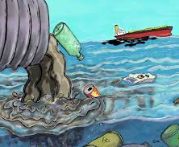
1.Water Pollution
Water pollution occurs when poisons, factory wastes, animal wastes and so on mix into our waters.

Slide 3
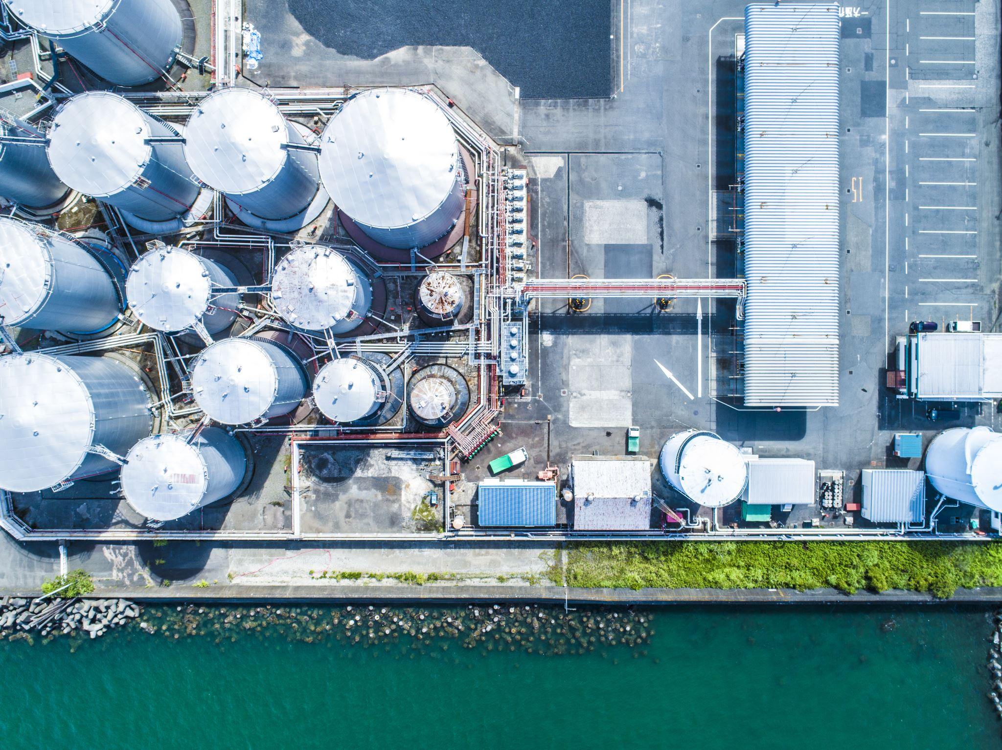
2. Factors Causing Water Pollution
We can list the factors that cause water pollution as follows.
1. sewage water
2. chemical waste
3. factory waste
4. plastic waste
5. gasoline
6. algae

Slide 4
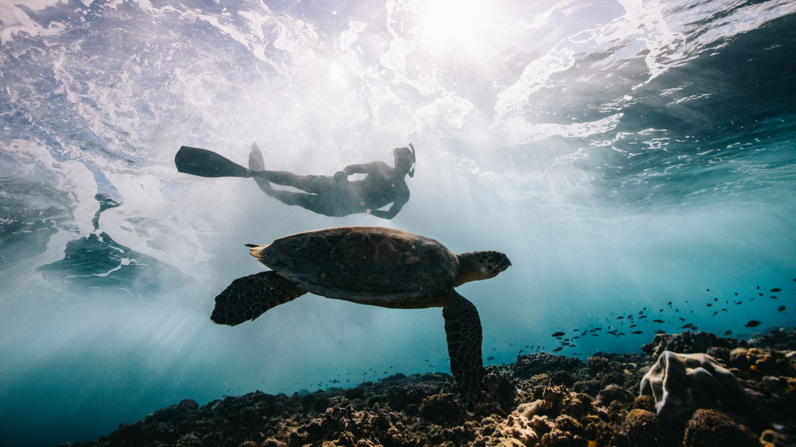
3.Water Pollution Harms to Living Creasture
Water pollution is a nightmare for every living creature. If all our water is polluted, we have no water left to use. And this situation will be very bad. Because it is the water that allows people to live. Water pollution is very bad for us. We still continue to pollute our water even though we people know this. "STOP!" Let's say and not pollute our water.

