Slide 1
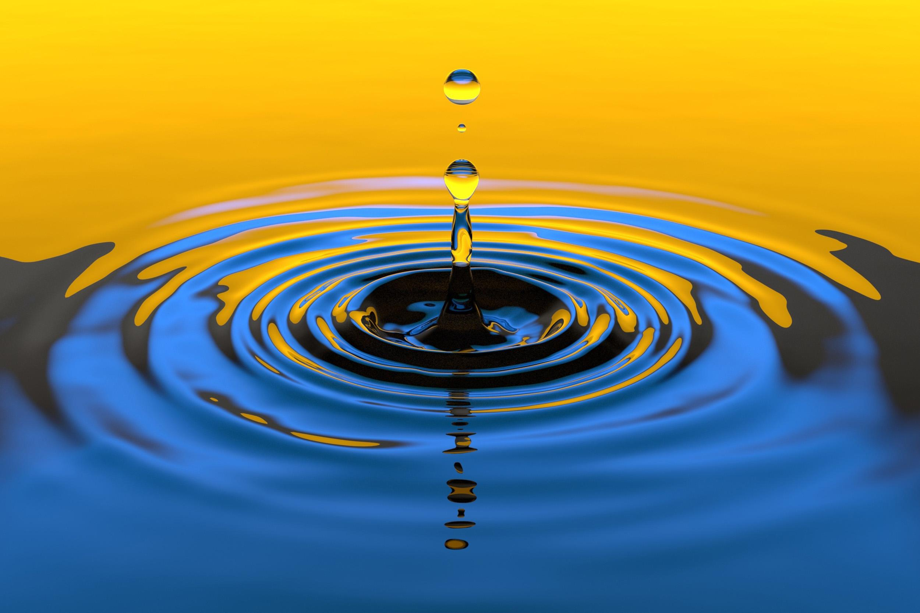

Slide 2
WATER and Life
The life of every living creature is an indispensable natural resource for water.All living things in the world live with water.Again,the majority of the world is covered with water.Therefore,we should appreciate our water resources and not pollute our water.With the rapid increase of industrialization in recent years,the rapid increase of the population,more water is needed and our water becomes more polluted.For this,state authorities should take necessary precautions regarding water.People may live hungry for a few weeeks,but it is wery difficult to live this long without water.

Slide 3
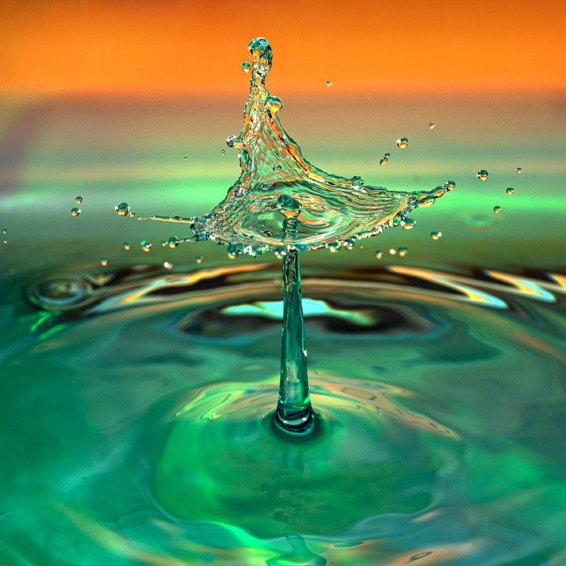
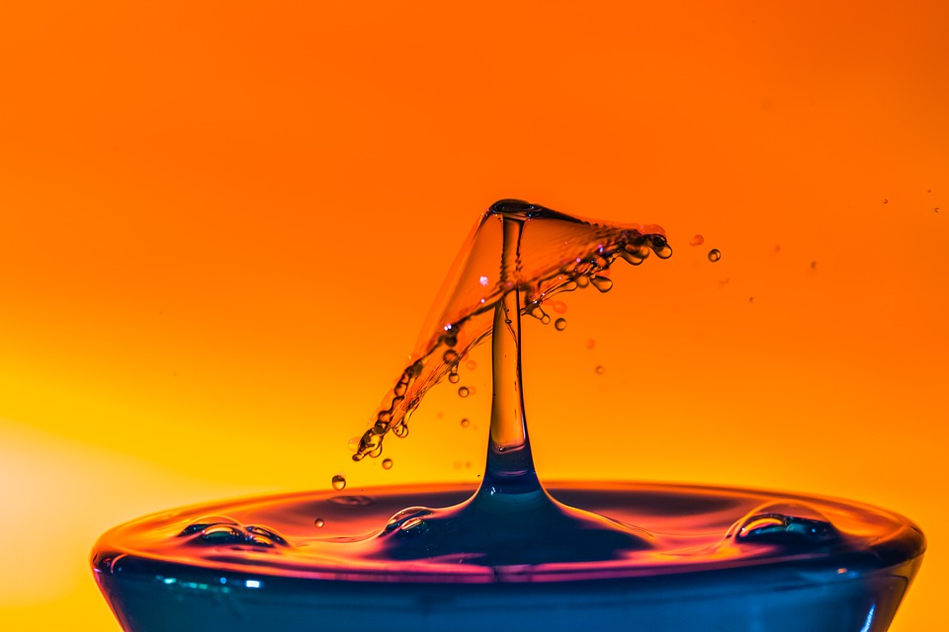
We must not pollute oceans,seas,streams,waterfalls.In this around,each of us should be conscious citizen.

