Slide 1
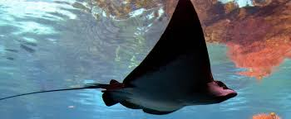
Poisonous undersea creatures: stingrays
submarine creatures
Stingrays can be considered the largest of the poisonous fish. At least the tail of the stingrays is 37 cm in long.
Each needle is wrapped in a toxic film and mucus.
Each can move in the direction.

Slide 2
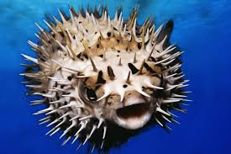
LIVES THAT TIME POISONED
Pufferfish Poisoning: liver, intestines, skin and ovaries neurotoxin
Porcupine fish containing tetrodotoxin can poison if eaten.

Slide 3
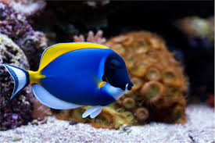
FISHES CAUSING CUTS
Surgeon Fish: It has sharp fins called scapelles. It can cause cuts.

