Slide 1
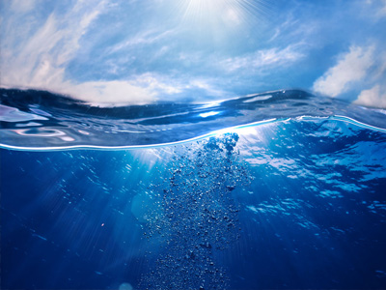
Water pollution
Keep the waters clean

Slide 2
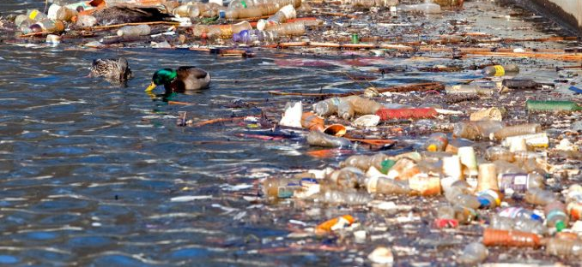
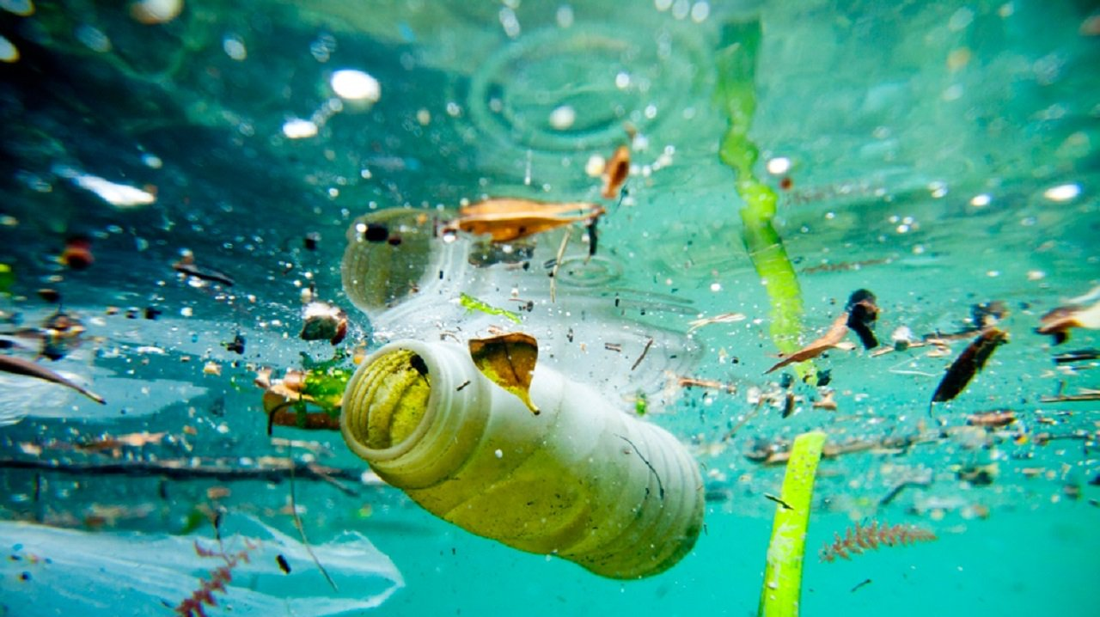
If we don't want this happen, let's be careful.

Slide 3
Water is life
A good future means clean water.
Which one looks healthier? Of course the clean water. ➔

