Slide 1
Aquarium Ecosystem
What are the roles of the bacteria in aquariums?
bacteria in aquariums take care of the degradation of pollutants and maintain biological balance

Slide 2
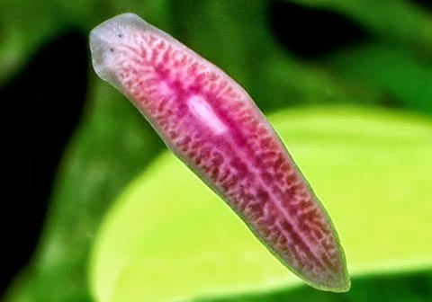
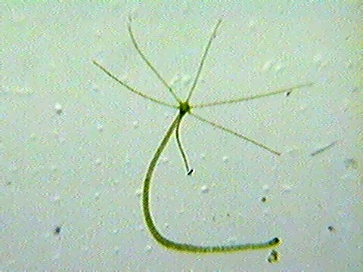
These are just some bacteria:
PLANARY
HYDRA

Slide 3
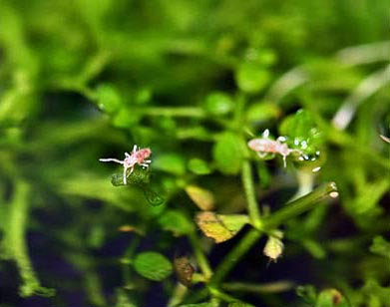
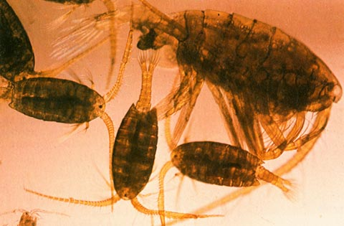
COLLEMBOLI
COPEPODES

