Slide 1
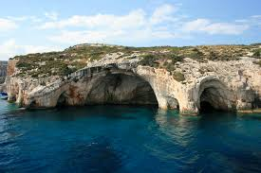
Today we are gonna learn water caves.
Water caves, coastal caves, caves formed on steep cliffs as a result of wave movements in the sea or lakes.

Slide 2
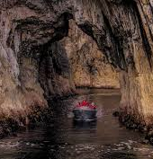
water caves
Water caves are seen on rocky ends or coasts where the waves break directly against the rocks.

