Slide 1
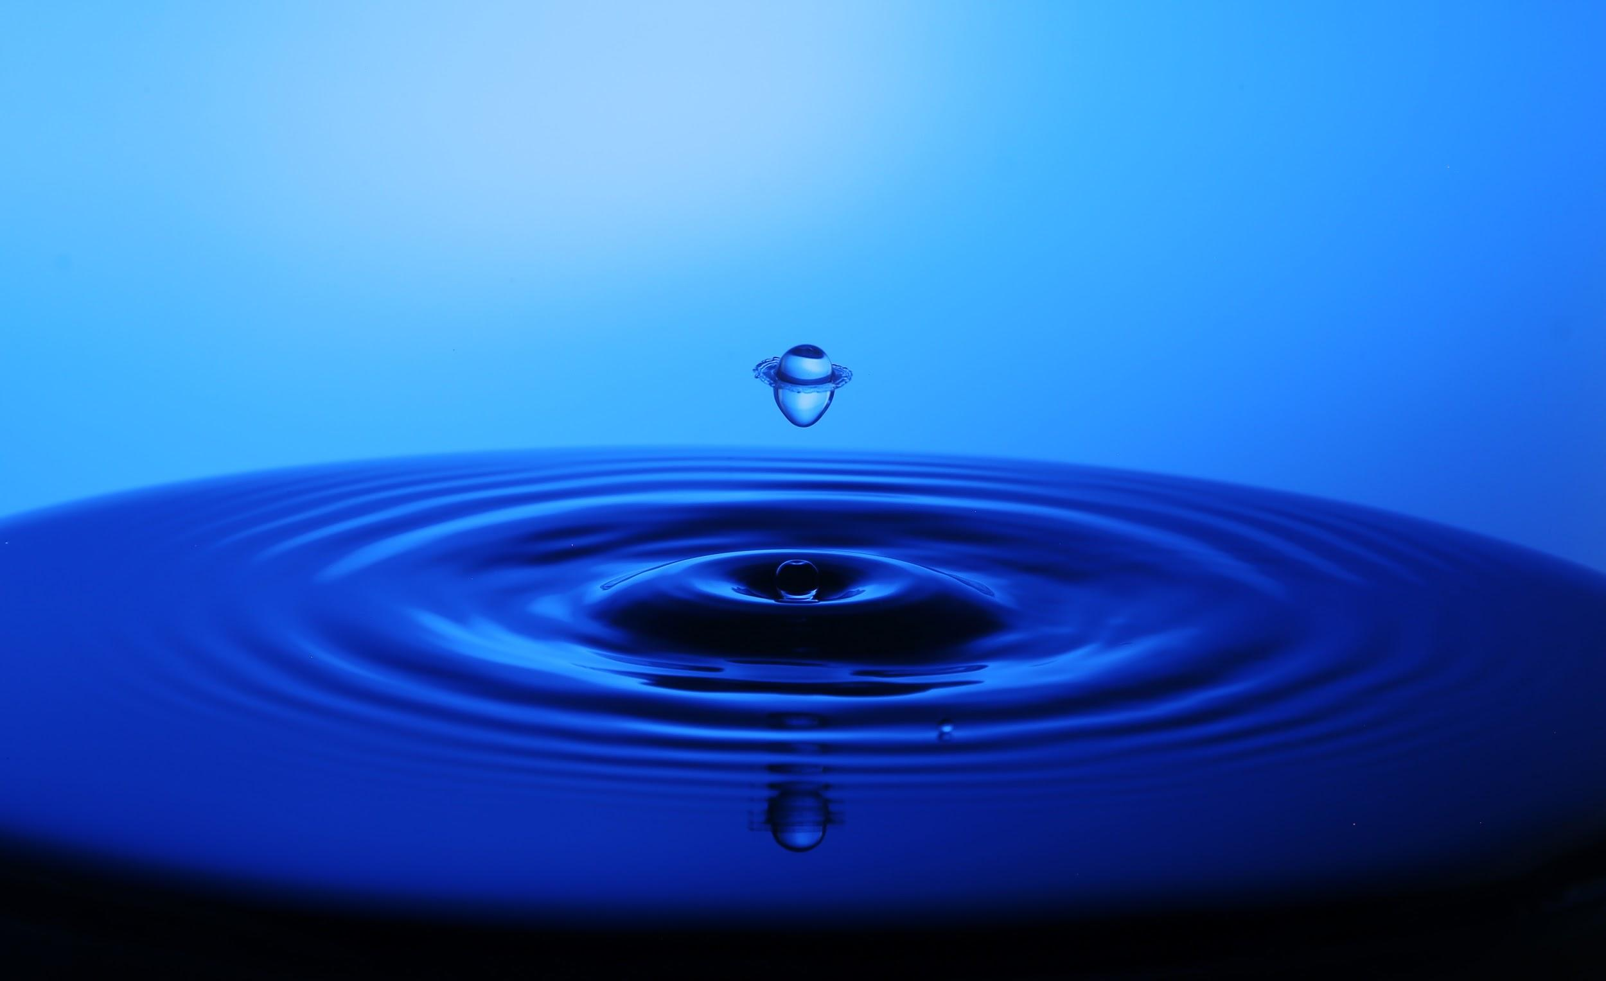
WITHOUT WATER THERE IS NO LIFE!

Slide 2
THE WATER PRESENT ON EARTH MAKES UP THE HYDROSPHERE, 97% OF WHICH IS CONTAINED IN THE SEAS AND OCEANS

Slide 3
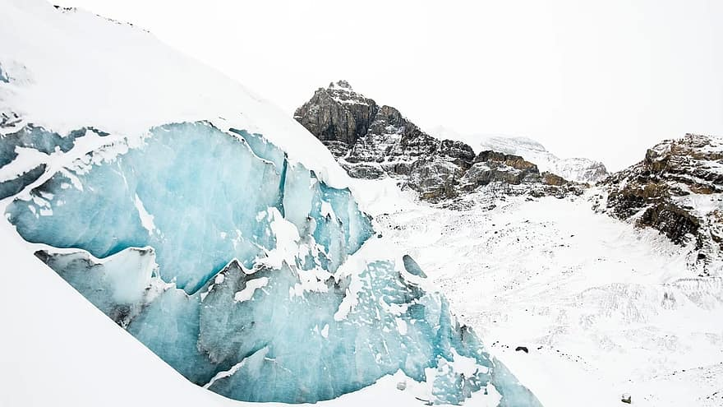
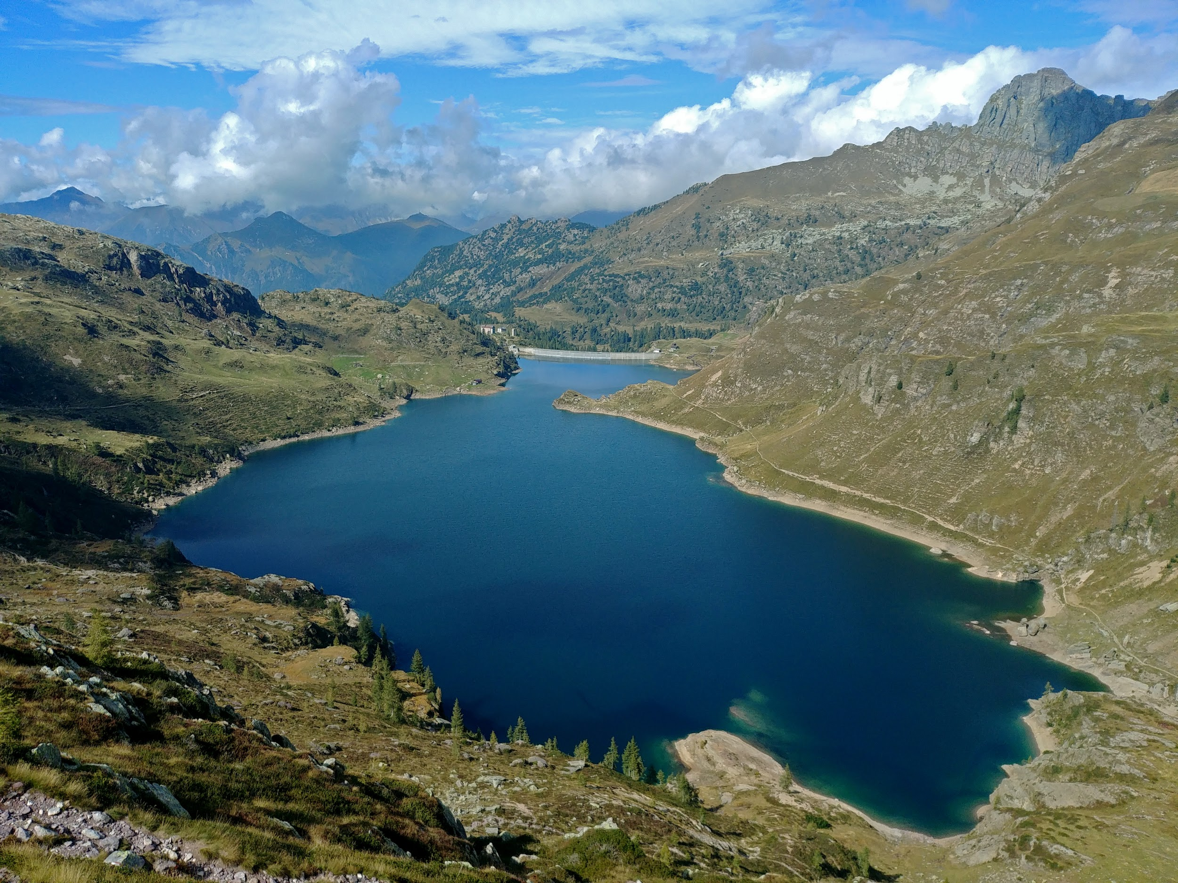
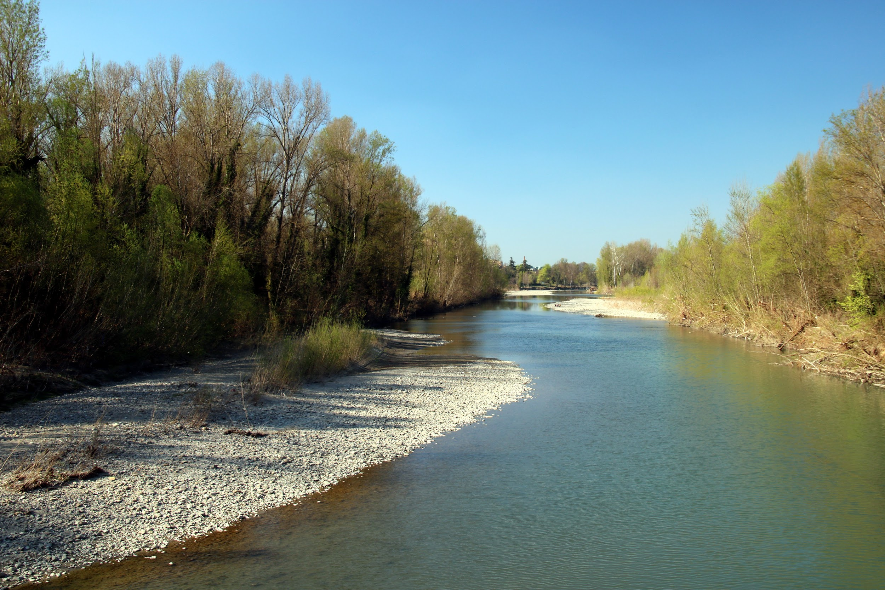
THE REST OF THE WATER IS DISTRIBUTED IN GLACIERS, LAKES, RIVERS

Slide 4
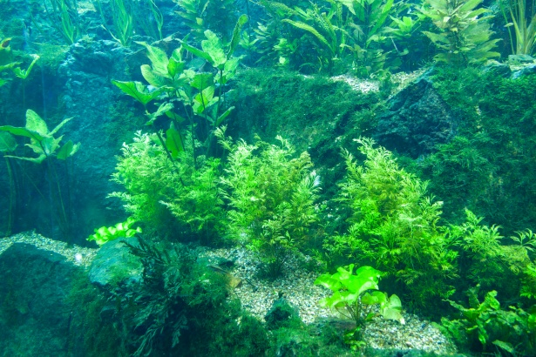
WATER IS ESSENTIAL FOR PLANT LIFE

Slide 5
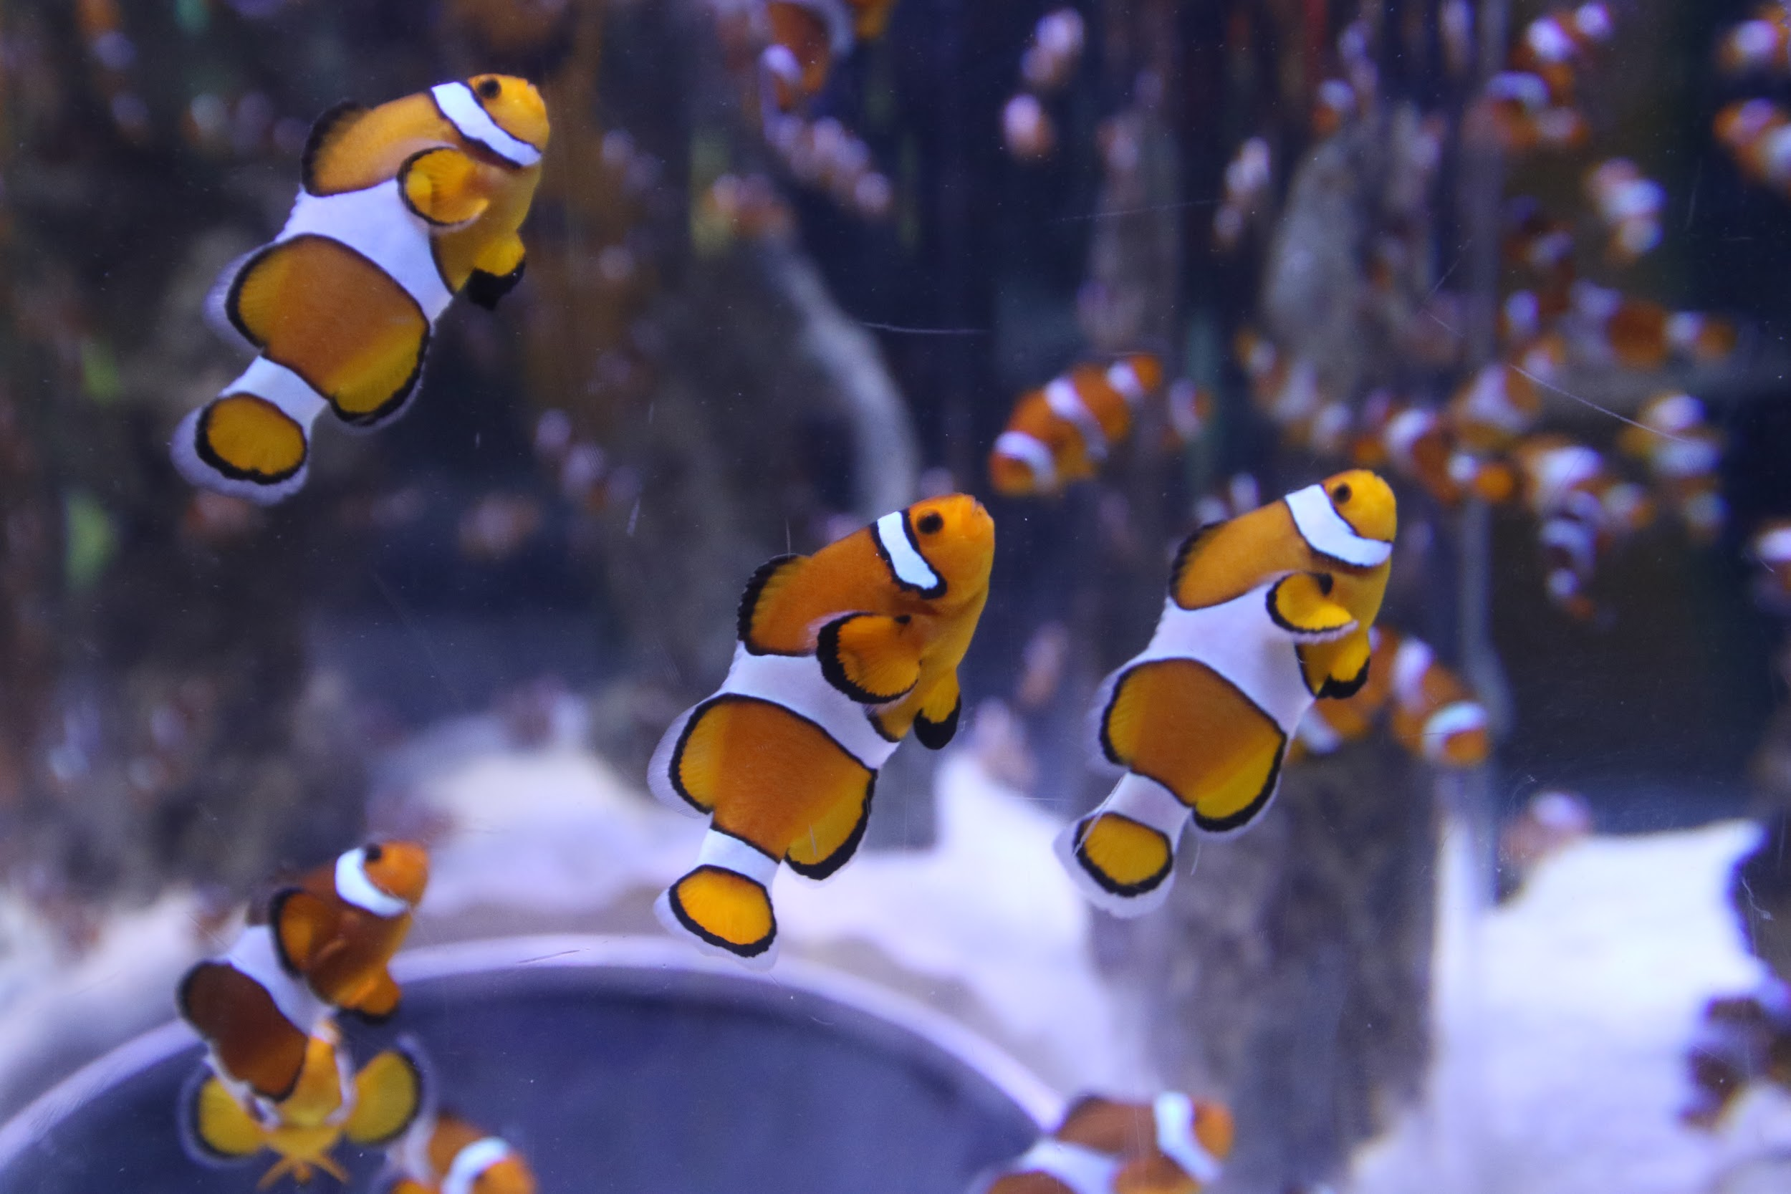
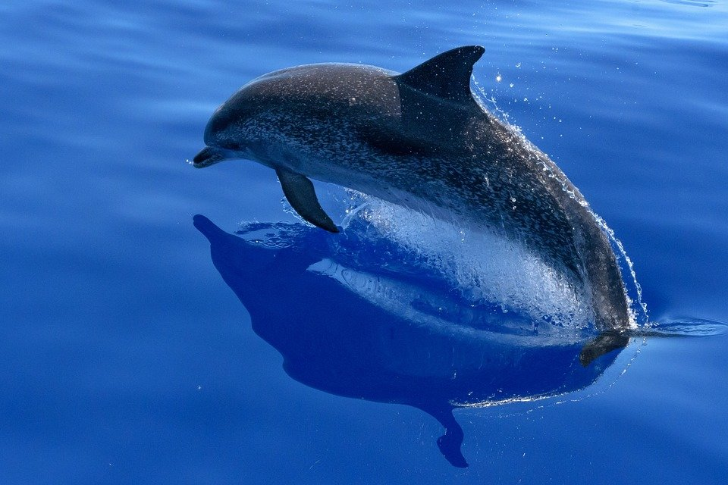
MARINE ANIMALS REPRESENT A LARGE AMOUNT OF THE FAUNA OF OUR PLANET

Slide 6
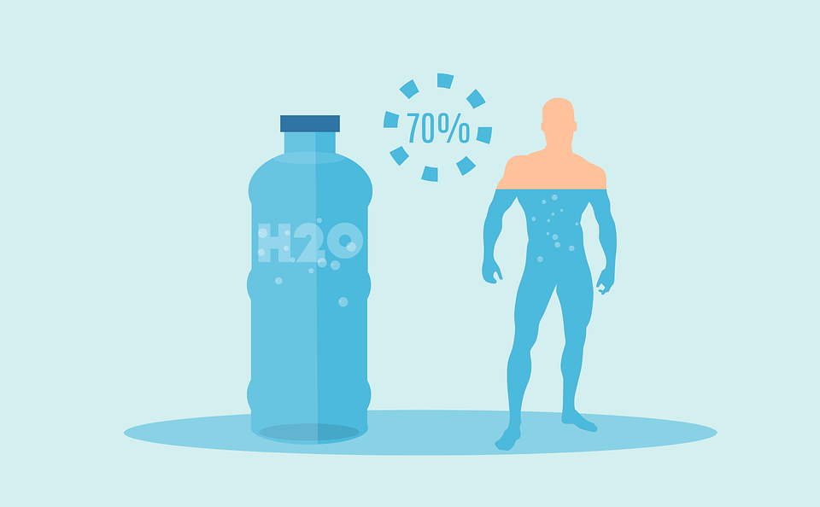
THE PERCENTAGE OF WATER IN THE HUMAN BODY IS 70%.
WATER CONTAINS NUTRIENT, ESSENTIAL MINERALS FOR THE FUNCTIONING OF THE HUMAN BODY.

Slide 7
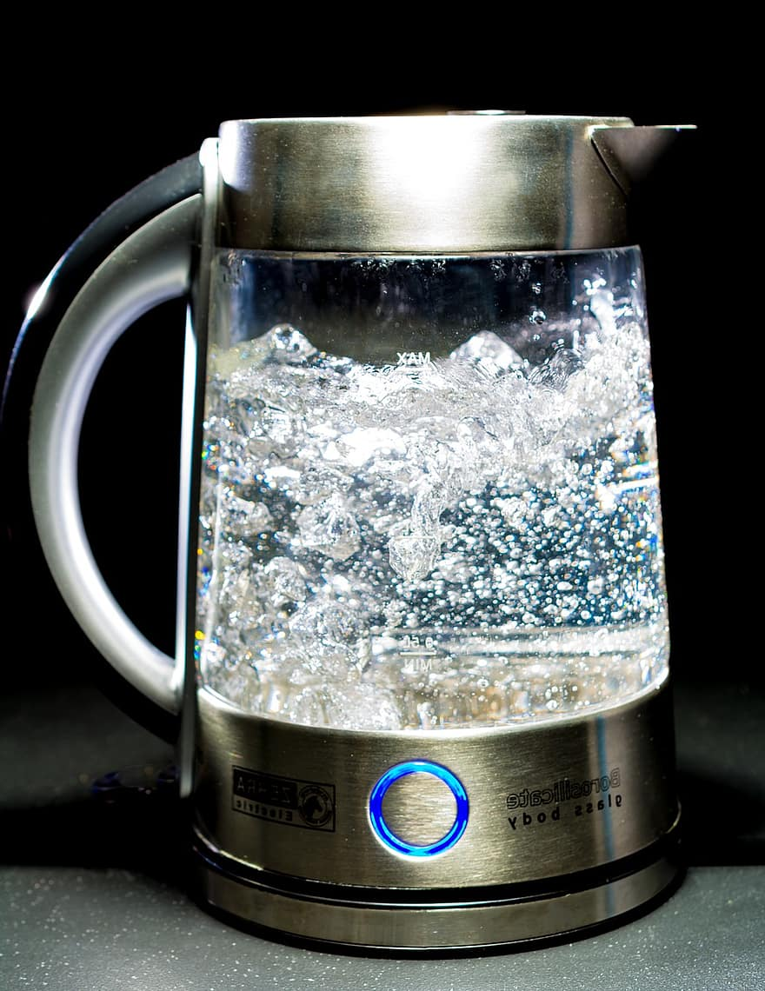
WATER IS A PRECIOUS COMMODITY IN OUR DAILY LIFE

