Slide 1
photosynthesis of the sea

Slide 2
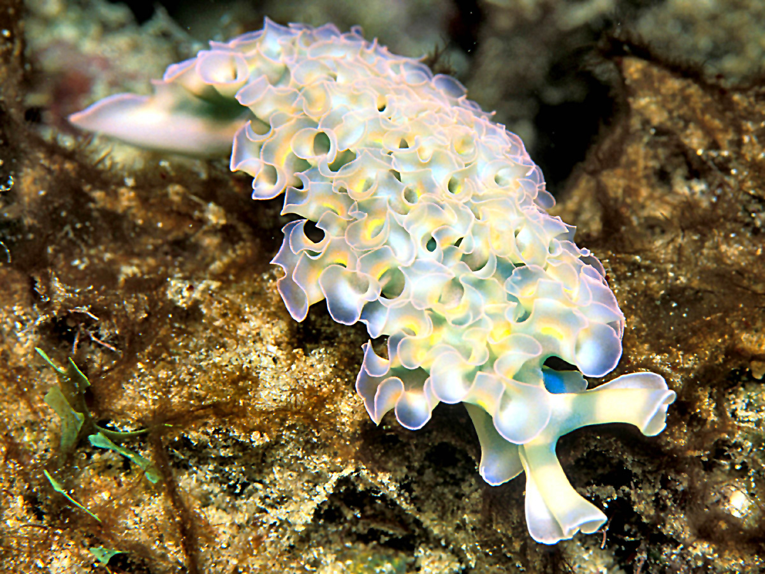
What marine creatures do photosynthesis?
Animals also perform chlorophyll photosynthesis
Until a few years ago it was believed that chlorophyll photosynthesis, which we all know, was a chemical-biological process reserved exclusively for the plant world, but in reality this is not really the case or at least it is no longer so after a series of recent discoveries like that of the singular behavior of some marine snails belonging to the genus Elysia. Do you think that these species can even survive for 10 months without necessarily having to feed.
Strange but true, this happens because their diet is mainly composed of algae through which they take on the chloroplasts that give them a green color and, above all, the ability to partially perform photosynthesis. In other words, a sort of chimera is formed between an animal and a plant.
This mollusk, belonging to the Gastropoda class, pierces the algae cells with the radula (tongue with small teeth) to feed and sucks the contents that are ingested and then ends up in the digestive tract which is suitably branched so as to be extended to almost everything the body of the animal. The cytoplasm and the other cellular organelles are digested, but the chloroplasts undergo a much more interesting and different fate: they are incorporated into special cells spread in the digestive tract of the snail, mainly all the ends of the intestinal convolutions, and there they continue to survive and function.
Chloroplasts are the organelles responsible for carrying out photosynthesis, which in practice is the process that captures carbon dioxide from the air and converts it into simple sugar glucose, with the release of oxygen as waste material.
The photo that I propose belongs to one of these species and precisely to Elysia crispata. As you can see, the shape of his body has widened and flattened and the dorsal surface is semi-transparent to allow the penetration of the sun's rays.

Slide 3
how does photosynthesis take place in the sea? and on earth?
This process uses solar energy to convert carbon dioxide and water into energy in the form of carbohydrates. It is a two-part process. First, the energy from solar radiation is trapped in the plant. Secondly, that energy is used to break down carbon dioxide and form glucose, the main energy molecule in plants.
In plants, the so-called "light" reactions occur within the chloroplast thylakoids, where the aforementioned chlorophyll pigments reside. ... The chloroplast is involved in both stages of photosynthesis. The light reactions take place in the thylakoid. There, water (H2O) is oxidized, and oxygen (O2) is released.

Slide 4
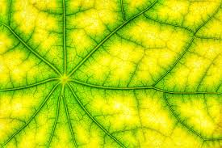
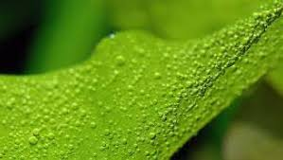
Is there any difference between photosynthesis in the sea and photosynthesis on land?
Most plants and many bacteria get their food by photosynthesis. ... Both types of plants require carbon dioxide, water, and energy to produce glucose (their food). The only difference between photosynthesis in aquatic and land plants is where in their environments they get these nutrients.

