Slide 1
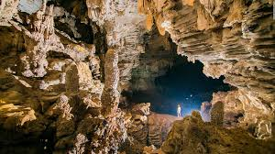
Caves
A cave is a natural void in the ground, specifically a space large enough for a human to enter.

Slide 2
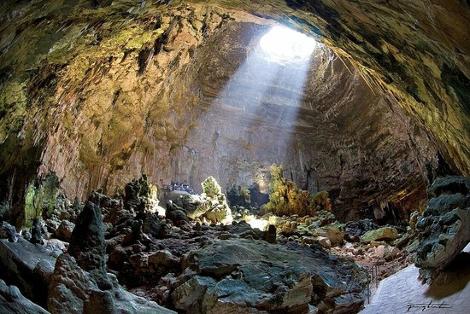
A solution cave
Solution caves or karst caves are the most frequently occurring caves. Such caves form in rock that is soluble; most occur in limestone, like in Castellana Grotte.

Slide 3
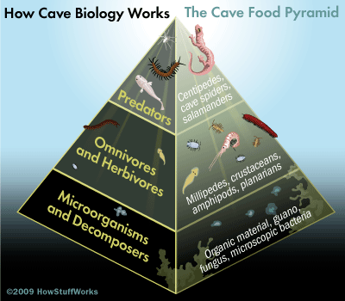
Cave ecosystem
In caves we find particular life forms and biology.

