Slide 1
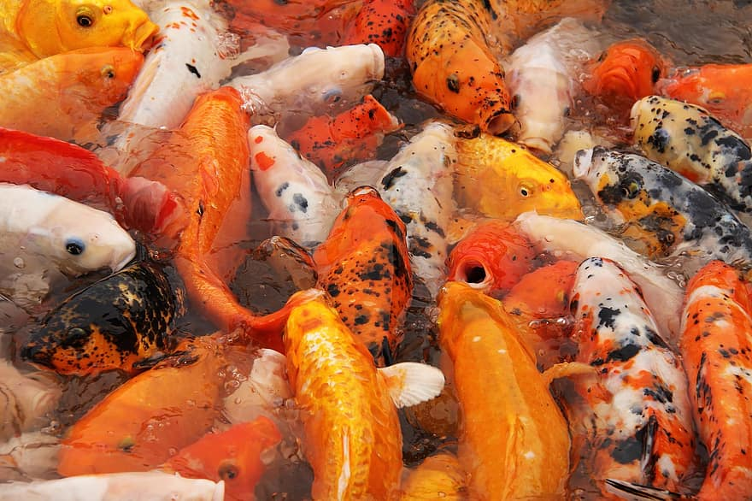
FISH IN MY REGION,YENIFOCA

Slide 2
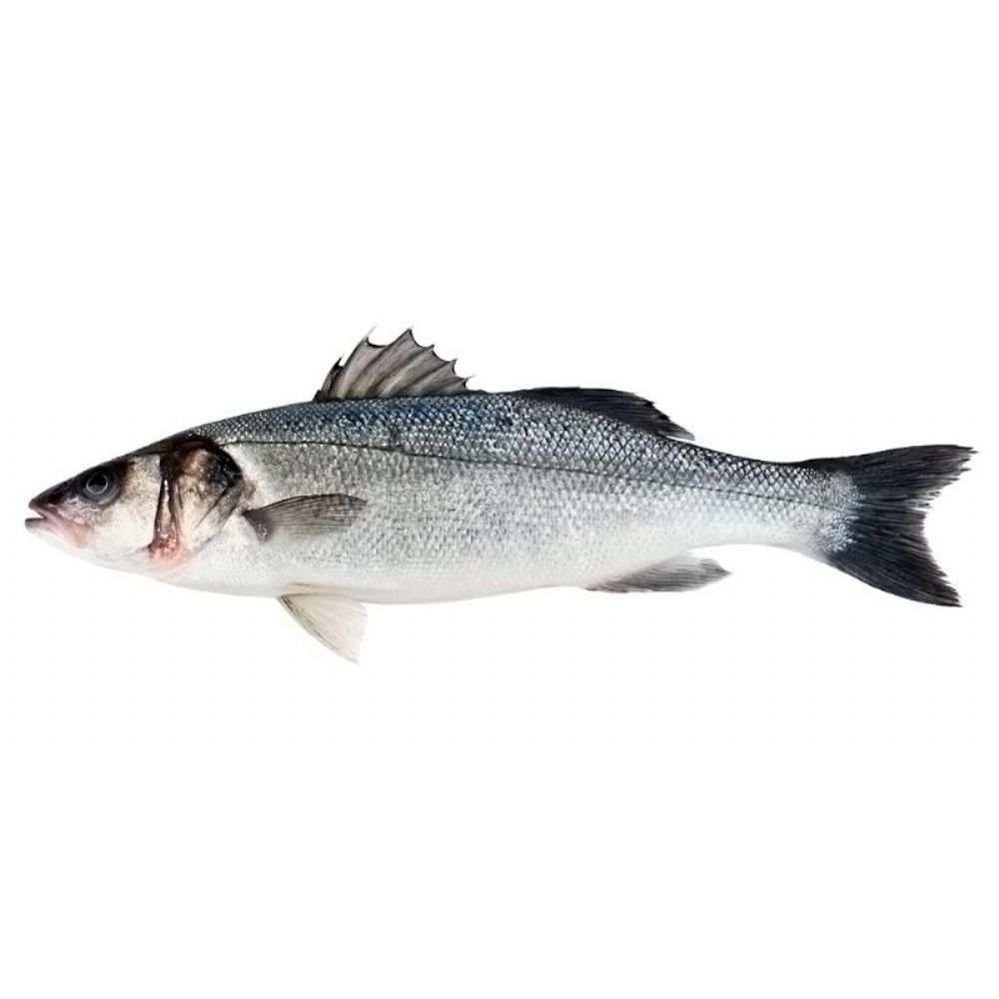
PERCH
Perch is a type of fish that we see in our
sea every season,it loves to hunt in the
first hours of the sun.

Slide 3
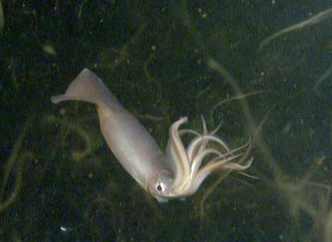
SQUID
Squid other name Ink fish loves cold
water so can bee seen ın our sea in
Winter.

Slide 4
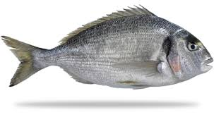
SEA BREAM
The bream fish starts to migrate towards
our sea here in April, the taste is very good,
so there is plenty of hunting.

