Slide 2
Power sources in Poland

Slide 3
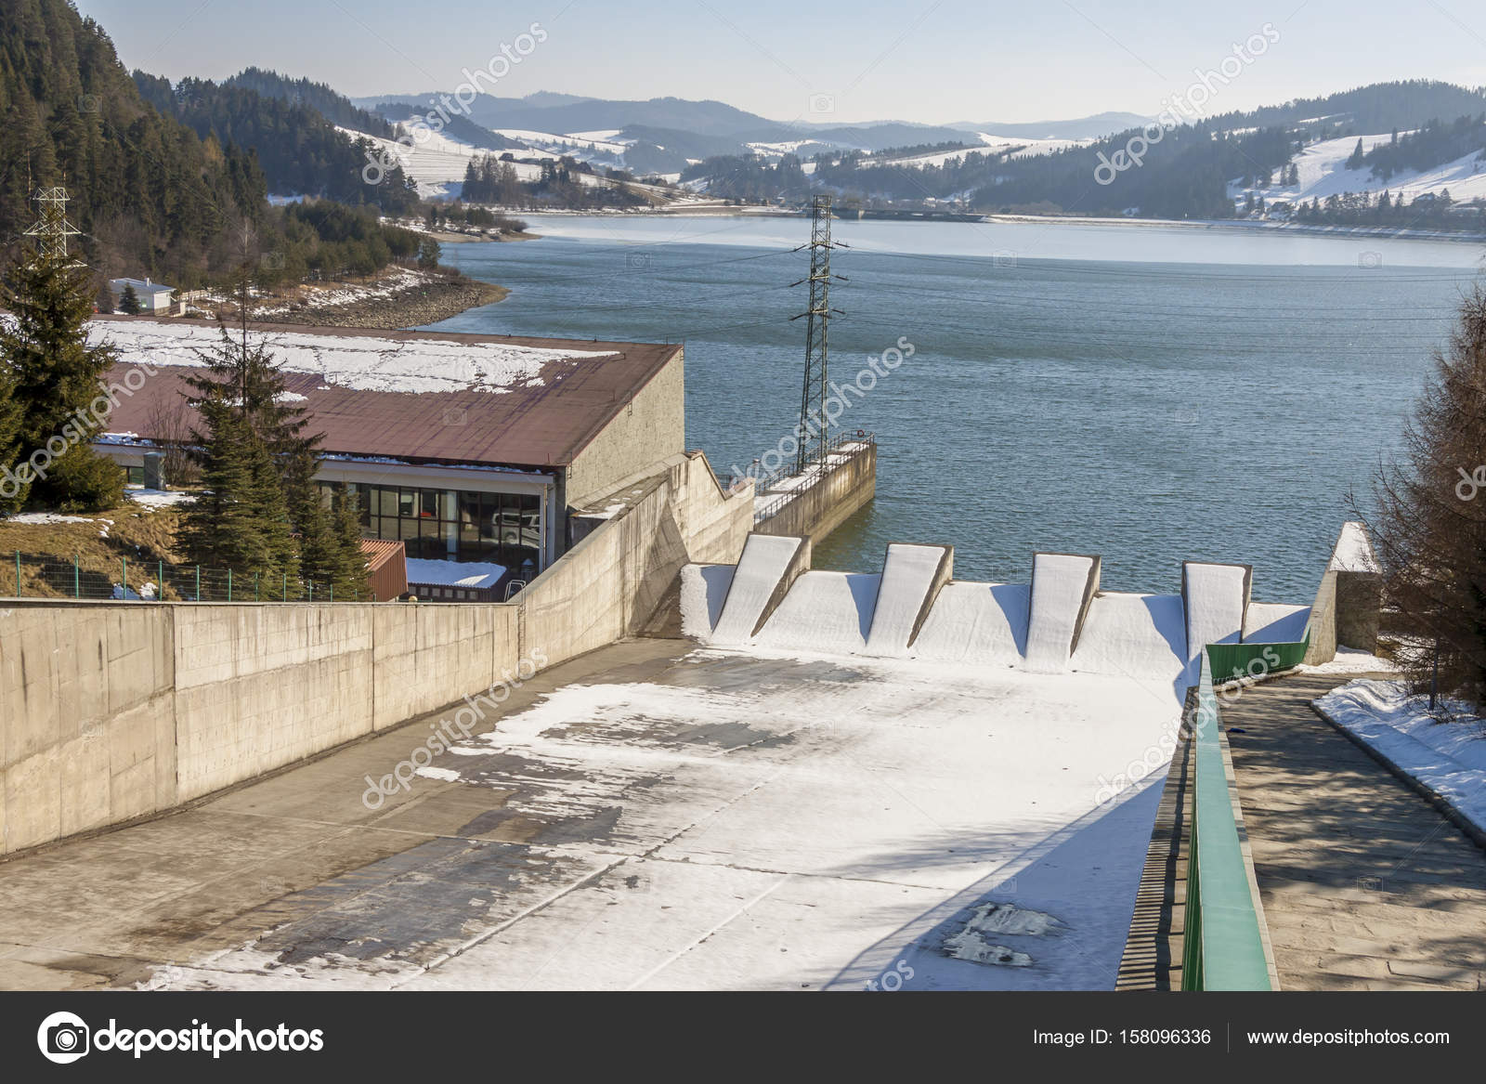
Hydropower - Polish hydroelectric resources are estimated to be around 13.7 TWh per year, unfortunately with its potential not fully used. The usage of the resources is difficult and does not bring good economic return, due to Polish water and energy resources being too small ( caused by relatively abundant and irregular rainfall during the year). Moreover, the geology of the country is unfavorable and can be characterized by high permeability and a slight decrease in land areas. Therefore, in 2013 electricity produced from hydropower in Poland was equal to 2.4 TWh

Slide 4
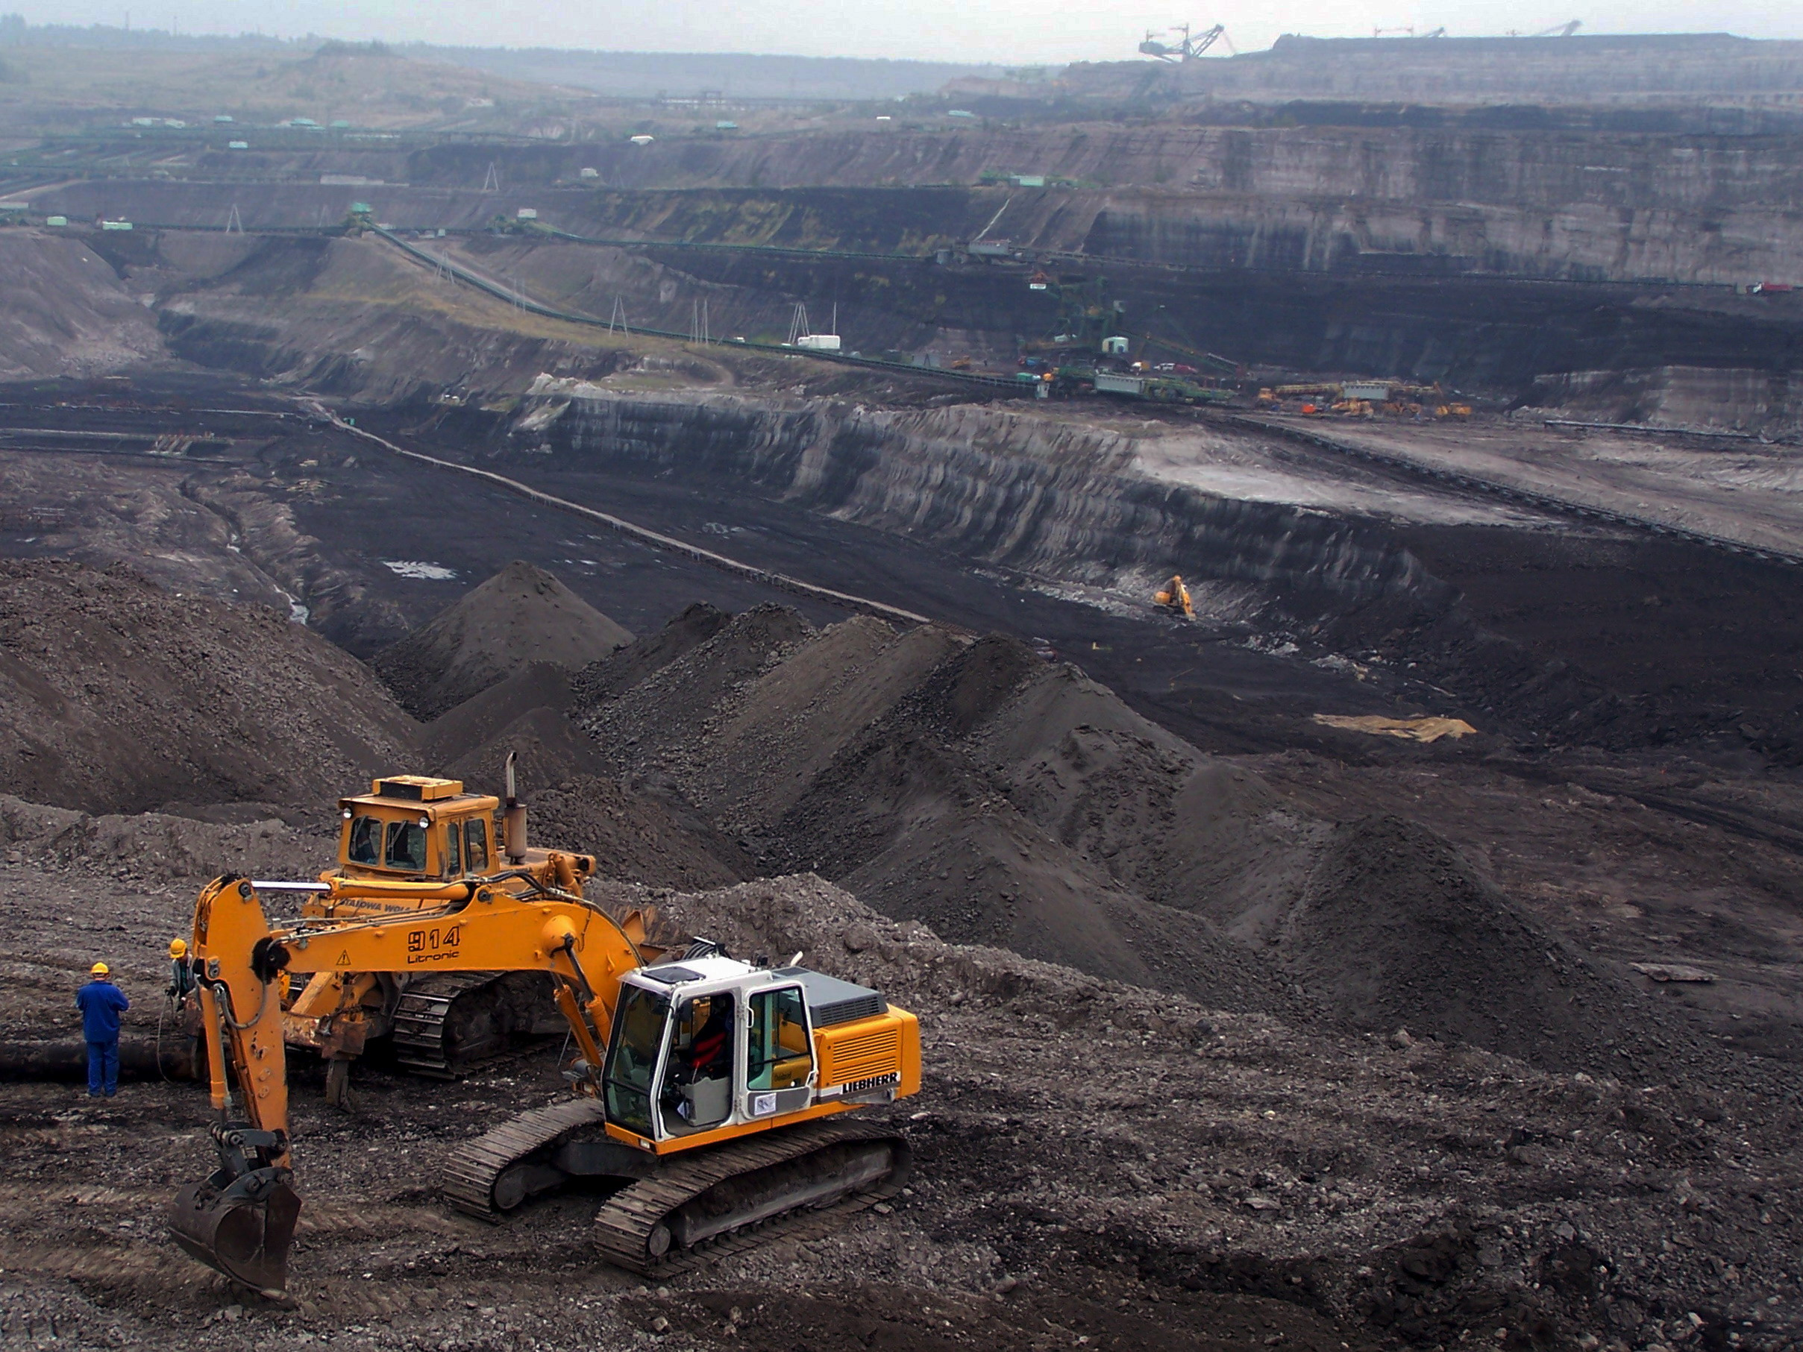
Coal mining in Poland produced 144 million metric tons of coal in 2012, providing 55 percent of that country’s primary energy consumption, and 75 percent of electrical generation. Poland is the second-largest coal-mining country in Europe, after Germany, and the ninth-largest coal producer in the world. The country consumes nearly all the coal it mines, and is no longer a major coal exporter.

Slide 5
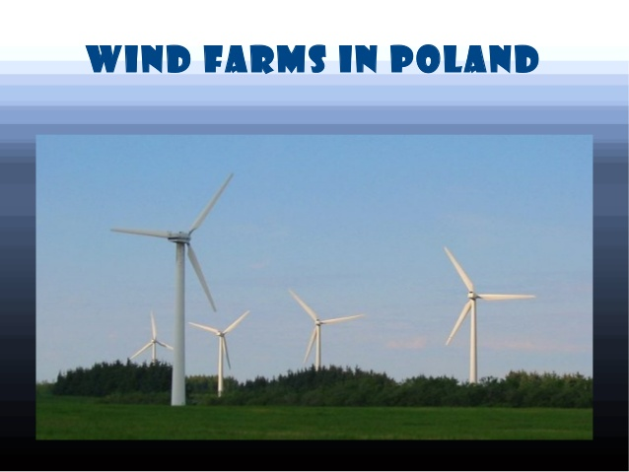
Wind power is a minor but growing source of electricity in Poland. As of the end of 2015, total installed capacity was 5.1 gigawatts (GW),[1] which provided 10,858 gigawatt-hours (GW·h)[1] — around 6.22% of the electricity consumed in the country. By year end 2016 total installed capacity had risen to 5,782 MW.

Slide 6
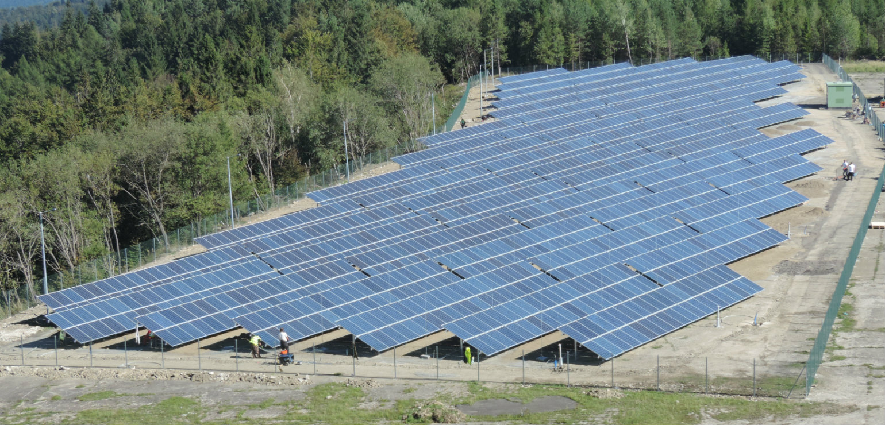
Solar energy in Poland is a new sector of renewable energy and consists of solar thermal and solar electricity. Solar thermal, used for heating water was widely used in about 1,700,000 square metres (18,000,000 sq ft) of solar thermal collector at the end of 2014. This corresponds to about 1,200 MWth capacity. Solar collectors are the second, after the biomass heating plants, source of "green heat" in Poland. In 2014, Poland was ranked fourth in sales of solar collector installations among European countries

Slide 7
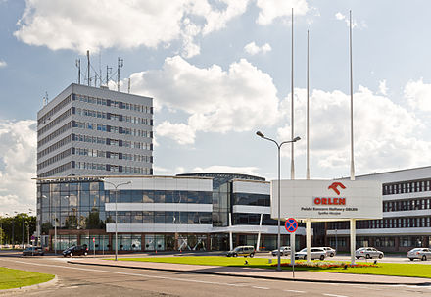
The oil industry in Poland began with the first oil well in the world, at Bóbrka Field in 1853, followed by the first refinery in 1854. Poland was the third most productive nation in the world in 1900. But, due to occupations by Nazis and then Soviets, it now has only a small, mostly state-owned component, with production from its Permian Basin in the west, small and very old fields in the Carpathians in the south, and offshore in the Baltic Sea. For natural gas the country is almost completely dependent on legacy pipelines from the former Soviet Union.

Slide 8
A binding European Union resolution, the Renewable Energy Directive 2009, stipulates a 15% renewable energy target for total energy use in Poland by 2020. According to the Polish National Renewable Energy Action Plan, the 2020 figure is set to exceed this target by 0.5% at 15.5% of overall energy use, broken down as 19.1% of total electricity consumption, 17% in the heating and cooling sector, and 10.1% in the transport sector.

