Slide 1
CARBON DİOXİDE
Notes:
“

Slide 2
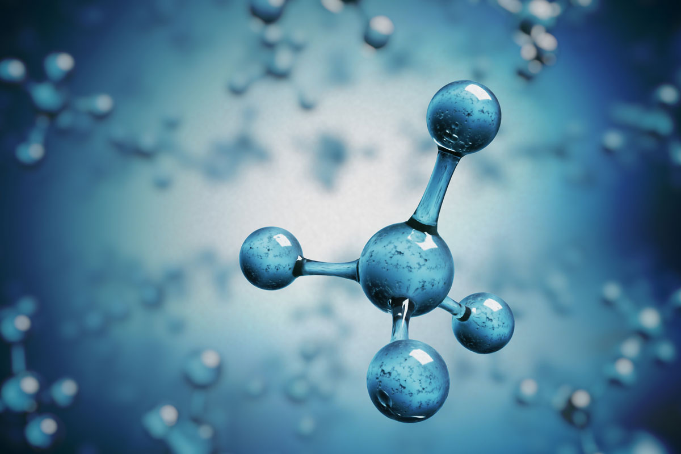
Carbon dioxide is a molecule containing
one carbon and two oxygen.
İt is gaseous under normal conditions.
it has no color and smell.

Slide 3
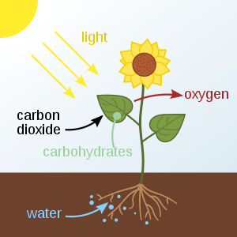
İt is a necessary molecule for
the continuity of life. Because it
is expose during photosynthesis
in plants, during respiration in
humans and animals.

Slide 4
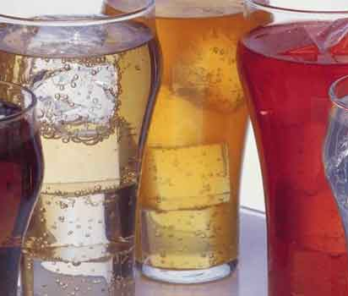
Carbon dioxide is also used in food and oil industry.

Slide 5
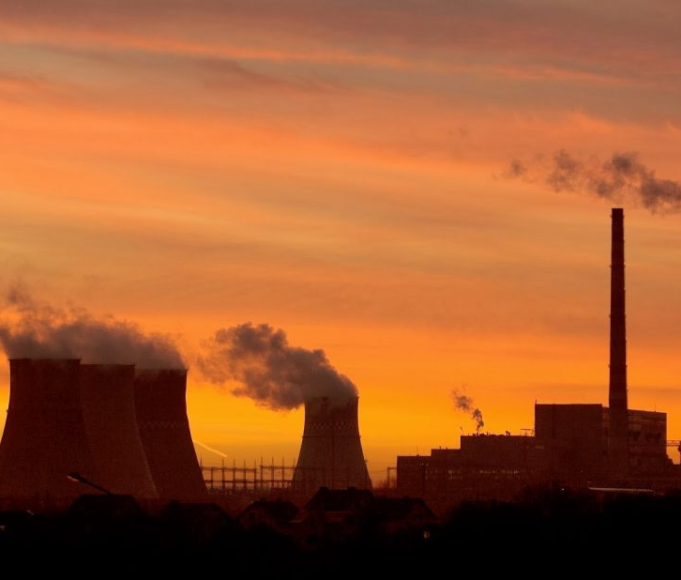
İt also has many
environmental impacts.
carbon dioxide is also
effective in climate
change and global warming

Slide 6
HAZIRLAYANLAR
ECRİN BURGAÇ
ESRA ELİF BOZBEY

