Slide 1
RECYCLING AND CLIMATE CHANGE

Slide 2
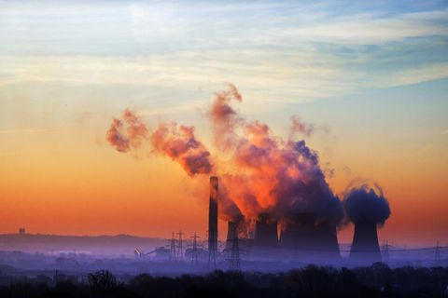
CLIMATE CHANGE

Slide 3
What are the effects of climate change?
What are the effects of climate change?
Even small increases in Earth’s temperature caused by climate change can have severe effects. The earth’s average temperature has gone up 1.4° F over the past century and is expected to rise as much as 11.5° F over the next. That might not seem like a lot, but the average temperature during the last Ice Age was about 4º F lower than it is today.
Rising sea levels due to the melting of the polar ice caps (again, caused by climate change) contribute to greater storm damage; warming ocean temperatures are associated with stronger and more frequent storms; additional rainfall, particularly during severe weather events, leads to flooding and other damage; an increase in the incidence and severity of wildfires threatens habitats, homes, and lives; and heat waves contribute to human deaths and other consequences.

Slide 4
What is Recycling?
What is Recycling?
Unless you have been on another planet for the last century, then you have probably heard of it. Recycling is the process of breaking down and re-using materials that would otherwise be thrown away as trash. Many communities and businesses make it easy to recycle by placing labeled containers in the open for public use, or providing bins for home and business owners who have curbside pickup.
There are numerous benefits to recycling, and with so many new technologies making even more materials recyclable, with everyone’s help we can clean up our Earth. Recycling not only benefits the environment but also have a positive effect on the economy. Recycling is reported throughout human history but has come a long way since the time of Plato when humans re-used broken tools and pottery when materials were scarce. Today, there is a multitude of benefits that come from recycling as well as tons of items that can be recycled.

Slide 5
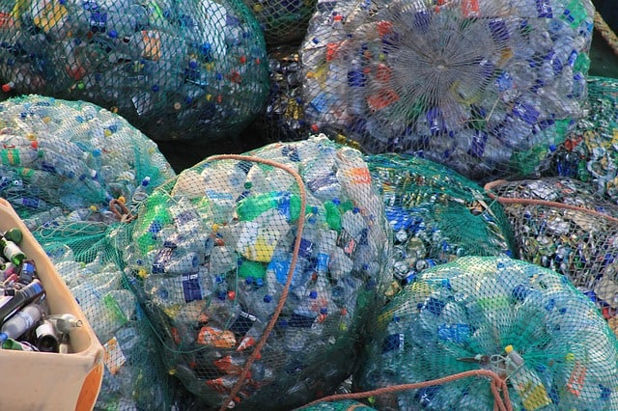
RECYCLING

Slide 6
DO THİS PROJECT
1-Çağrı AKÇURA
2-Ege CİN
3-Aytun YILDIRIM
4-Samet Eymen TEZCAN

