Slide 1
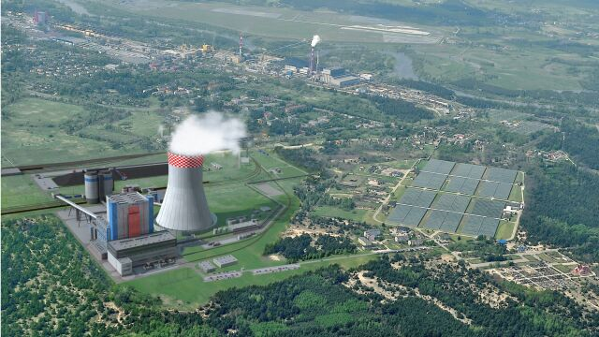
Power sources in my country
OPOLE, POLAND

Slide 2
Resources of non-renewable enegry
Non-renewable resources are these which does not renew by itself or the time needed to renew is greater then the speed of usage by human.

Slide 3
Resources of renewable enegry

Slide 4
Nuclear and see-wave power
Unfortunatelly, see-wave power in Poland is not used.
The main reason is that we have only one seaside.
Baltic See is not enough rough to supply the power station.
The problem with nuclear power which would be the best option for our country to fit our needs(instad of coal power) is that it costs a lot of money and also the society does not approve that idea because of the Chernobyl incident.

Slide 5
THIS PRESENTATION WAS DONE BY
Anna Gomułka

