Slide 1
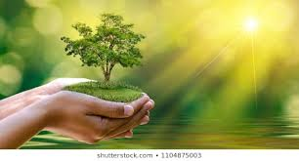
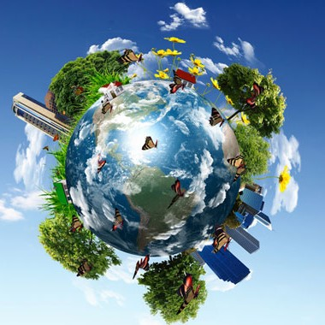
ECOSYSTEM
The ecosystem , is a community of anımals and anımals that is in good contact with each other and with the inanimate envıronment. It is the system in which living and inanimate beings in nature are formed by the ties of mutual interaction . All living things in one place and their environment and living conditions.
Ece Ayten ÖZKAN
Ecenur GÜLENÇ
Hakan Emre KURUCAN

