Slide 1
Consequences of the melting of the ice caps
and the perma- frost

Slide 2
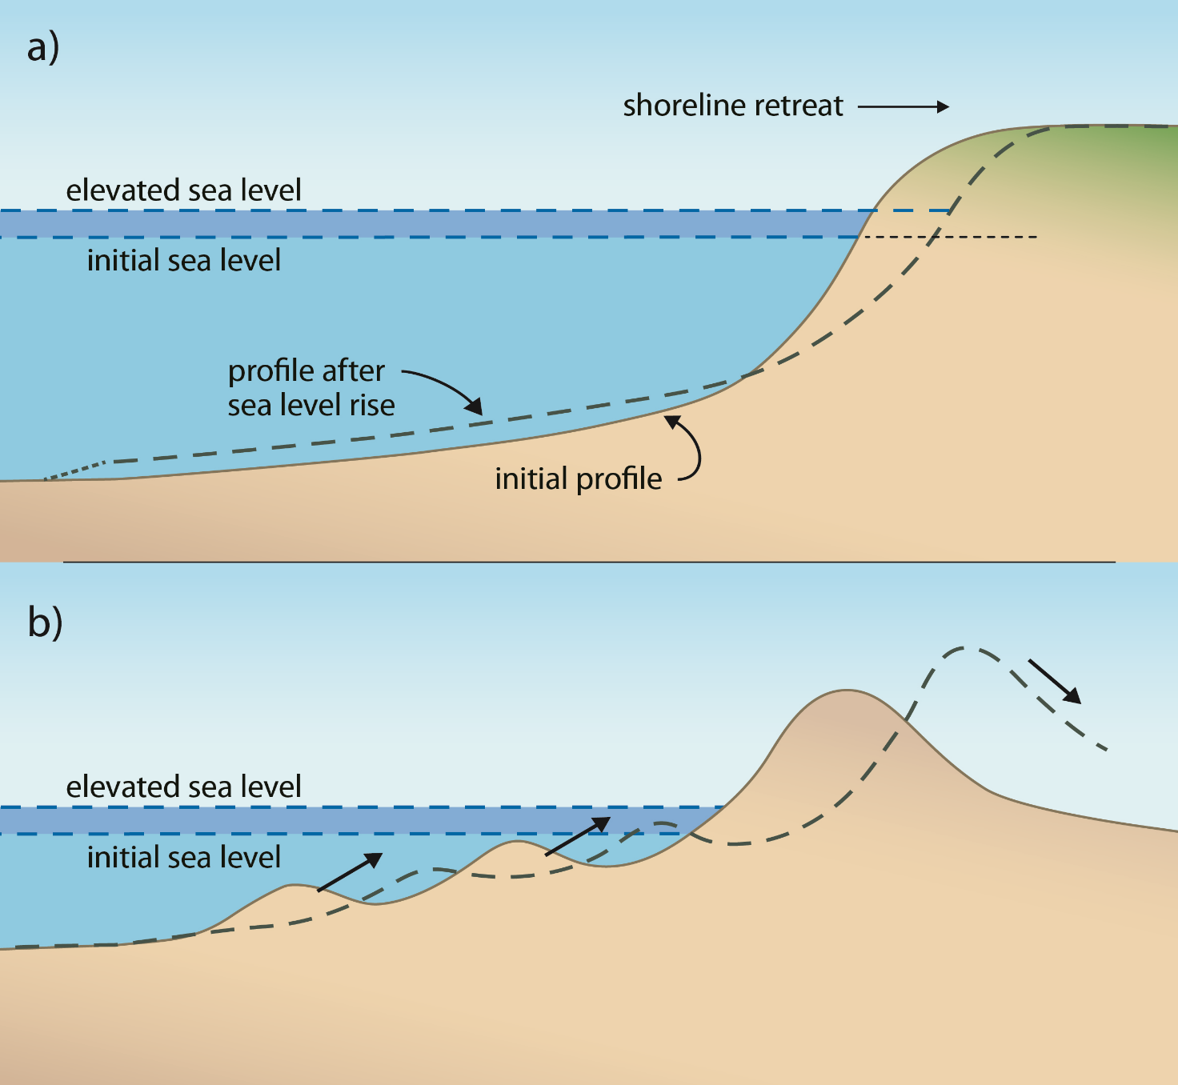
SEA LEVEL
Sea level – a point situated at a height theoretically equal to zero, in the place where the sea is facing the mainland. Adopted in geography and cartography, the average sea level is the average of all levels of the sea, resulting from its fluctuations, caused by phenomena tides . It is also necessary to take longer cycles of sea level fluctuations: 19-year cycle of Metona and 223-monthly cycle of Saros.

Slide 3
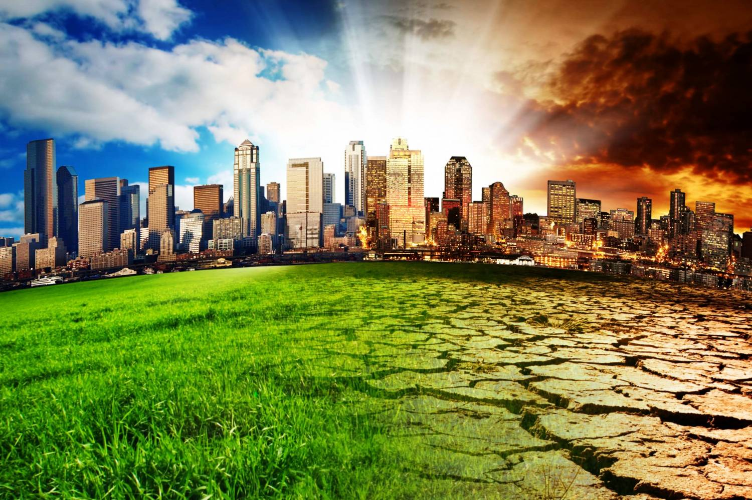
CLIMATE CHANGES
Climate change arises from external factors such as the amount of solar radiation occurring, or internal factors such as human activity (anthropogenic changes) or the influence of natural factors. In recent years, the term "global climate change" is used in the context of global warming and the rise of temperature on the Earth's surface, but scenarios are considered to coldness the surface of the Ear.

Slide 4
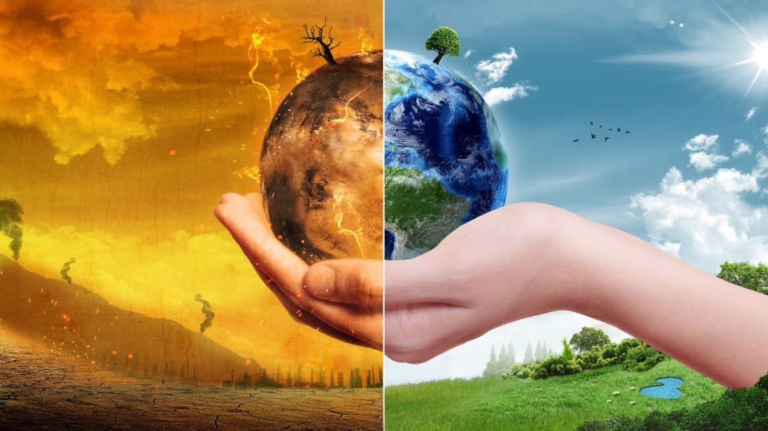
GLOBAL WARMING
Global warming is a long-term rise in the average temperature of the Earth's climate system, an aspect of climate change shown by temperature measurements and by multiple effects of the warming . The term commonly refers to the mainly human-caused observed warming since pre-industrial times and its projected continuation, though there were also much earlier periods of global warming.

Slide 5
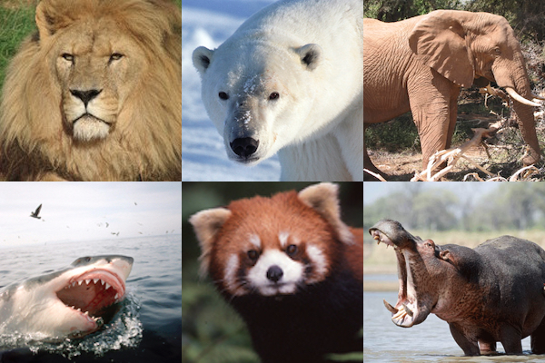
ENDANGERED ANIMALS
For some species, time on our planet Earth is running out. Human beings are the greatest threat to the survival of endangered species through poaching, habitat destruction and the effects of climate change.
The most endangered animals are:
Amur Leopard
Gorillas
Sea turtles

Slide 6
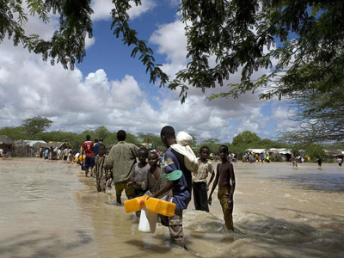
CLIMATE REFUGEE
Climate refugee are people who are forced to leave their home region due to sudden or long-term changes to their local environment. These are changes which compromise their well-being or secure livelihood. Such changes are held to include increased droughts, desertification, sea level rise, and disruption of seasonal weather patterns .Climate refugees may choose to flee to or migrate to another country, or they may migrate internally within their own country.

Slide 7
THANKS FOR WATCHING!

