Slide 1
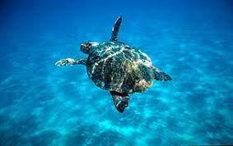
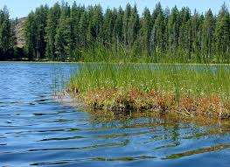
HABITAT
We live in earth .We must protect the earth and we must keep it clean for healthy life . Envıronment problems are affectıng anımals . Anımal’s die out . That’s why protect anımals , don’t throw garbage in places and we need too protect the envıronment. We are habıtats colorful complitaces one in the area we are living.
Hakan Emre KURUCAN
Ecenur GÜLENÇ
Ece Ayten ÖZKAN

