Slide 1
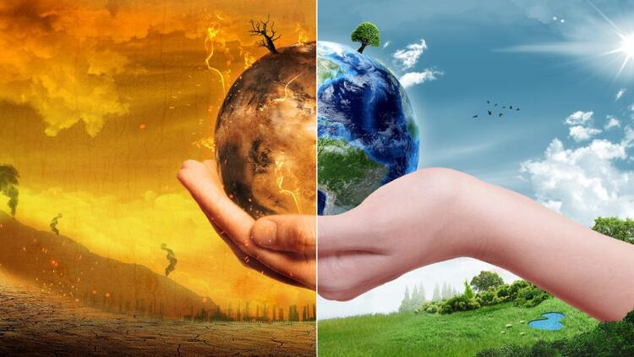
GLOBAL WARMING
One of the biggest problems facing the world today is global warming. Many scientists believe that our production of carbon dioxide and other greenhouse gases is having a heating effect on the atmosphere, and this could be very dangerous for human life.
Many problems could result from global warming. One of the biggest problems is rising sea level. Another problem caused by global warming is changes in weather patterns. A third problem associated with global warming is the effect on animals.
There are several things we can do to solve the problem of global warming. One solution is to stop producing CO2. We can do this by switching from oil, coal and gas to renewable energy. Another solution is to plant more trees. A third solution is to use less energy and to recycle more products.
In conclusion, if we make small changes now in the way we live, we can avoid huge changes in the future.
HAZIRLAYAN: GÖZDE ERCAN
MİRAY ÇETİN
EFRANUR ÖZDEN

