Slide 1
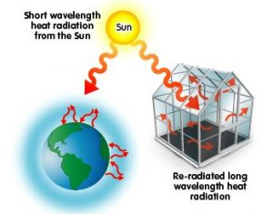
GREENHOUSE EFFECT
The Greenhouse Effect Is a Naturel Process That Warms The Earth’s Surface.When The Sun’s Energy Reaches The Earth’s Atmosphere ,Some Of It Is Reflected Back The Space And The Rest Is Absorbed And Re_radiated By Greenhouse Gases.
Merve GÖKMENOĞLU Deva ÖZ 6/A

