Slide 1
eTwinning
Work done by
Filipe Ferreira & Mariana Costa

Slide 2
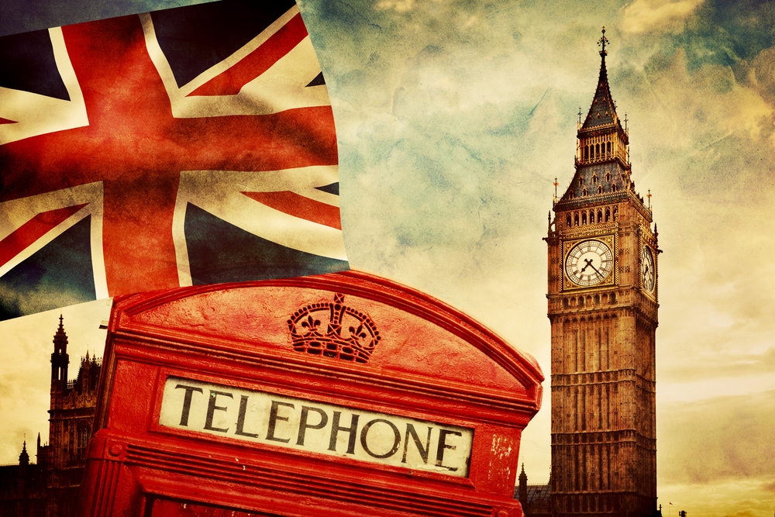
England

Slide 3
Flag

Slide 4
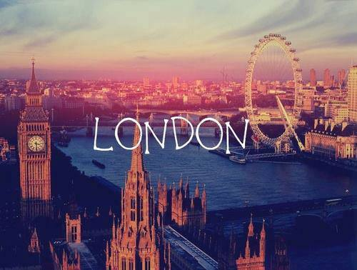
Capital
London

Slide 5
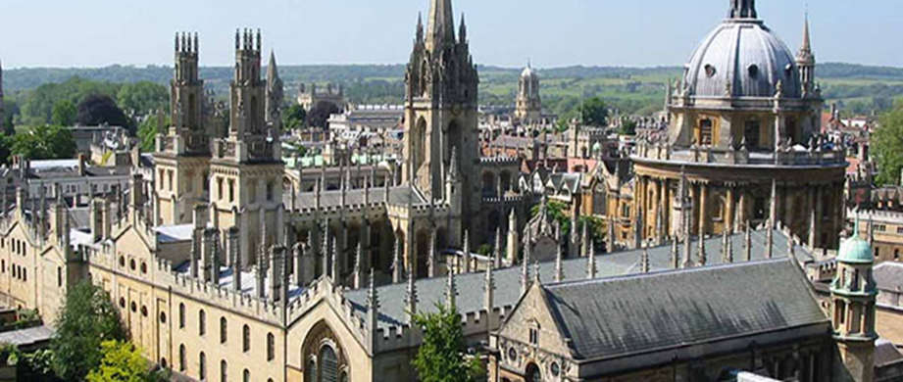
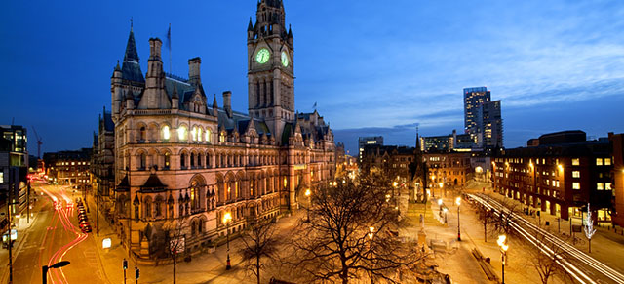
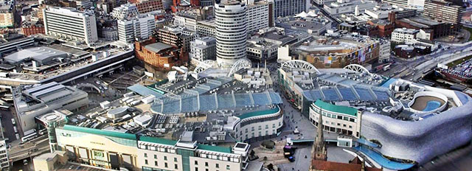
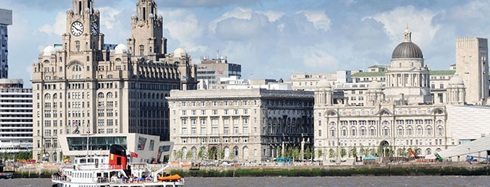
Important cities
Oxford Manchester
Birmingham Liverpool

Slide 6
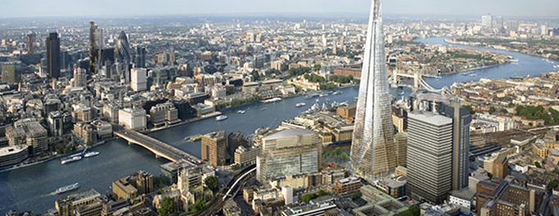
Important cities
London

Slide 7
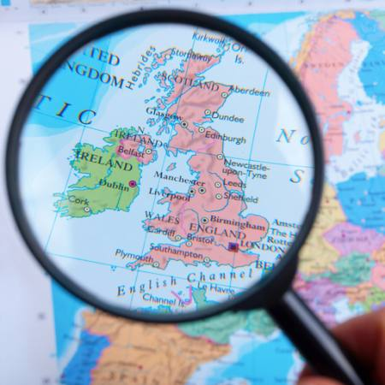
Map
Borders
Atlantic Ocean
Scotland
North Sea
Wales
Sea of Ireland
English Channel

Slide 8
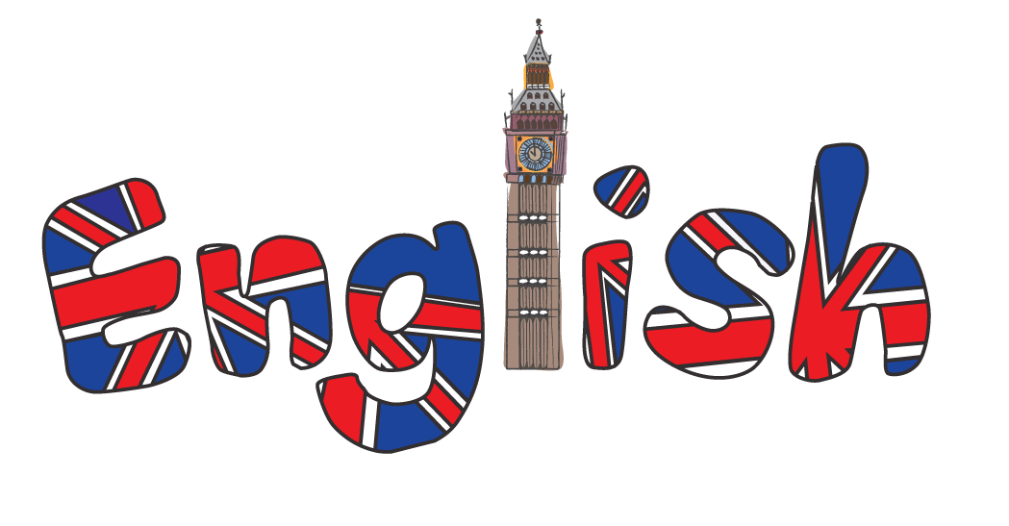
Official Language
English

Slide 9
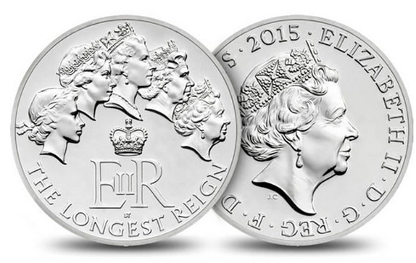
Coin
Lb

Slide 10
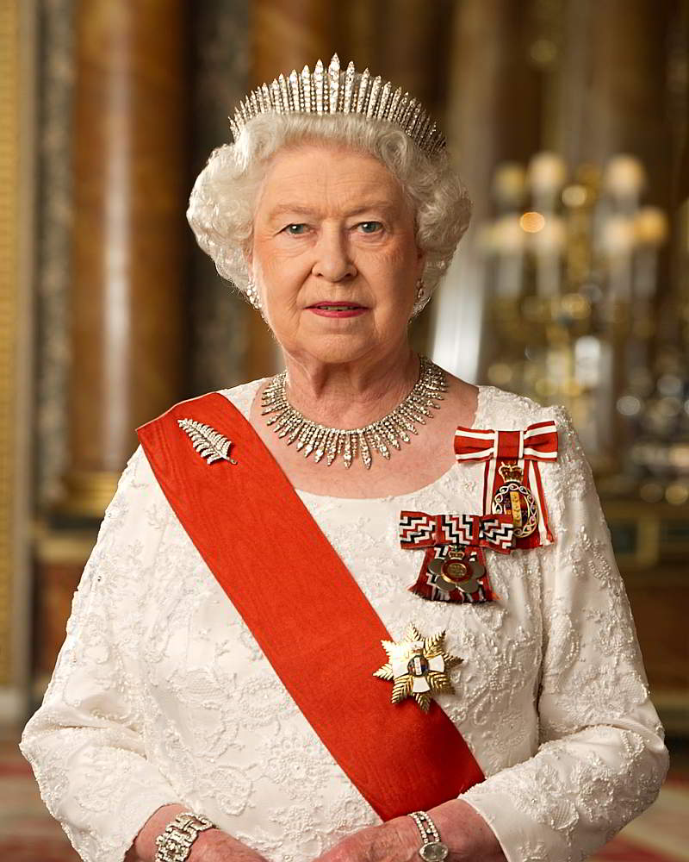
Political Regime
Monarchy

Slide 11
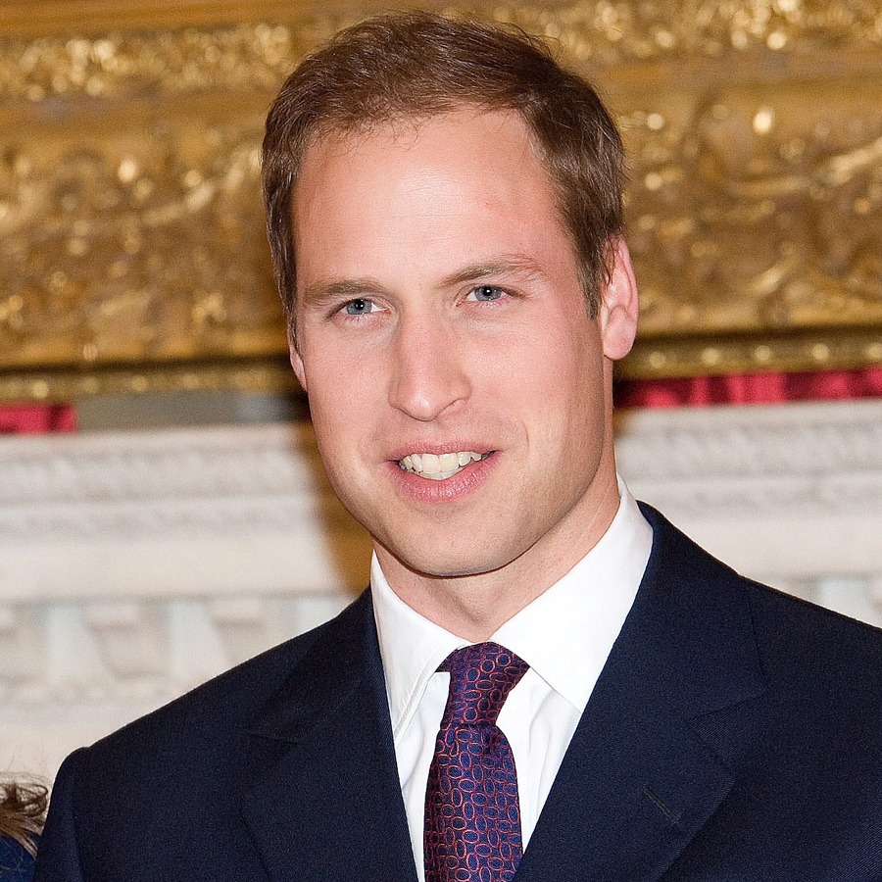
Famous Personality
Prince Wiliam

Slide 12
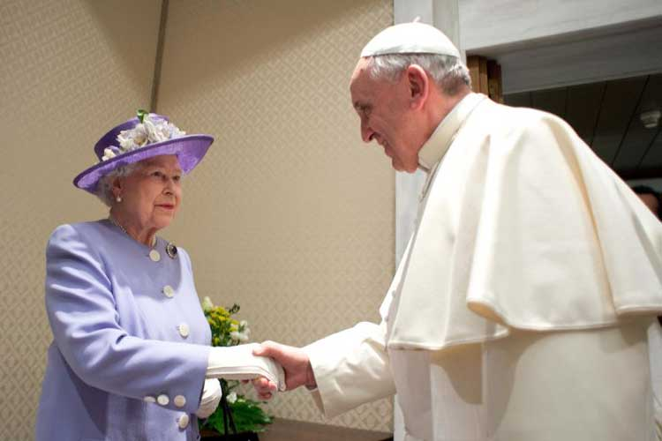
Official Religion
Anglicanism

Slide 13
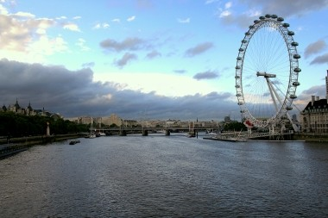
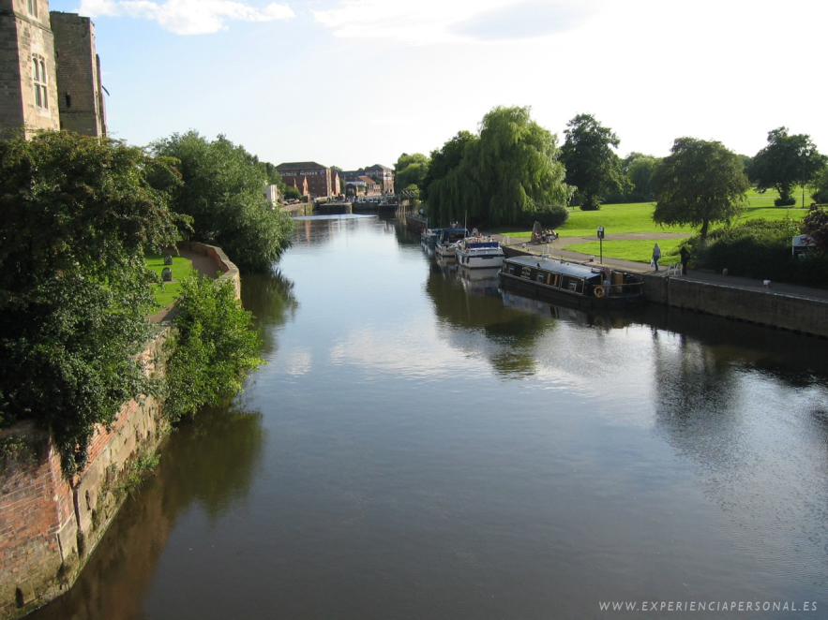
Relief (river)
River Thames River Trent

Slide 14
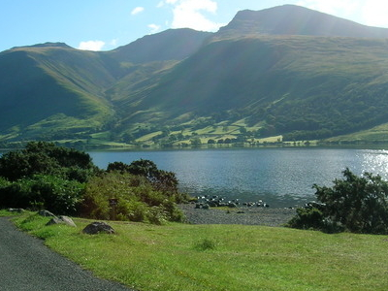
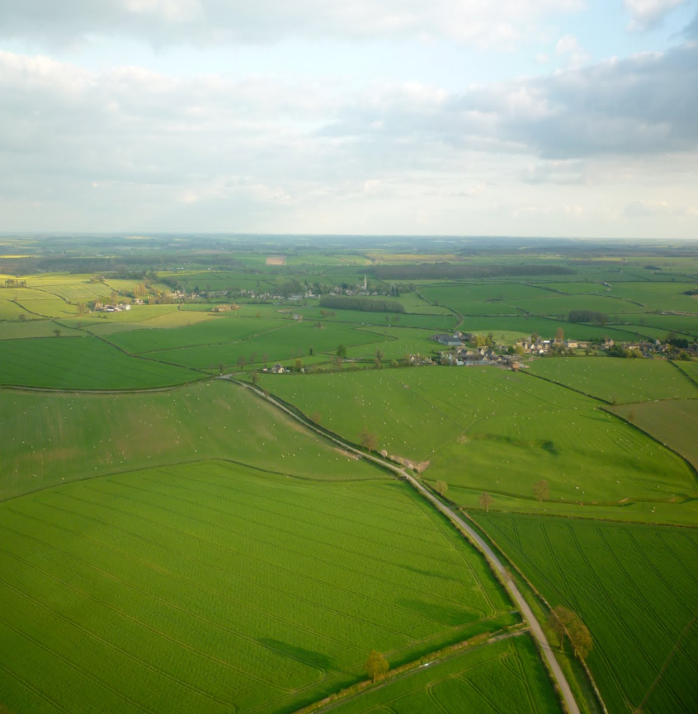
Relief (mountains)
Peack Scafell The Fens

Slide 15
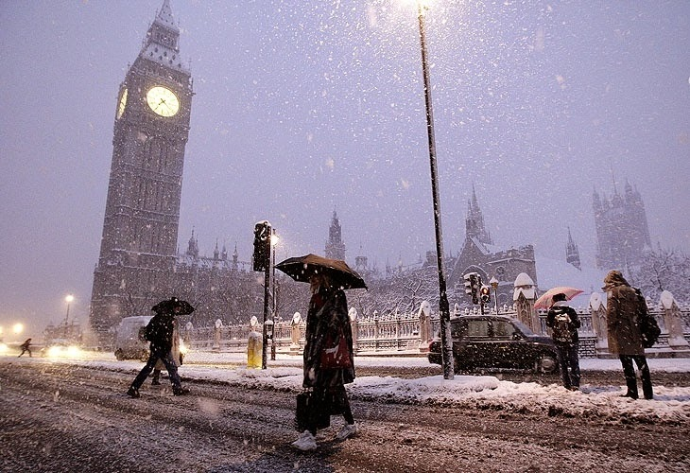
Climate
Cold (temperate ocean)

Slide 16
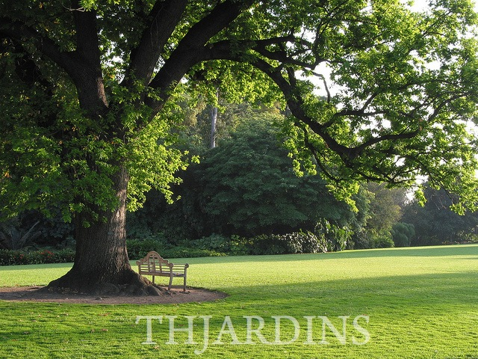
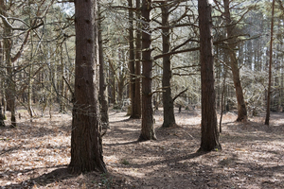
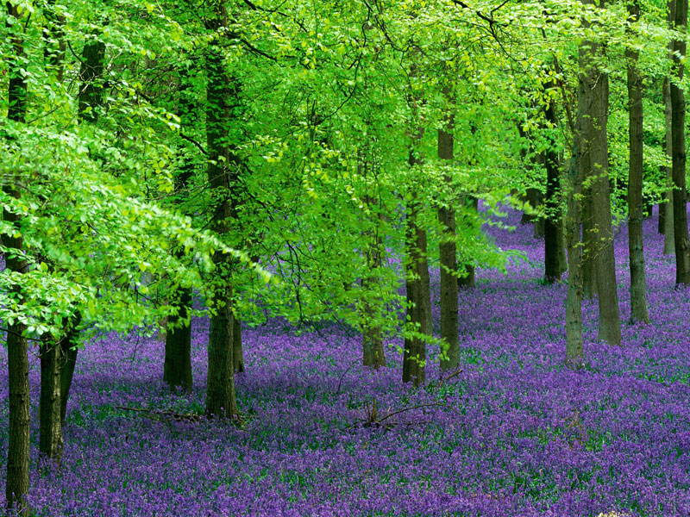
Vegetation
Oaks Pine trees Beeches

Slide 17
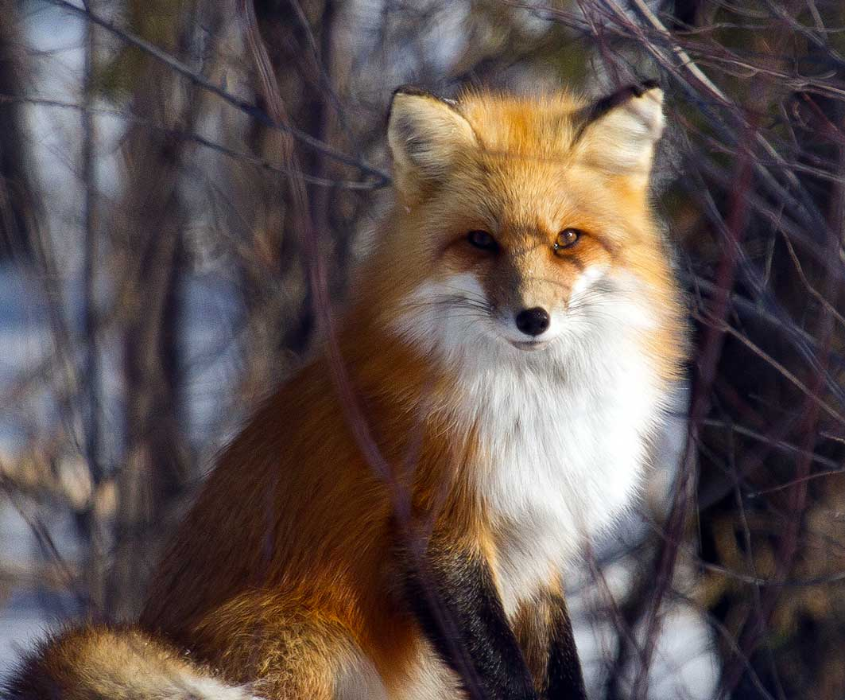
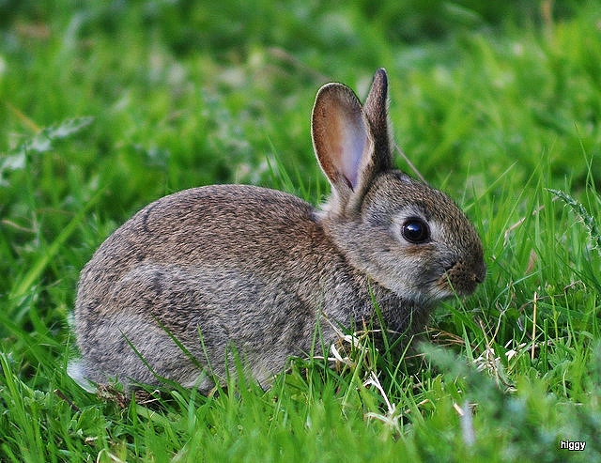
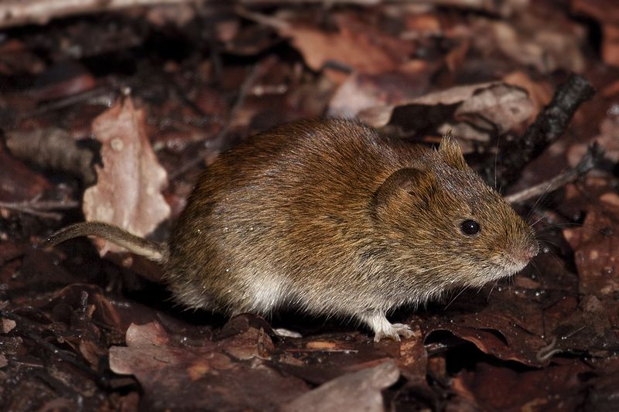
Fauna
Fox Rabbit Badger
Mouse

Slide 18
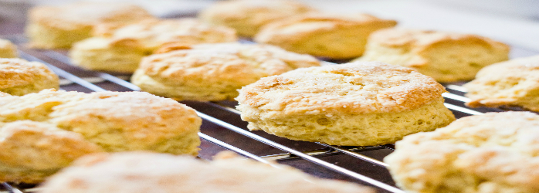
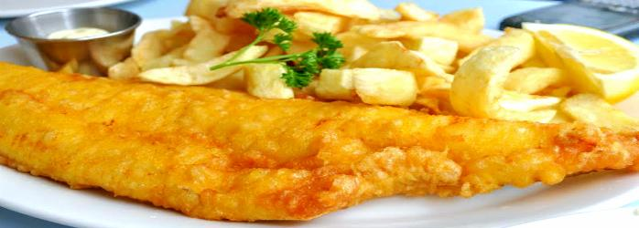
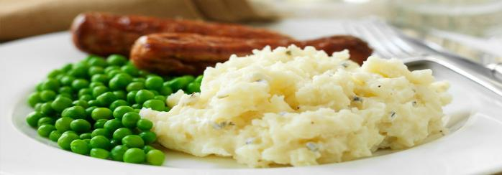
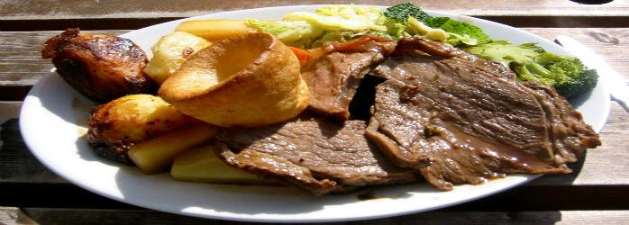
Typical dishes
Scones Fish and chips
Bangers and mash Roast beef

Slide 19
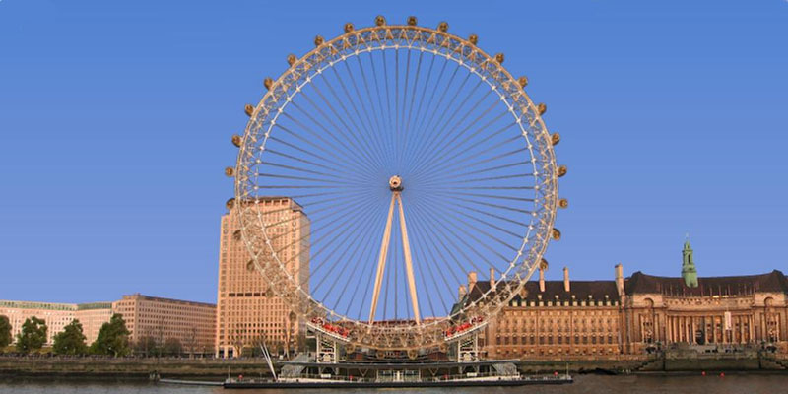
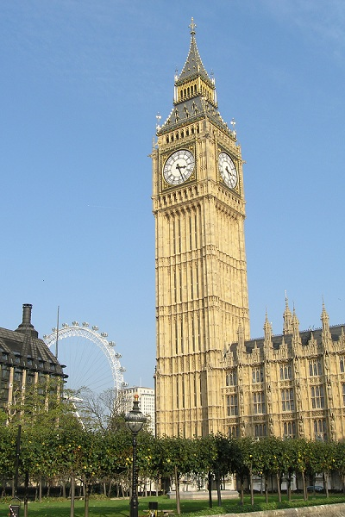
Monuments
Eye of London Big Ben

Slide 20
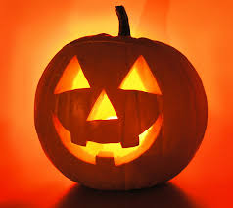
Old legends
A long, long time ago there was an alcoholic and uneducated man named Jack. One afternoon Jack was under a tree and the devil came to get him, but Jack deceived him by climbing a tree and picking up a piece of fruit, but before going down Jack carved a cross on the tree bark so that the Devil could not come down from the tree and the Devil promised not to bother him for more than 10 years. Shortly afterwards Jack died, but they did not allow his entrance in the sky. The Devil also did not allow his entry into hell, but to annoy him sent him into the dark night with only a charcoal ember to light his way. Jack put the ember inside a carved turnip and has since wandered. And then the Irish began to refer to the ghost as Jack O 'Lantern.

Slide 21
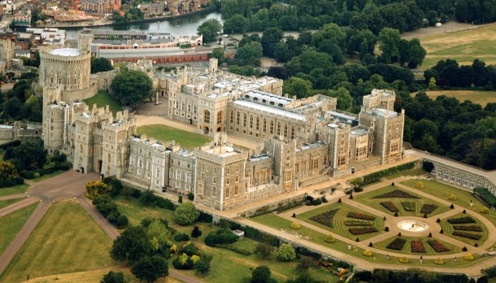
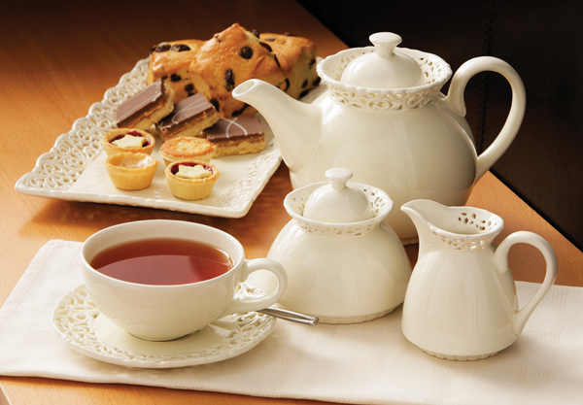
Curiosity
Punctually at 5:00 p.m., the English take afternoon tea, an important tradition in the country. According to surveys England is the country that consumes most tea in the world.
Windsor Castle is the largest and oldest royal residence still used in the world. Built in the 11th century the castle has over 50,000 square meters of construction.

Slide 22
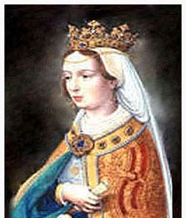
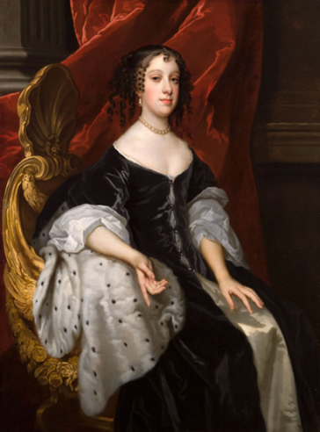
Questions
Did you know we had an English queen? Who was she?
Did you know that you had a Portuguese queen who took the 17 o'clock tea there? Who was she?

Slide 23
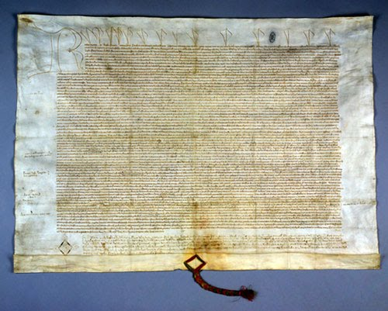
Questions
Europe's oldest treatise of friendship, between two countries, is between Portugal and England. What is the name of this treaty?
Filipe
5F class
Mariana Costa
5F class

Slide 24
END

