Slide 1
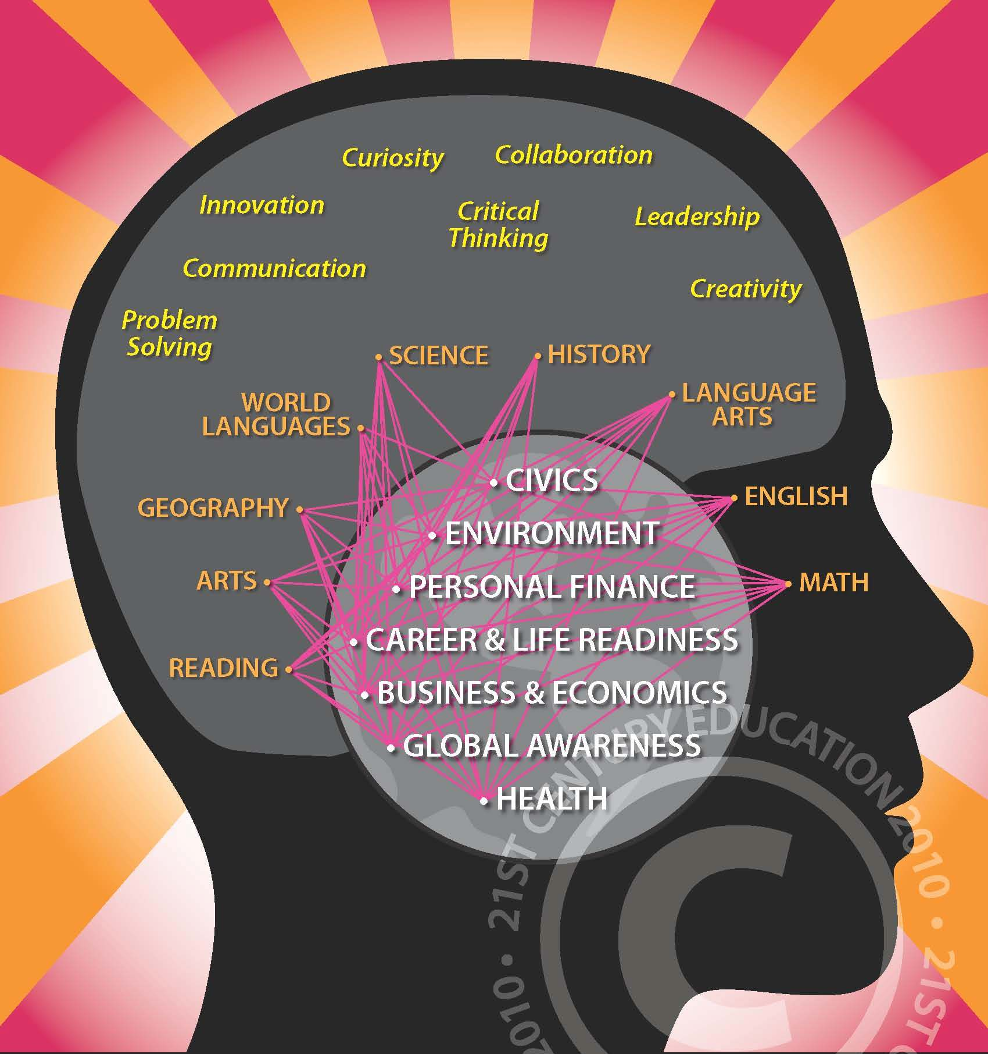
1
LET'S ETWIN ER&MVO 2
Marta Pey Pratdesaba
Foreign Languages Coordinator MVO
Etwinning Ambassador
SESSION 4

Slide 2
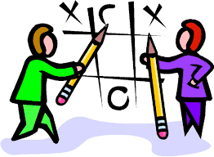
Session 4:
GAMIFICATION OF LEARNING

Slide 3
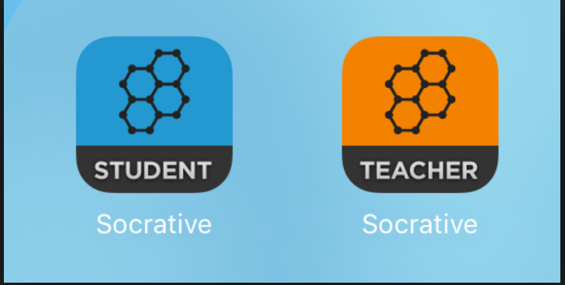
GAMIFICATION VS. GBL (GAME-BASED LEARNING)
http://inservice.ascd.org/the-difference-between-gamification-and-game-based-learning/
SOCRATIVE GAME

Slide 4
INFOGRAFIC
GAMES
VS
GBL
VS
GAMIFICATION

Slide 5
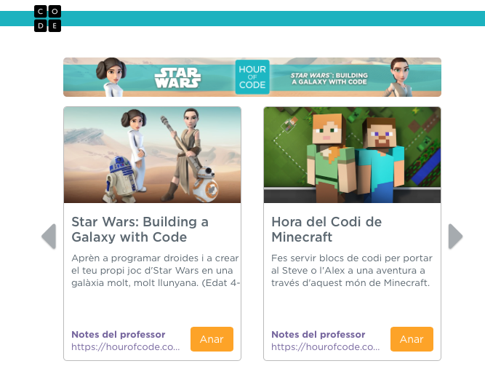
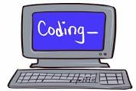
CODING
https://code.org/learn
LET'S HAVE A GO!!!

Slide 6
GAMIFICATION
A) What are the key elements of this methodology/pedagogy?
B) How can it benefit your teaching practice?
C) Any disadvantages?
D) What skills are taught?
IIN PAIRS, WRITE IN THE PADLET: https://padlet.com/martapcallis/qmn8znjdhnsr or http://bit.ly/2nniNZj

Slide 7
What is it?
Gamification in the classroom is...
The process by which teachers use video game design principals in learning environments

Slide 8
Components
Avatars: players' profiles
A system of points: (can take the place of grades)
scoreboards: to see position and winners.
challenges
levels: (could be lessons)
rewards: badges and awards as public recognition of achievment
Bonuses: (unexpected rewards): i.e. homework free night...

Slide 9
PROS
CONS
Can increase student engagement: attractive presentation, challenges...
It can lead to students only doing things for points or lead to unneccessary competition
Brings multimodal learning into the classroom.
It isn't useful in every learning situation
Require problem-solving and critical thinking based on a meaninful purpose
It requires extensive planning, design and tracking
peer learning
Each player starts at zero and builds their score, rising up as they progress

Slide 10
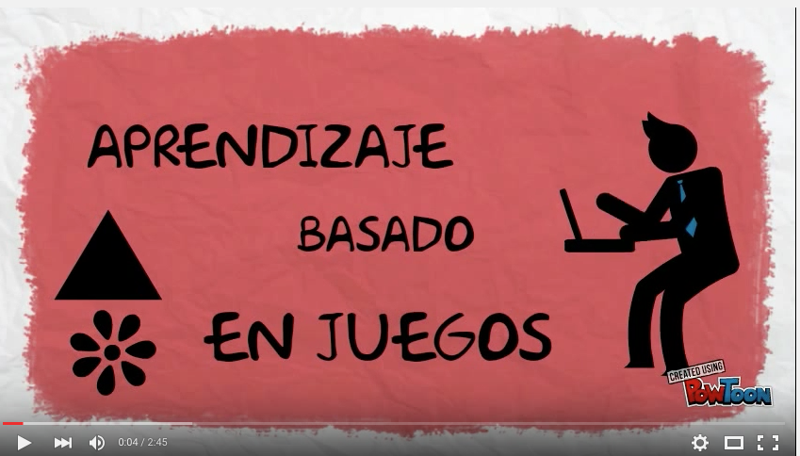
WHAT IS GBL?
APRENDIZAJE BASADO EN JUEGOS: VIDEO https://www.youtube.com/watch?v=KHrxTplN1-g

Slide 11
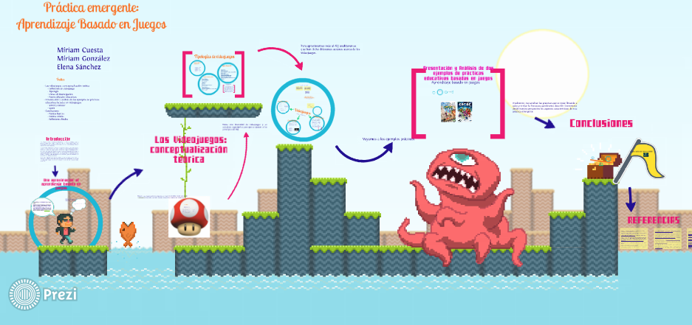
GBL (game-based learning)
very complete presentation:
PRÁCTICA EMERGENTE: APRENDIZAJE BASADO EN JUEGOS: http://prezi.com/sh1cngurz5dz/?utm_campaign=share&utm_medium=copy&rc=ex0share

Slide 12
EXAMPLES CREATED BY STUDENTSPROJECTS 1
http://www.classtools.net/ :
Project “Sharing Languages”
Games created by students with the information given by their partners on their mother tongues: Irtalian, German, Swiss German, Spanish and Catalan
The Dustbin Game
The Arcade Game
The Pacman Game

Slide 13
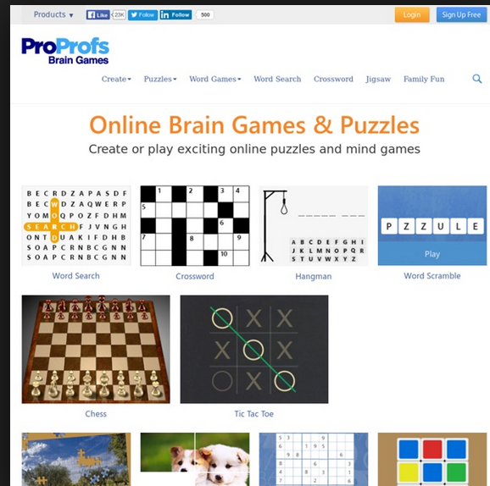
ANOTHER EXAMPLE
E-BOOK: http://issuu.com/filmsfashion/docs/ebookcatalancampaigns/11?e=0
PROPROFS BRAINGAMEShttp://www.proprofs.com/games/
http://www.proprofs.com/games/crossword/spanishcatalan-campaigns/

Slide 14
Which game elements have we seen with...
CLASSTOOLS?
SOCRATIVE?

Slide 15
How to gamify your classroom?

Slide 16
BÀSIC COMPONENTS
The process of actual video game development includes:
- design
- programming
- graphic design
- sound engineering
Teachers: no time or budget to create their own digital learning quests

Slide 17
Tips to add aspects of gamification to your classroom
1. BACKWARDS PLANNING:
- what is the goal?
- how will the kids get there?
- what evidence will you collect along the way? (progress measurement)
2. USE WHAT'S AVAILABLE:
- use free, open platforms
3. GAMIFY ONE ASPECT:
- start small
- gamify grading: by turning assignments into experience points
- gamify homework: by creating individual quests
- gamify personalized learning: by allowing students to work on a skill until they have achieved mastery
- use badgets

Slide 18
Tips to add aspects of gamification to your classroom
4. ESTABLISH A MARKETPLACE: Allow students to buy, sell, swap, trade with each other and with you: i.e. use points to buy a homework-free night, extra playground time (for the whole group)
5. ALLOW LEVELING UPS: if a student has mastered the material in a lesson, offer fun and engaging extension work
6. JUST DIVE IN :):
- see what works
- change your plans along the way

Slide 19
Platforms:
GOOGLE CLASSROOM
CLASSCRAFT (not free)
DUOLINGO (languages learning)
GOALBOOK
SOCRATIVE
EDMODO
MOODLE

Slide 20
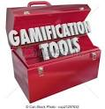
RESOURCES AND TOOLS

Slide 21
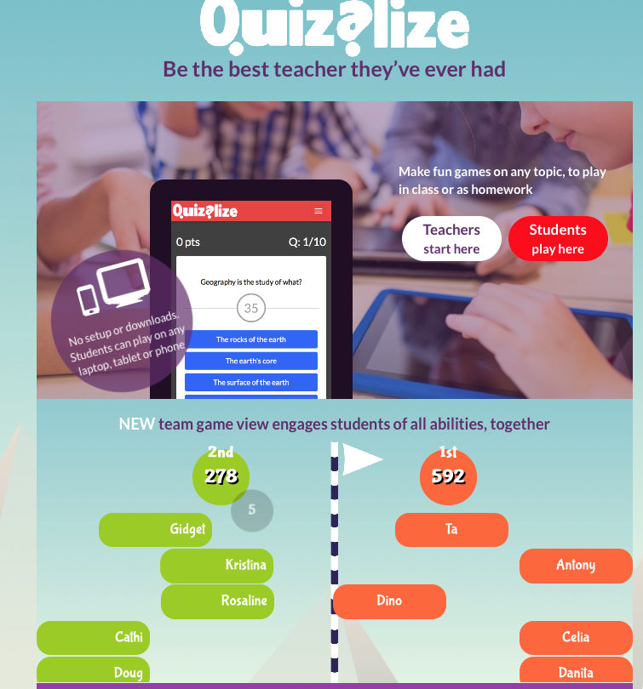
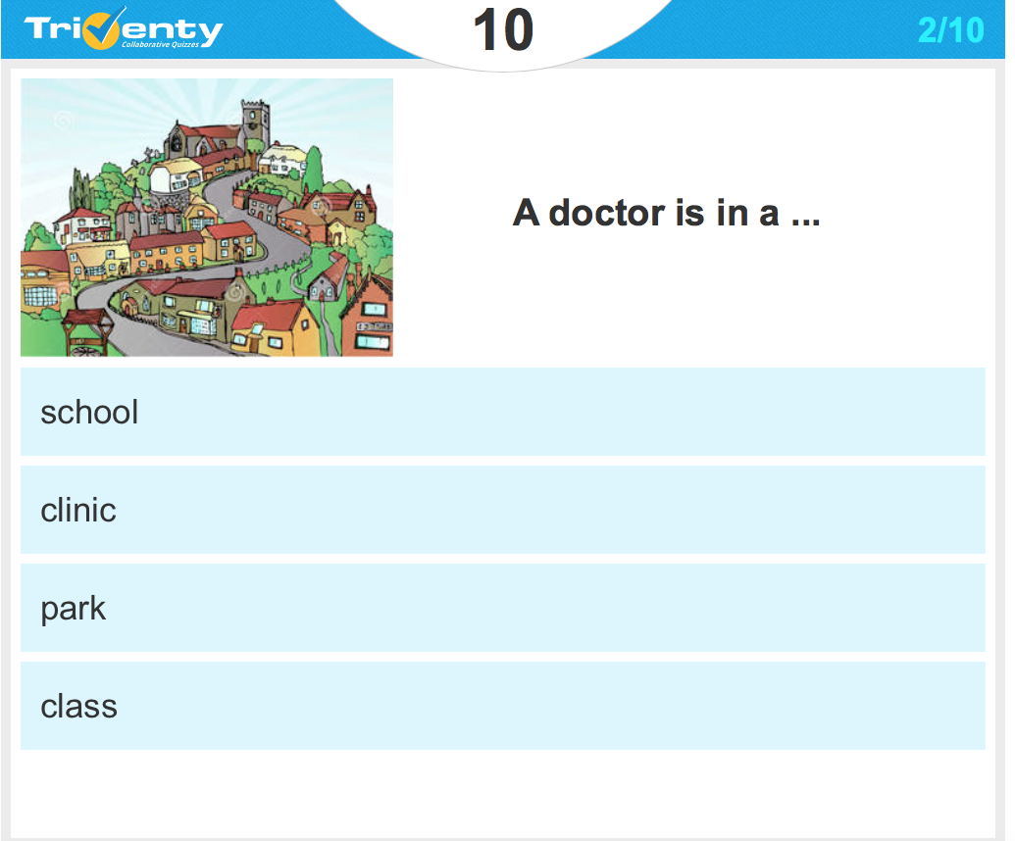
Similar to Kahoot
http://www.triventy.com
https://www.quizalize.com

Slide 22
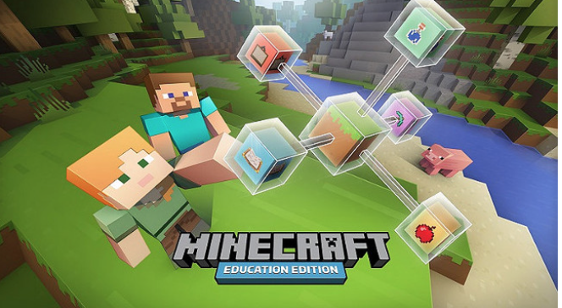
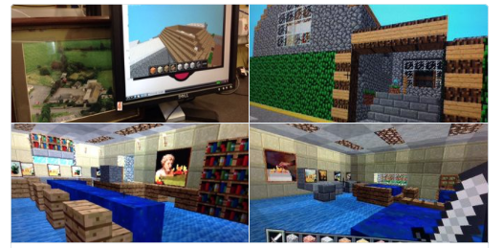
MINECRAFT
ARTICLE “EL Periódico” (20/01/16): http://www.elperiodico.com/es/noticias/extra/minecraft-llega-escuela-4830305
EXAMPLES:”The Guardian” (02/07/15) http://www.theguardian.com/global/2015/apr/07/three-ways-minecraft-classroom
“5 RAZONES POR LAS QUE MINECRAFT ES INTERESANTE PARA USAR EN EL AULA” (Educación 3.0.)

Slide 23
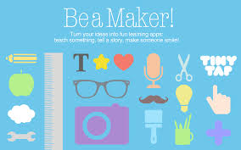
One more
TINYTAP: http://www.tinytap.it
To play online
To create: download app

Slide 24
More tools
Tools & links
https://www.zondle.com/ | For primary: Track individual progress
https://www.classdojo.com https://www.youtube.com/watch?v=KaeNSYJvrn0 (video presentation) | For primary: to work on habits, behaviour, motivation, participation...
https://quizlet.com Video-presentació | Flashcards / vocabulary
http://www.socrative.com | Questiionnaire and games at real time. Instant results Resultats instantanis.
http://www.educaplay.com | Loads of games: interactive maps, fill in the gaps, crosswords...
https://jeopardylabs.com | “jeopardy”game, no registration needed.

Slide 25
Resources
Resource | Link
Infographic about gamification | http://www.knewton.com/gamification-education/
List of games: WEB20GURU | http://web20guru.wikispaces.com/Web+2.0+Resources
MOOC course (European Schoolnet) | http://www.europeanschoolnetacademy.eu/web/games-in-schools
Research, case studies | http://badgeville.com/wiki/education
Gamification of Education: video and lesson | http://ed.ted.com/on/uk36wtoI
Course MOOC | https://www.mooc-list.com/course/games-education-gamification-openlearning

Slide 26
AVATARS AND BADGES

Slide 27
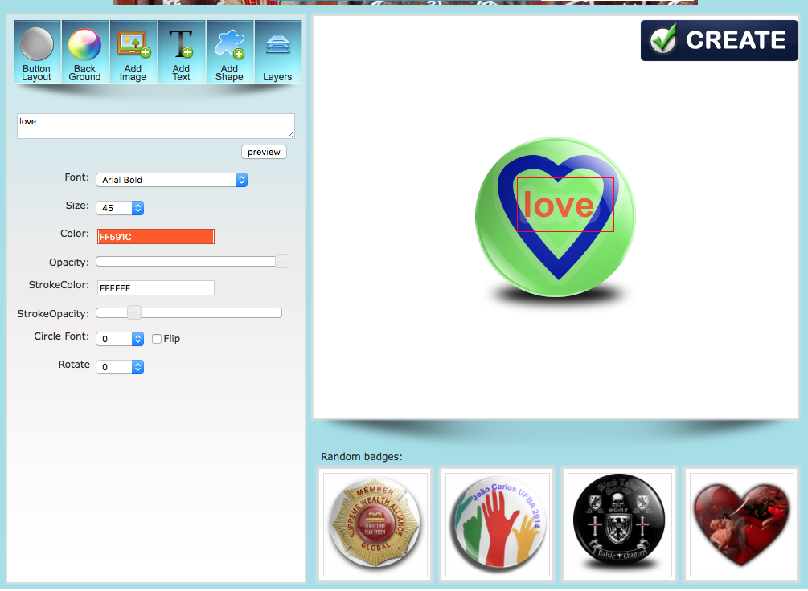
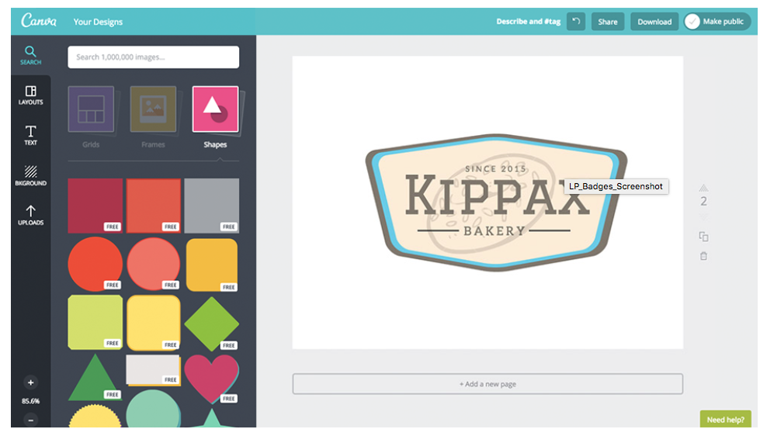
badges
.
https://www.imagefu.com/create/badge: IMAGE FU
https://www.canva.com/features/badges/CANVA.COM
http://www.onlinebadgemaker.com/3d-badge-maker. ONLINE BADGE MAKER

Slide 28
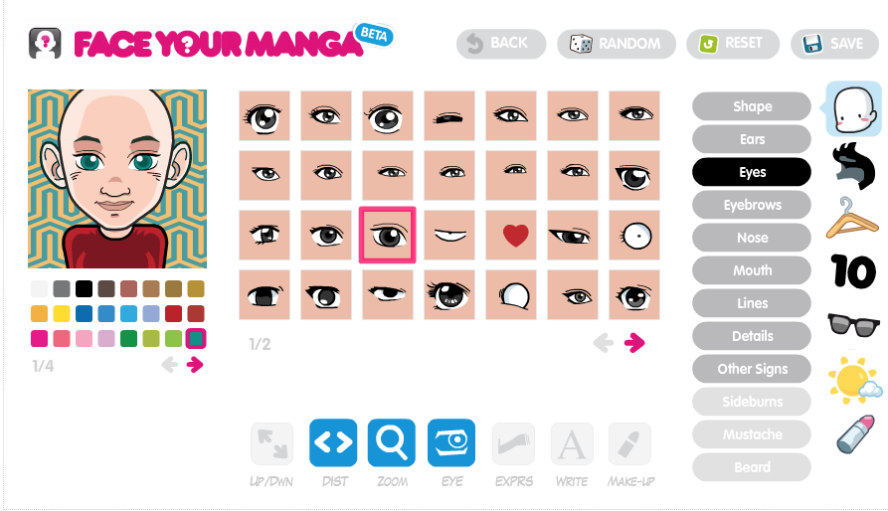
Avatars
DOPPELME: http://doppelme.com/
FACE YOUR MANGA: http://www.faceyourmanga.com/
http://pickaface.net: PICKAFACE

Slide 29
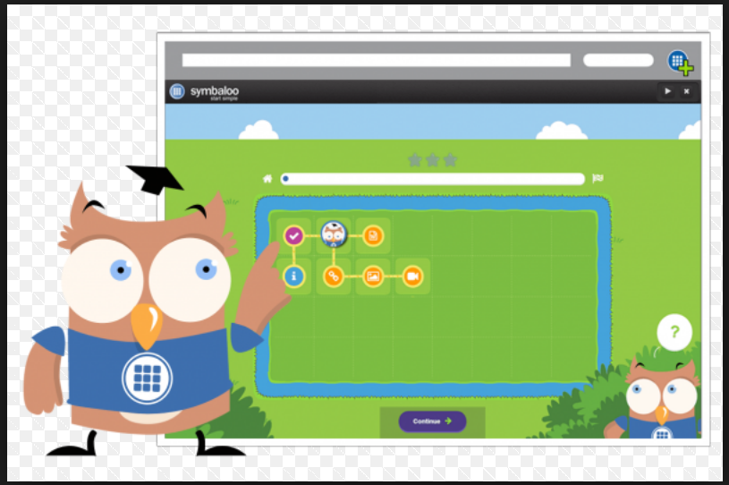
Some practice
http://teachersfirst.com/blog/2016/09/gamify-learning-with-symbaloo-lesson-plans/
SYMBALOO LESSON PLANS: https://lessonplans.symbaloo.com/

