Slide 1
Collaborative activities
TRAINING COURSE: LET’S ETWIN ER&MVO
Marta Pey Pratdesaba
Referent Llengües Estrangeres MVO
eTwinning Ambassador

Slide 2
WHAT AM I GOING TO TALK ABOUT?
1) Collaborative learning
2) Collaboration among teachers
Examples
Webtools
3) Collaboration among students
In the same school
From different schools
Exemples
Webtools

Slide 3
1) Collaborative learning
Teachers and students
Joint work
Peer learning
Responsible of own learning / others

Slide 4
2) Collaboration among teachers
Negotiation
Good understanding
To be taken into account:
Different curricula: different needs

Slide 5
webtools
wikis: pbworks
Trello
Google docs

Slide 6
Wiki: www.pbworks.com
Example of a Comenius/eTwinning project
http://energycrunch.pbworks.com/w/page/29221751/WELCOME

Slide 7
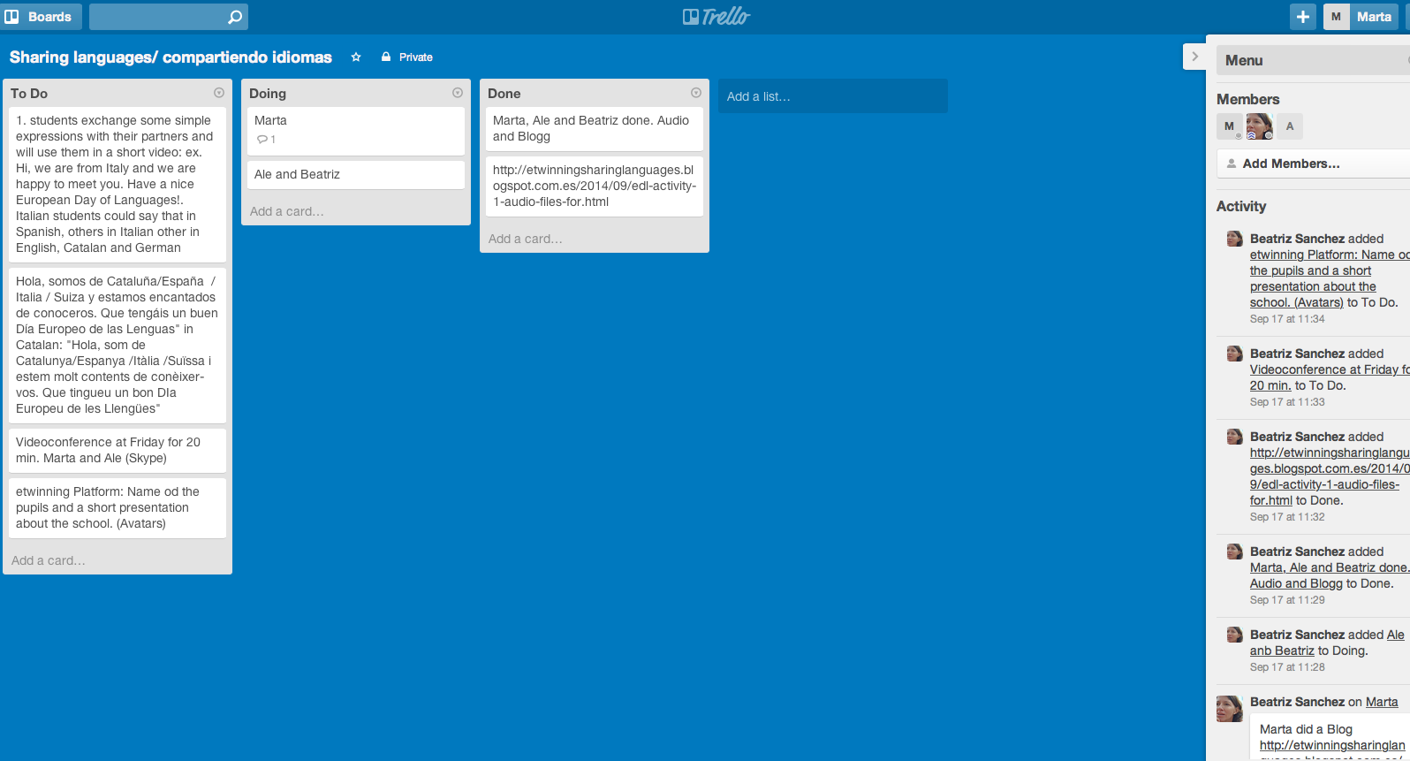
Trello: www.trello.com

Slide 8
Google Docs

Slide 9
PROS:
Information stored in one single place
To be shown as evidence of collaboration
Notification in your email

Slide 10
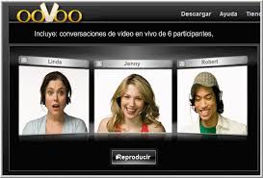
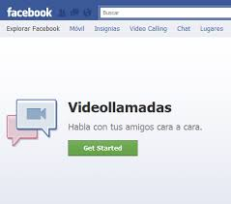
VIDEOCONFERENCES: WEBTOOLS

Slide 11
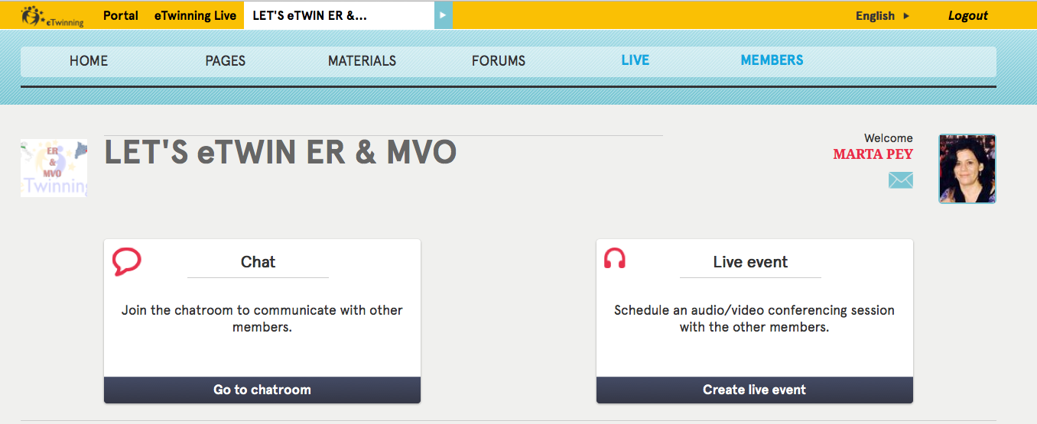
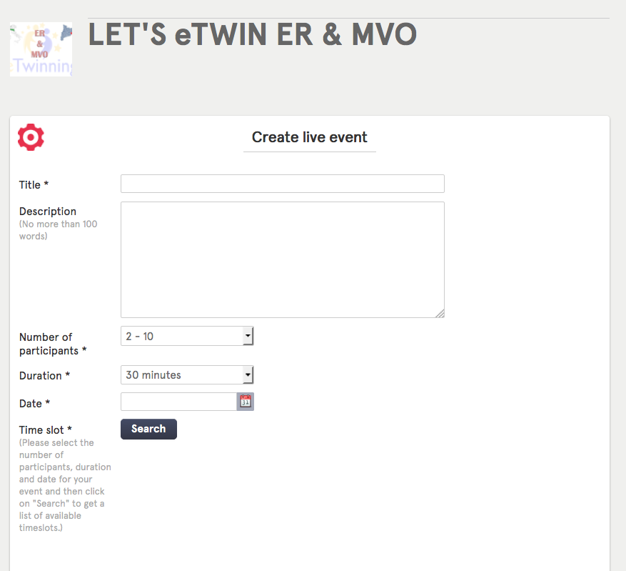
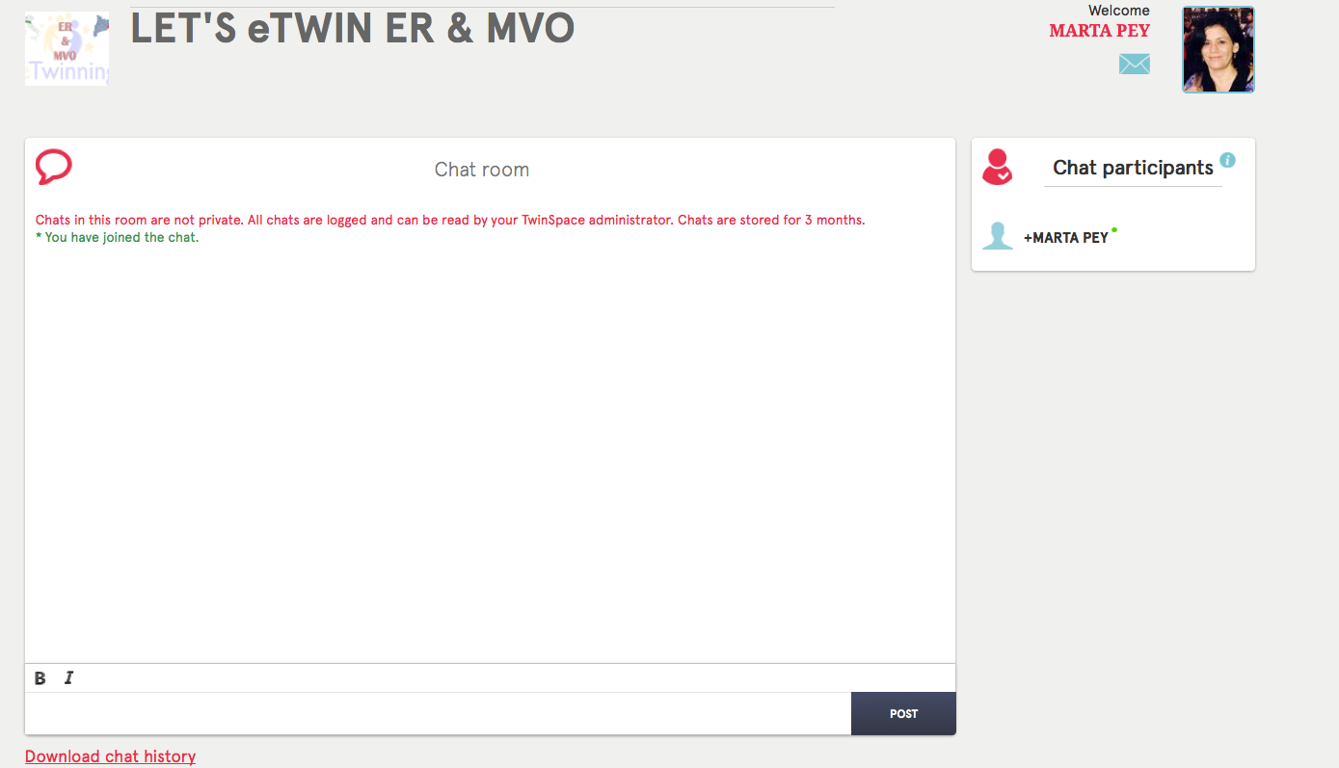
IN THE TWINSPACE
CHAT
LIVE

Slide 12
3) COLLABORATION AMONG STUDENTS
In the same school
From different schools

Slide 13
IN THE SAME SCHOOL
More motivation if: they take active part
Team organization:
Social skills
Self-learning skills
Team work allows students:
Tasks according to students’s profile
Search for information
writing
Drawing
Presentations...

Slide 14
From different schools
Key element in eTwinnng projects
If there is interaction among students of the different schools
Students will develop their skills
Language
Cultural
Social

Slide 15
Planning parallel activities is not enough!!!!
Let’s see some examples

Slide 16
Online collaboration

Slide 17
“Addressing the Energy Crunch, Every Little Action Helps”
Comenius Multilateral Partnership
3 countries: Sweden, Lithuania & Spain
Topic: energy saving
Project blog
Twinspace

Slide 18
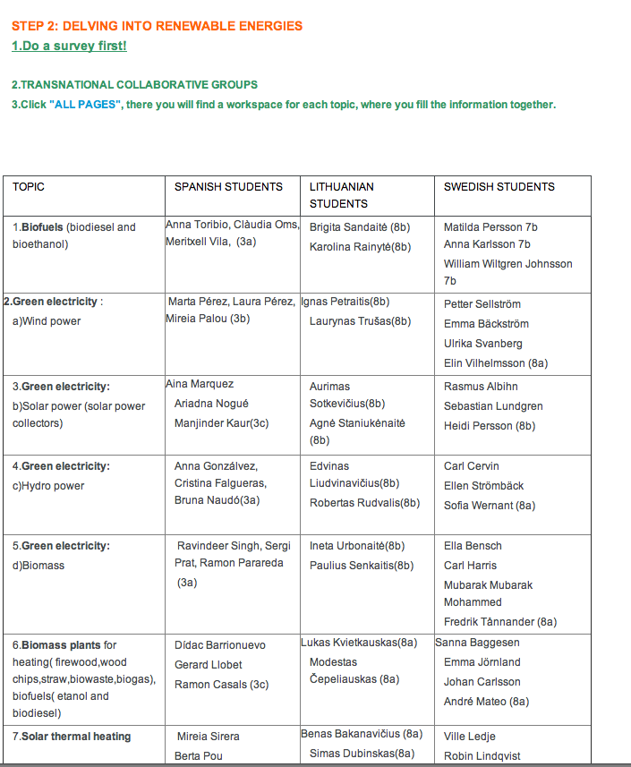
Transnational groups

Slide 19
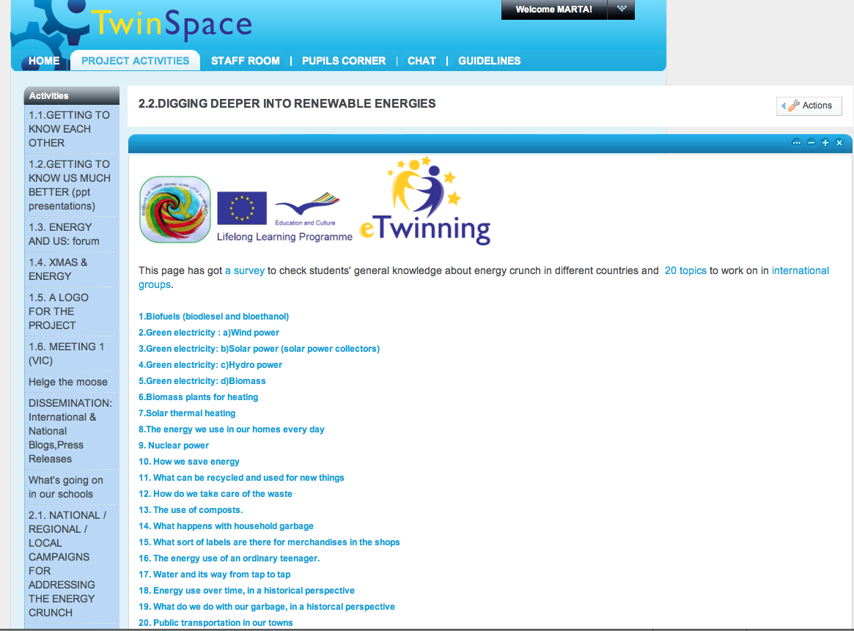
Content activity
2.2) DIGGING DEEPER INTO RENEWABLE ENERGIES

Slide 20
Collaborative work in the twinspace

Slide 21
LITHUANIAN GLOG ON NUCLEAR POWER IN SPAIN
SWEDISH GLOG ON NUCLEAR POWER IN LITHUANIA
SPANISH GLOG ON NUCLEAR POWER IN SWEDEN

Slide 22
“Songs, Language and Culture”
6 countries: Italy, Poland, Czech Rep., Bulgaria, Lithuania &Spain
Runner-up European Prizes 2010, cat. 15-19
Final products: Booklet /Song of the project
http://martapey.edublogs.org/
http://teacherscorner.edublogs.org/

Slide 23
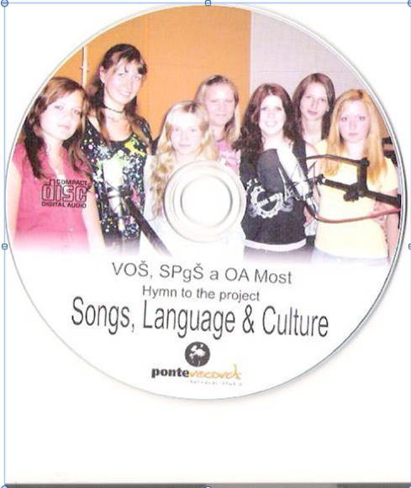
A collaborative song
Melody /chorus (Czech students)
One stanza per country
The Czech choir records the song
Vote for the title
Other countries record own version

Slide 24
“this is europe”
The Bulgarian stanza:
Land of roses and flowered spring Lovely summer and winter skiing Autumn - beauty that we cannot measure Bulgaria - our little golden treasure.
The Lithuanian stanza:
Lithuanians living by the Baltic sea will happily everybody meet Lithuania is small But all for one and one for all
The Italian stanza:
Land of music and poetry That's our beautiful country Venice, Florence and Rome, That's our beautiful home
The Catalan/Spanish stanza:
Catalonia, our little country Sunshine in the morning The nights are very special When the sun goes down
The Czech stanza:
The Czech Republic's my native country. Like the romantic poetry. Czech is of the Europe part, forever in my heart
The Swedish stanza:
You think Sweden is full of blue eyes
But there is so much more people
With any colour and size
Also rich and poor.
Chorus (for all):
There are beautiful places.
There are beautiful countries. //:Everybody will find:// (x2) //:A wonderful home:// (x2) Satisfied home.
https://www.youtube.com/watch?v=n-IouDfd3B0 ; VIDEO OF THE SONG

Slide 25
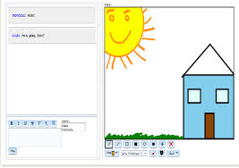
Collaborative drawing
www.drawitlive.com
Examples of drawing of literary works

Slide 26
OUR SHARED FASHION MISSION
- Collaborative presentations
http://issuu.com/filmsfashion/docs/going_partying/26?e=0

Slide 27
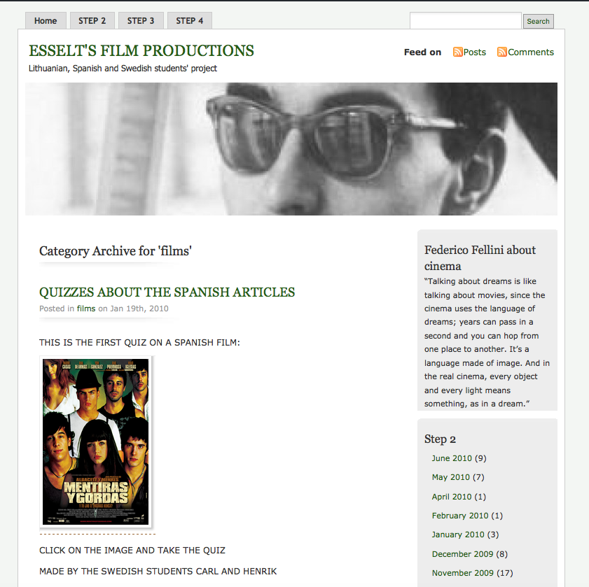
Articles & quizzes
THE FILM INDUSTRY IN OUR COUNTRIES
from the project: ES.SE.LT’S FILM PRODUCTIONS
instructions: http://esseltsfilmproductions.edublogs.org/about/
ARTICLES: (films): http://esseltsfilmproductions.edublogs.org/category/films/
QUIZZES: http://esseltsfilmproductions.edublogs.org/category/quizzes/

Slide 28
Collaborative activities during the visits
Recording of a play: actors and actresses: students from different countries.
Example: HARRY SPOTTER AND THE QUEST OF THE RIGHT LIGHT: http://www.youtube.com/watch?v=2rdZP7KTVQ0

