Slide 1
LET’S ETWIN ER & MVO
Training Course
MARESME-VALLÈS ORIENTAL
Abril-maig 2016
Marta Pey Pratdesaba
Referent Territorial de Llengües Estrangeres
Secció dels Serveis Educatius i Formació Permanent
Serveis Territorials al Maresme-Vallès Oriental
eTwinning Ambassador

Slide 2
Project Showtime

Slide 3
DIFFERENT LEVELS:
KINDERGARTEN: TALKING PICTURES
PRIMARY: “GOLD RULES FOR GOOD BEHAVIOUR”
SECONDARY (ESO): “EN LA RED, QUE NO TE PESQUEN”
SECONDARY (BATXILLERAT): “SONGS, LANGUAGE AND CULTURE”
VOCATIONAL TRAINING: “ EUROPIA: EUROPE TOMORROW”
SPECIAL NEEDS: “TE CUENTO, ME CUENTAS UN CUENTO”

Slide 4
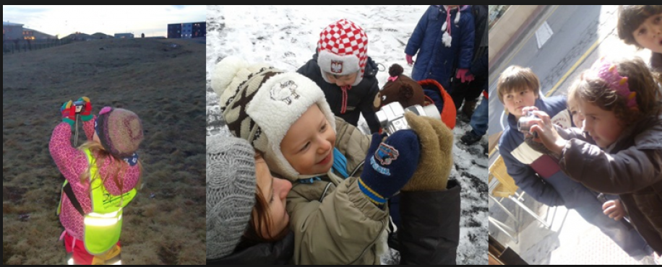
NURSERY: Talking pictures
Anna Ibáñez: C.R.A. ALTO CIDACOS (Arnedillo, La Rioja), Poland and Iceland.
National Prize 2014
Runner-up European Prizes 2014
Vídeo-presentació del projecte

Slide 5
Primary: Gold Rules for Good Behaviour
Fina Vendrell Vila, Collegi Sant Josep de Navàs (Bages)
Szkoła Podstawowa im. Tadeusza Kościuszki w Gębicach (Gębice, Poland)
2 school years: 6th grade Primary
National Prize 2013
European Prize 2014
Video-presentació del projecte

Slide 6
Secondary ESO: “En la red, que no te pesquen”
In Spanish
Tutoria 4th. ESO
Topic: Internet Safety
Countries: Astúries, Portugal and Sweden
“Proyecto mes de Enero” a Etwinning Espanya.
National and Quality Labels
National Prize 2012
http://new-twinspace.etwinning.net/web/p35394
Runner-up European Prizes 2012, cat. 15-19

Slide 7
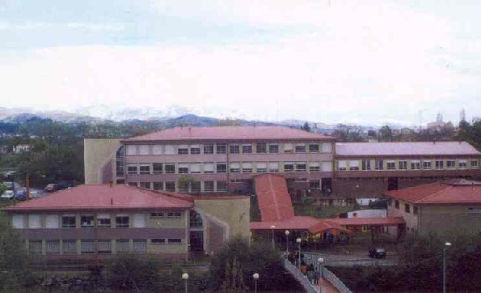
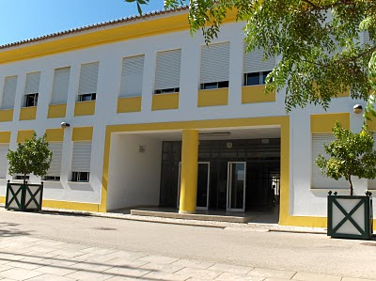
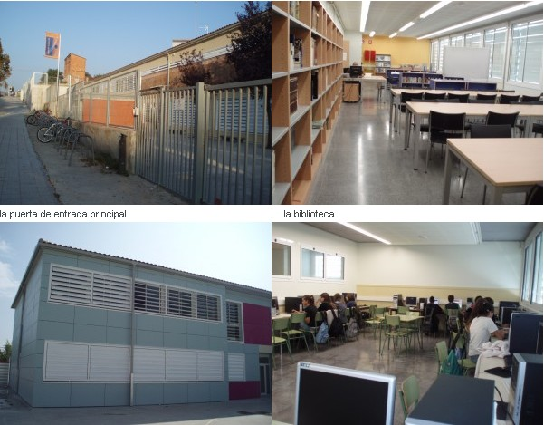
The schools
Instituto Escultor Juan de Villanueva de Pola de Siero (Asturias)
Escuola Pinheiro e Rosa de Faro (Portugal)
Institut Jaume Callís, VIC, (Catalonia)
It-gymnasiet, Göteborg, (Sweden)

Slide 8
Number of pupils, areas & levels
Catalunya: 25 pupils aged 15-17 (4th ESO) / Tutoria
Astúries: 10 pupils aged 15-17 (4th ESO) / Informatics
Portugal: 30 pupils aged 15-18 / Spanish as a foreign language
Sweden:
10 pupils
aged 17 Spanish as a foreign language

Slide 9
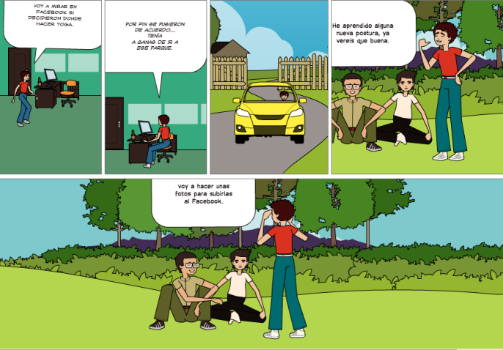
Results and Products:
Articles and Presentation in the Twinspace;
Comments in the forums
Profiles editing
Videoconferences
Collaborative work
Participation in online games

Slide 10
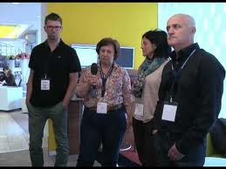
Interview to the teachers

Slide 11
Batxillerat: “Songs, Language and Culture”
Italy, Poland, Sweden, Czech Republic, Lithuania, Bulgaria and Spain.
Runner-up European Prizes (2010),
cat. 15-19 anys
Vídeo-presentació del proyecto
Project of the Month: June 2010 in Sweden
In English

Slide 12
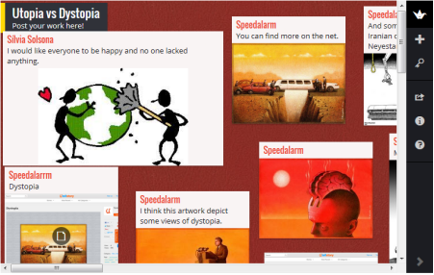
Vocational Training: “Europia”
Ins. Ronda (Lleida): Maribel Vila & Laskarina Polemi del 1st Senior High School Kessariani (Greece)
Duration: 6 months
Presentació del projecte:

Slide 13
“SHARING LANGUAGES” An eTwinning project
Integrated in Projecte de Recerca:
“Influenciats per l’anglès”
4t. ESO
Participating schools:
Institut Jaume Callís, Vic
ISIS Gallilei, Gorizia (Italy)
RG Rämibülh, Zürich (Switzerland)
Main Languages: Spanish and English

Slide 14
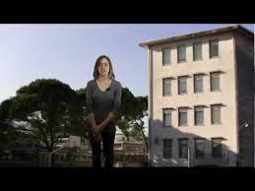
ISIS GALLILEI (Gorizia)
http://isitgo.it

Slide 15
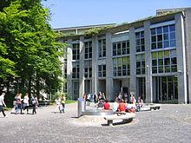
RG RÄMIBÜLH, ZÜRICH
http://rgzh.ch

Slide 16
Students
Institut Jaume Callís: 11 students aged 15-16
ISIS Gallilei: 18 students: aged 15-16 electronics module
RG Rämibühl: 24 alumnes: aged 16-17 year 5

Slide 17
Objectives
Use the ICT to create, communicate, exchange information and collaborate online;
Develop writing, listening, reading and writing skills in the mother tongues and foreign languages;
Describe and analyze the influence of foreign languages (esp. English) in the languages spoken in the three partner countries;
Describe and analyze the influence of foreign cultures (esp. English) in the own cultures and everyday life;
Learn about other countries and cultures, and infer in their own;
Create a European identity

Slide 18
Calendar of activities
WARMING UP:
CELEBRATION OF THE EUROPEAN DAY OF LANGUAGES, SEPT 26
STEP 1: (SEP-NOV 14):
INTRODUCTIONS: INDIVIDUAL, SCHOOLS, CITIES, REGIONS AND COUNTRIES.
STEP 2: (DEC 14-FEB 15)
OUR LANGUAGES: INFLUENCES, HISTORY, BORROWED WORDS.
STEP 3: (MARCH-JUNE 15)
INFLUENCE OF ENGLISH IN OUR LANGUAGES

Slide 19
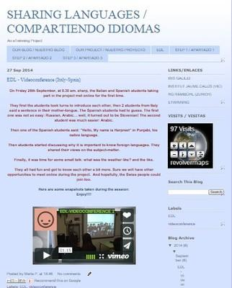
Working places
TWINSPACE DEL PROJECTE: http://twinspace.etwinning.net/156/home (our meeting point)
PROJECT BLOG: http://etwinningsharinglanguages.blogspot.com.es (dissemination)

