Slide 1
LET’S ETWIN ER&MVO II
SESSION 2: COLLAbORATION IN ETWINNING

Slide 2
Collaboration
What is collaboration in eTwinning projects for you?
Write your ideas here: (max. 20 characters)
https://answergarden.ch/393494

Slide 3
QL criteria: Collaboration between partner schools
Collaborative activities go beyond communication: the partners are not just recipients of information; they are team-members, co-authors and co-creators.
Collaboration means that both classes need the contribution of their partner class to complete the activity.
Working in mixed-nationality groups is a very effective practice for collaborative work. (small group from one class + small group from another class = mixed-nationality group)

Slide 4
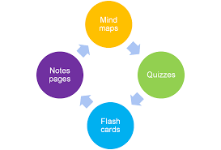
Tips for a Successful eTwinning Collaboration
https://www.goconqr.com/en/p/7131654

Slide 5
discussion
In groups, discuss the following tips. You’ve got 2-3 min. For each one.
I do this (How well does it work?
I would try this (what do you like about it?)
I wouldn’t do this (what don’t you like about it?

Slide 6
Tip #1
Get to know your partners
Share with your partners all the necessary
information:
Number of students participating in the project.
Your students’ age and interests.
Your students’ level in the foreign language and their ICT skills.

Slide 7
Tip #2
Create a detailed time schedule
Set the starting dates for each task
Mark the dates each one of the partner schools is on holidays.
Share it with your students
Set deadlines and keep to them.

Slide 8
Tip #3
Preparatory planning leads to a successful eTwinning project
Plan a meeting, introduce the project to the children and inform the parents, the colleagues and the headteacher about the specific project.
Add more teachers from your school to the project and form school teams.
Announce the beginning of the project on the school website.
Create Twinspace Accounts for all the participants and invite the students to the Twinspace.
Organise mini-courses for your students on ICT tools to be used and on how to use the Twinspace
Create Twinspace tutorials for students or partners who are beginners in eTwinning (if necessary).

Slide 9
Tip #4
Design your Twinspace carefully
Create activity pages for each one of the planned tasks.
Add a short description for each one of the activities planned on the top of each activity page.
Agree with your partners about the most suitable tools for each one of the activities and add them to your activity pages

Slide 10
Tip #5
Break the Ice and Get to know each other
Have students interact as much as possible.
Ask them to update their Twinspace profiles by adding a short description of themselves and a representative avatar.
Ask them to leave comments on their partners’ walls.
Vote for the best Twinspace profiles.
Plan chat sessions and skype meetings regularly.
Find creative ways to have your students introduce themselves and their school or country.

Slide 11
Tip #6
Team your students up in Transnational Groups
Create a table with the newly formed transnational groups and add it to the Twinspace.
Ask your students to work together and write a short description of their group members
Ask your students to agree upon a name for their group and draw together a symbol or an emblem for each group

Slide 12
Tip #7
Plan as many collaborative activities as possible
Try to plan activities that need your partners’ contribution to be completed.
Use as many collaborative tools as possible
Try to avoid creating folders for each country in Twinspace. Successful collaborative activities are the ones in which you cannot tell which of the partners did what!

Slide 13
Tip #8
Assign Responsibilities to your students
Discover your students’ talents and skills and give them responsibilities.
Team the students up in groups, according to their talents (the painting group, the photography group, the ICT group etc)
Assign to some students the role of ‘student administrator” in Twinspace

Slide 14
Tip #9
Set Evaluation Criteria
Try to evaluate along with your partners the quality of your project.
Recognize Key Strengths
Identify areas that need improvement
Plan ongoing evaluation activities ( Ts and Ss share opinions, make proposals, comment on each other’s work)

Slide 15
When should collaboration take place?
• At the very beginning of the project: project planning and icebreaking
• During the project: collaborative activities, crossed tasks, mixed groups, constant peer feedback …
• At the end of the project: shared and collaborative project outcome, evaluation

Slide 16
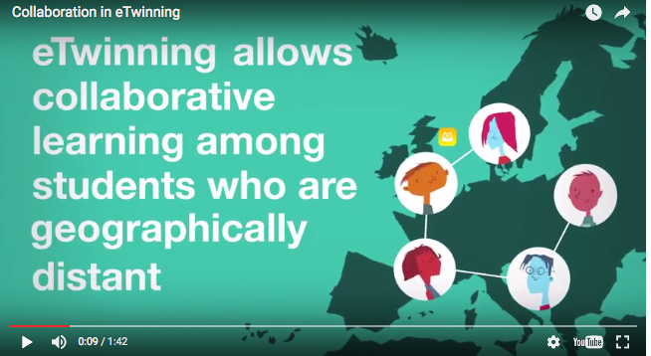
video
COLLABORATION IN ETWINNING: Spanish NSS

Slide 17
Let's collaborate
1) TRICIDER: http://www.tricider.com/home
Article: https://www.fractuslearning.com/2011/12/05/how-to-brainstorm-with-tricider/
Example: http://www.tricider.com/admin/3HxCpWZZ7gV/EFKMYh7FiJp
Practice:
http://www.tricider.com/admin/3YdcbxPQUQl/71CTrRic6AX
2) PRIMARY PAD: http://primarypad.com/
Article: http://primarypad.com/teachers/
Practice: http://free.primarypad.com/p/Dhlhz9kAf8
3) AWWAPP: https://awwapp.com/
Article: https://awwapp.com/edu/
Practice: https://awwapp.com/b/uc9gc00et/

Slide 18
Special thanks to:
Irene Pateraki
NSS Greece

