Slide 1
LET’S ETWIN ER & MVO
Marta Pey Pratdesaba
Foreign languages coordinator MVO
eTwinning Ambassador
TEACHER TRAINER
April 2016

Slide 2
SESSION 1:
1.1. 21st c. education and key competences
1.2. Introduction to eTwinning
Portals
eTwinning Live

Slide 3
1.1.. Education in the 21st. C.

Slide 4
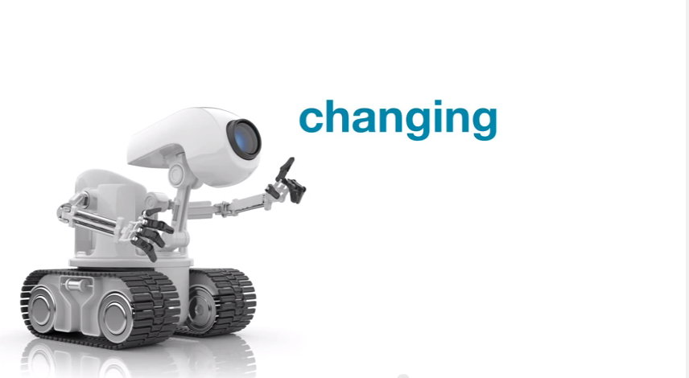
1.1. EDUCATION IN THE 21st CENTURY
Video: https://www.youtube.com/watch?v=Ax5cNlutAys#t=118

Slide 5
Which are the 21st century skills?
- skills usually not covered in formal education, but
- highly prized in the workplace.
The 7 SURVIVAL SKILLS:
Critical Thinking and Problem Solving
Collaboration across Networks and Leading by Influence
Agility and Adaptability
Initiative and Entrepreneurialism
Effective Oral and Written Communication
Accessing and Analyzing Information
Curiosity and Imagination
Tony Wagner , The Global Achievement Gap

Slide 6
These skills have to be acquired in a curriculum
Interdisciplinary,
integrated,
project-based

Slide 7
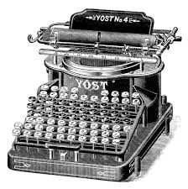
Educational demands of the 21st century
The world of work is changing
We are only certain that it is going to be a constant & continuing change

Slide 8
The knowledge society
More and more global
The explosion of technology and the internet: access to this information in a click

Slide 9
Changes in the curriculum
Schools are changing: more autonomy
Less formal curriculums
More project-based learning
More collaborative learning

Slide 10
FORMAL
INFORMAL

Slide 11
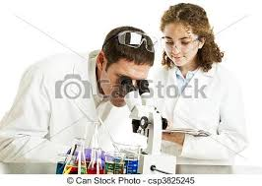
Changes in the roles of teacher & learners
Changes in practices
Changes in societal expectations

Slide 12
Youth culture
Consumers
Collaborators
Creators
Leaders of tomorrow
What capabilities do they need as learners?

Slide 13
Learners: key capabilities
s. XX
Conformity, compliance
Working alone, silence, teacher rules
Vs.
Collaboration, community, work
s. XXI
Creativity
Interaction, noise, teacher-helper

Slide 14
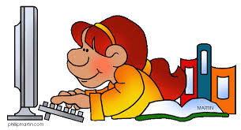
All in all
Students are changing
They are CONNECTED students
The core values of education: radical change
Teachers are still conservative in their methods and views about learning

Slide 15
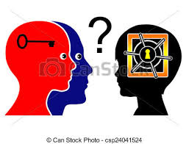
1.1.2.KEY COMPETENCES

Slide 16
What is a competence?
The ability to apply
A synthesis of knowledge
Skills and attitudes in a particular situation and with a particular quality.

Slide 17
European key competences in learning

Slide 18
PISA
Program for International Student Assessment
Every three years
An international assessment that measures 15-year-old students’:
reading,
mathematics,
science literacy
measures of general or cross-curricular competencies, such as collaborative problem solving

Slide 19
PISA
emphasizes functional skills that students have acquired as they near the end of compulsory schooling
PISA 2015 will also include:
a collaborative problem solving assessment
an optional financial literacy assessment

Slide 20
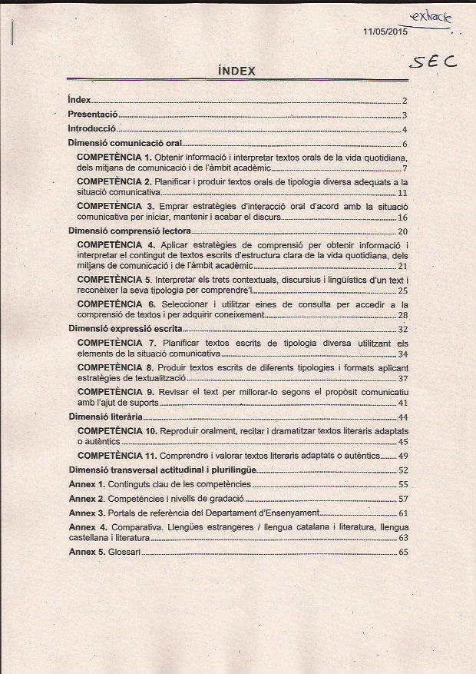
New Curriculum in Catalonia

Slide 21
What is competence learning?
• Active learning
• In realistic settings
• Together
• Aimed at actual performance
• Aimed at learning to learn

Slide 22
Pedagogies
Pedagogy is the theory and practice of learning.
It represents the creation of environments designed to foster learning.
Learner-centered pedagogy represents the creation of environments designed to foster learning through the learner’s active role in
creating knowledge,
social engagement
collaborating with (a) network(s) of peers.

Slide 23
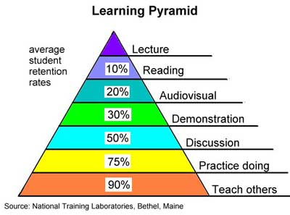
The Learning Pyramid
the more the learner is involved in the learning process
the higher the retention rate (better learning outcome).

Slide 24
COMPETENCE IN THE MOTHER TONGUE
ability to express and interpret concepts, thoughts, feelings, facts and opinions in both oral and written form
to interact linguistically in an appropriate and creative way in a full range of societal and cultural contexts; in education and training, work, home and leisure.

Slide 25
COMPETENCE IN FOREIGN LANGUAGES
the ability to understand, express and interpret
concepts
thoughts
feelings
facts
opinions
in both oral and written form
in an appropriate range of societal and cultural contexts according to one’s wants or needs
in education and training,
Work
Home
Leisure
skills
Mediation
intercultural understanding

Slide 26
MATHEMATICAL COMPETENCE AND BASIC COMPETENCES IN SCIENCE AND TECHNOLOGY
Mathematical competence is the ability to develop and apply mathematical thinking in order to solve a range of problems in everyday situations
Competence in science refers to the ability and willingness to use the body of knowledge and methodology employed to explain the natural world, in order to identify questions and to draw evidence-based conclusions.
Competence in technology is viewed as the application of that knowledge and methodology in response to perceived human wants or needs

Slide 27
DIGITAL COMPETENCE
basic skills in ICT
the use of computers to
retrieve
assess
store
produce
present
exchange information
communicate and participate in collaborative networks via the Internet.

Slide 28
LEARNING TO LEARN
ability to
pursue and persist in learning
organise one’s own learning, including through effective management of time and information, both individually and in groups.

Slide 29
SOCIAL AND CIVIC COMPETENCES
Include competences:
personal
Interpersonal
intercultural
cover all forms of behaviour that equip individuals to participate in an effective and constructive way in social and working life, and particularly in increasingly diverse societies, and to resolve conflict where necessary.

Slide 30
SENSE OF INITIATIVE AND ENTERPRENEURSHIP
an individual’s ability to turn ideas into action.
It includes:
creativity
innovation
risk-taking, ability to plan and manage projects in order to achieve objectives.

Slide 31
CULTURAL AWARENESS AND EXPRESSION
Appreciation of the importance of the creative expression of ideas
experiences and emotions in a range of media
music
performing arts
literature
visual arts

Slide 32
These key competences are all interdependent
the emphasis in each case is on
critical thinking
creativity
initiative
problem solving
risk assessment
decision taking
constructive management of feelings.

Slide 33
TIME FOR A GAME
But also a test ☹
Kahoot.it

Slide 34
Special thanks to
Anne Gilleran
Pedagogical Manager eTwinning at European Schoolnet - EUN - Brussels

