Slide 1
PROJECT KITS & MODULES
Inspiration for eTwinning Projects
Marta Pey Pratdesaba
Referent Llengües Estrangeres MVO
Formadora Departament d’Ensenyament
Embajadora eTwinning

Slide 2
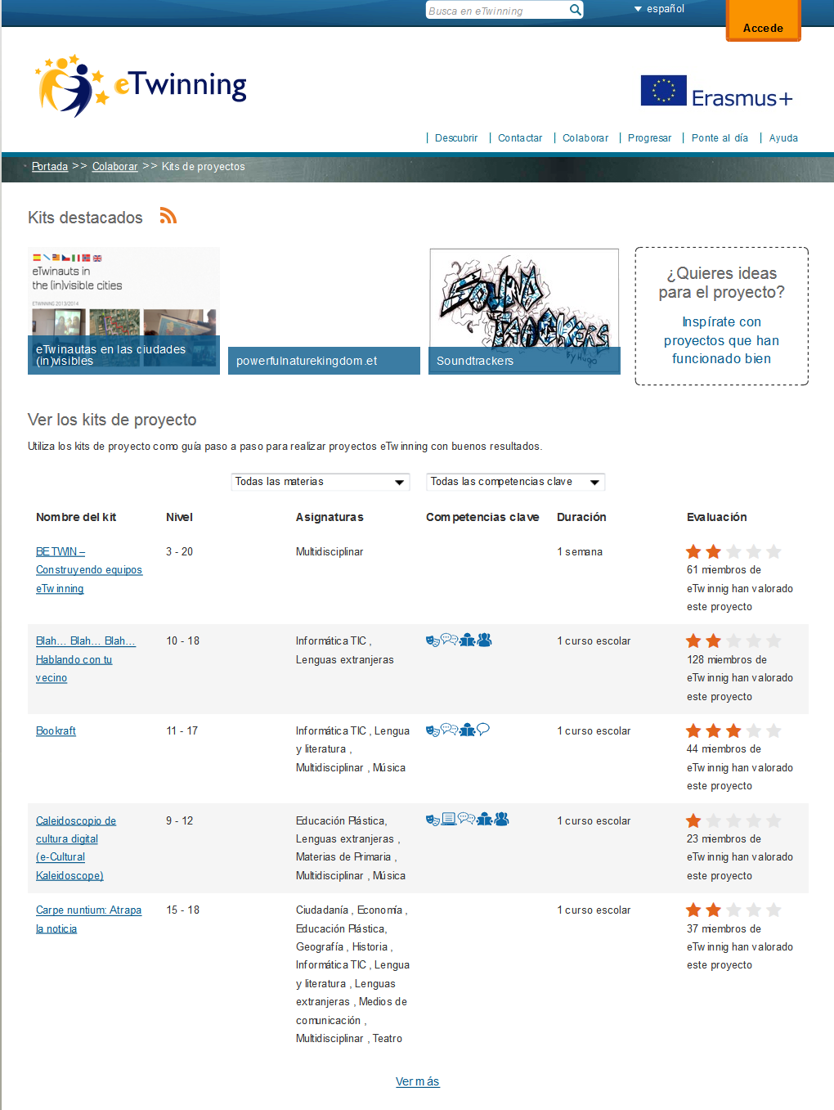
What is a PROJECT KIT
Step-by-step kits for teachers who are looking for concrete ideas on how to implement a European collaborative project.
Each kit relates to a topic and provides information on the target group, objectives and pedagogical value of the activities. At the end of each kit, you also have follow-up options and related links.
The eTwinning kits can be used as they are or adapted to your teaching context. The kits can be found at www.etwinning.net

Slide 3
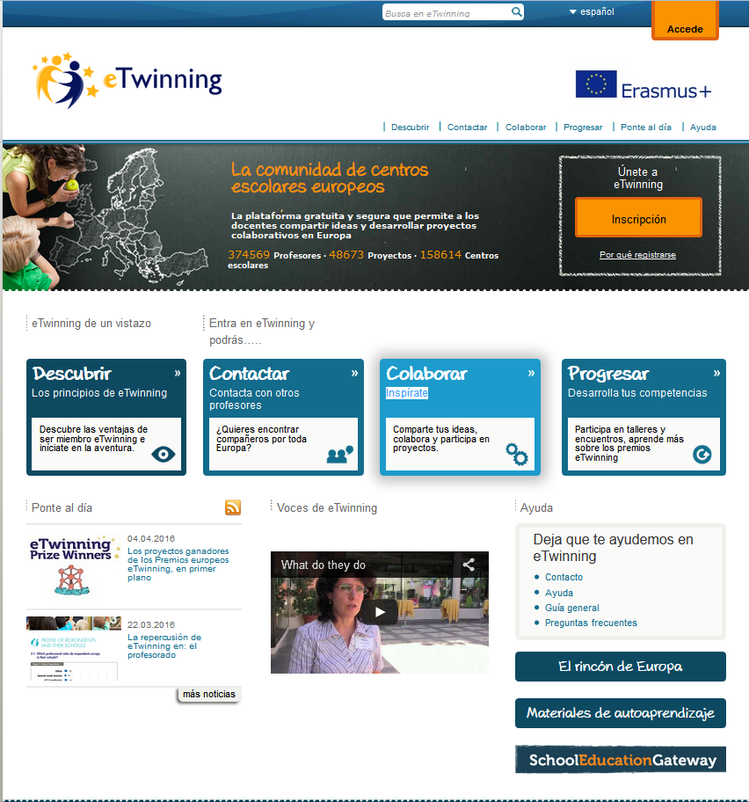
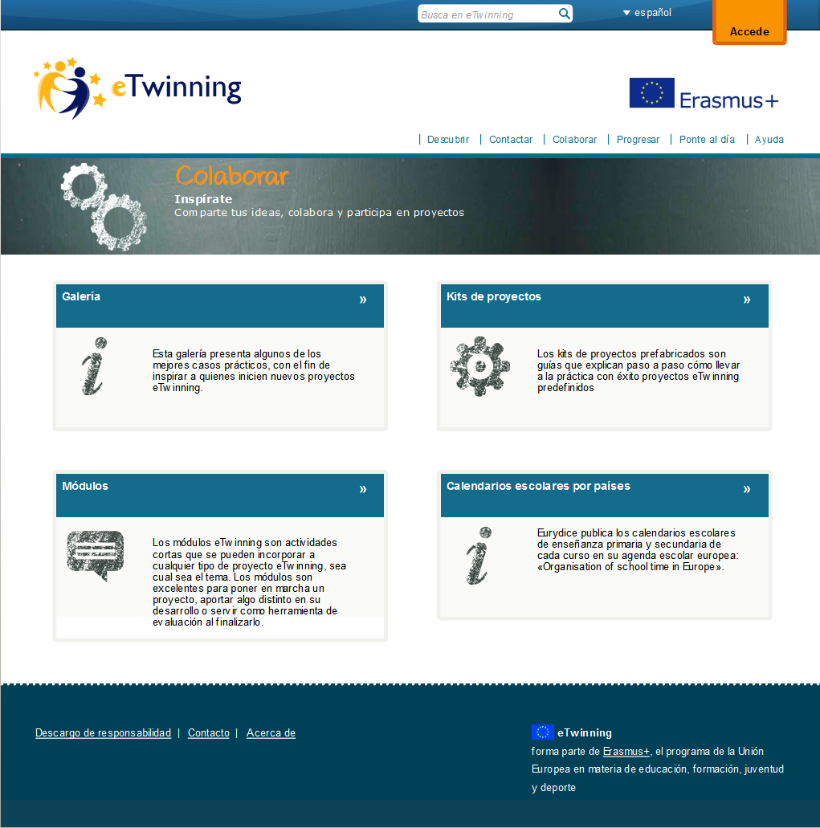
Whre are the PROJECT KITS?
https://www.etwinning.net/es/pub/collaborate/kits.cfm

Slide 4
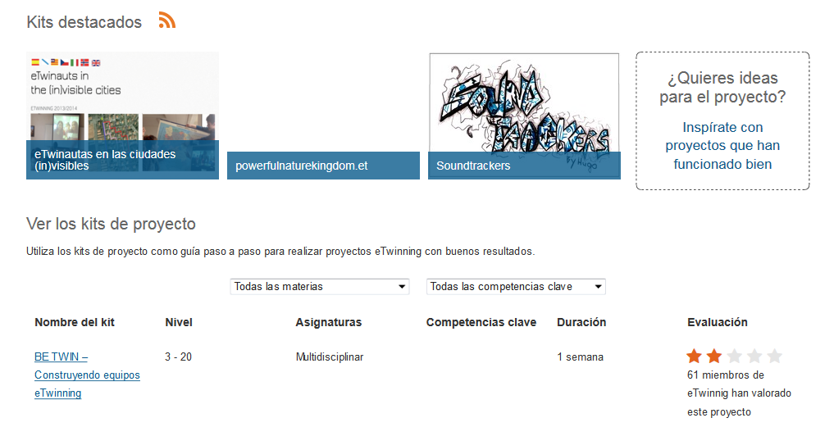
Project kits. Let's have a look
Highlighted kits
Best-rated projects
Search by Key Competences
List of Kits
Includes name, level, area, KC, duration & evaluation
Search by subject-area

Slide 5
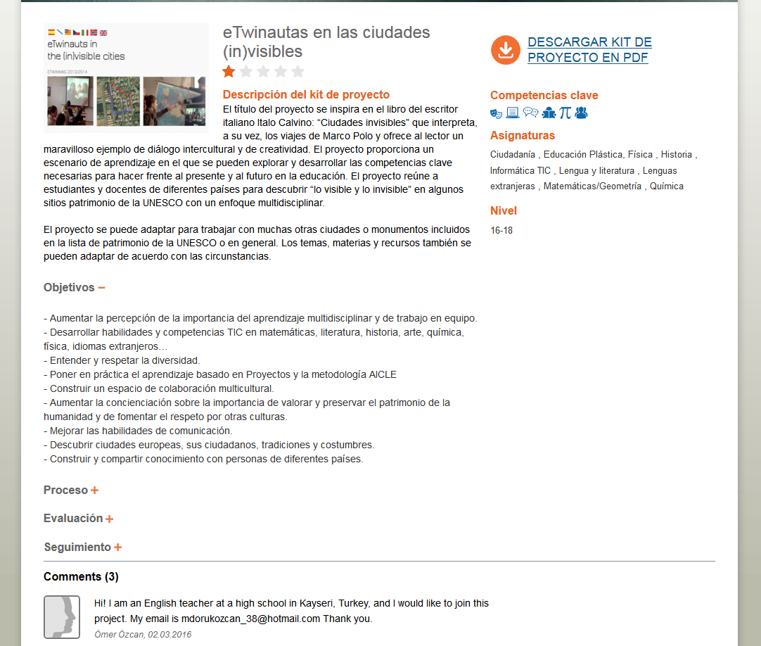
Project Kits: let's have a closer look
Downloadable (PDF)
Title and description
Competences
Subject-areas & Age
Project
Useful to fill in the application form
Comments& Rates
You can find partners, even here.

Slide 6
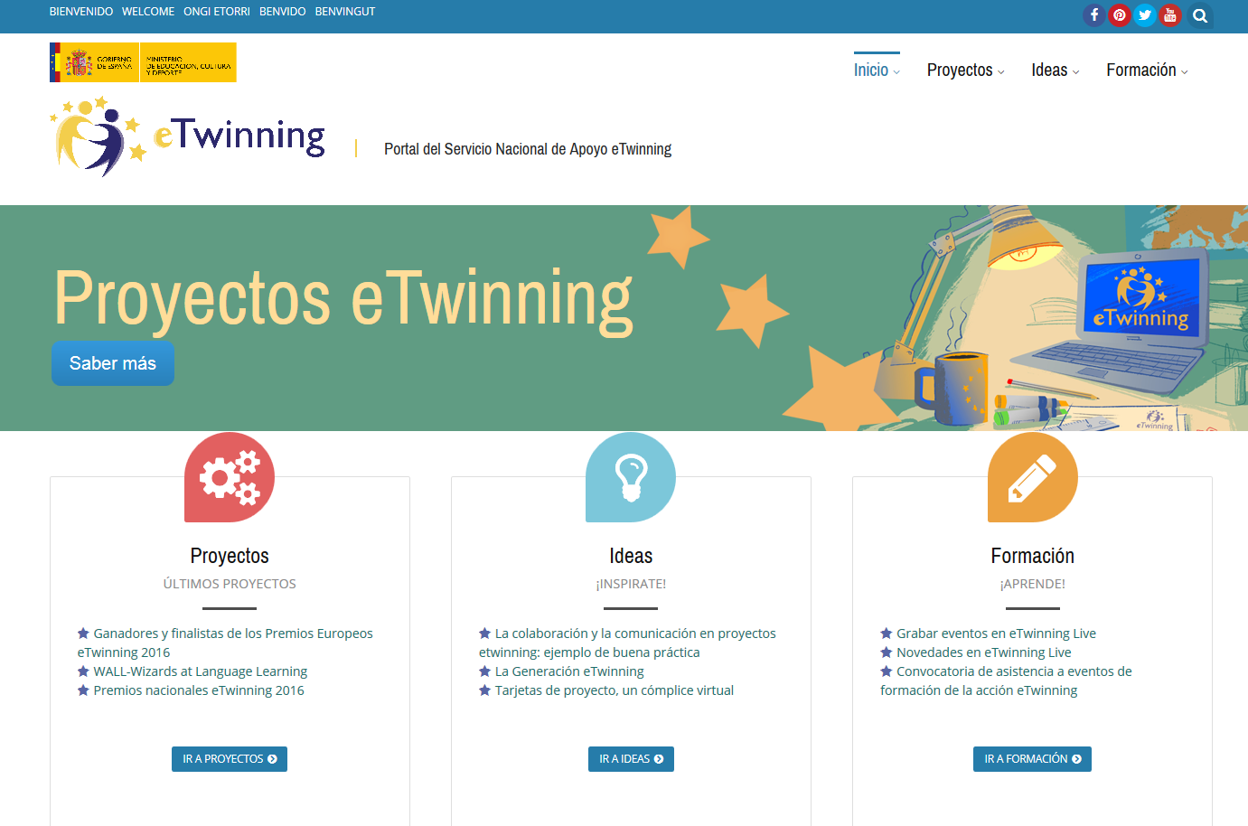
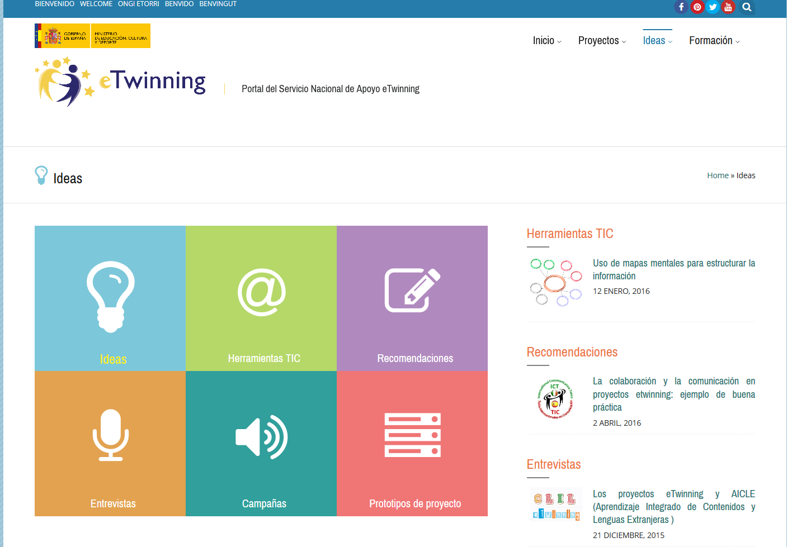
Project Prototypes
The Spanish NSS (www.etwinning.es) offers you something similar
http://etwinning.es/ideas/prototipos-de-proyecto/?lang=es .
They are inspiring ideas.
Activities and Key Competences. Dissemination and Evaluation.

Slide 7
STOP & CHECK
1) Are Project Kits for both Primary & Secondary?
2) If a Project Kit has 5 stars, does this mean it is a good one?
3) Can you also rate a kit?
4) Are Project Kits for a fixed period of time?
5) Will the Follow-Up section tell you anything about the objectives of the Project Kit?

Slide 8
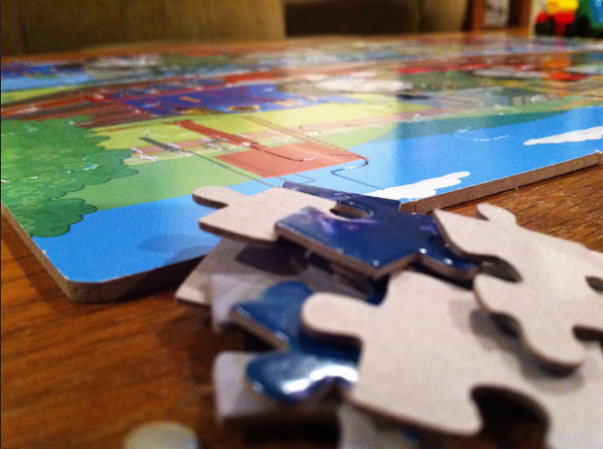
Modules
short activities which can be incorporated in any type of eTwinning project, no matter which subject.
a great way to kick off a project, provide something different mid-way through or act as an evaluation tool at the end.

Slide 9
where can Modules be found?
in www.etwinning. net
https://www.etwinning.net/es/pub/collaborate/modules.htm

Slide 10
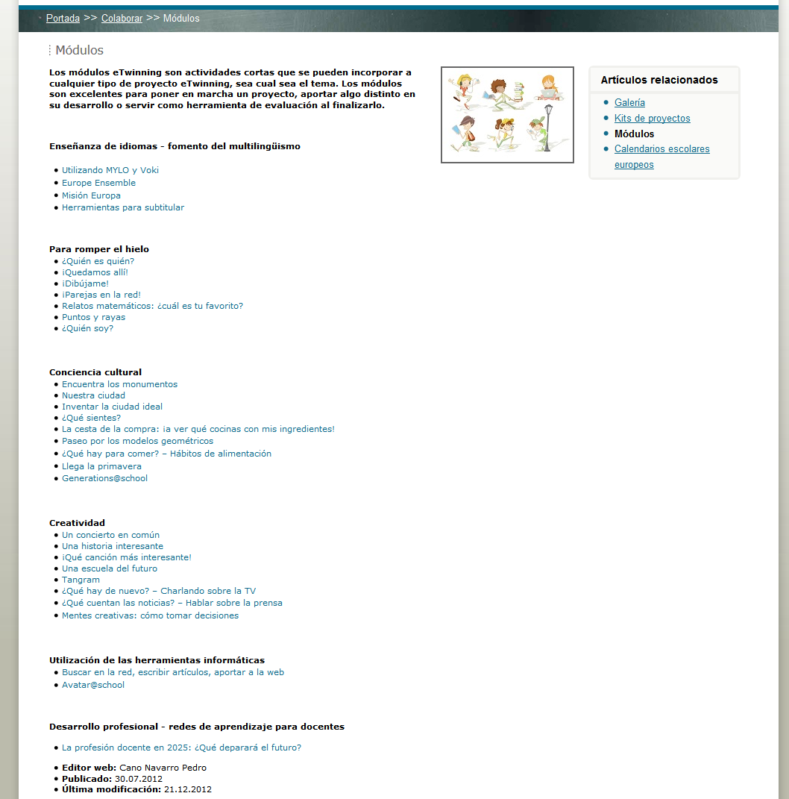
Modules: let's have a look
You can find modules on:
Language learning
Ice-breakers
Cultural and social awareness
Creativity
Online tools
Professional development

Slide 11
One last question...
Where can I find examples of good projects?

Slide 12
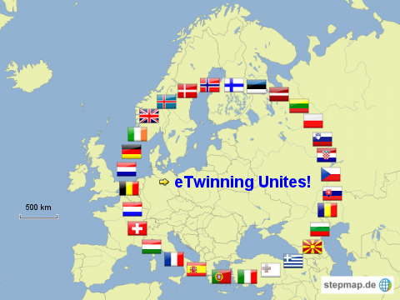
Thanks to:
Embajada de Extremadura:
Ángel Luis Gallego Real, Camilo Rodríguez Macías, Francisco Miguel García Barroso

