Slide 1
LET’S ETWIN ER&MVO
Webinar 1: Let’s meet (again) (14/12/16)

Slide 2
Participant organizations
“Servizio Marconi TSI”
USR (Ufficio Scolastico Regionale per l’Emilia-Romagna).
BOLOGNA (EMILIA-ROMAGNA- ITALIA)
Serveis Educatius i Formació Permanent dels Serveis Territorials Maresme-Vallès Oriental Departament d'Ensenyament
Generalitat de Catalunya:
MATARÓ (BARCELONA- CATALUNYA)

Slide 3
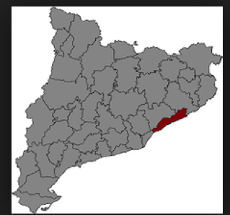
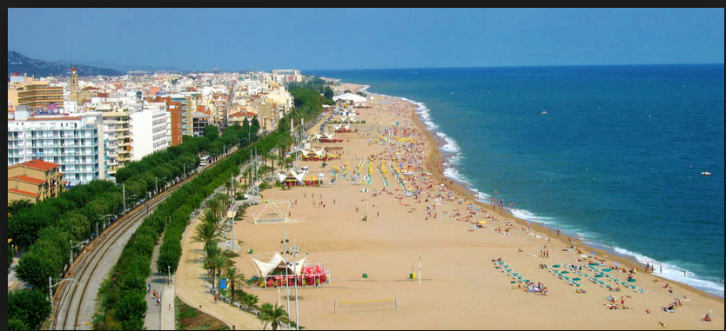
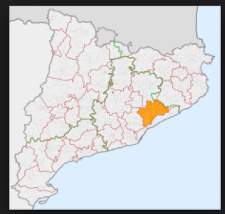
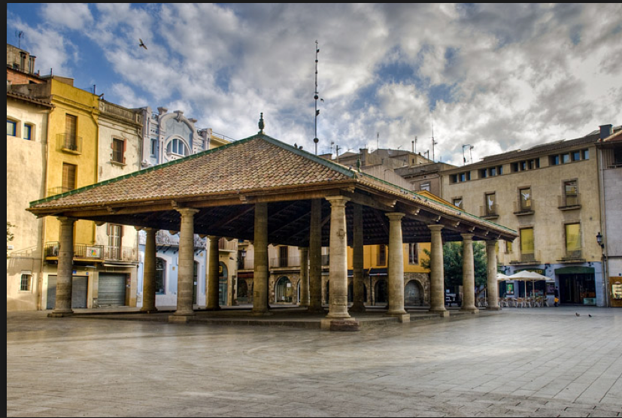
The areas
MARESME
VALLÈS ORIENTAL

Slide 5
Founder partners /trainers
Spanish teacher at Liceo Laura Bassi (Bologna)
Member of USR (Ufficio scolastico Regionale per l'Emília-Romagna)
eTwinning Ambassador
Foreign Languages Coordinator
Teacher trainer
eTwinning Ambassador
ELENA PEZZI
MARTA PEY PRATDESABA

Slide 6
Participants
CATALONIA:
ITALY:
13 Catalan teachers
12 Italian teachers
10 schools (8 primary / 2 secondary)
8 schools (2 primary / 6 secondary)
Different subject areas
Different subject areas

Slide 7
CALENDAR
From Nov 2016 to May 2017:
training course (in-site)
webinars
partner up
September 2017-June 2018:
development of eTwinning projects

Slide 8
THE PROJECT
AIMS:
To get to know eTwinning and promote participation in it
To exchange experiences and practices among teachers, councelours and eTwinning Ambassadors
To plan collaborative activities using Web 2.0 tools and the Twinspace
To advise and guide schools in eTwinning projects and professional development activities
To promote the use of foreign languages
To encourage the use of new pedagogies
To promote the European dimension and internationalization of schools and Departments of Education
To encourage schools and Departments of Education to partipate in KA2 Erasmus + strategic partnerships.

Slide 9
THE COURSE
CONTENTS:
ETwinning – revision
Webtools 2.0.
Collaborative activities
21st c. pedagogies: gamification, flipped classroom, PBL
Etwinning & Erasmus+
COLLABORATIVE ACTIVITIES
1) Guess who
2) Xmas' multimedia book
3) an e-activity
...
WEBINARS
WEBINAR 1: Let’s meet (again)
WEBINAR 2: Useful tips for etwinning projects (Emma Giurlani): Feb. 2017
WEBINAR 3: Etwinning & Flipped Classroom (Simone Bionda): April 2017

Slide 10
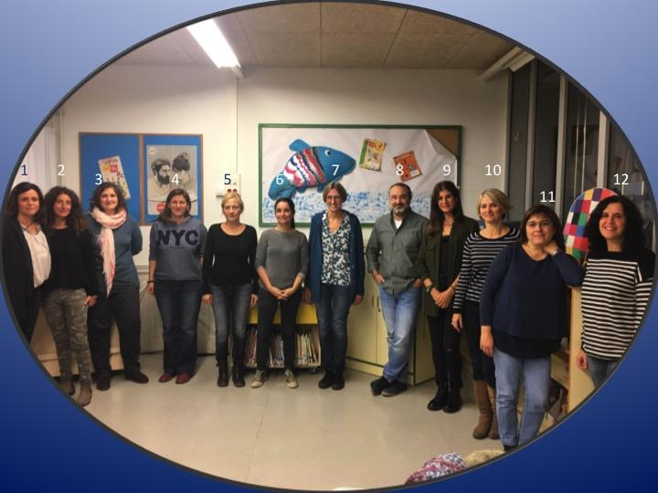
COLLABORATIVE ACTIVITY 1: GUESS WHO
DOTSTORMING BOARD: CATALAN TEACHERS

Slide 11
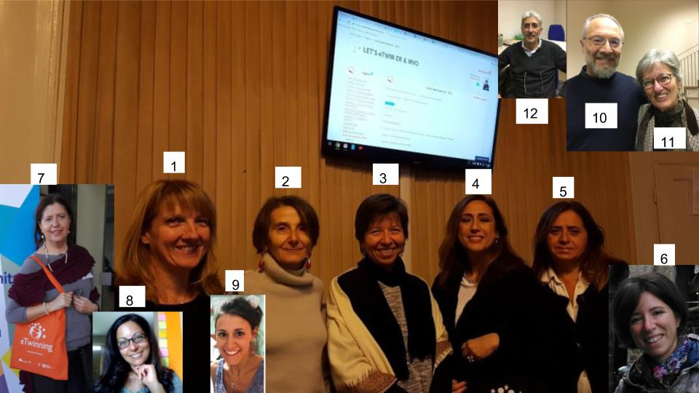
COLLABORATIVE ACTIVITY 1: GUESS WHO
DOTSTORMING BOARD: ITALIAN TEACHERS

Slide 12
COLLABORATIVE ACTIVITY 2:
A XMAS'S MULTIMEDIA BOOK
Instructions:
1) https://www.writereader.com/
2) LOG IN AS A STUDENT
3) CLASS CODE: ss8s
Create a book (see tutorial):
-
TUTORIAL:
https://www.writereader.com/tool-tutorial-how-to-use-and-create-books

Slide 13
THANKS AND SEE YOU IN

