Slide 1
LET’S ETWIN ER & MVO
Marta Pey Pratdesaba
Foreign languages coordinator MVO
eTwinning Ambassador
TEACHER TRAINER
April 2016

Slide 2
contents
What’s eTwinning?
eTwinning projects & 21st c. Competences

Slide 3
What’s eTwinning?

Slide 4
e- : for ELECTRONIC
ETwinning:
for TWIN

Slide 5
Programme of the European Commission
It offers a platform for schools to
Communicate
Collaborate
Carry out projects together
On the internet
With two or more schools in different countries in Europe or same country

Slide 6
2005: official launching
2007: part of LLP (Lifelong Learning Programme)
2014: part of Erasmus+

Slide 7
eTwinning projects are based on:
Collaborative work
Use of ICT
Fostering of an European identity

Slide 8
Nursery
Upper-Secondary Education, Vocational Training & adults
Primary School
Secondary School

Slide 9
The basics
AT PRESENT
254,527 teachers registered throughout Europe
33,825 projects in Europe
33 European countries
eTwinning +: Extension to 6 more countries: Armenia, Azerbaijan, Georgia, Moldova, Ukraine, Egypt and Tunisia

Slide 10
EVOLUTION OF ETWINNING

Slide 11
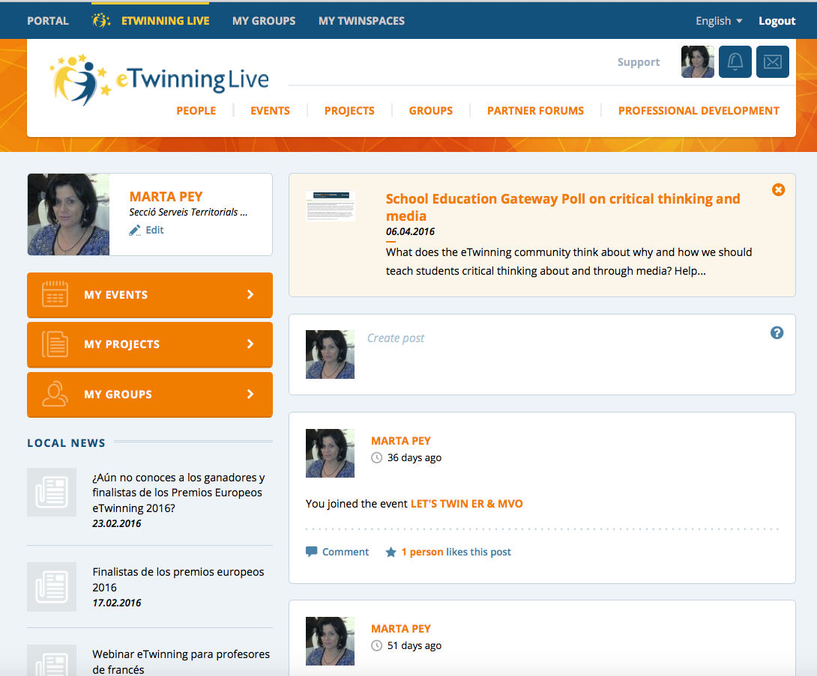
Biggest European Community of Teachers
THE DESKTOP: https://live.etwinning.net/

Slide 12
Types of Services offered

Slide 13
1.
Ideas
Advice
A safe online platform (Twinspace)
To set up and carry out projects

Slide 14
2. Professional networking in an European context:
Tools for finding partners for projects
Forums
Communities of practice
Teachers’ Rooms
eTwinning Groups

Slide 15
3. Education opportunities
Face-to-face
PDW
Conferences
Online
Learning Events
eTwinning Groups
Webinars

Slide 16
4. Recognition
Quality Labels
National
European
Awards
National
European

Slide 17
Easy and
cost-effective way for schools
to engage in international cooperation
Benefits of eTwinning
No financing,
but
support by offering
tools and services
.

Slide 18
No spam
Flexible and versatile tool:
No official dates for registering
Duration and activities self-tailored by partners
Initial plan can be revised/altered

Slide 19
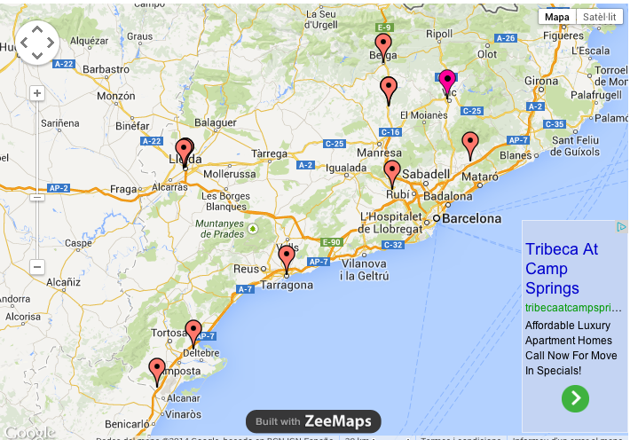
Coordination
The Central Support Service (CSS) in Brussels
The National Support Services (NSS) in each country
A network
of 1,000 Ambassadors

Slide 20
The European Portal: http://www.etwinning.net

Slide 21
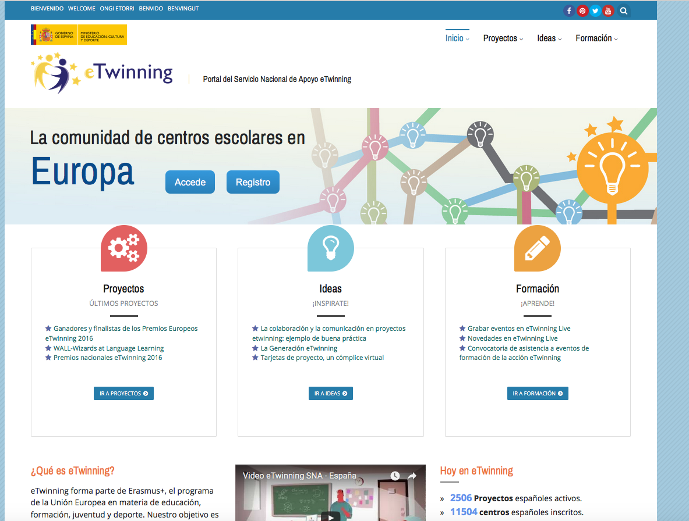
The National Portal: http://www.etwinning.es

Slide 22
CATALAN ETWINNING AMBASSADORS BLOG
http://ambaixadacatalanaetwinning.blogspot.com.es/

Slide 23
Animation
https://www.youtube.com/watch?v=1062iBe8oSs

Slide 24
A study

Slide 25
24 school case studies
in 13 countries
a survey in 25 languages
6,000 teachers registered for eTwinning

Slide 26
Impact on teachers
networking across Europe
improvement of foreign language skills
Acquired new or improved ICT skills
a sense of involvement in an international teaching community

Slide 27
Impact on pupils
Change and improvement in:
abilities
knowledge
Attitudes
Better and less formal communication and interaction between teachers and pupils.

Slide 28
Pupils were enthusiastic about
collaboration and team working
learning about other cultures.
Made pupils feel empowered or more independent

Slide 29
Impact on schools
more international outlook
has lead to more projects
more involvement of teachers
curricular integration

