Slide 1
E-TWINNING PROJECT

Slide 2
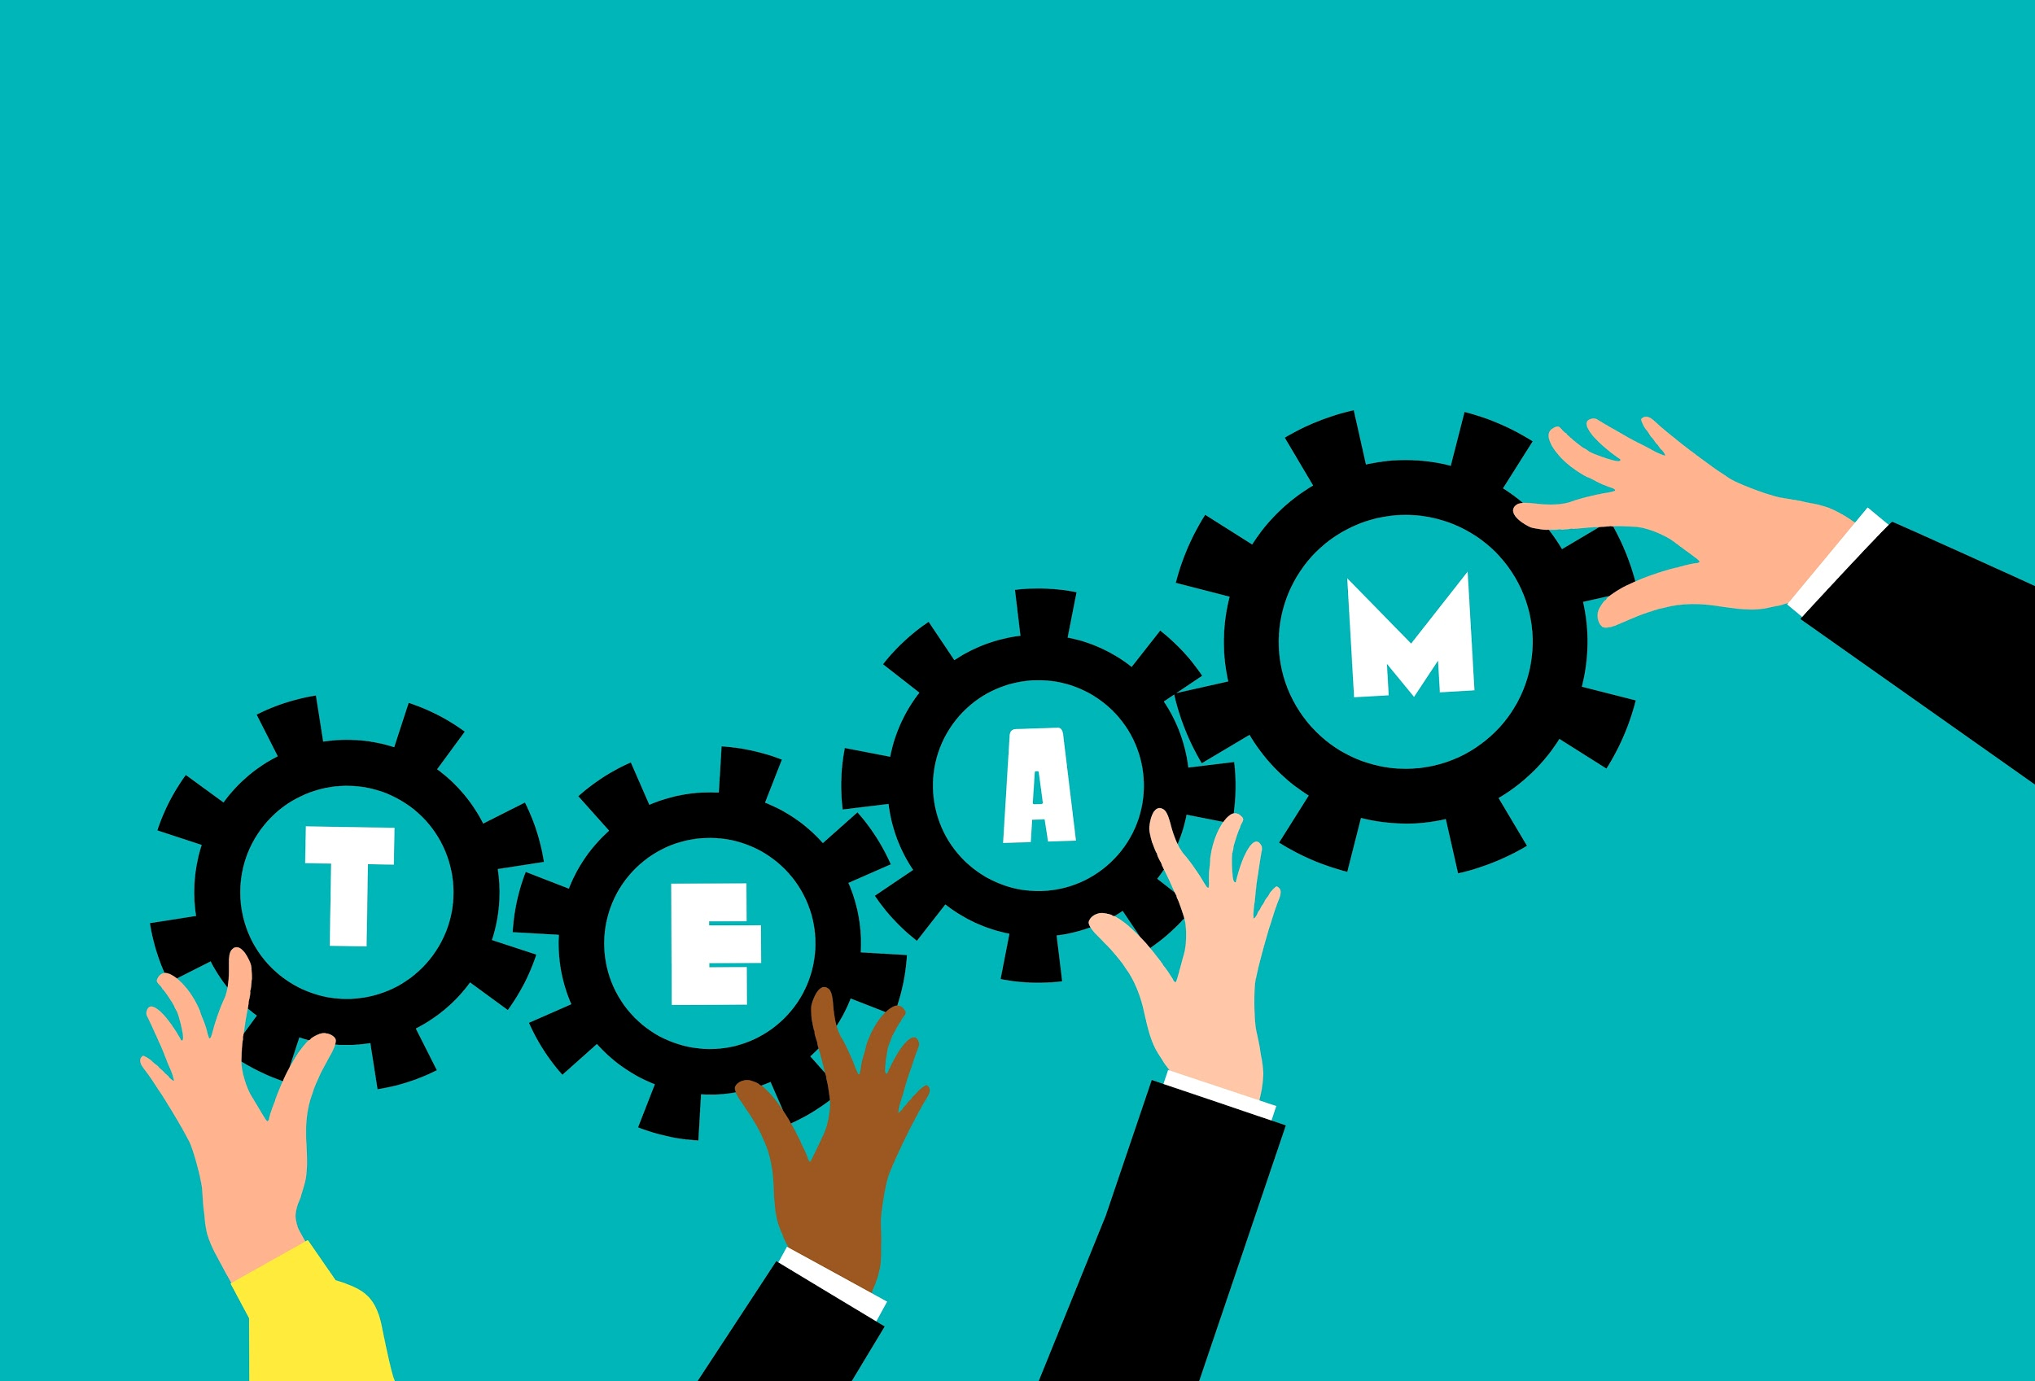
MY TEAM
Italian members: Anna Grassilli, Vladyslav Compagnucci;
International members: Ander, Jon, Joris, Emma, Lotte.
Gender inequlities in health world

Slide 3
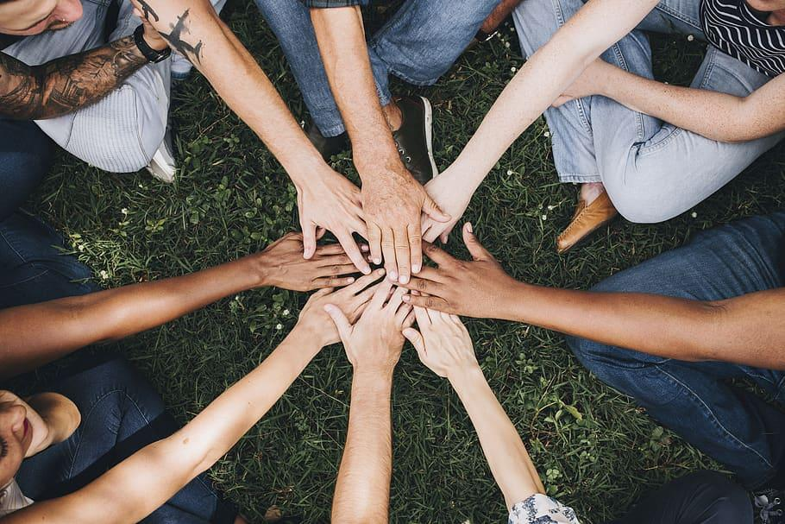
ADVANTAGES OF THE PROJECT
Language improvement;
Digital skills improvement;
Meeting new people.

Slide 4
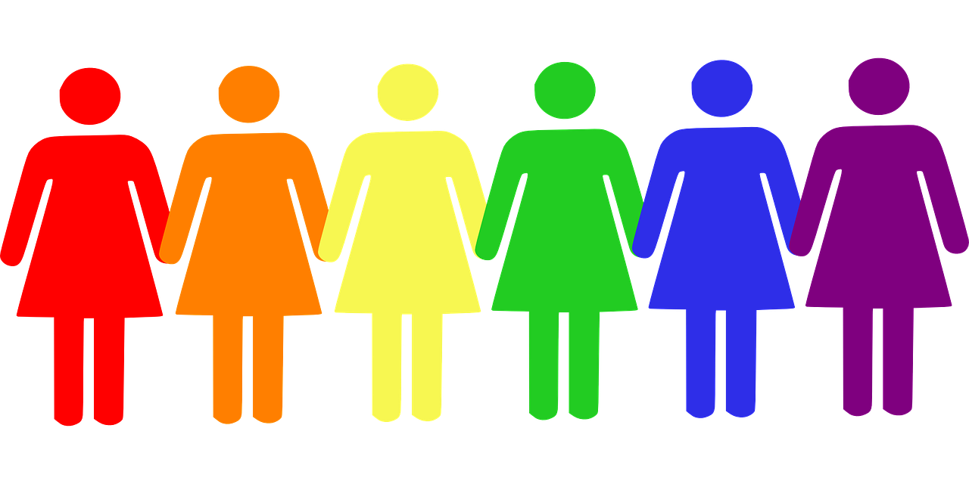
THE MAIN BENEFIT
Know better what gender inequalities are

Slide 5
