Slide 1
SOA FOR PEER EDUCATION

Slide 2
What is Peer Education?
Peer education is a learning process that gives empowerment, confidence and independence to young people whatever their background.
Peer education happens when young people carry out informal or organised activities with their peers, over a period of time, to develop their knowledge, skills, beliefs and attitudes enabling them to be responsible for themselves and others and to create a space where they can feel well, safe and respected.

Slide 3
What is Peer Education?
Peer education typically involves the use of members of a given group to effect change among other members of the same group.
Peer education is often used to effect change at the individual level by attempting to modify a person’s knowledge, attitudes, beliefs, or behaviors.
However, peer education may also effect change at the group or societal level by modifying norms and stimulating collective action that leads to changes in programs and policies.

Slide 4
Role Of Peer Educator
The main role of the peer educator is to help the group members define their concerns and seek solutions through the mutual sharing of information and experiences.
S/he is the best person to disseminate new information and knowledge to the group members and can become a role model to others by “practicing what s/he preaches”.
Since s/he is from the same group, s/he can empathize and understand the emotions, thoughts, feelings, language of the participants, and, therefore, relate better.

Slide 5
Role Of Peer Educator
A peer educator should be sensitive, open minded, a good listener and a good communicator.
S/he should be acceptable to the community and be trust worthy. In brief, s/he should possess good interpersonal skills.
If you are a peer, you speak the same language and are familiar with the cultural norms and values of the group/community.

Slide 6
Role Of Peer Educator
In order to answer questions clearly and correctly, the peer educator also needs to have an overall knowledge of the subject. It is not necessary to be an expert.
People often tend to judge others. Peer educators need to be non-judgmental and open minded.
A peer educator should also develop leadership and motivation skills.

Slide 7
Advantages of Peer Education
Youth are ready-made experts. They have a unique perspective on the issues that affect them and can often “make things happen“.
As role models to their peer group, youth have the potential to demonstrate effective communication styles and approaches. This may be accomplished through workshops and games.

Slide 8
Advantages of Peer Education
Where resources are limited and large numbers of people have to be reached, peer group education has a multiplier effect. Such programs also have an informal cascade effect, creating “buzz“ in a local community.
If encouraged and supported, youth can control the process of education and information exchange. Whether or not this occurs depends upon the setting in which a program is operating. Peer group education can help to foster youth participation in programs of formal and informal education.

Slide 9
EDUCATIONAL TOOLS ON
SOA
FOR PEER EDUCATION

Slide 10
Play Stations
Description: There are some groups that are supposed to study on a specific game or sport so that they will present them to their peers. Once groups are ready, each group sets up their ‘play points’ in the schoolyard or sports hall. Then they show how these sports are played, demonstrate what kind of materials needed to play it, inform about the rules, and perform that sport. In the meantime, their peers visit these ‘play points’ and learn how to play them.

Slide 11
Play Stations
Trained Skills: Students learn by observing and doing in person. They will be self-directed and self-employed. They will enjoy getting to know one another better, spending time together, and working together. They will be self-confident. They will develop in communicating. Shy students will become more active.

Slide 12
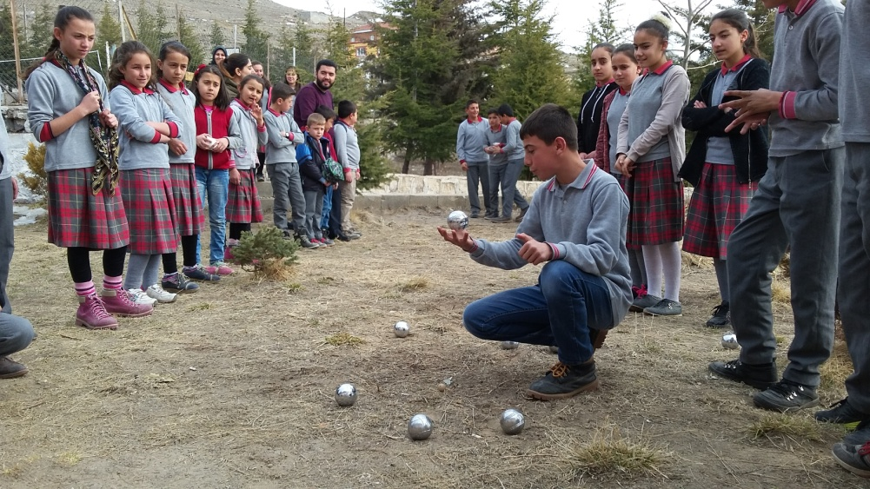
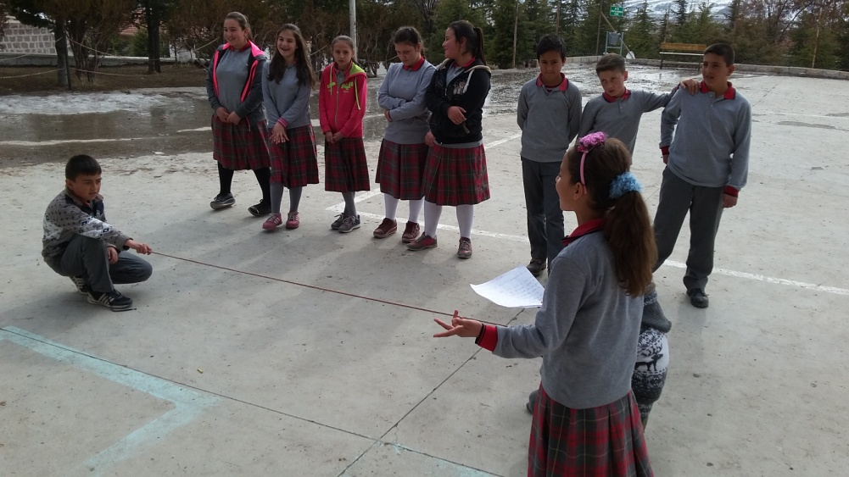
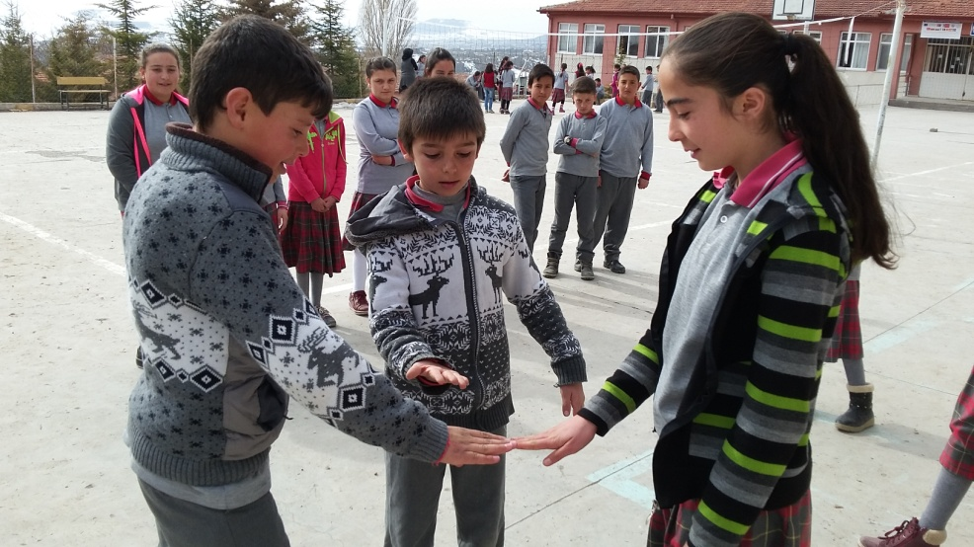
Play Stations

Slide 13
Book A Peer Instructor
Description: P.E. teacher chooses some volunteer students to be peer instructors at the beginning of the term. When the lower grader feels that s/he has difficulty understanding the rules of a game or performing a certain movement of a sport, s/he can demand a peer instructor from the teacher. Teacher assigns a peer instructor to the demanding student so that peer instructor can help her/his with what s/he is missing: showing movements, supporting while exercising, explaining the rules, etc.

Slide 14
Book A Peer Instructor
Trained Skills: Students learn by observing their peers and experiencing in person. They will be self-aware in that they will get responsibility for their own learning. They will be self-administered and self-employed. They will get to recognize one another better, spend some time together, and be busy on a task together. They will be more self-confident and open to interaction. They will be better at communication skills. Shy students will become more active, and open to dialogue.

Slide 15
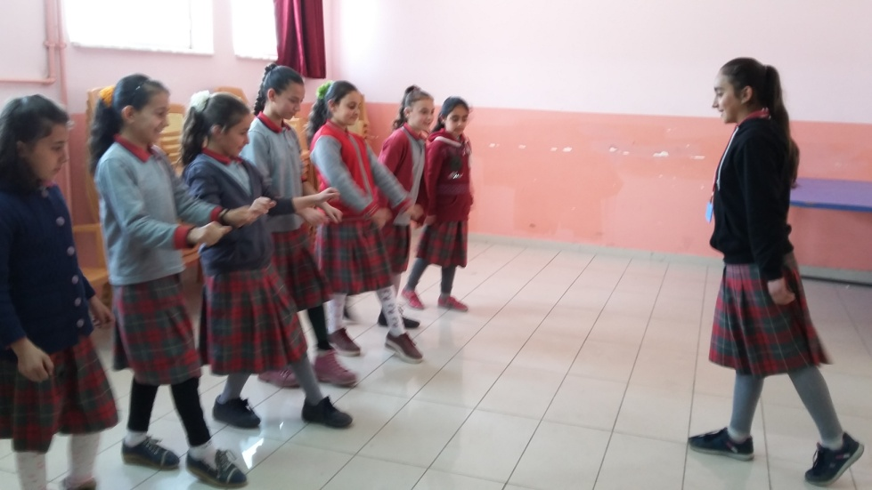
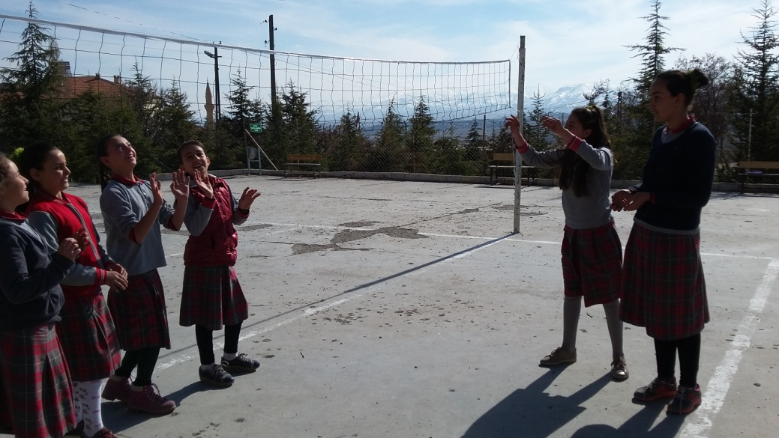
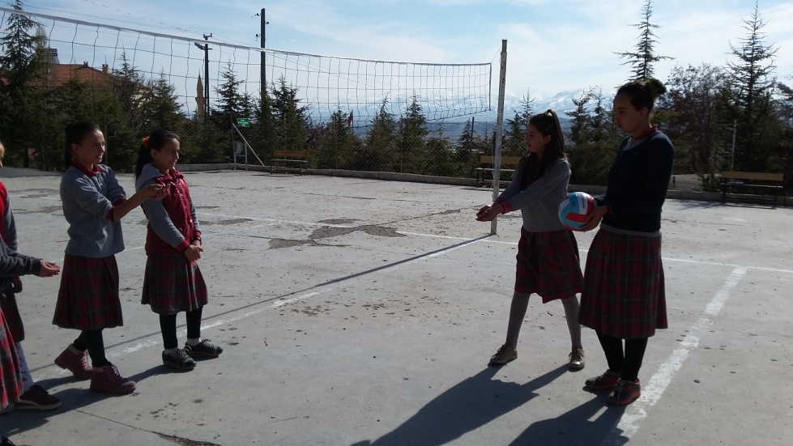
Book A Peer Instructor

Slide 16
Pay It Forward - Learning Circle
Description: This practice is designed to take place among classes. P.E. teacher assigns a class to find a game and make a research about it so that they will teach it to another class .They are given some time to get prepared. When they are ready, they visit another class to teach the game. They make a presentation, give the general information, talk about the rules, and demonstrate how to play it. Then both classes play it together to practice it. When this class learns the game completely, then they should do the same thing to another class. In other words, they should pay it forward.

Slide 17
Pay It Forward - Learning Circle
Trained Skills: Students learn by observing and experiencing. They will take parts in a group, and develop a sense of belonging. They will be more outgoing. They will be more responsible for their own learning. They will also get responsibility for instructing their peers. They will experience what it is like to teach something, and be more empathetic towards their teachers. They will have fun spending time together on a task. They will be more self-reliant. They will further their communication skills. Shy students will become more active, and find a nice environment to get socialized.

Slide 18
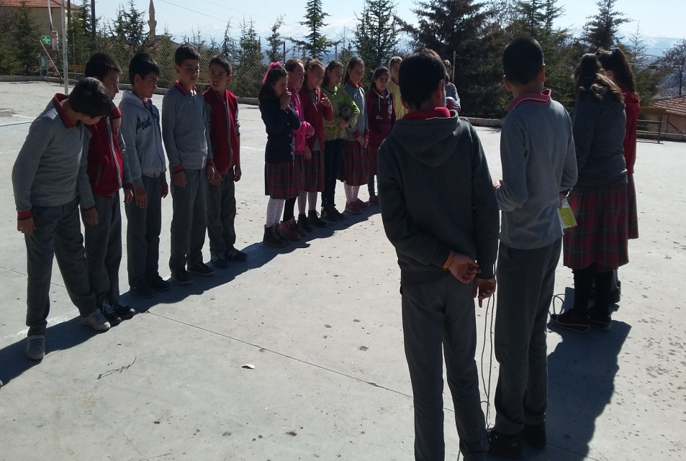
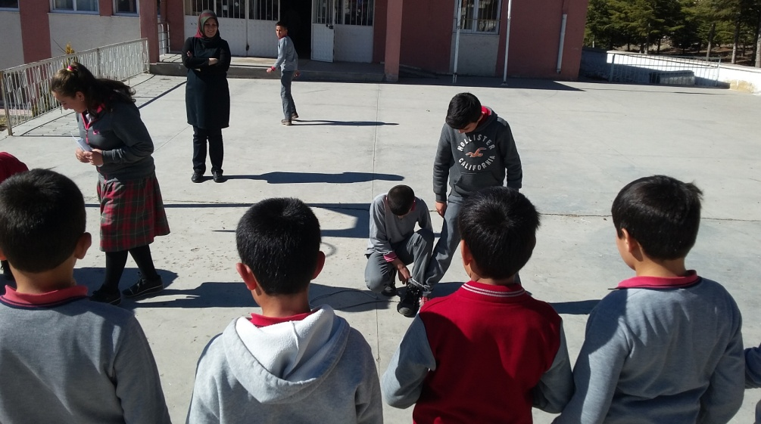
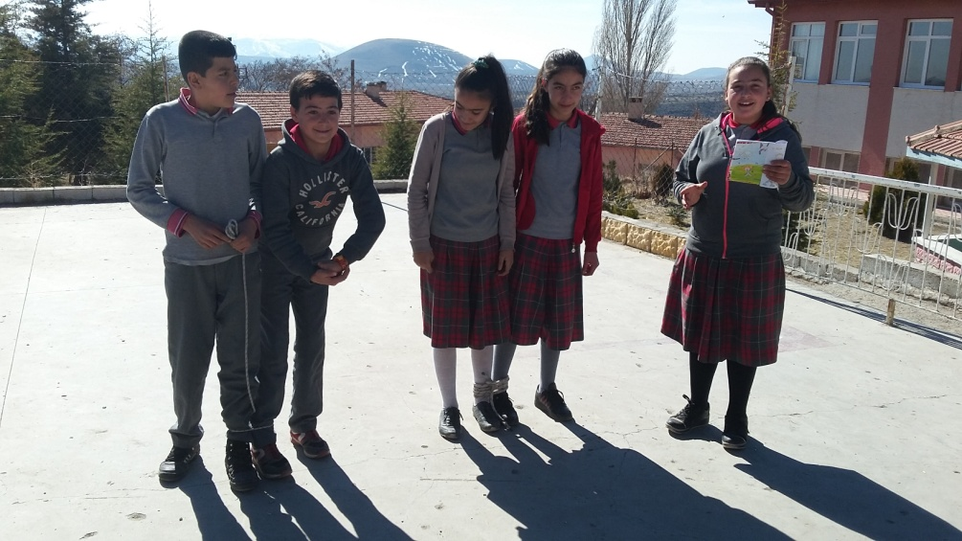
Pay It Forward - Learning Circle

Slide 19
References
SALTO Youth Cultural Diversity Resource Centre. PEERing In PEERing Out: Peer Education Approach in Cultural Diversity Projects.
United Nations Population Fund and Youth Peer Education Network (2005). Youth Peer Education Toolkit. Training of Trainers Manual, New York (USA).
Council of Europe (1996). DOmino. A manual to use peer group education as a means to fight racism, xenophobia, anti-semitism and intolerance.

