Slide 1
THE LITTLE PRINCE
Antoine de Saint-Exupery

Slide 2
When he was six years old, he wanted to draw a boa snake, and everyone looked like a hat.

Slide 3
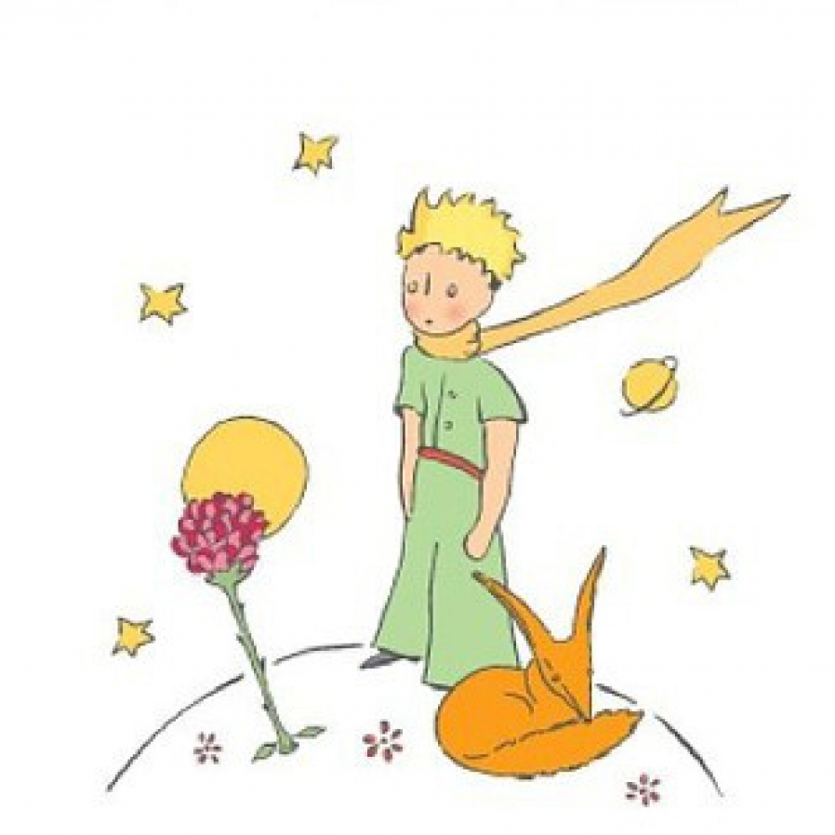
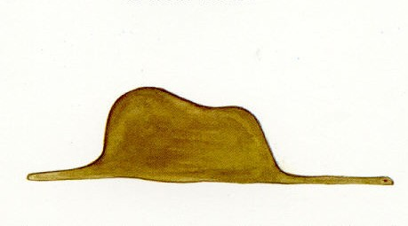

Slide 4
Everyone around you wanted to stop painting and take care of geography and Mathematics.That's why he decided to become a pilot.

Slide 5
He's a pilot.His plane crashed into the Sahara desert.His plane was badly damaged and he had very little food and water.A little blond boy approached him and asked him to draw a sheep.the pilot drew a sheep, but the little prince did not like the sheep he drew.

Slide 6
The pilot drew a closed box and asked him to imagine that there was a sheep inside the box.

Slide 7
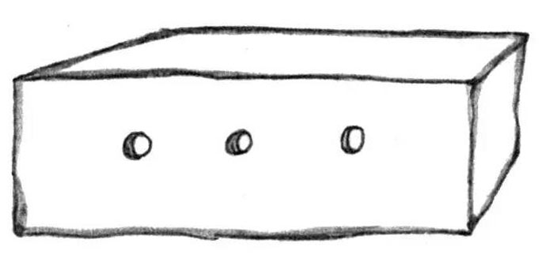
The is sheep in this box

Slide 8
The pilot asked questions to find out where the little prince came from, but he didn't get the answer he wanted. The pilot learns that the little prince comes from a small planet that the little prince calls Asteroid 325 but that people on Earth call Asteroid B-612. The little prince took great care of this planet, preventing any bad seeds from growing and making sure it was never overrun by baobab trees.

Slide 9
One day, a mysterious rose sprouted on the planet and the little prince fell in love with it. But when he caught the rose in a lie one day, he decided that he could not trust her anymore.

Slide 10
He grew lonely and decided to leave. Despite a last-minute reconciliation with the rose, the prince set out to explore other planets and cure his loneliness.

Slide 11
On the first planet, a king lived.When the King saw the little prince, he shouted to him, " a citizen at work «
The little prince said by himself adults very weird.
.

Slide 12
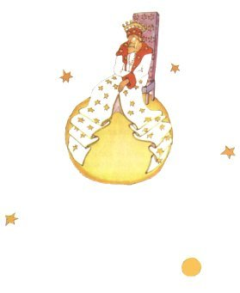
The king who lives alone.

Slide 13
A conceited man inhabited the second planet. the little prince asked the man a few questions
And he went away.
‘The grown-ups are definitely very strange’ her said to himself.

Slide 14
A drunkard inhabited the next planet.The little prince did not stay long,but he got into a deep dejection.

Slide 15
The fourth planet belonged to businessman.He was so busy with work that he did not even look up when the little prince arrived.

Slide 16
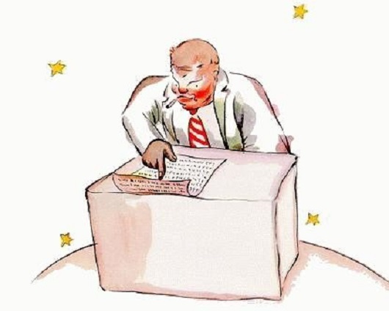
Businessman

Slide 17
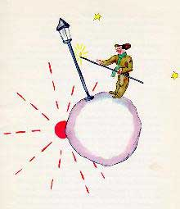
The fifth planet was very strange one.It was the smallest of all.

Slide 18
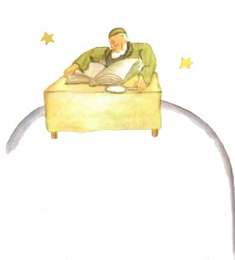
The sixth planet ten times larger than the last one.And old sholar,who wrote big,this books,inhabited it.

Slide 19
The seventh planet was the Earth. The little prince was born for the first time.The little prince crossed the desert and saw only one flower.He climbed a high mountain. he saw a fox and told the fox that he was looking for a man, and later he encountered a Mongolian and a merchant.

Slide 20
He was drinking the last drop of his water while listening to the merchant's story.and in the desert, they searched the well, and after finding the well, he drank the water.

Slide 21
The little prince tells the pilot it is time for them both to return home. The pilot is home. It has been six years since his meeting with the little prince. He tells how well received he was upon his return home and how pleased everybody was to see him.

Slide 22
He talks about the little prince and what he learned from him. He understands, now, how important it is to be able to look up at the stars and ask the question, did the sheep eat the flower, yes or no?

Slide 23
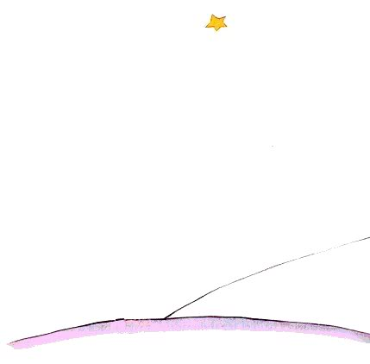

Slide 24
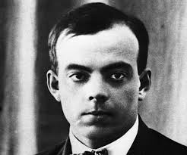
Antoine de Saint-Exupery
He met the plane at the age of 12. the pilot took him to his plane and blew him away. He was called to the military when he was 21. He left his training and went to the military. He served as a French Air Force technician. By the way, he started writing.
1926 was the turning point in life one was beginning to fly in the single OTA ozone.

Slide 25
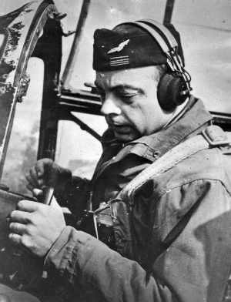
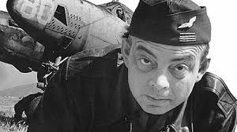
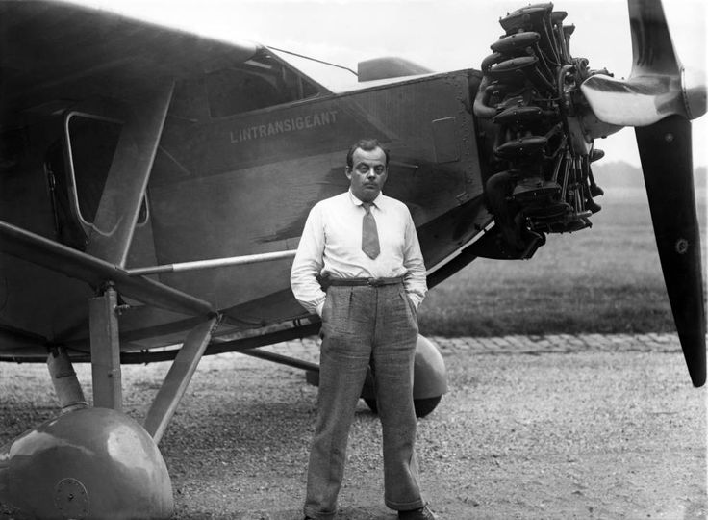
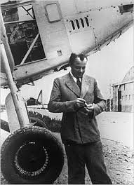
The first book was the Southern Post. This is the first flight experience in this period
When he was 35, he made the plane a down and landed in the desert in Tunisia, disappeared.

Slide 26
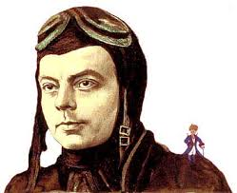
His most important work ,The Little Prince, He wrote it in World War II.
During the reconnaissance flight, the plane was shot on July 31, 1944. said he fell to the edge of the sea. Flying debris was found in 2000 by fishermen.

