Slide 2
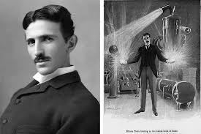
1. THE NIKOLA TESLA MUSEUM
Nikola Tesla (1856–1943) was a Serbian-American inventor, electrical engineer and mechanical engineer.

Slide 3
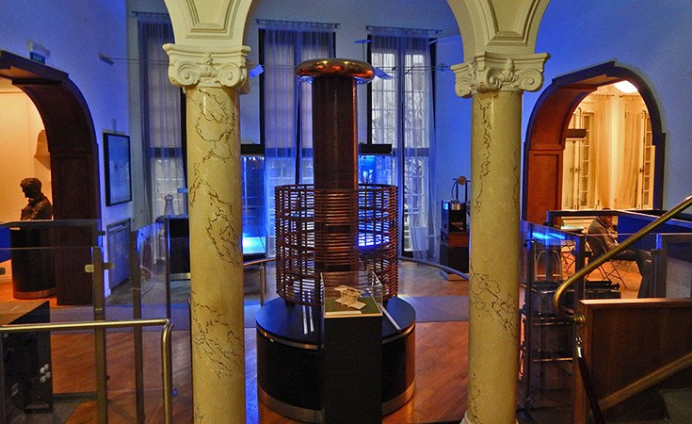
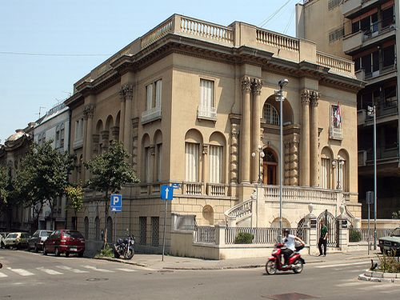
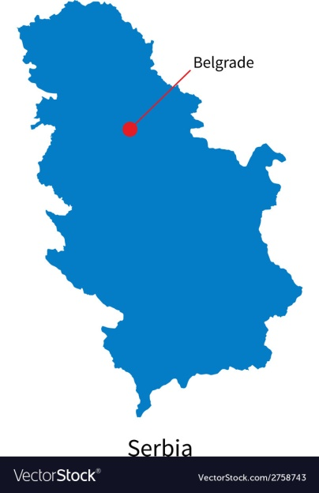
1. THE NIKOLA TESLA MUSEUM
The Nikola Tesla Museum is dedicated to honoring and displaying the life and work of Nikola Tesla. The museum is located in the central area of Belgrade, Serbia. It holds more than 160000 original documents, over 2000 books and journals, over 1200 historical technical exhibits, photographs and photo plates of original, technical objects, instruments and apparatus, and over 1000 plans and drawings. The Nikola Tesla Archive was inscribed on UNESCO's Memory of the World Programme Register in 2003, due to its critical role regarding history of electrification of the world and future technological advancements in this area.

Slide 4
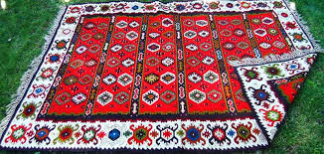
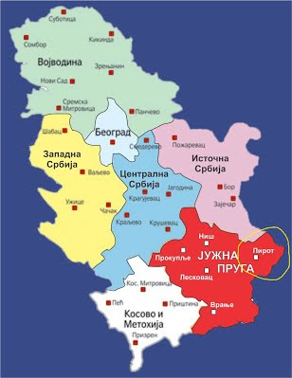
2. PIROT KILIM
Pirot kilim refers to a variety of flat tapestry-woven rugs traditionally produced in Pirot, a town in southeastern Serbia. Pirot kilims with some 122 ornaments and 96 different types have been protected by geographical indication in 2002. They are one of the most important traditional handicrafts in Serbia. In the late 19th century and up to the Second World War, Pirot kilims have been frequently used as insignia of Serbian royalty. This tradition was revived in 2011, when Pirot kilims were reintroduced for state ceremonies in Serbia.

Slide 5
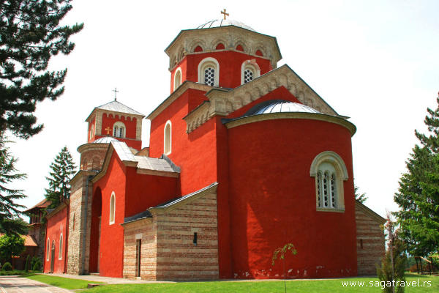
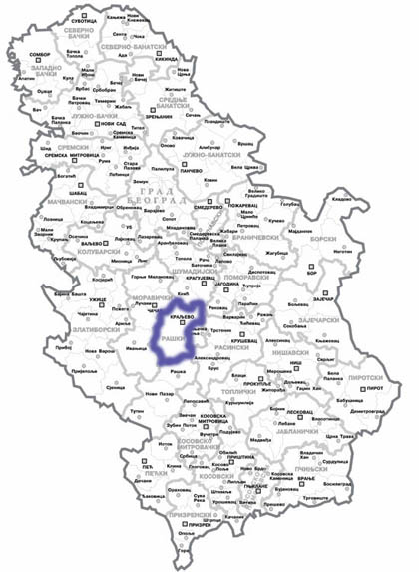
3. ŽIČA MONASTERY
Žiča is an early 13th century Serbian Orthodox monastery near Kraljevo, Serbia. The monastery, together with the Church of the Holy Dormition, was built by the first King of Serbia, Stefan the First-Crowned, and the first Head of the Serbian Church, Saint Sava.

Slide 6
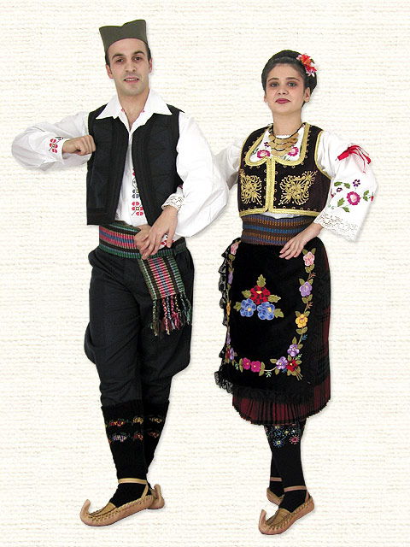
4. TRADITIONAL SERBIAN CLOTHING
Serbian folk costumes like any traditional dress of a nation or culture, has been lost to the advent of
urbanization,
industrialization and the growing market of international clothing trends.

Slide 7
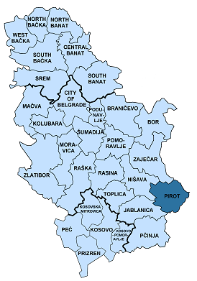
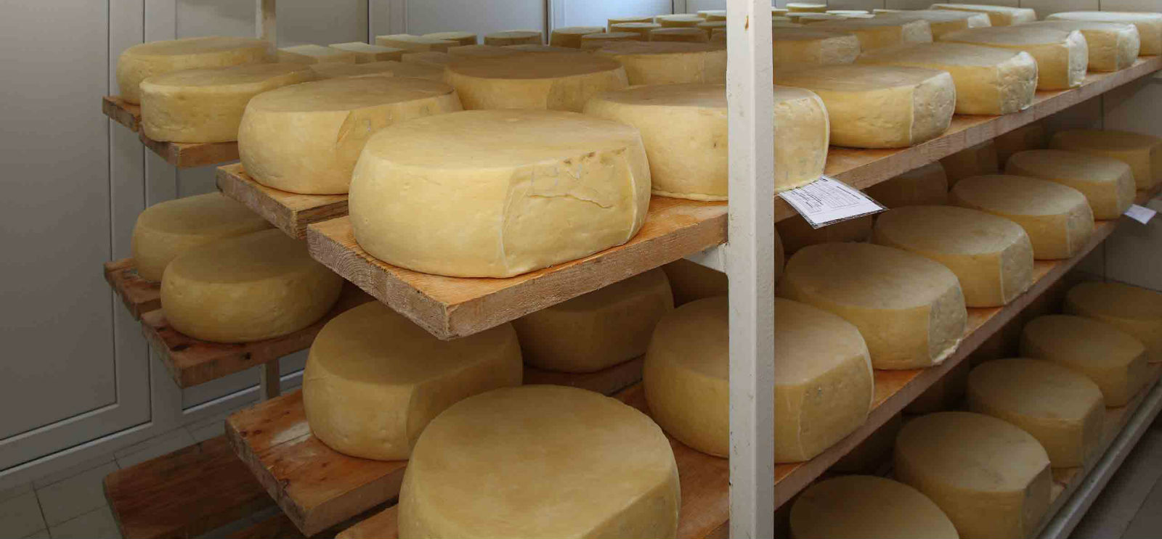
5. Kačkavalj
Kashkaval (kačkavalj) is a type of yellow cheese made of cow milk or sheep milk. In Serbia, kačkavalj is traditionally a sheep milk hard cheese, and as such a protected brand of the city of Pirot.

Slide 8
THE END
Thank you for your attention!
Dunja Mitić
Iva Krstev
Evanđelija Živković
Tara Stojanović
Sofija Minić

