Slide 1
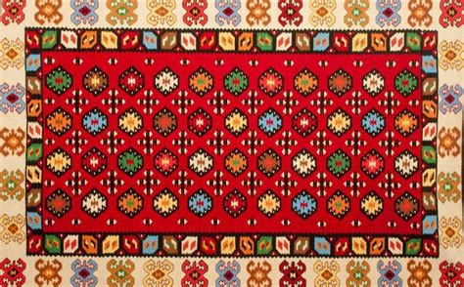
CULTURAL HERITAGE

Slide 2
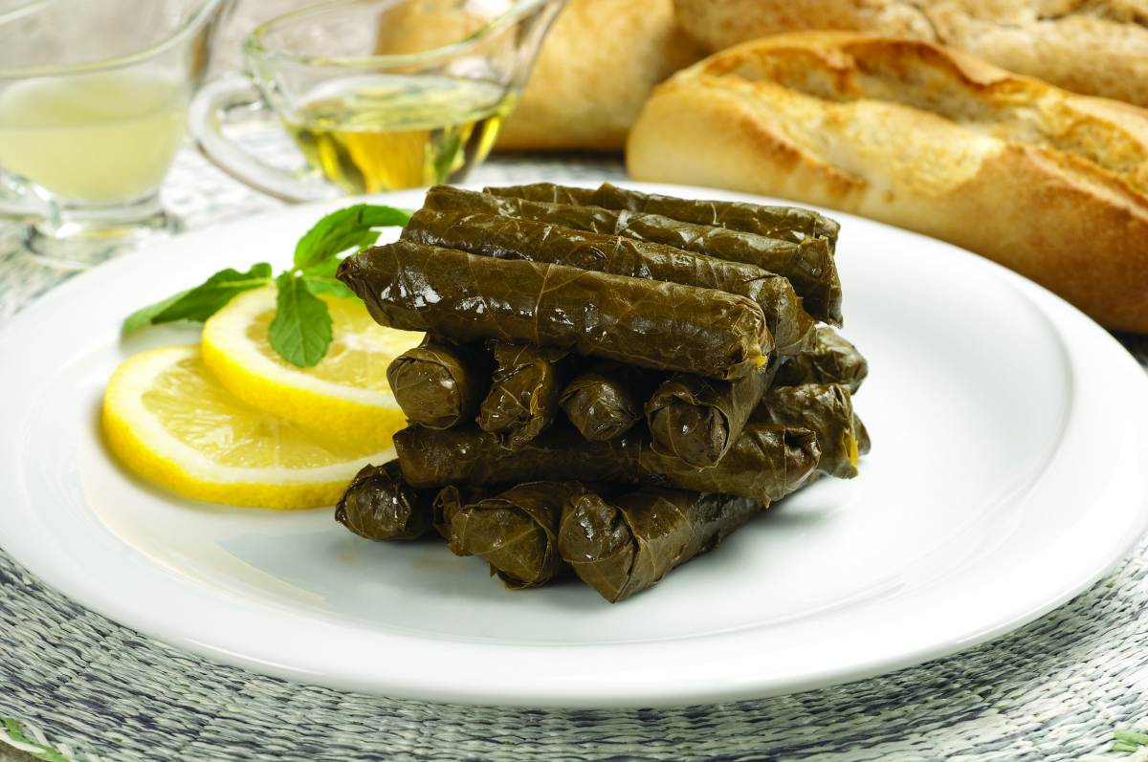
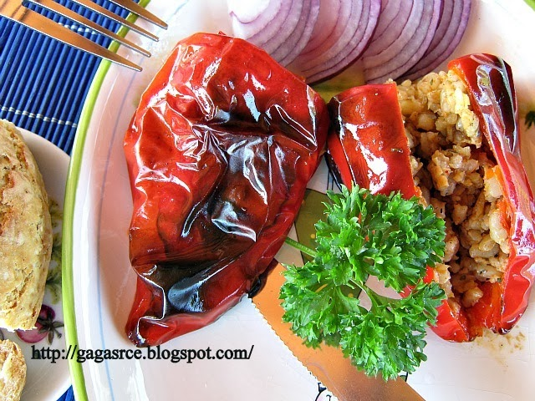
*SPECIALTIES OF OUR TOWN*
Filled pepper(punjena paprika)
Filled peppers are specialties of our town.They are made from pepper and minced meat.

Slide 3
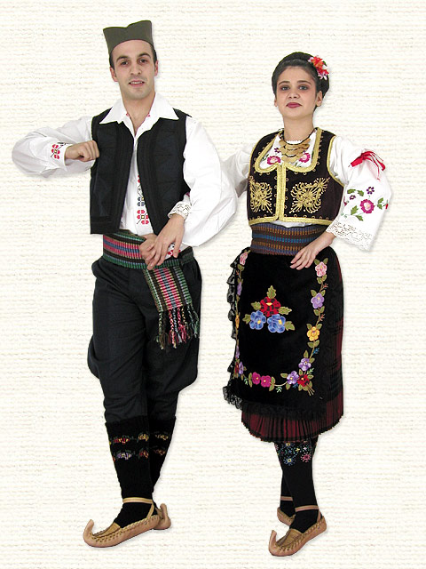
*NATIONAL COSTUMES*
Folk costume is the name for traditional clothes.
It occupies a special place in the culture and tradition of the Serbian people.
https://youtu.be/PMkRpVCn9hQ

Slide 4
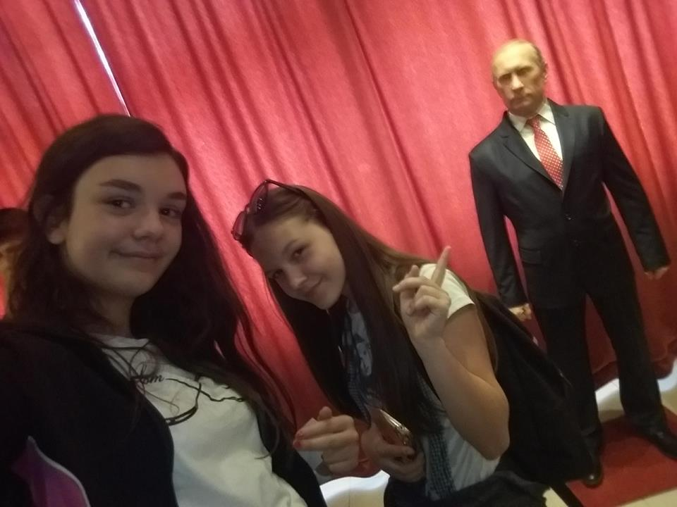
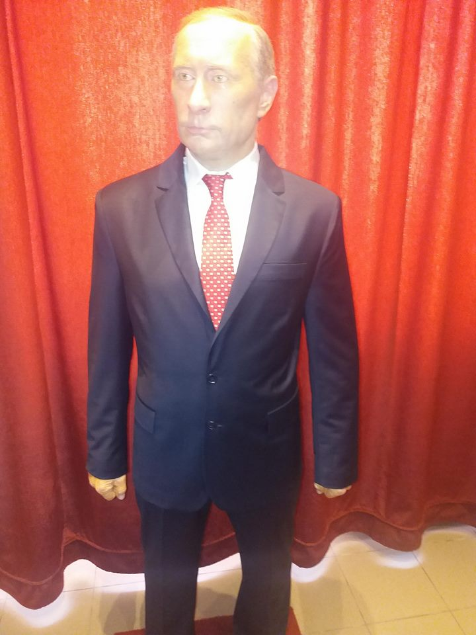
*MUSEUM OF WAX FIGURES*
In Serbia,there is one museum of wax figures located in Jagodina. There are only six museum in Europe.

Slide 5
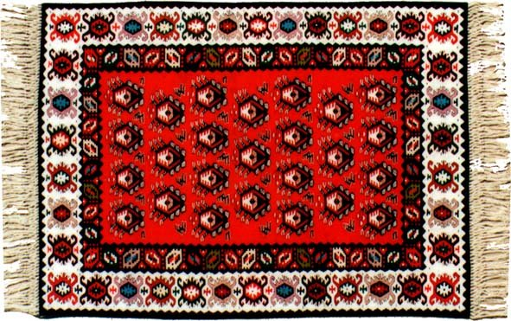
*FOLK CARPET*
Cilim is a Serbian folk carpet.Cilim used as a decoration.It is important Serbian decoration.

Slide 6
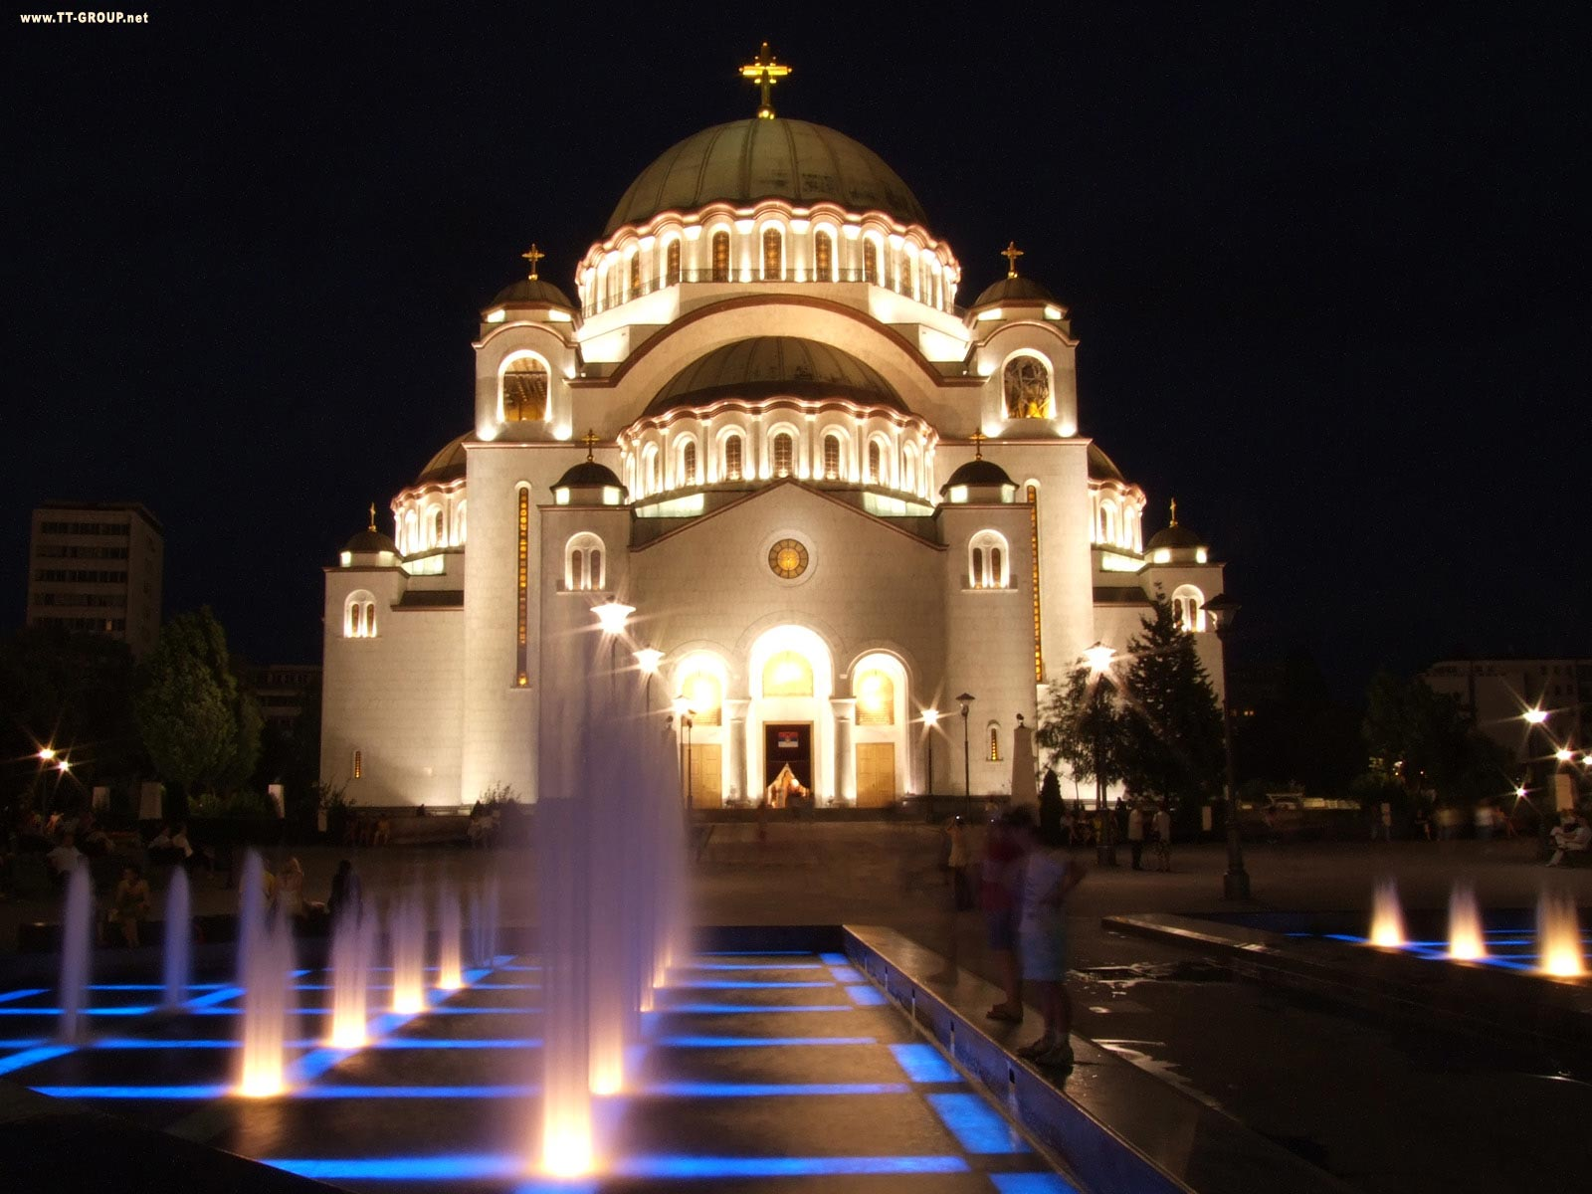
*TEMPLE OF SAINT SAVA*
There are many churches in Serbia.Most famous is a Temple of Saint Sava.
There are a lot icons in it.

Slide 7
THANK YOU
NNNNNNN

