Slide 1
Measurement gravity acceleration with subatmospheric pressure

Slide 2
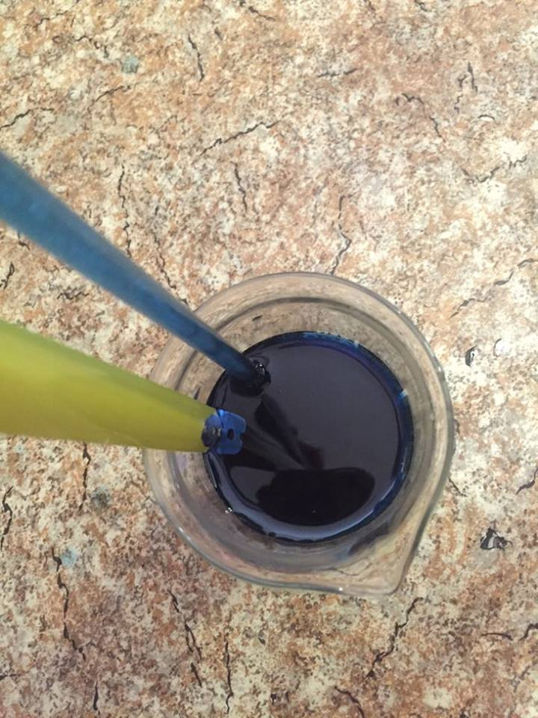
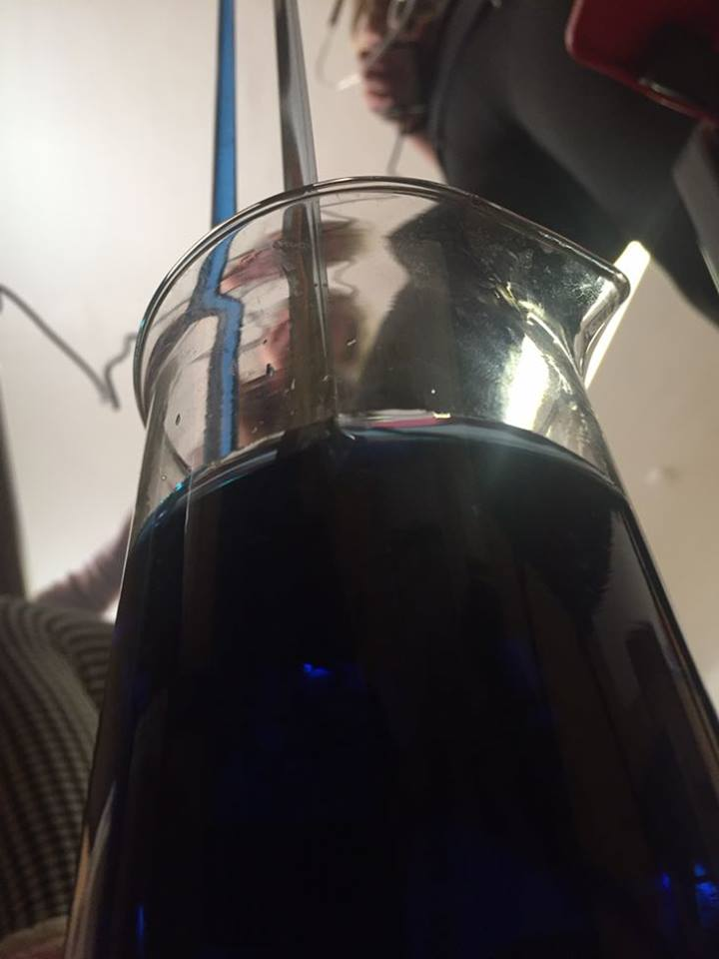
Our group made a measurement of gravity acceleration with suction aid.
1. We put a colorant to a beaker with some water.

Slide 3
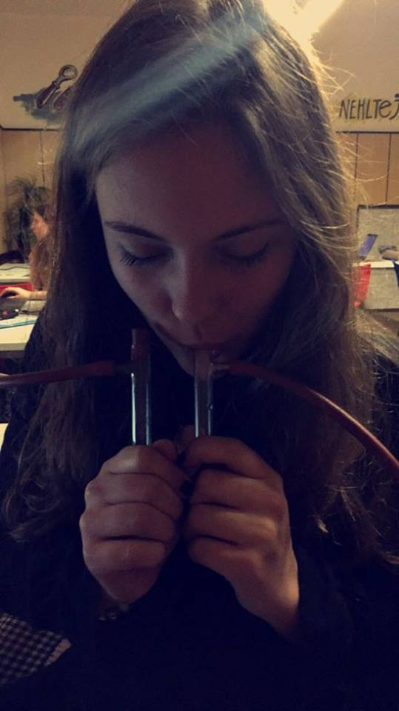
2. We put a special pipe into it. And started to suck the water up.

Slide 4
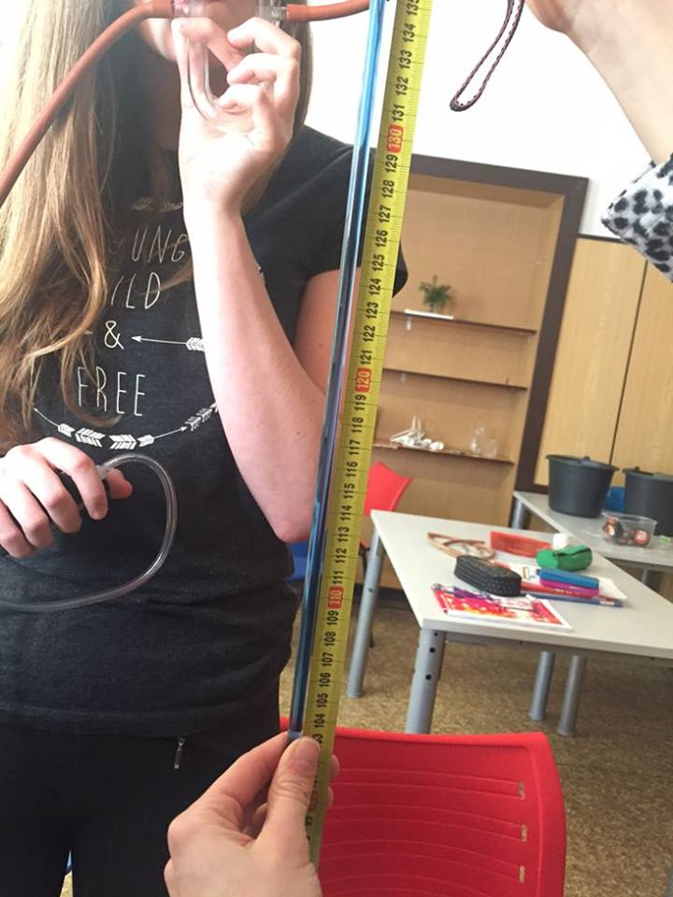
3. We measured a distance between the surface of the water to the guideline where we stopped sucking.

Slide 5
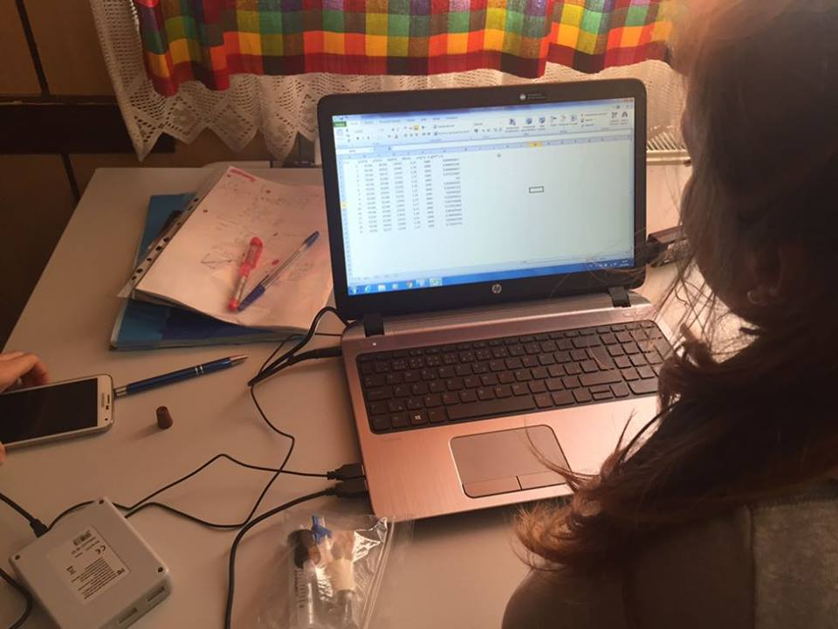
4. We put the measured value to a pattern.
pattern: g=Δp/Δhρ

Slide 6
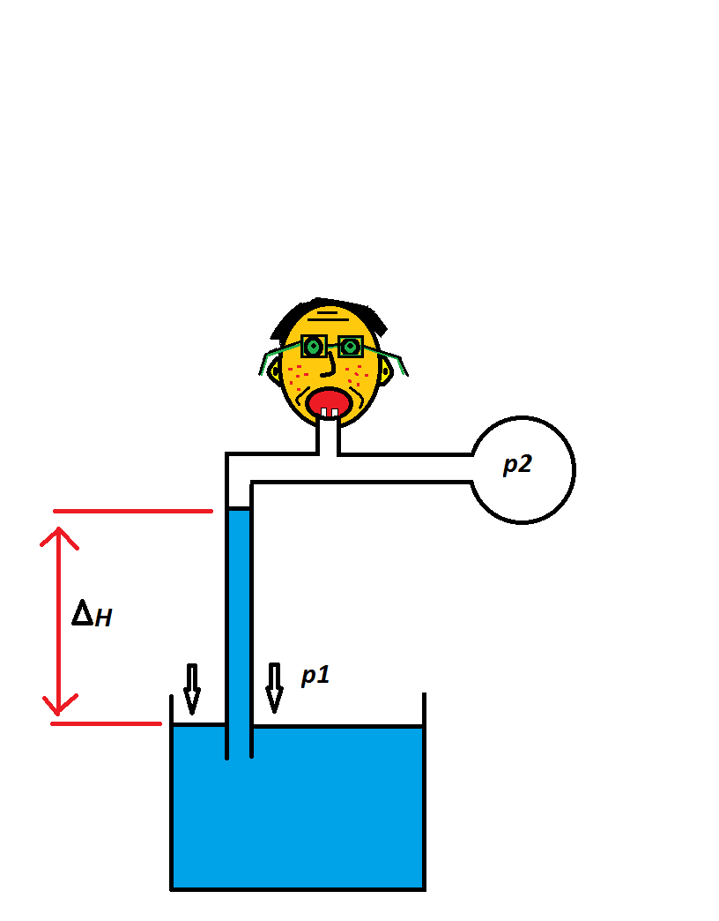
Derivation of the pattern
Δh = Δp/ρg
=
g = Δp/ρΔh
=
g = p/Δhρ

Slide 7
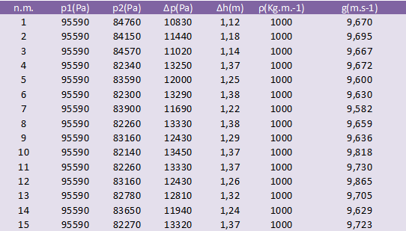

Slide 8
g=(9,685±0,074)m.s⁻²

Slide 9
AUTHORS
„JUMP“ AND COMPANY
Aneta Tabášková
Aneta Čajánková
Lenka Výmolová
Beáta Gřundilová
Michaela Šindlerová

