Slide 1
BODY MASS AND GRAVITY FORCEyvity force
Guillem Segura, Paula Forcadell. Alba Roca | Florenci Sales | INS La Sénia

Slide 2
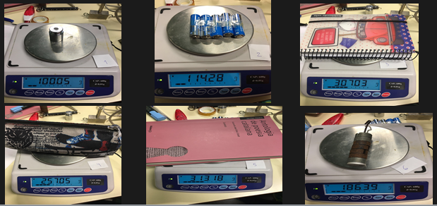
OBJECTS MEASURED

Slide 3
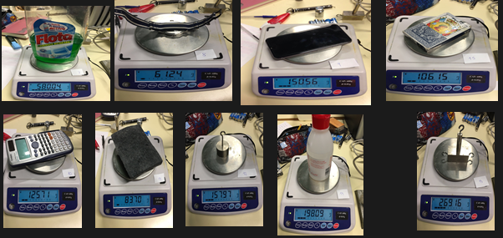
OBJECTS MEASURED

Slide 4
PROCEDURE
Step 1
Step 2
Step 3
Step 4
Measure the weight
Measure the force
Pass the results on an Excel
Calculate the gravity, the average and the standard deviation
Notes:
Enumere todos los pasos realizados para completar el experimento.
Recuerde numerar los pasos.
Incluya fotos del experimento.
4

Slide 5
RESULTS
OBJECTS | MASS(g) | WEIGHT (N) | GRAVITY ACCELERATION (m/s²) | ABSOLUT ERROR | RELATIVE ERROR (%)
1 | 100,06 | 1 | 9,994 | -0,139 | -1,39
2 | 114,29 | 1,12 | 9,800 | 0,056 | 0,57
3 | 307,1 | 3 | 9,769 | 0,086 | 0,88
4 | 257,09 | 2,42 | 9,413 | 0,442 | 4,70
5 | 313,22 | 3,11 | 9,929 | -0,074 | -0,74
6 | 186,39 | 1,85 | 9,925 | -0,070 | -0,71
7 | 580,06 | 5,783 | 9,970 | -0,114 | -1,15
8 | 61,22 | 0,61 | 9,964 | -0,109 | -1,09
9 | 150,56 | 1,499 | 9,956 | -0,101 | -1,01
10 | 125,71 | 1,24 | 9,864 | -0,009 | -0,09
11 | 83,98 | 0,824 | 9,812 | 0,043 | 0,44
12 | 157,96 | 1,54 | 9,749 | 0,106 | 1,09
13 | 269,15 | 2,65 | 9,846 | 0,009 | 0,10
14 | 198,09 | 1,97 | 9,945 | -0,090 | -0,90
15 | 106,15 | 1,05 | 9,892 | -0,036 | -0,37

Slide 6
RESULTS
AVERAGE | 9,855 m/s²
STANDARD DEVIATION | 0,1448
RELATIVE ERROR | 0,02 %

Slide 7
CONCLUSIONS
As we can see, the gravity is approximate 9,81 but, as it is an experiment in the real life, this is normal.
Also we can relate this with the different places we calculate it.

Slide 8
PAULA FORCADELL, ALBA ROCA I GUILLEM SEGURA
END

