Slide 1
Measurement gravity acceleration by inclined plane

Slide 2
Experiment
1) We measured height h and lenght l of inclined plane by ruler.
2) We counted path and time of the car by sonar called Vernier.
3) With these numbers, we can finally use these formulas:
a = 2s/t²
a = g sin α
g = a / sin α, sin α = h/l
g = a l / h

Slide 3
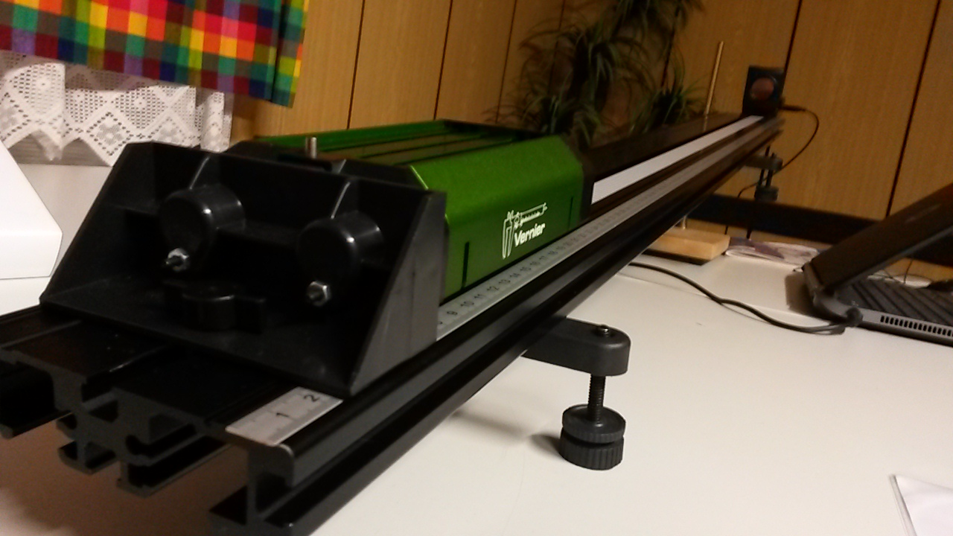
Inclined plane and Sonar Vernier

Slide 4
Car´s acceleration

Slide 5
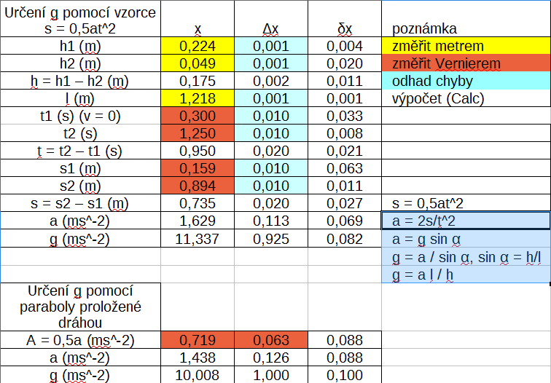
Data of Measurement of gravity acceleration

Slide 6
g=(10,0±1,0) m.s⁻²

Slide 7
Main Author – Dan Lokaj z kozlovic
+420 777 680 804
Handsome boy from Kozlovice.
He is waiting for your girl .

Slide 8
Other authors
Kryštof Štihel
Šimon „Pekař“ Bárta
Tomáš Tatran
Dedicated to Tomáš „Kašpy“ Kašpárek.
We are missing U bro ☹

