Slide 1
my native
Kutaisi

Slide 2
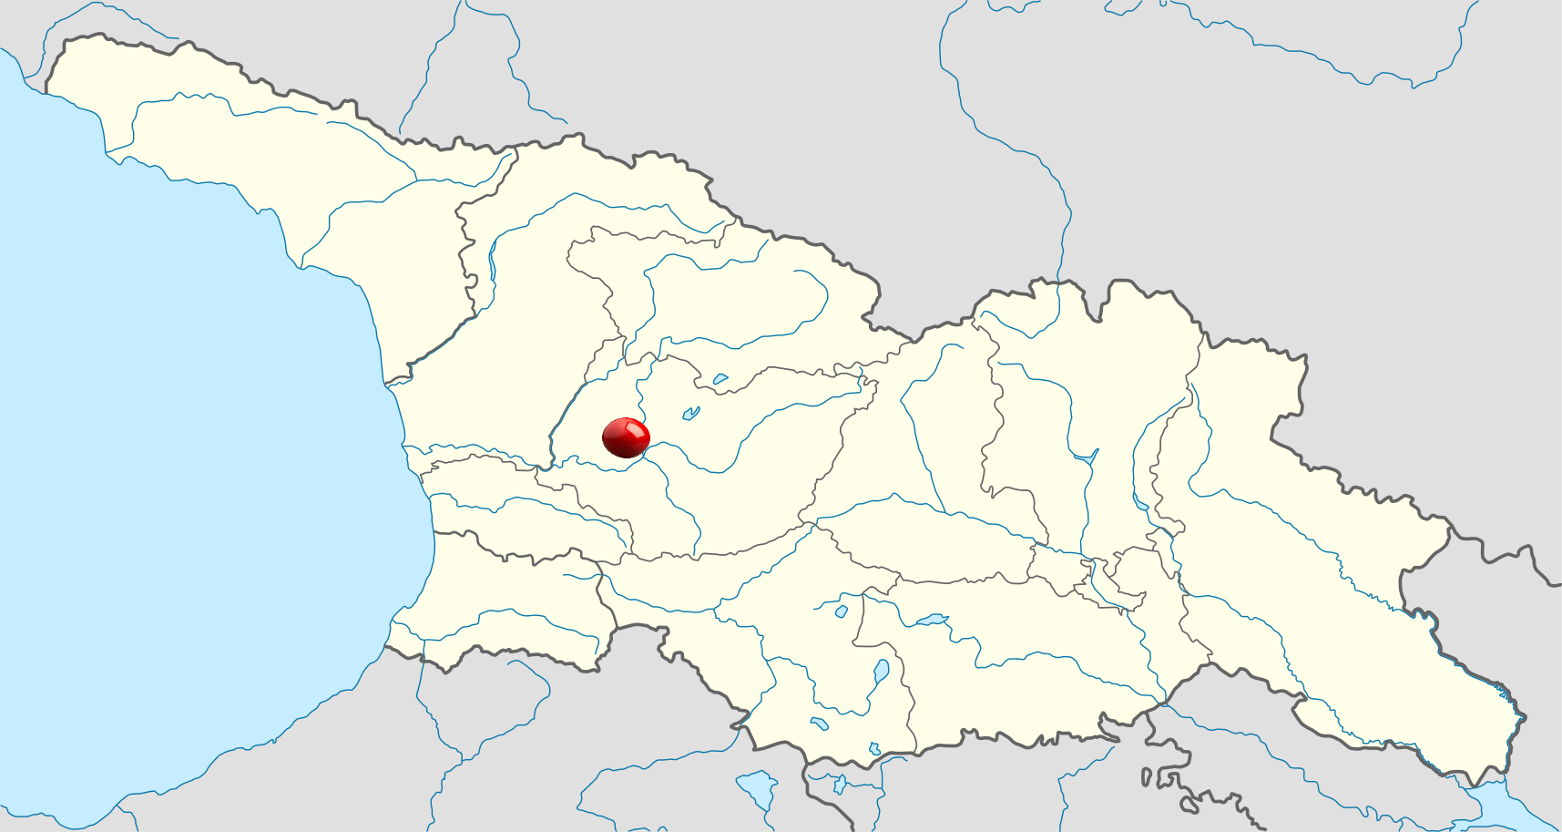
Kutaisi
Kutaisi is Georgia's second largest city, legislative capital, and the capital of the western region of Imereti. It is 226 kilometers west of Tbilisi.

Slide 3
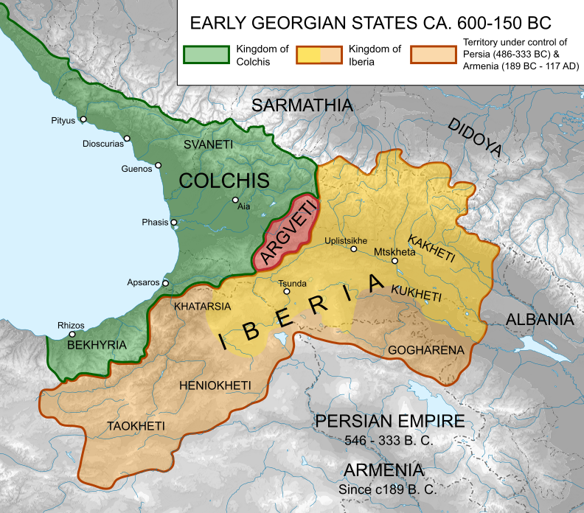
Kutaisi
Kutaisi was the capital of the ancient Kingdom of Colchis In than time it was named Aia

Slide 4
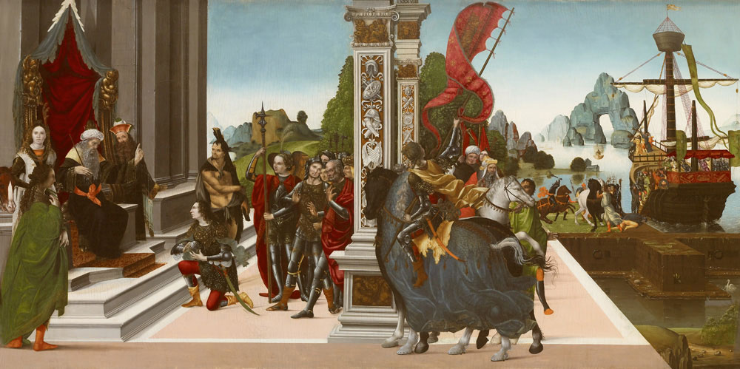
Several historians believe that, in Argonautica, a Greek epic poem about Jason and the Argonauts and their journey to Colchis, author Apollonius Rhodius considered Kutaisi their final destination as well as the residence of King Aeëtes

Slide 5
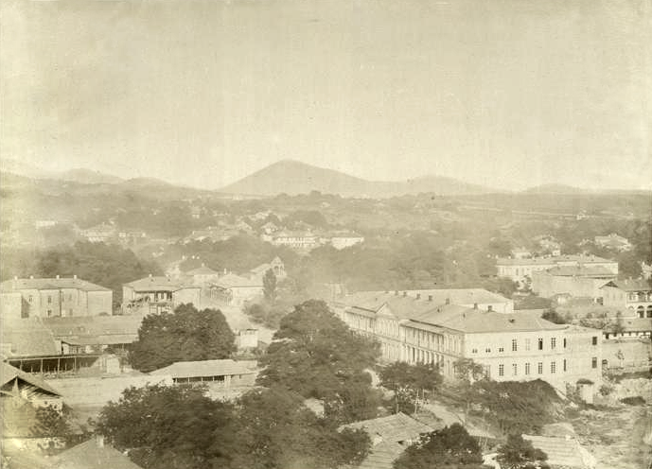
From 978 to 1122 CE, Kutaisi was the capital of the united Kingdom of Georgia, and from the 15th century until 1810, it was the capital of the Imeretian Kingdom

Slide 6
Kutaisi was a major industrial center before Georgia's independence in 1991

Slide 7
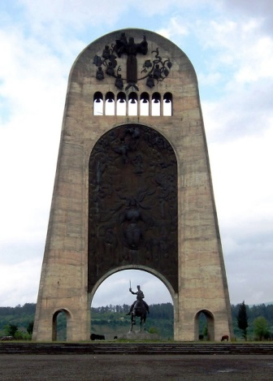
The city had a massive Soviet war memorial for the Georgians killed in World War II

Slide 8
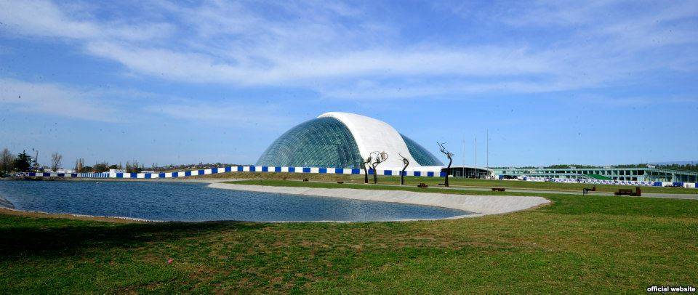
On December 18, 2009, a private demolition company working for the Georgian government demolished the monument to make room for a parliament building

Slide 9
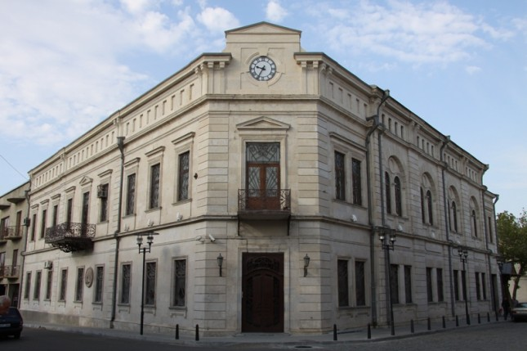
Kutaisi State Historical Museum - A major museum, it is also considered to be one of the most important scientific-research institutions in Georgia with its extensive research library and laboratory

Slide 10
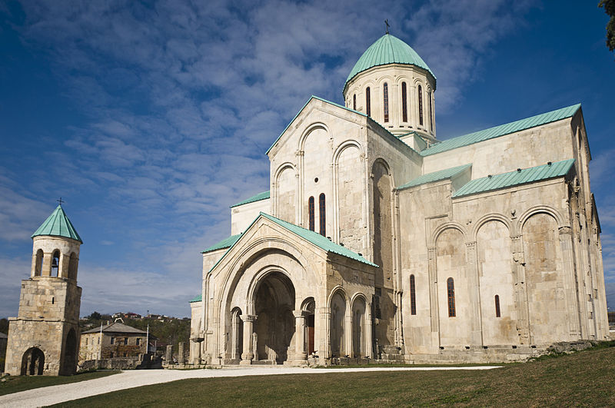
The Cathedral of the Dormition, or the Kutaisi Cathedral, more commonly known as Bagrati Cathedral, is the 11th-century cathedral church in the city of Kutaisi. The cathedral, rebuilt officially on September 16, 2012 after heavy damage ages ago

Slide 11
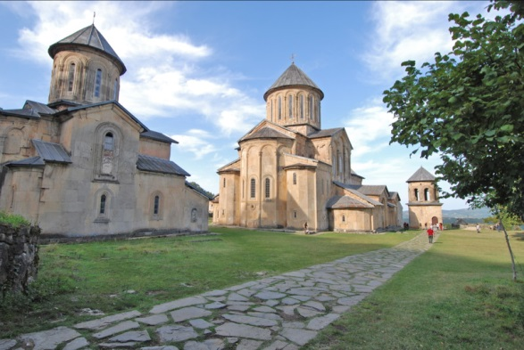
Gelati is a monastic complex near Kutaisi. It contains the Church of the Virgin founded by the King of Georgia David the Builder in 1106, and the 13th-century churches of St George and St Nicholas

Slide 12
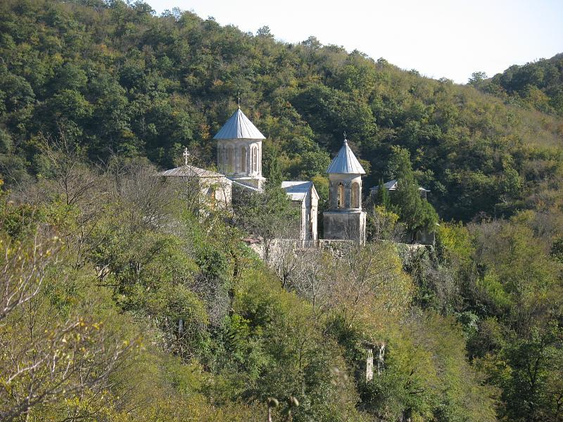
Motsameta Gelati is a monastic complex near Gelati, It was built for David and Konstantine Mxeidzeebi

Slide 13
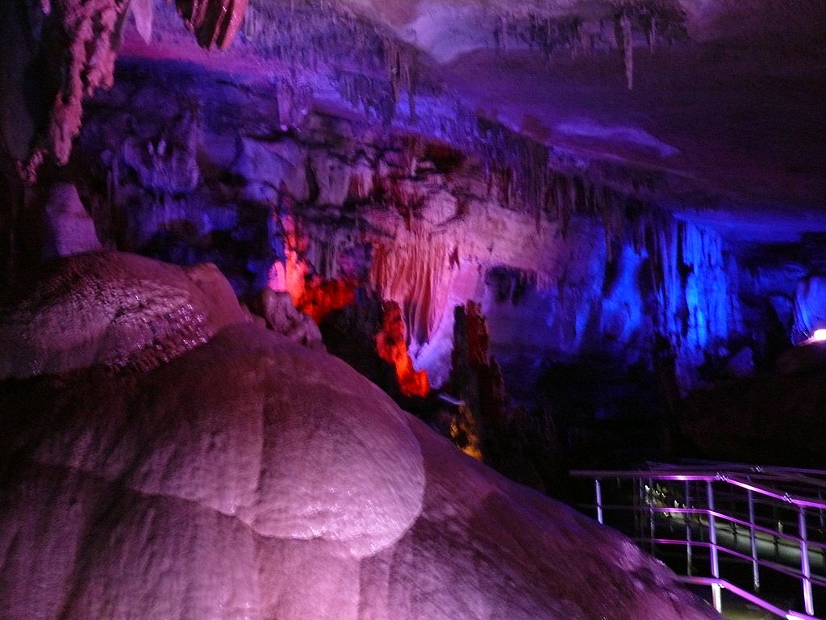
Sataplia preserve located near Kutaisi. There were found over 200 track of dinosaurs

Slide 14
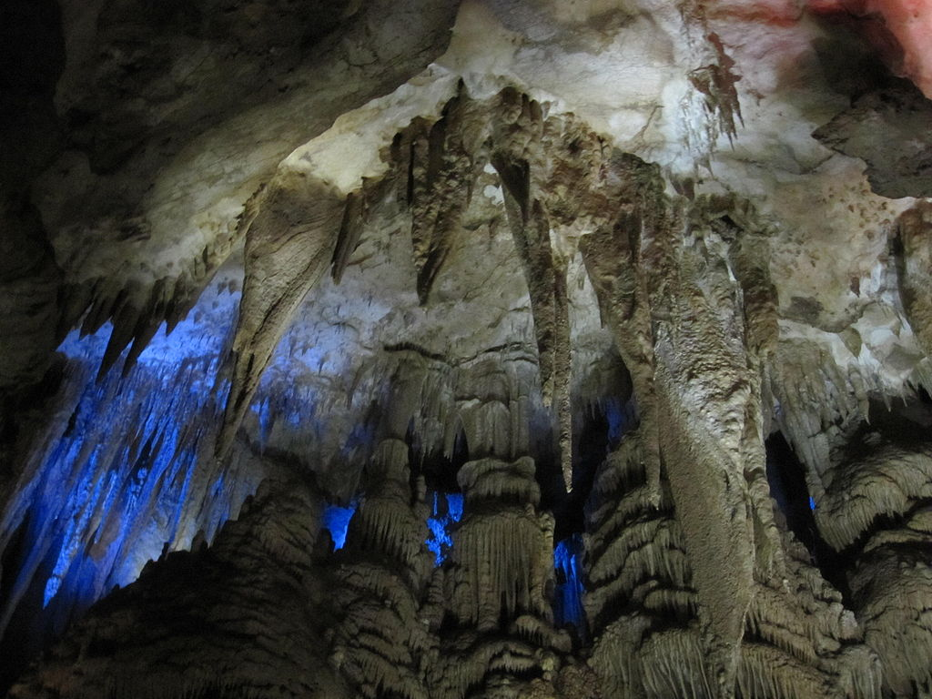
Promethe Cave it 40 kilometers far from Kutaisi. There were found 16 halls, which are different from each other.

Slide 15
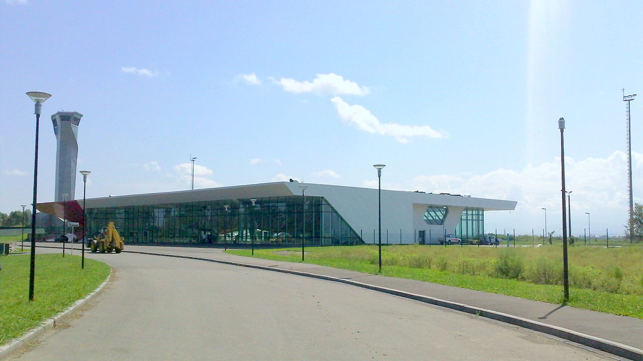
David the Builder Kutaisi International Airport is an airport located 14 km west of Kutaisi. It is one of three international airports currently in operation in Georgia.

Slide 16
Kutaisi Physico-mathmetical Public School N 41 After Andria Razmadze
6-th graders
For eTwinning project : “My World My Classroom”

