Slide 1
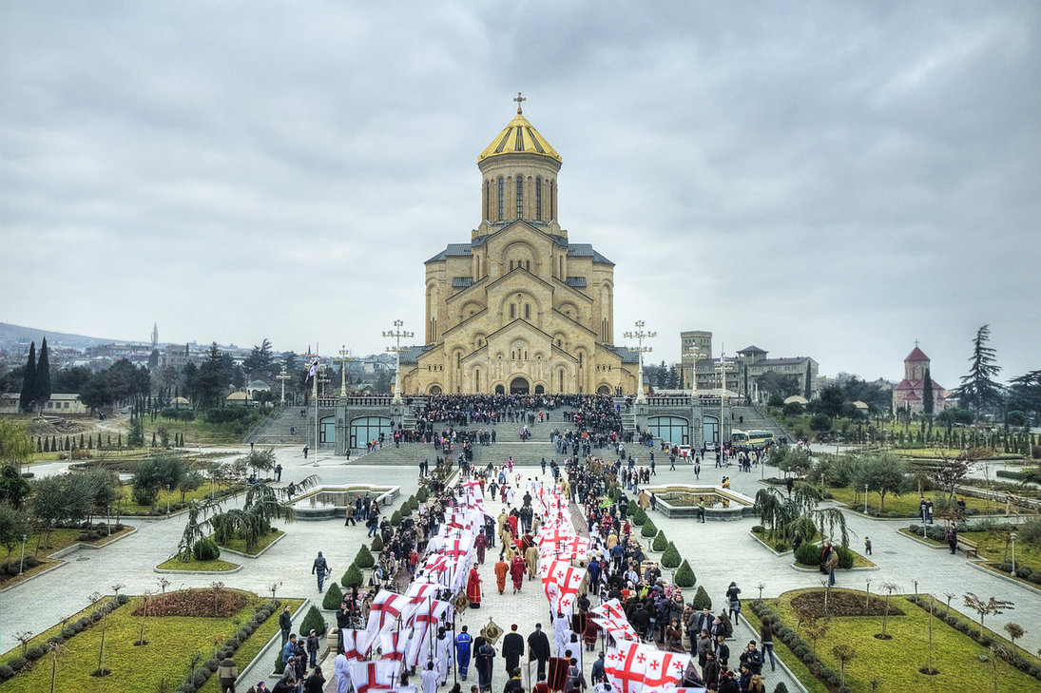
Easter traditions in Georgia

Slide 2
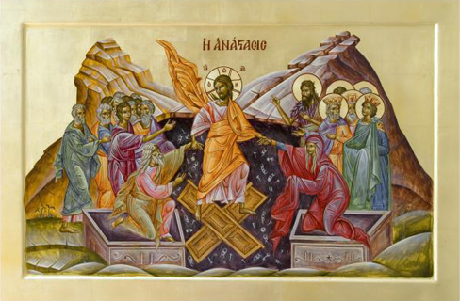
Easter, which celebrates Jesus Christ’s resurrection from the dead, is Christianity’s most important holiday. It has been called a moveable feast because it doesn’t fall on a set date every year, as most holidays do. Instead, Christian churches in the West celebrate Easter on the first Sunday following the full moon after the vernal equinox on March 21. Therefore, Easter is observed anywhere between March 22 and April 25 every year. Orthodox Christians use the Julian calendar to calculate when Easter will occur and typically celebrate the holiday a week or two after the Western churches, which follow the Gregorian calendar.

Slide 3
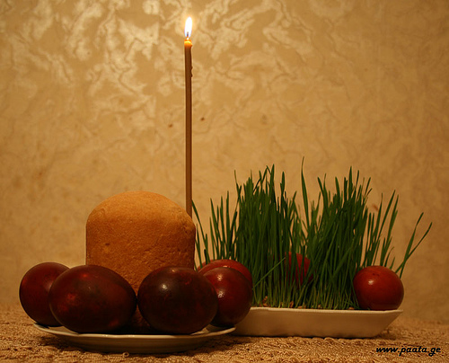
Easter is the most important holiday for Orthodox Christians. The week before Easter is called Passion Week. This is when special services are conducted in almost every church in Georgia, but most particular days are PASSION THURSDAY and GOOD FRIDAY.

Slide 4
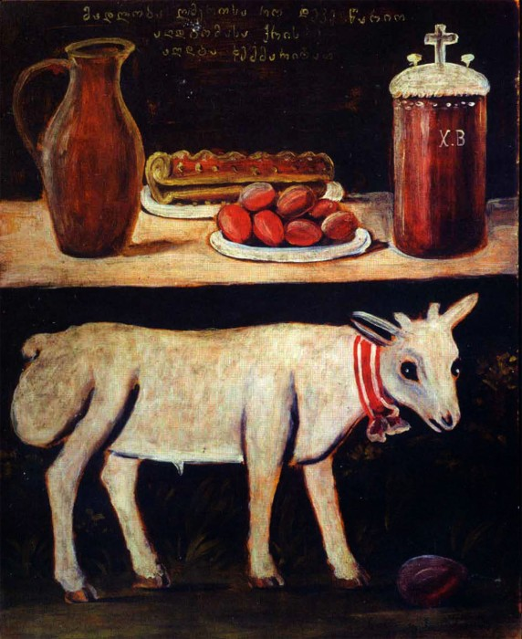
Several days starting from Easter Sunday greet each other saying the following phrase “Christ had risen” to which the response is “Indeed” .

Slide 5
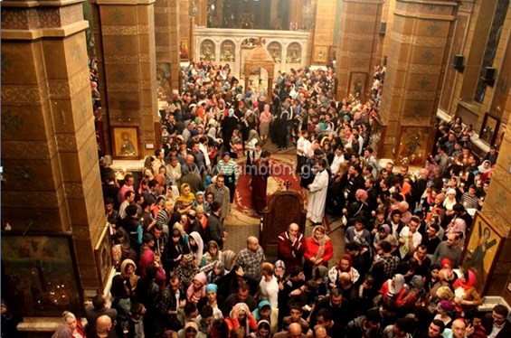
On Saturday night, the day before Easter Sunday, the most devout Orthodox Christians go to church and stay there overnight until late Easter morning. A special service is conducted in almost every church across the country. Following this people have a special meal to break the fast.

Slide 6
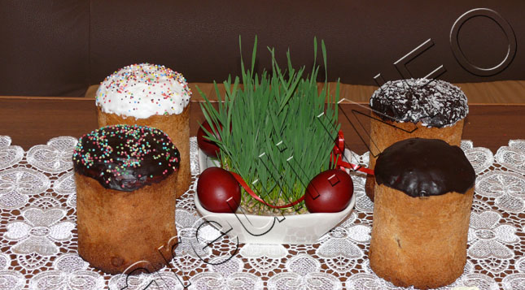
Three important elements of Easter preparation are dying eggs red on Good Friday ,baking Easter Bread, Paska and Blade

Slide 7
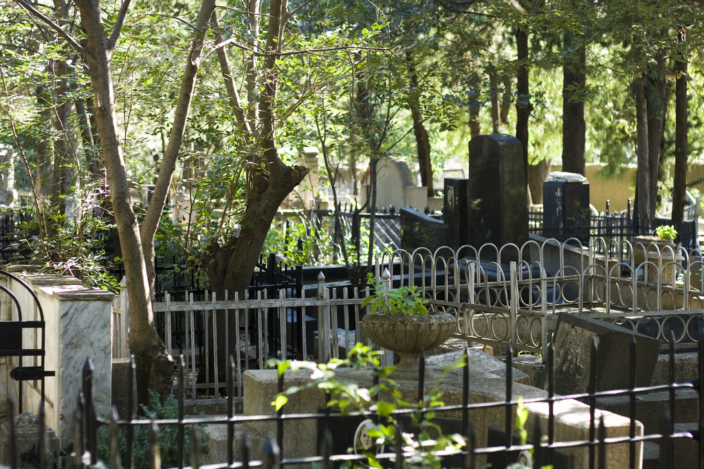
Easter morning begins with a social affair where neighbors' greet and congratulate each other. After this comes the most traditional part of the holiday – visiting cemeteries. Every Easter Georgians bring food and wine to cemeteries and feast near the graves of their loved ones. This is the way of telling their ancestors Jesus has risen. At small Georgian villages like Partskhnali, everyone knows each other and almost all of the residents are distant relatives. So people visit each grave at the cemetery one by one, and drink a glass of wine and roll a red egg on each grave.
This is where traditional egg fights begin.

Slide 8
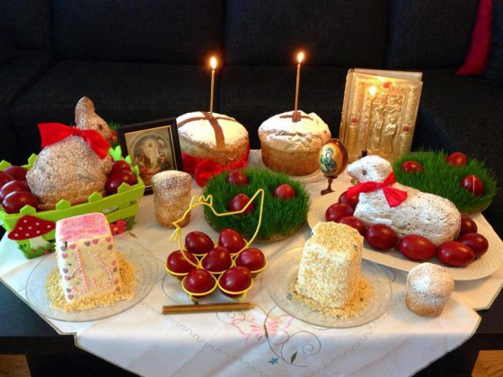
The Easter celebration is not finished yet - this is only the start. The next phase is ahead at home, where a feast awaits the family. The table is set full of delicious traditional Georgian dishes waiting for the guests to get back from the cemetery.

Slide 9
Kutaisi physico-mathmetical Public school N 41 after andria razmadze 6-th graders For etwinning project : “my world my classroom”
Thank you for your attention!

