Slide 1
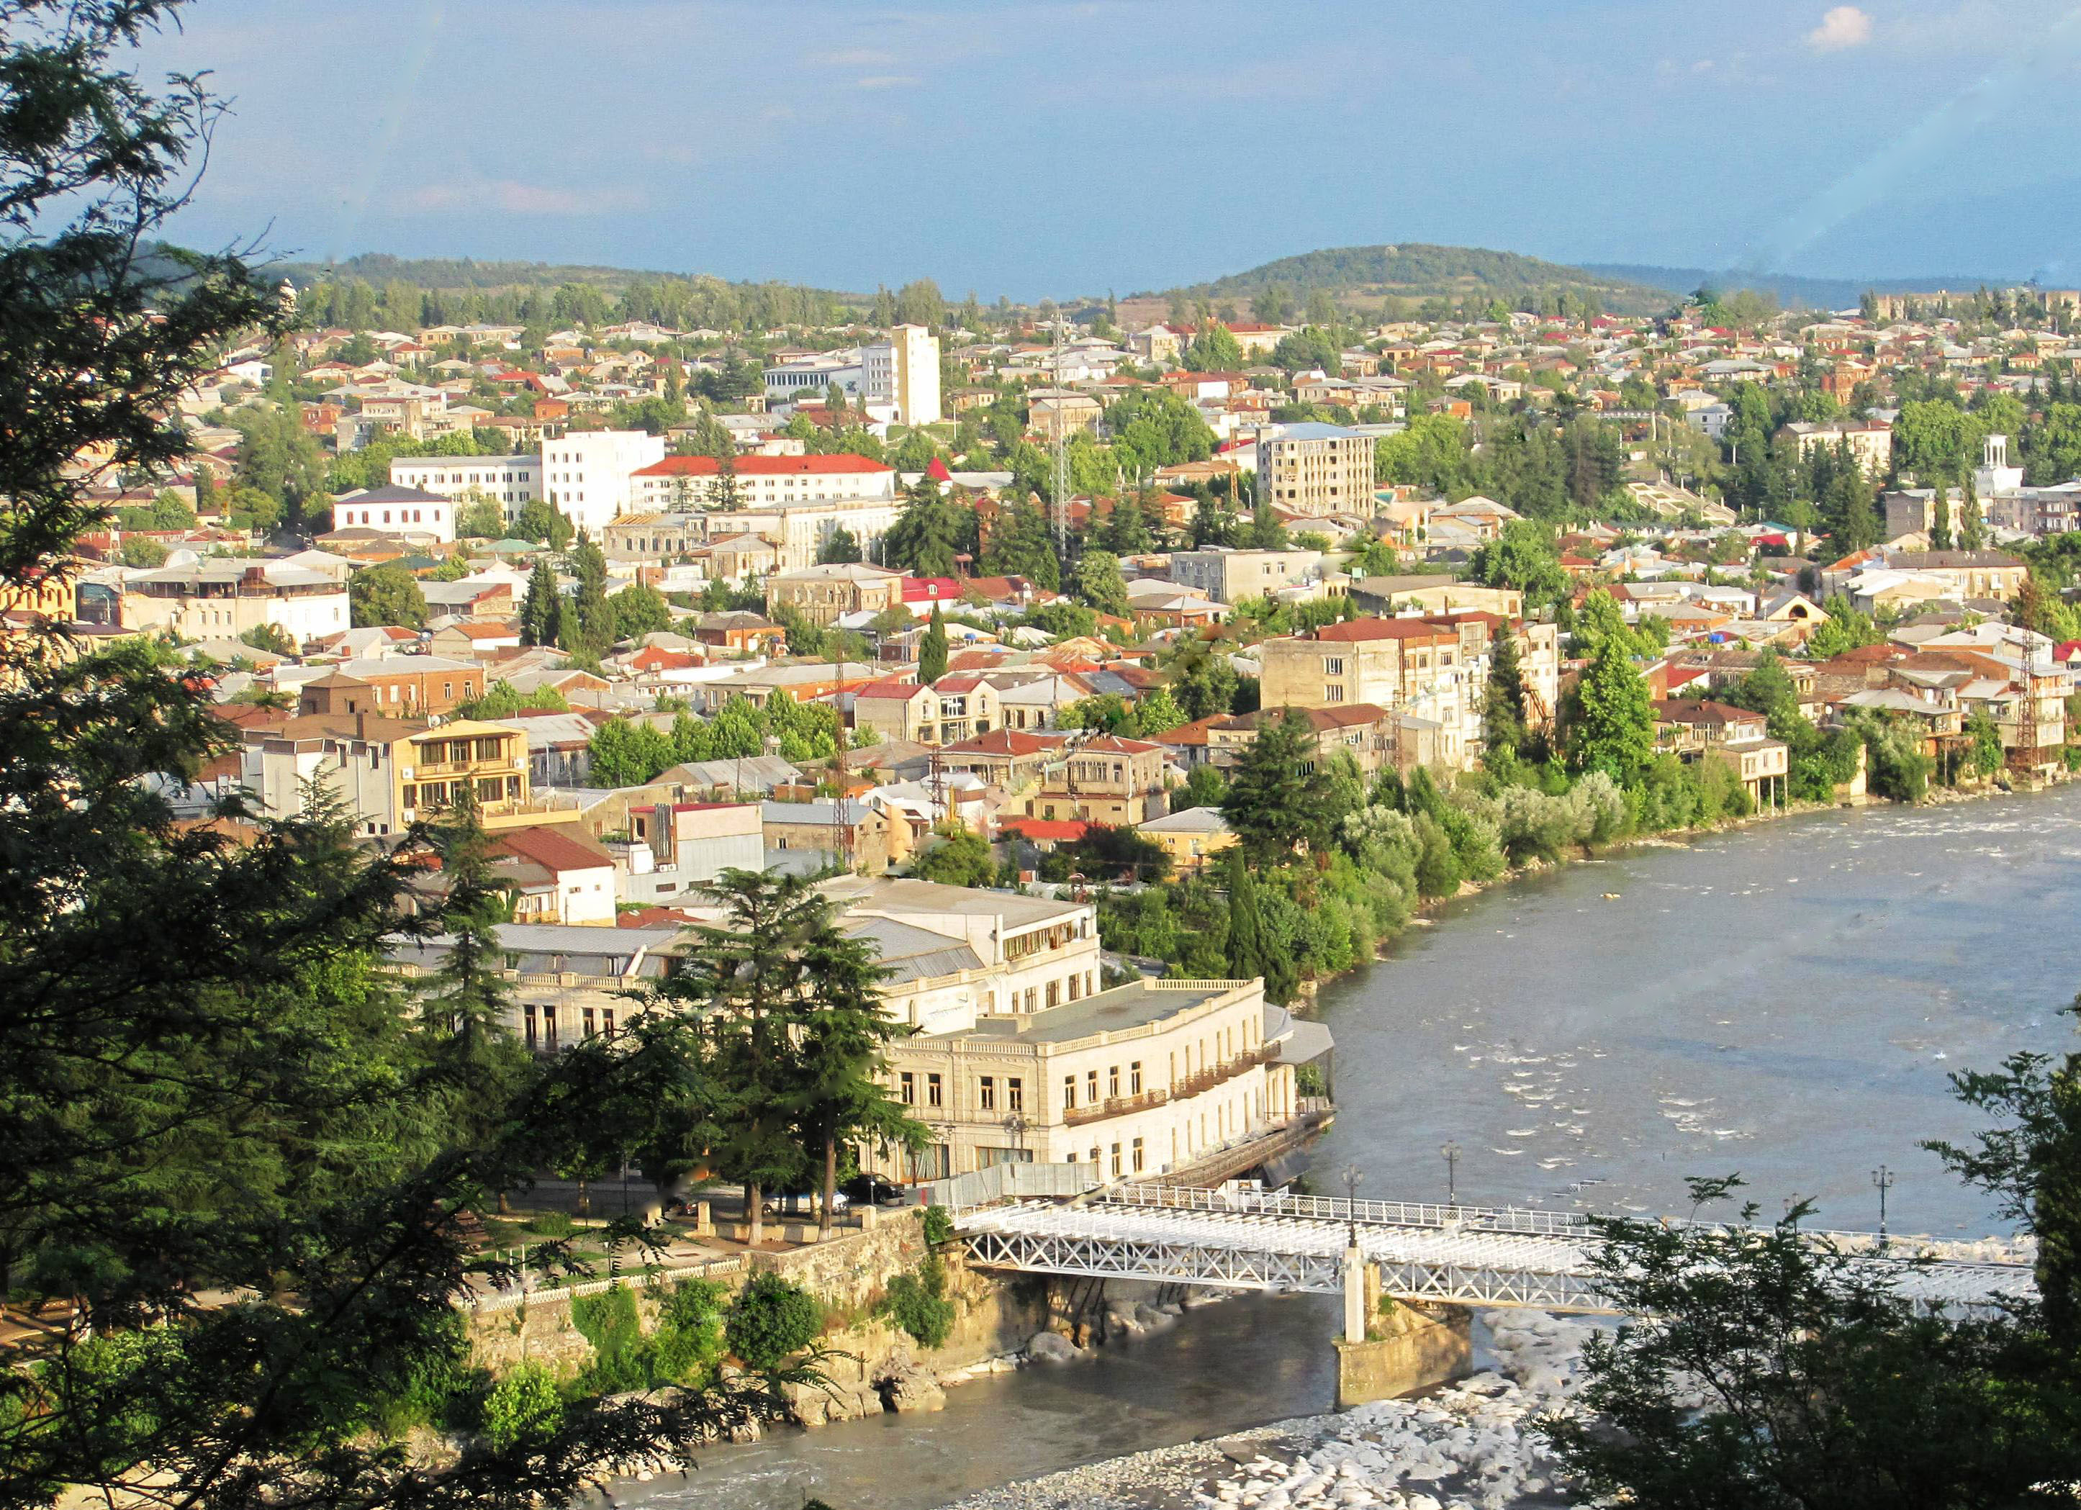
K U T A I S I

Slide 2
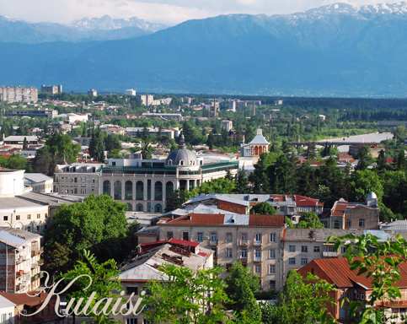
Kutaisi (Georgian: ქუთაისი; ancient names: Aea/Aia, Kotais, Kutatisi, Kutaïssi) is Georgia's second largest city, legislative capital, and the capital of the western region of Imereti. It is 221 kilometres (137 miles) west of Tbilisi.

Slide 3
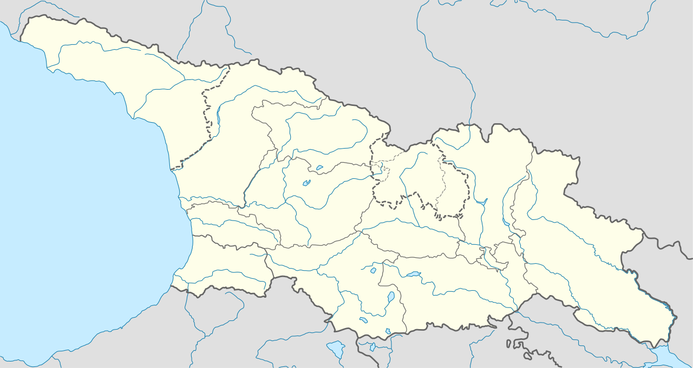
Kutaisi is located along both banks of the Rioni River. The city lies at an elevation of 125–300 metres (410–984 feet) above sea level. To the east and northeast, Kutaisi is bounded by the Northern Imereti Foothills, to the north by the Samgurali Range, and to the west and the south by the Colchis Plain.

Slide 4
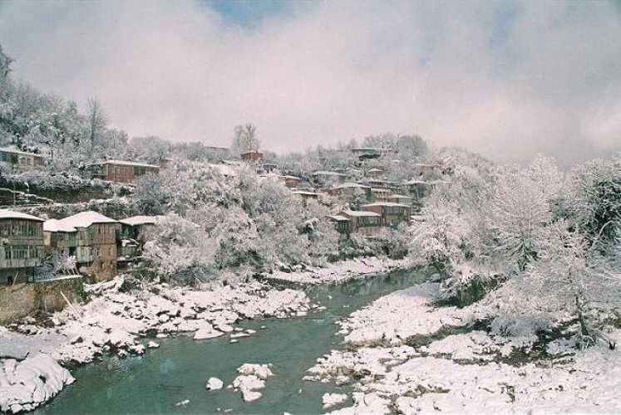
Kutaisi is surrounded by deciduous forests to the northeast and the northwest. The low-lying outskirts of the city have a largely agricultural landscape. The city centre has many gardens its streets are lined with high, leafy trees. In the springtime, when the snow starts to melt in the nearby mountains, the storming Rioni River in the middle of the city is heard far beyond its banks.

Slide 5
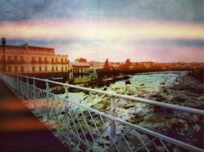
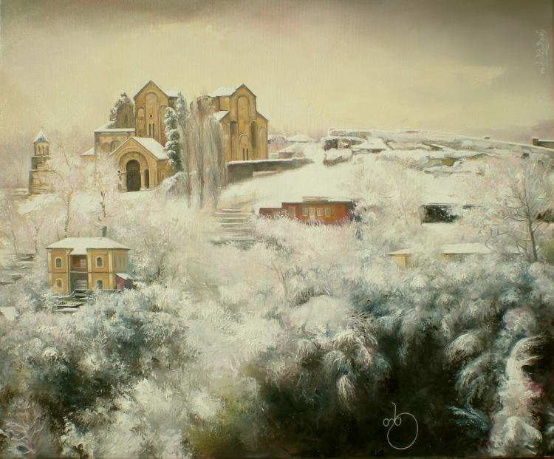
The climate in Kutaisi is humid subtropical with a well-defined on-shore/monsoonal flow (characteristic of the Colchis Plain) during the Autumn and Winter months. The summers are generally hot and relatively dry while the winters are wet and cool. Average annual temperature in the city is 14.5 degrees Celsius.

Slide 6
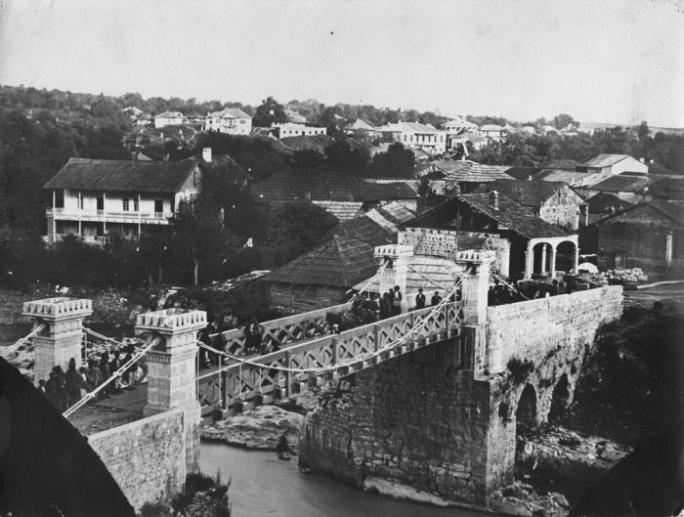
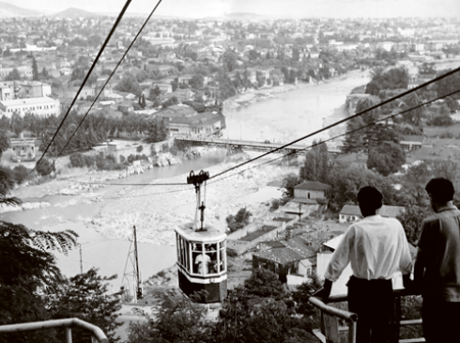
Kutaisi was the capital of the ancient Kingdom of Colchis. Several historians believe that, in Argonautica, a Greek epic poem about Jason and the Argonauts and their journey to Colchis, author Apollonius Rhodius considered Kutaisi their final destination as well as the residence of King Aeëtes. From 978 to 1122 CE, Kutaisi was the capital of the united Kingdom of Georgia, and from the 15th century until 1810, it was the capital of the Imeretian Kingdom.
Kutaisi was a major industrial center before Georgia's independence in 1991.
The city had a massive Soviet war memorial for the Georgians killed in World War II. On December 18, 2009, a private demolition company working for the Georgian government demolished the monument to make room for a parliament building, despite massive protest from Russia and the Georgian opposition.

Slide 7
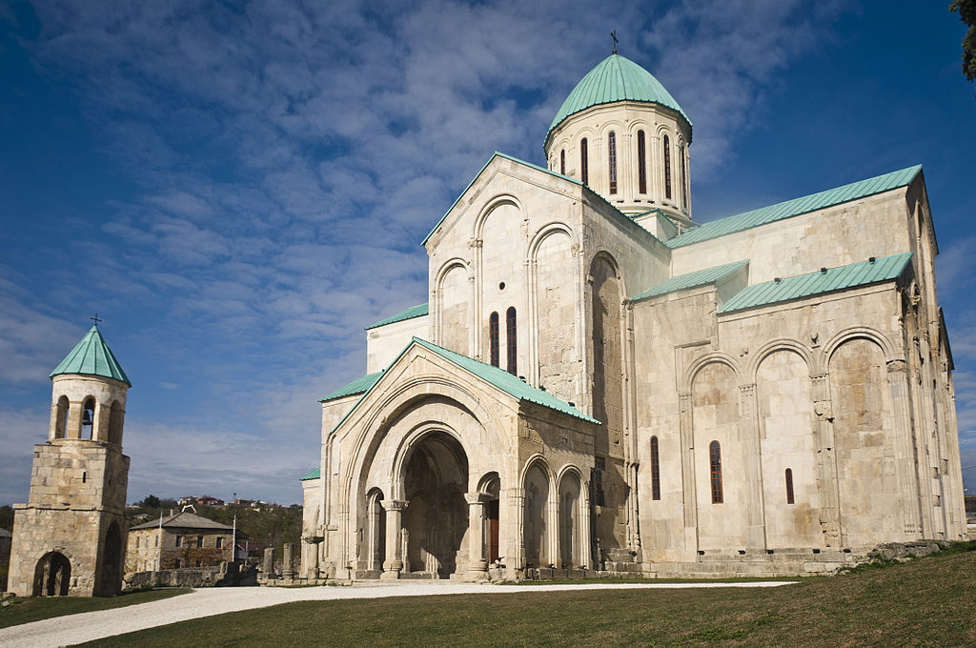
Kutaisi has an ancient cultural tradition. Here is a list of the cultural centers in Kutaisi.
The Cathedral of the Dormition, or the Kutaisi Cathedral, more commonly known as Bagrati Cathedral. it is the 11th-century cathedral church in the city of Kutaisi, the region of Imereti, Georgia.It was built in the early years of the 11th century, during the reign of King Bagrat III, due to which it was called "Bagrati", i.e., Bagrat’s cathedral. An inscription on the north wall reveals that the floor was laid in "chronicon 223", i.e., 1003. In 1692, In 1994 the Bagrati Cathedral, together with the Gelati Monastery, was included in UNESCO's World Heritage Site list as a single entity. In 2001
Bagrati Cathedral

Slide 8
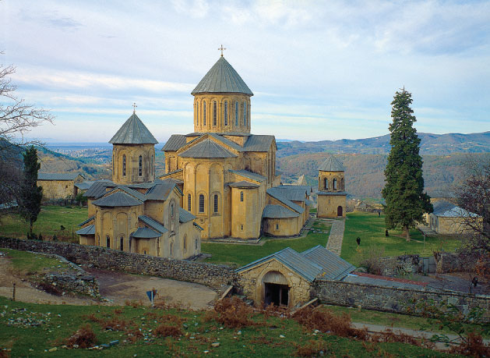
Gelati is a monastic complex near Kutaisi, Imereti, western Georgia. It contains the Church of the Virgin founded by the King of Georgia David the Builder in 1106, and the 13th-century churches of St George and St Nicholas.
The Gelati Monastery for a long time was one of the main cultural and intellectual centers in Georgia. It had an Academy which employed some of the most celebrated Georgian scientists, theologians and philosophers, many of whom had previously been active at various orthodox monasteries abroad.
In 1994, Gelati Monastery was recognized by UNESCO as a World Heritage Site. The site was included in the 2008 World Monuments Watch List of 100 Most Endangered Sites by the World Monuments Fund to draw attention to deterioration caused by prolonged neglect
Gelati Cathedral

Slide 9
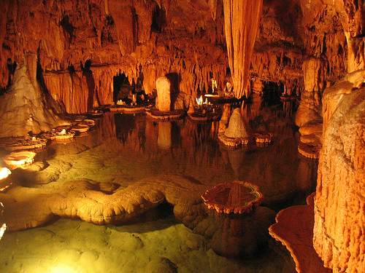
This is Sataflia’s National preserve. There was found footsteps of dinosaurs.

Slide 10
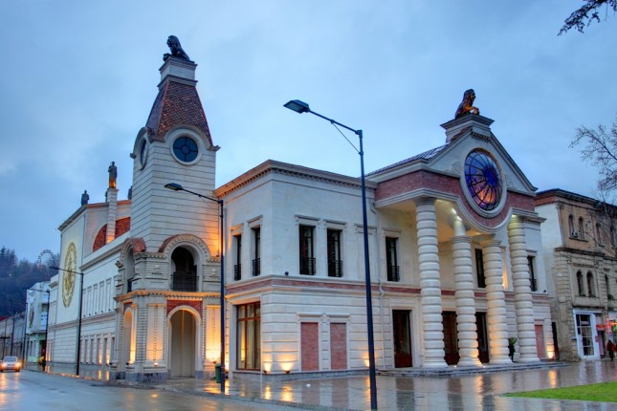
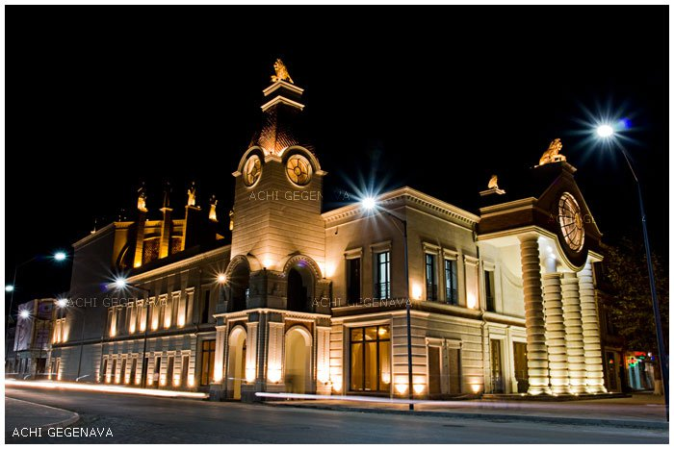
In Kutaisi you can find different cultural centres, such is for example Opera

Slide 11
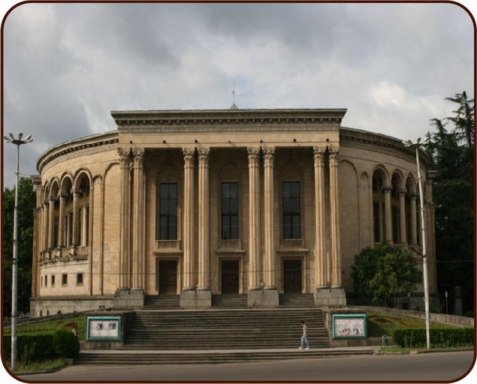
Meskhishvili Theatre

Slide 12
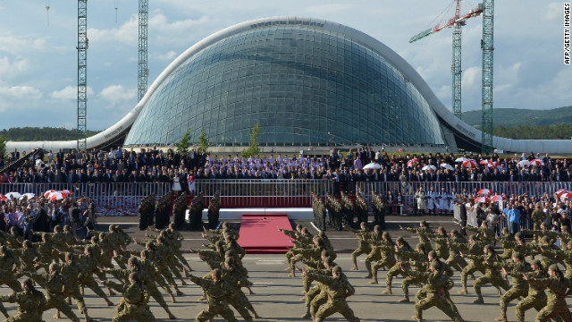
The Georgian Parliament Building in Kutaisi has been the home of the Parliament of Georgia since its inauguration on May 26, 2012, replacing the Parliament building at 8 Rustaveli Avenue in Tbilisi. The building is in the form of a 100-metre (330 ft) by 150-metre (490 ft) oval-shaped glass dome.

Slide 13
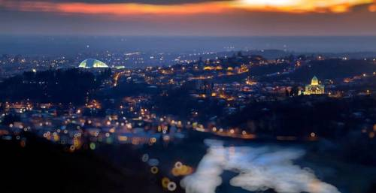
Here you can see some photos which are pictured at night.

Slide 14
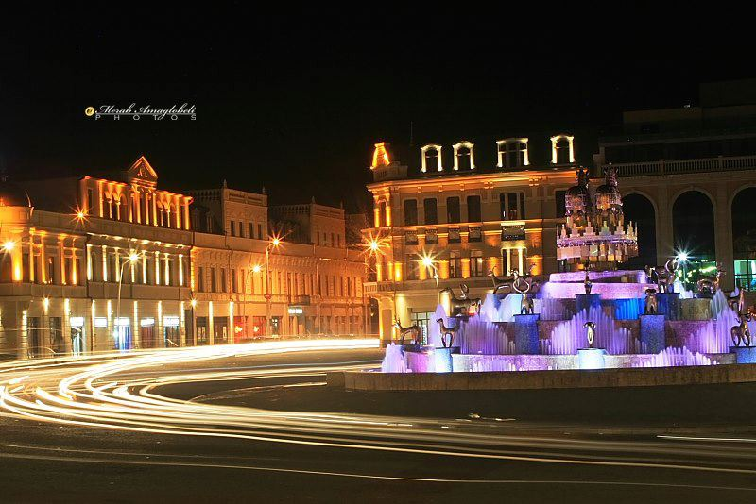
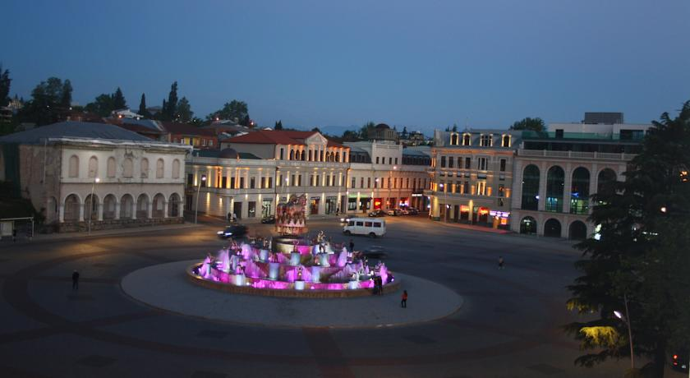

Slide 15
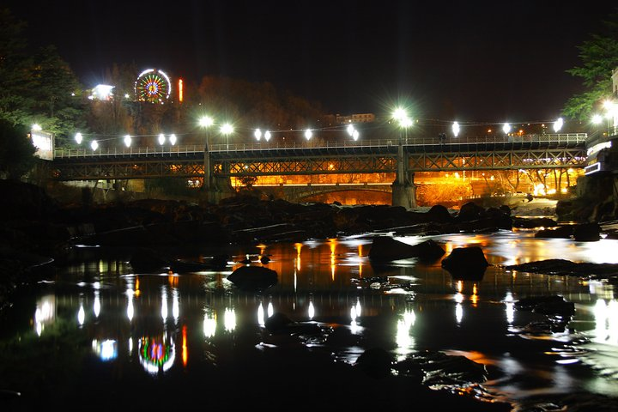

Slide 16
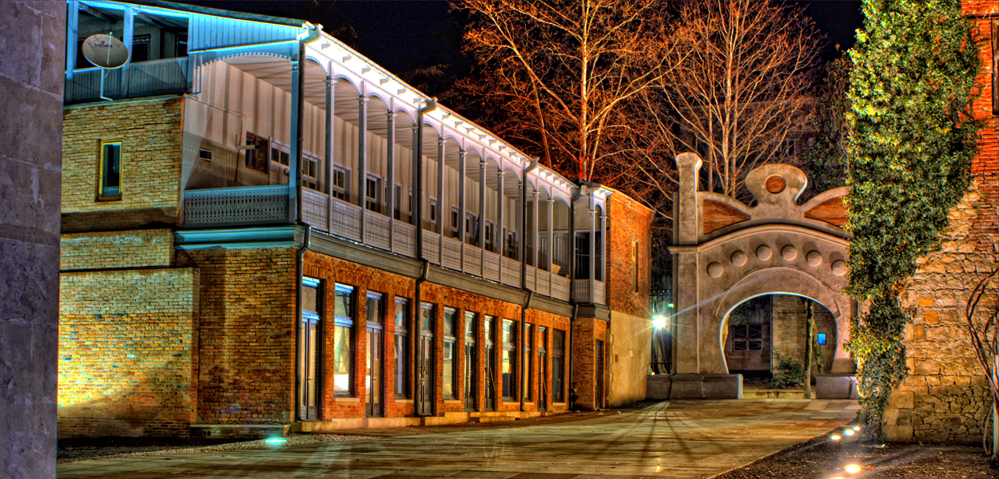
Kutaisi is waiting for you with its great sence of humour and hospitality…

Slide 17
Kutaisi Physico-mathmetical Public School N 41 After Andria Razmadze
6-th graders
For eTwinning project : “My World My Classroom”

