Slide 1
Thumb sized boy ცეროდენა
For eTwinning project “My World My Classroom”
2016

Slide 2
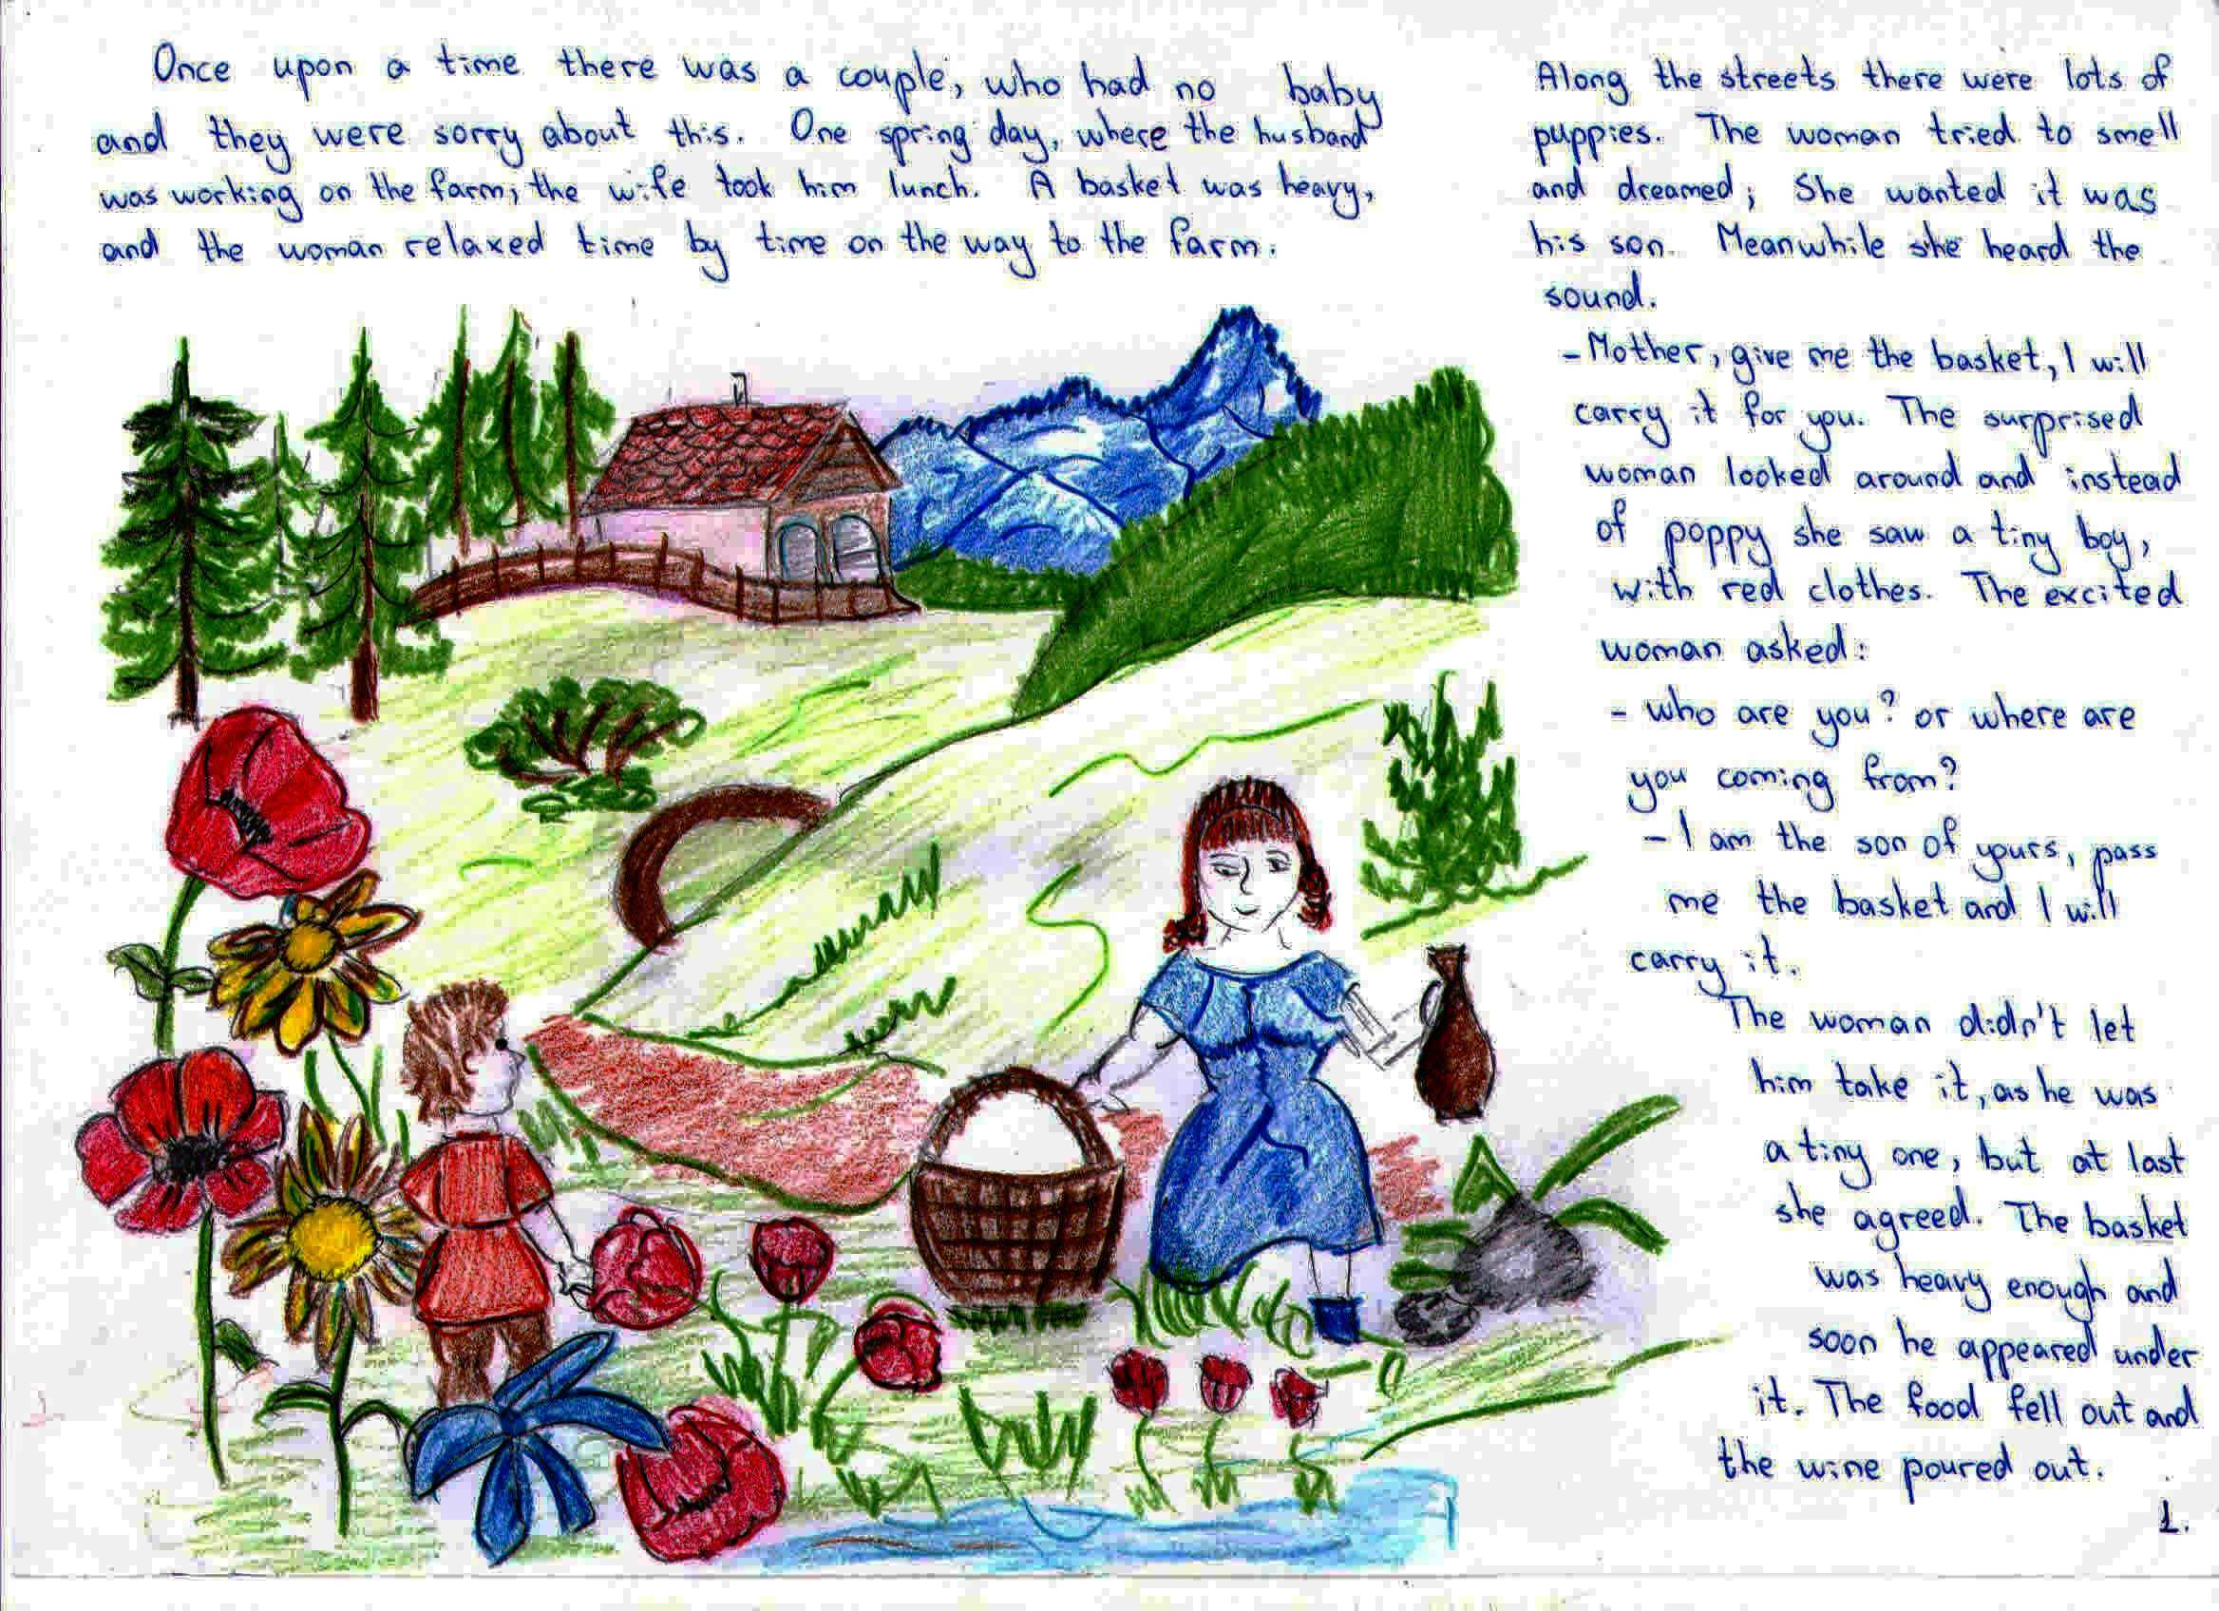

Slide 3
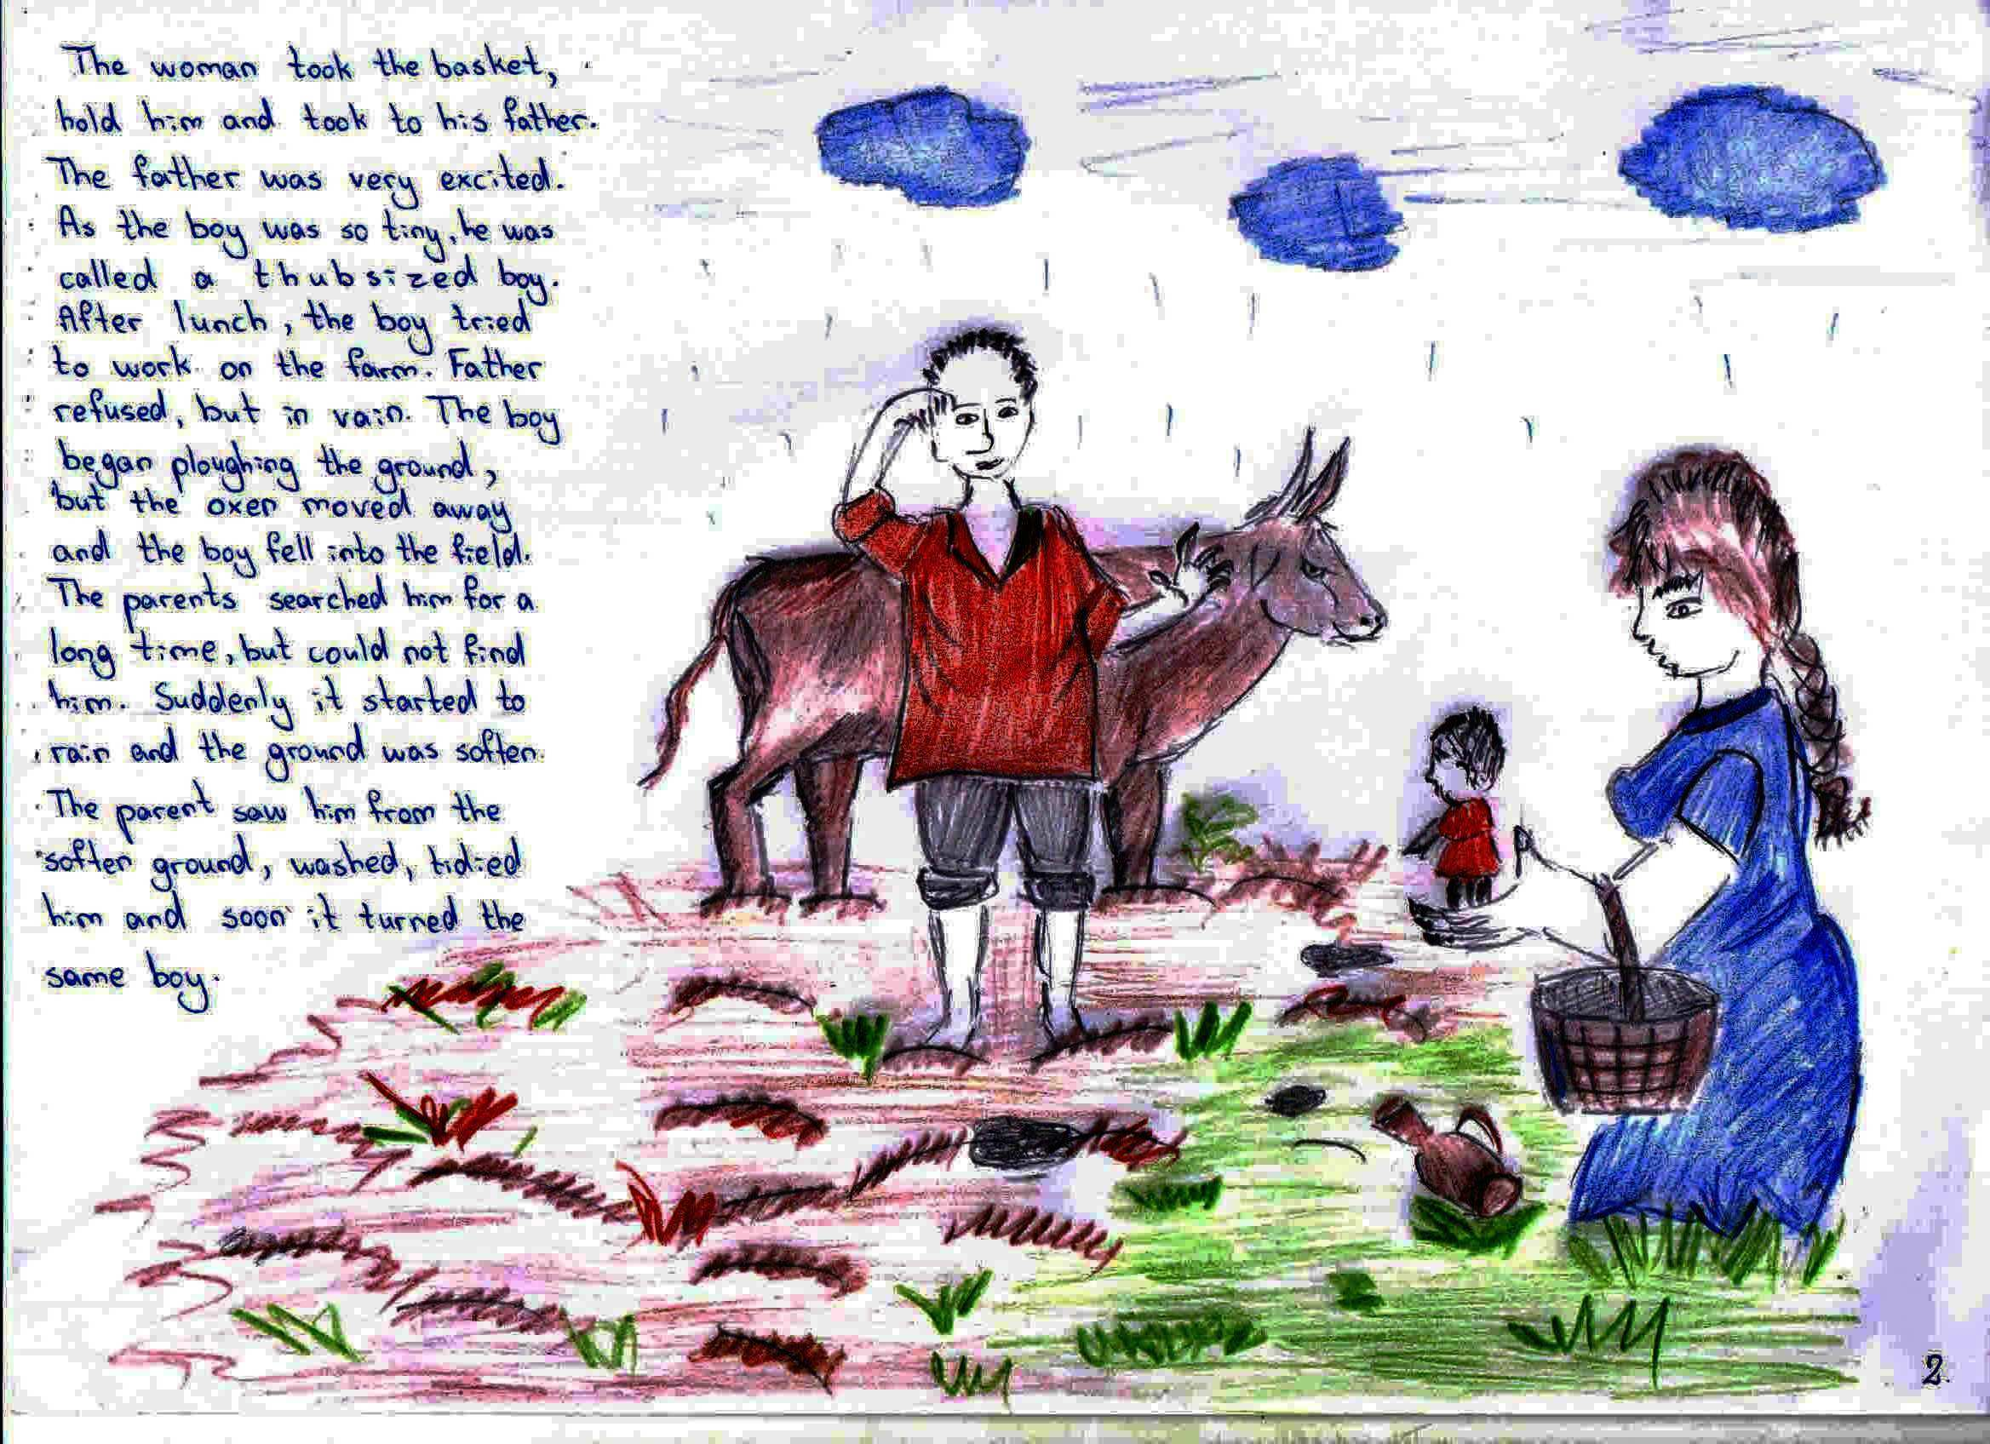

Slide 4
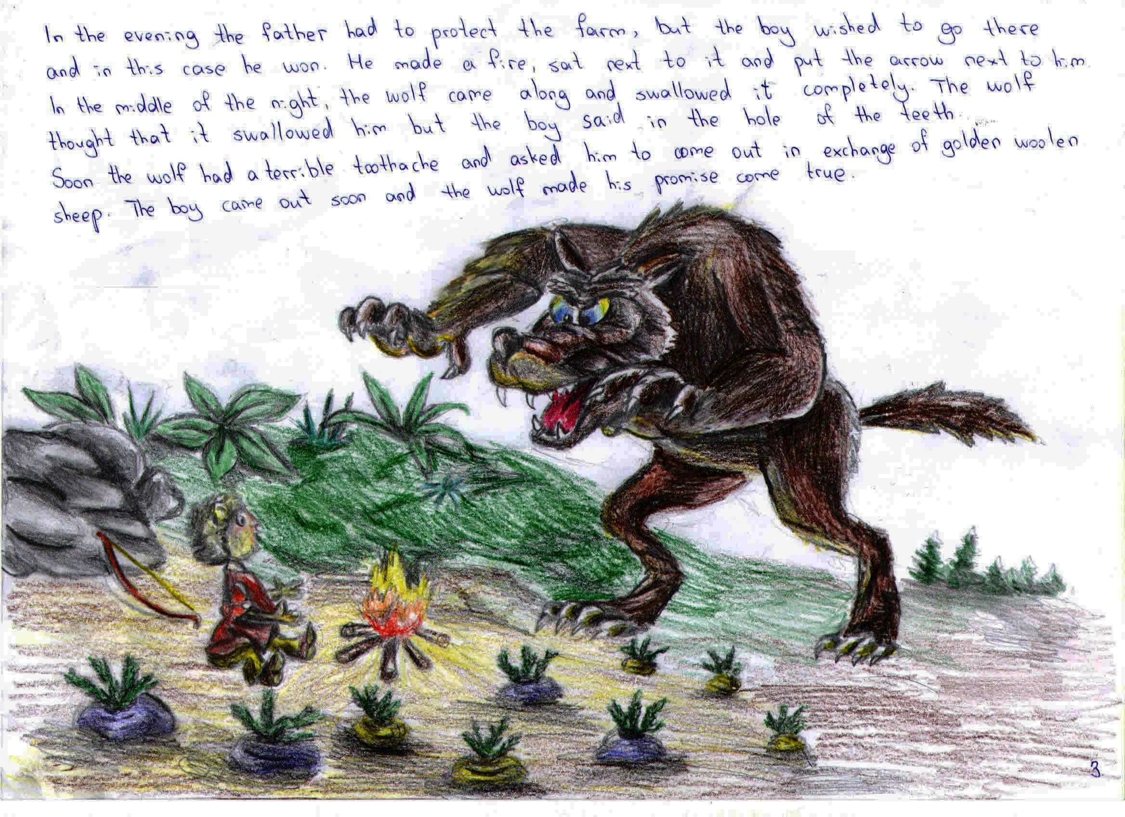

Slide 5
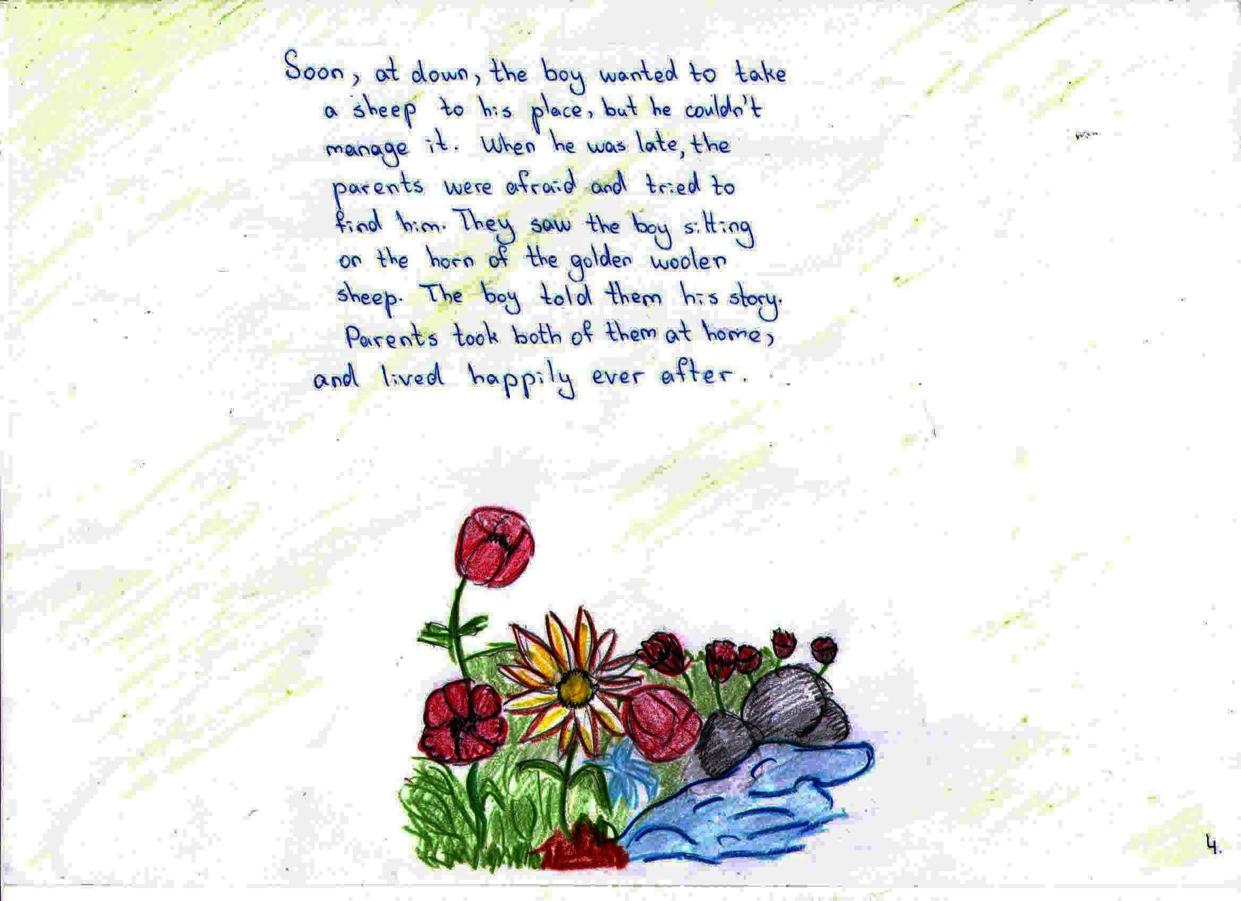

Slide 6
Georgia, Kutaisi, Physical-mathmetical school N41 after Andria Razmadze
6-th graders

