Slide 1
A man with clab
კომბლე
For eTwinning project: “My World My Classroom”
2016

Slide 2
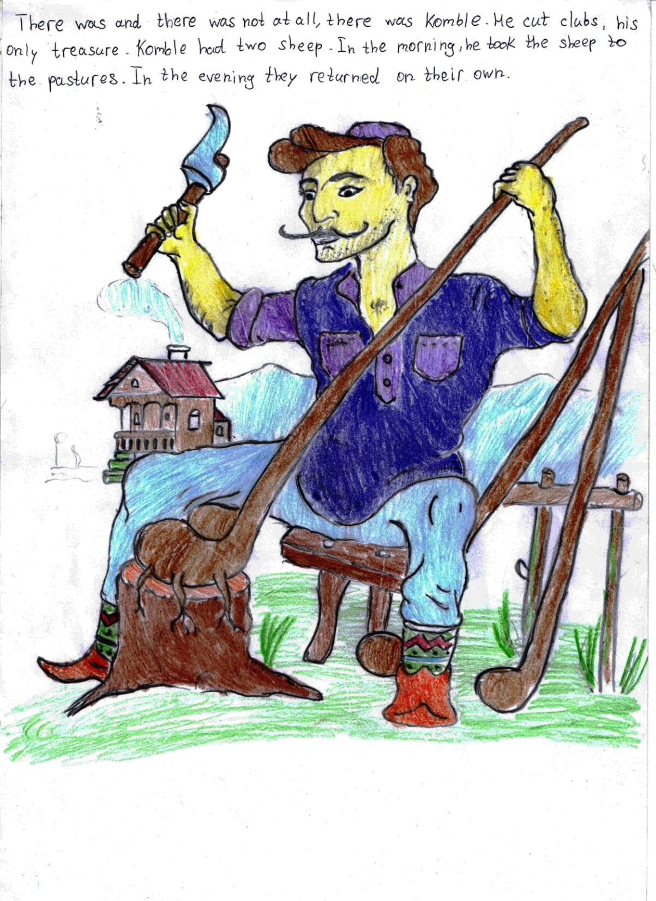

Slide 3
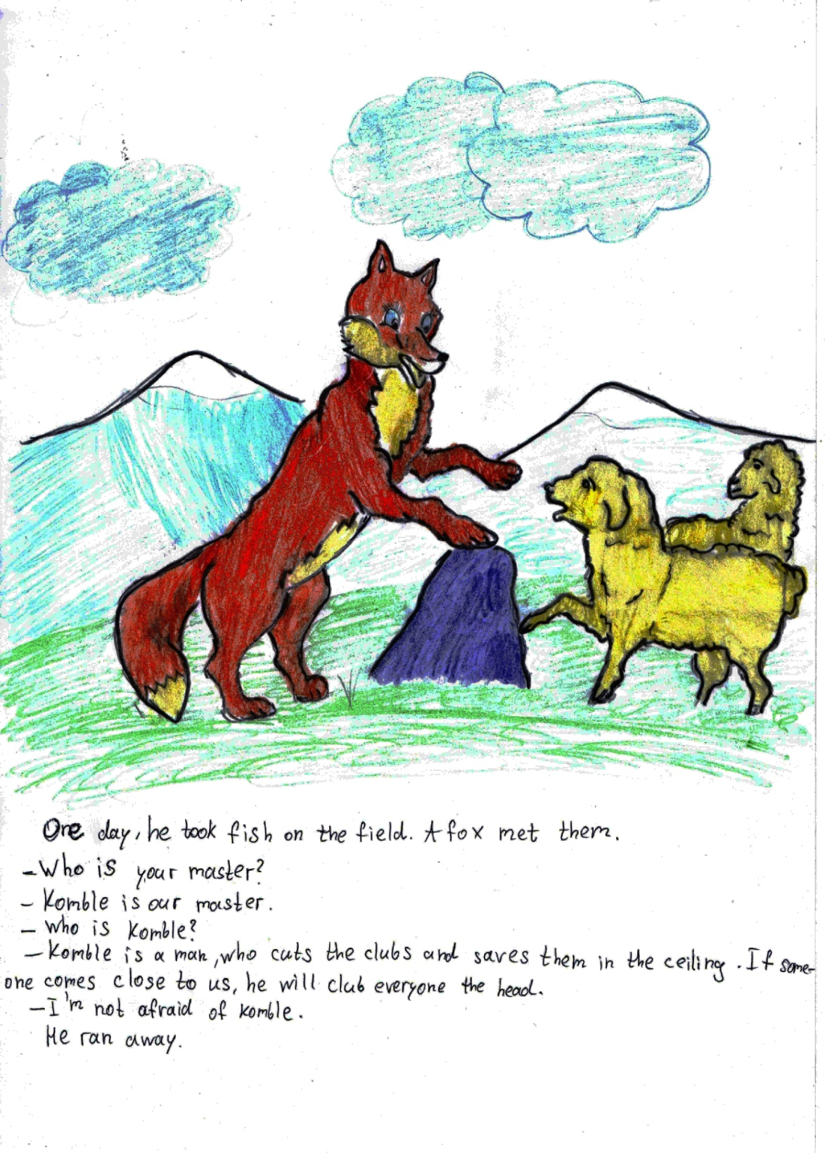

Slide 4
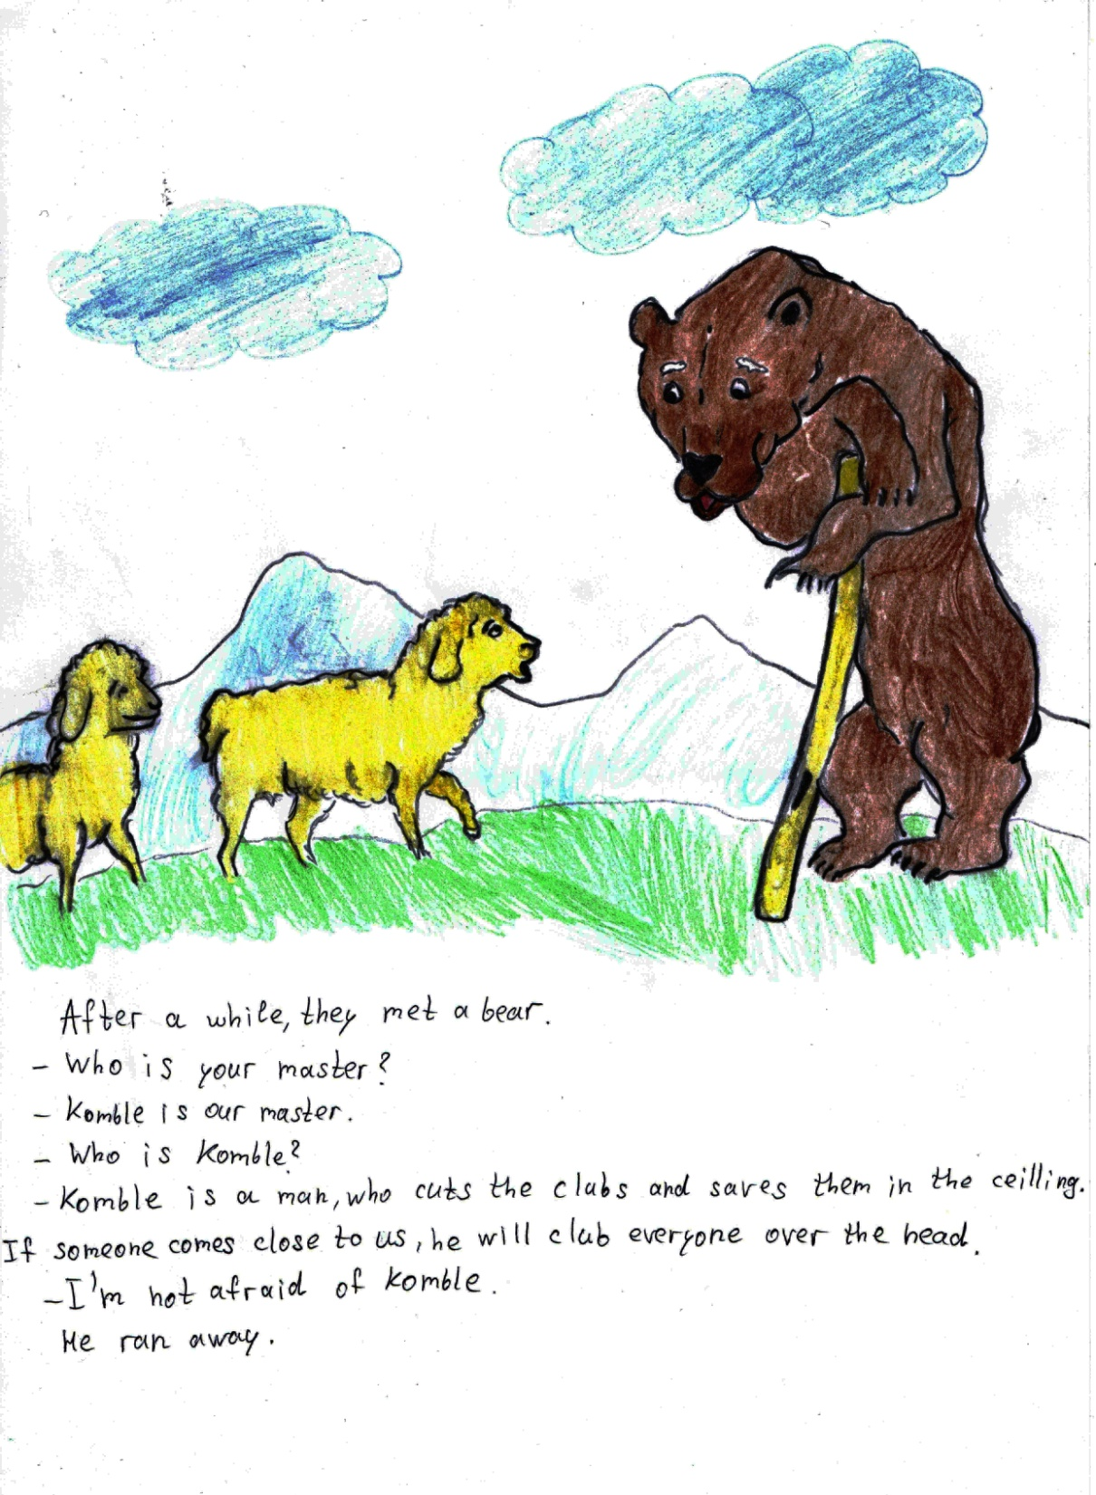

Slide 5
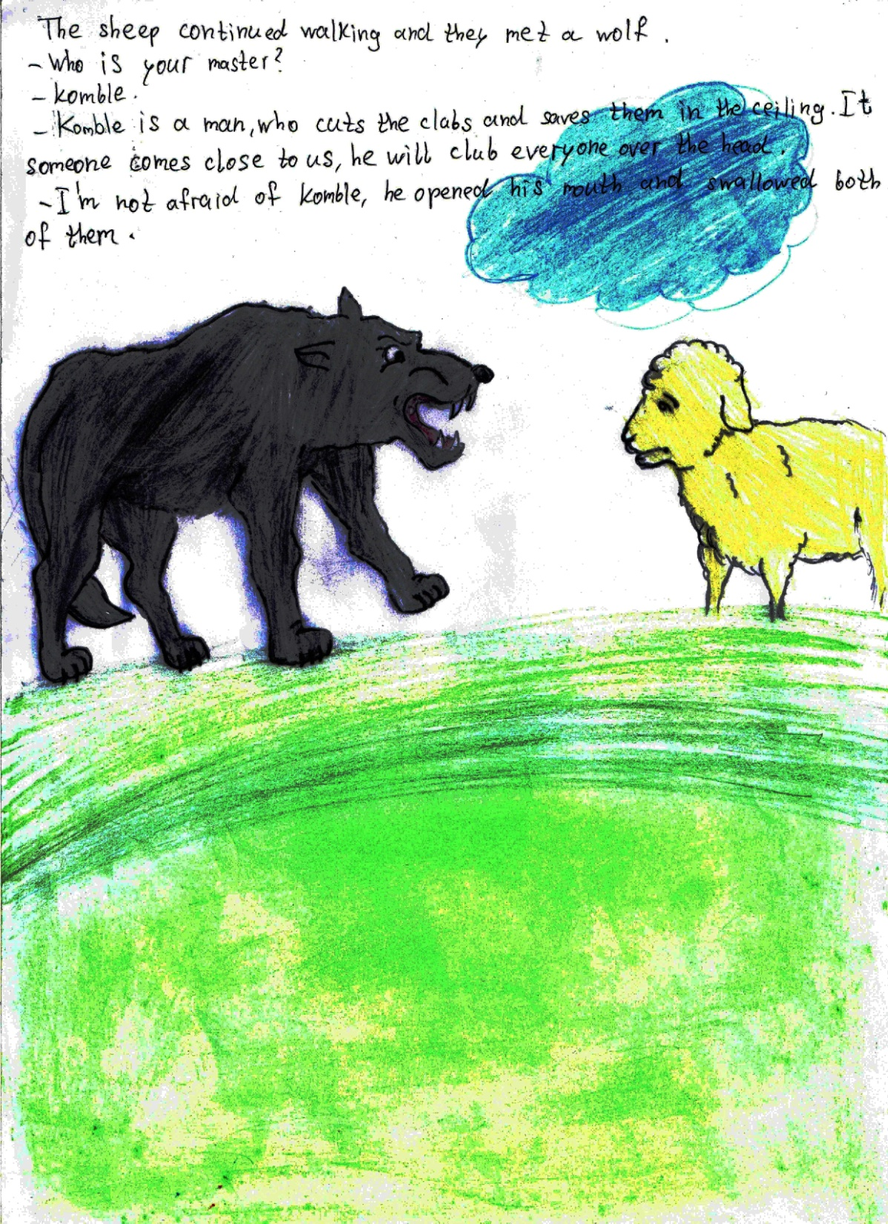

Slide 6
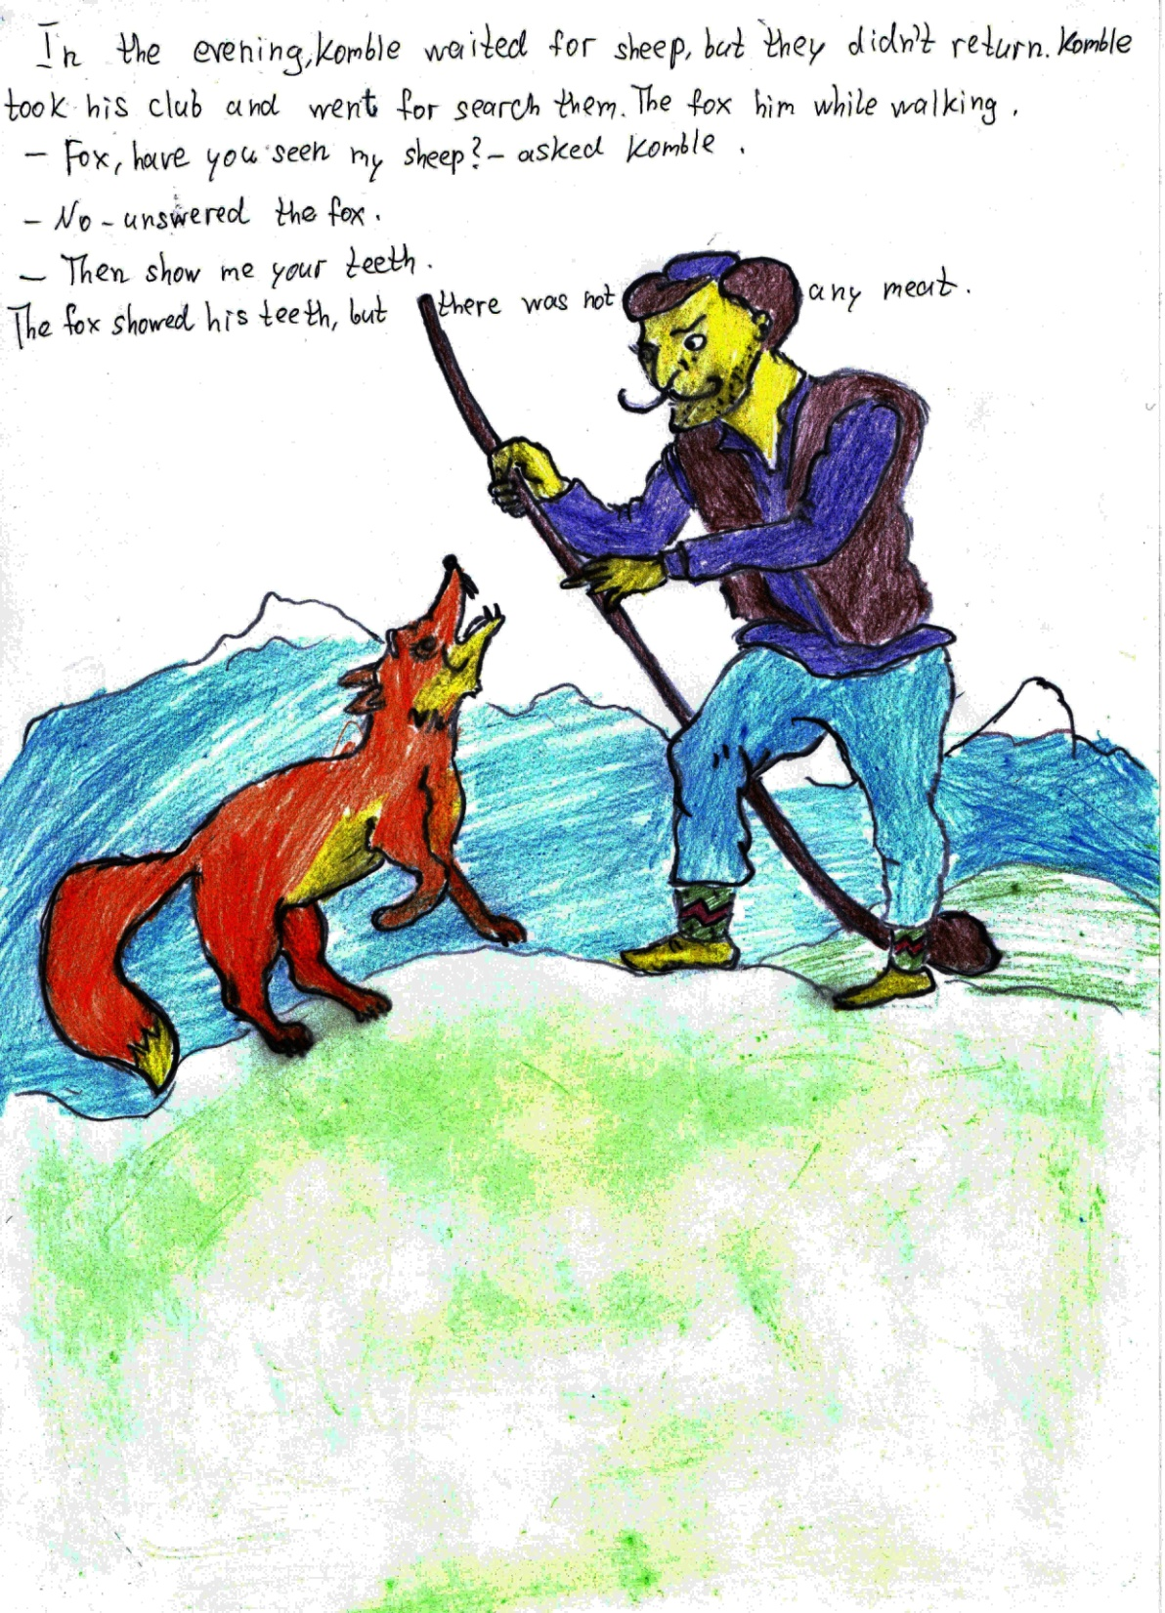

Slide 7
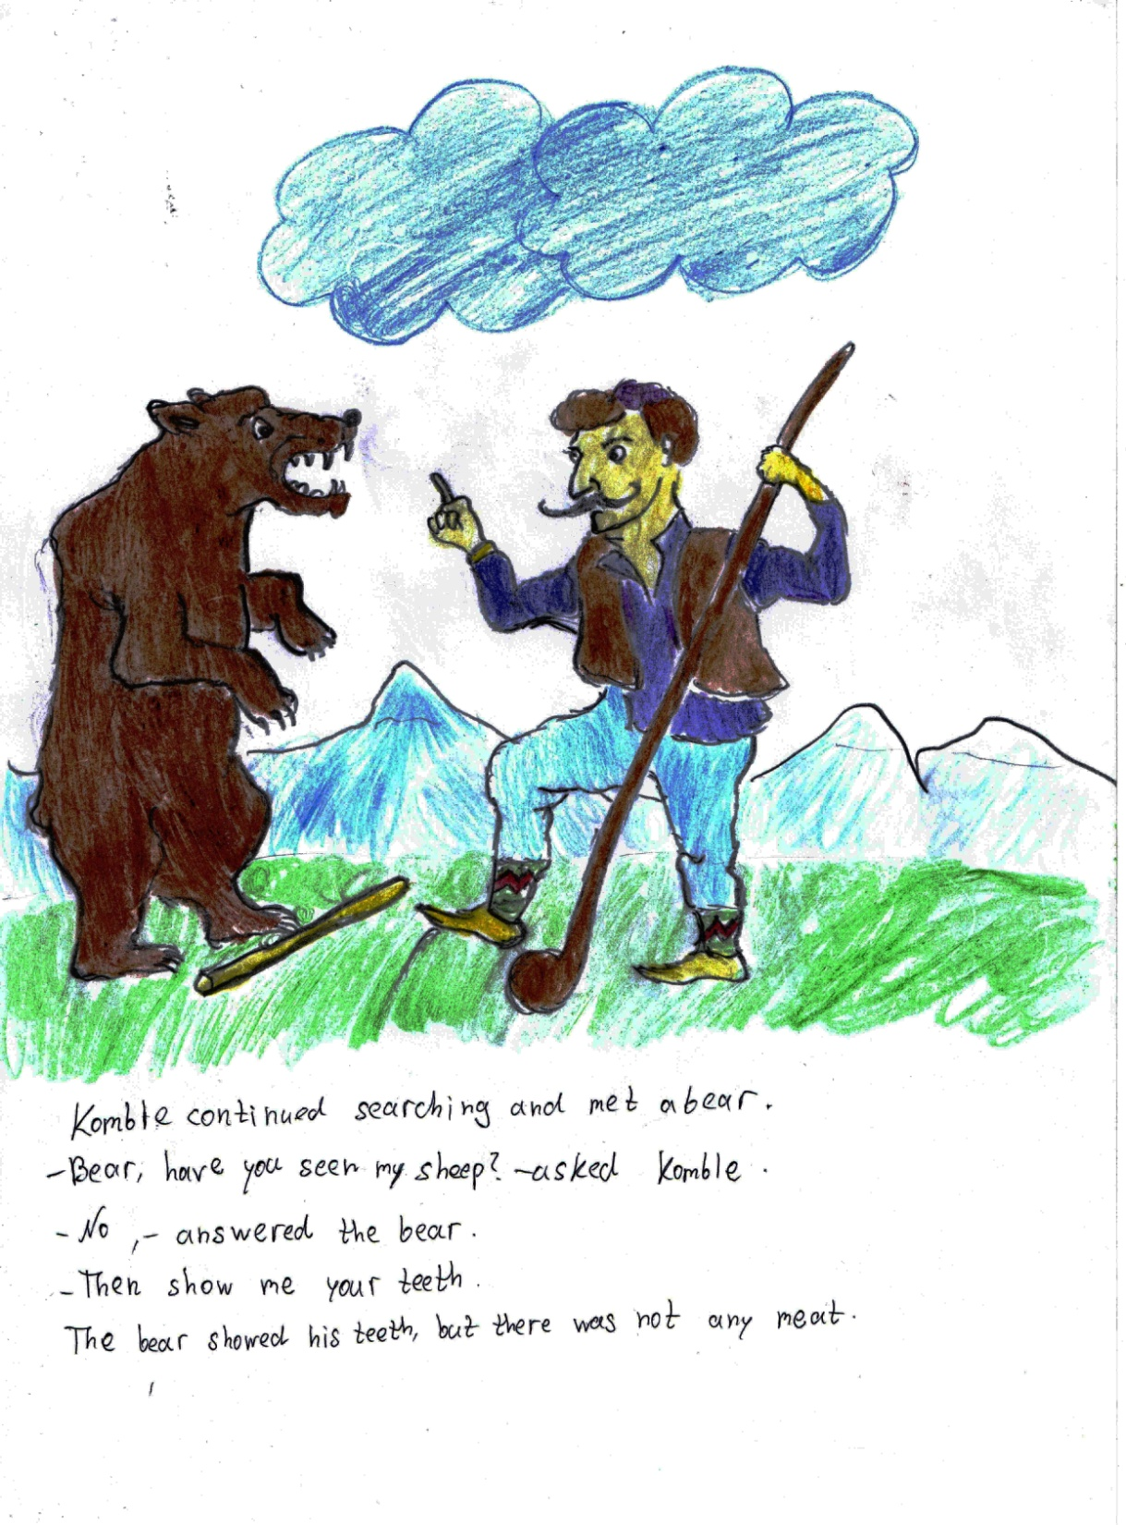

Slide 8
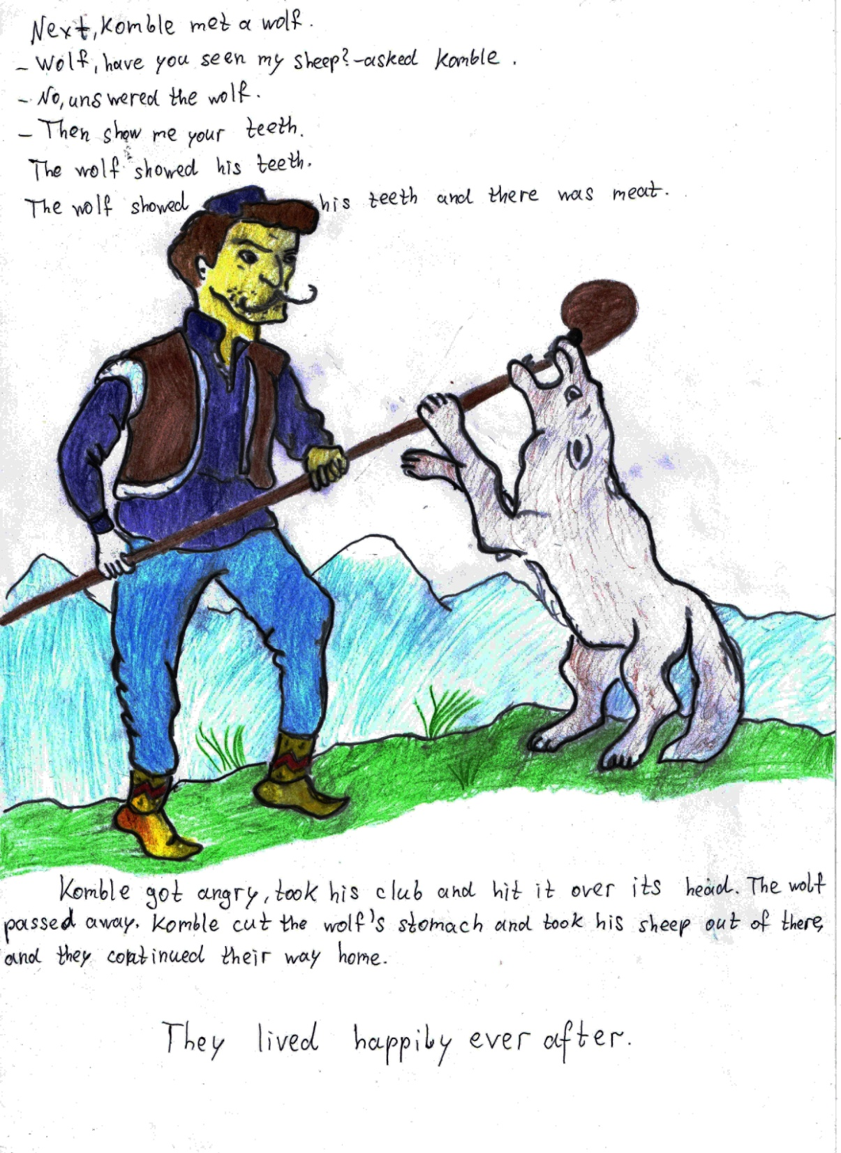

Slide 9
Georgia, Kutaisi, Phisical-mathmetical school N41 after Andria Razmadze
6-th graders

