Slide 1
A’ ENGOMI’S PRIMARY SCHOOL (KA)
E-Twinning project:
Let’s CODE TOGETHER

Slide 2
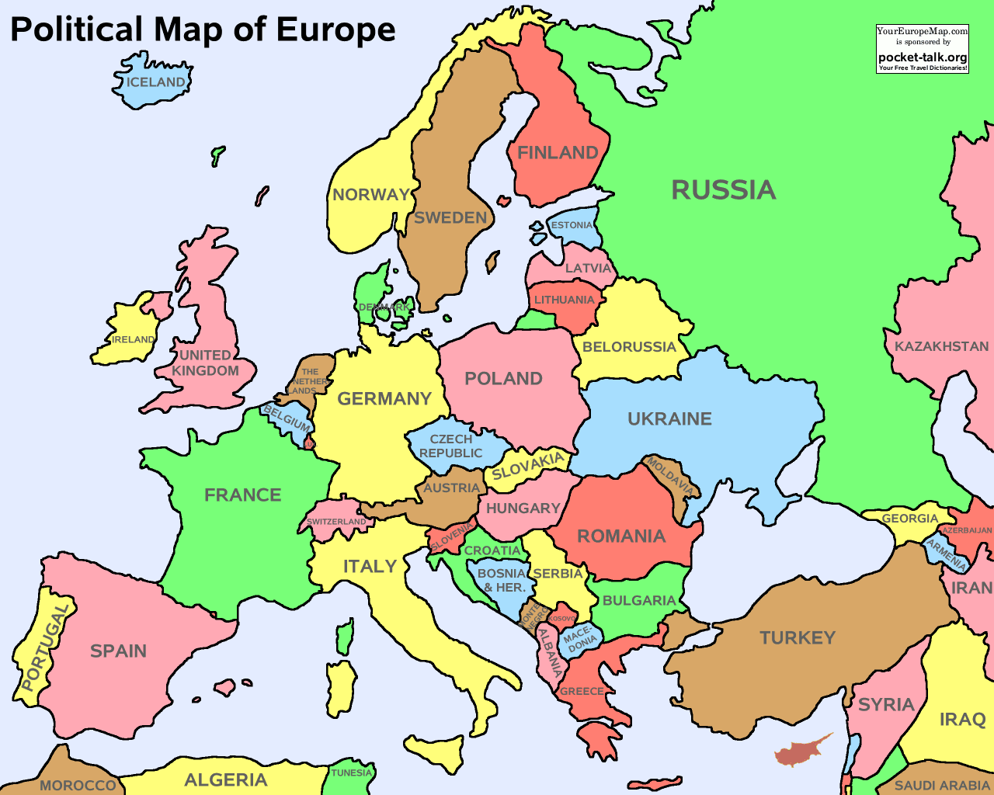
6
CYPRUS

Slide 3
FLAG AND EMBLEM

Slide 4
Our school is situated in the middle of the capital of Cyprus, Nicosia

Slide 5
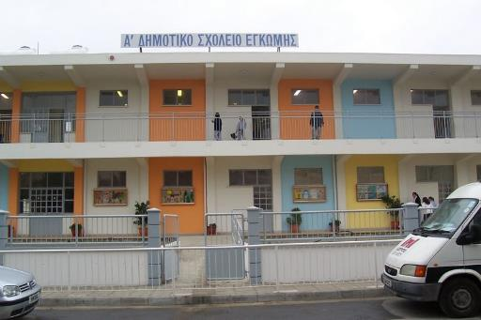
Our school

Slide 6
Important information
A’ Engomi’s Primary School was built in 1916!
Students are aged from 6-9
In 2017 we have 160 students.
There are 13 teachers.

Slide 7
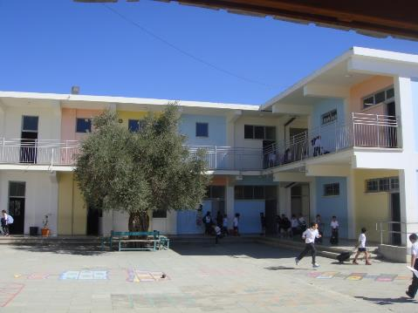
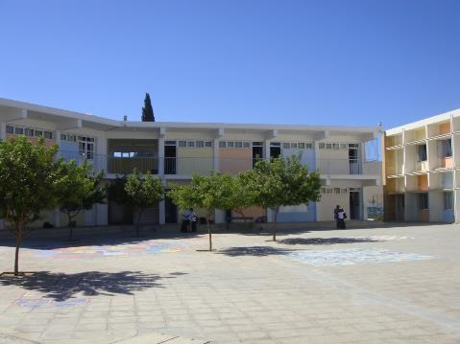
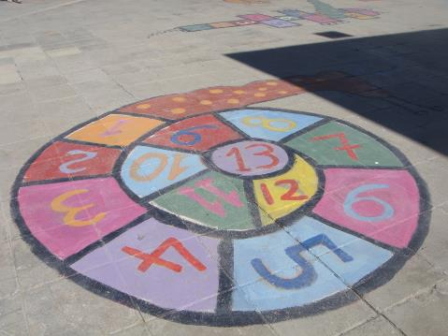
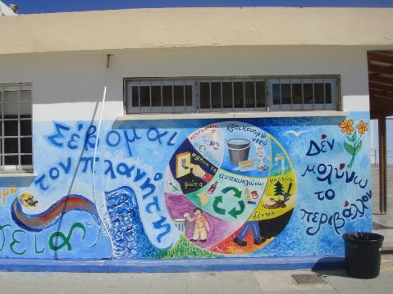
Our school yard!

Slide 8
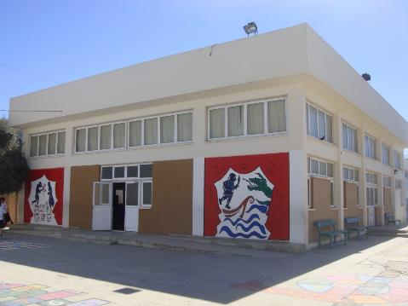
Our school’s theatre

Slide 9
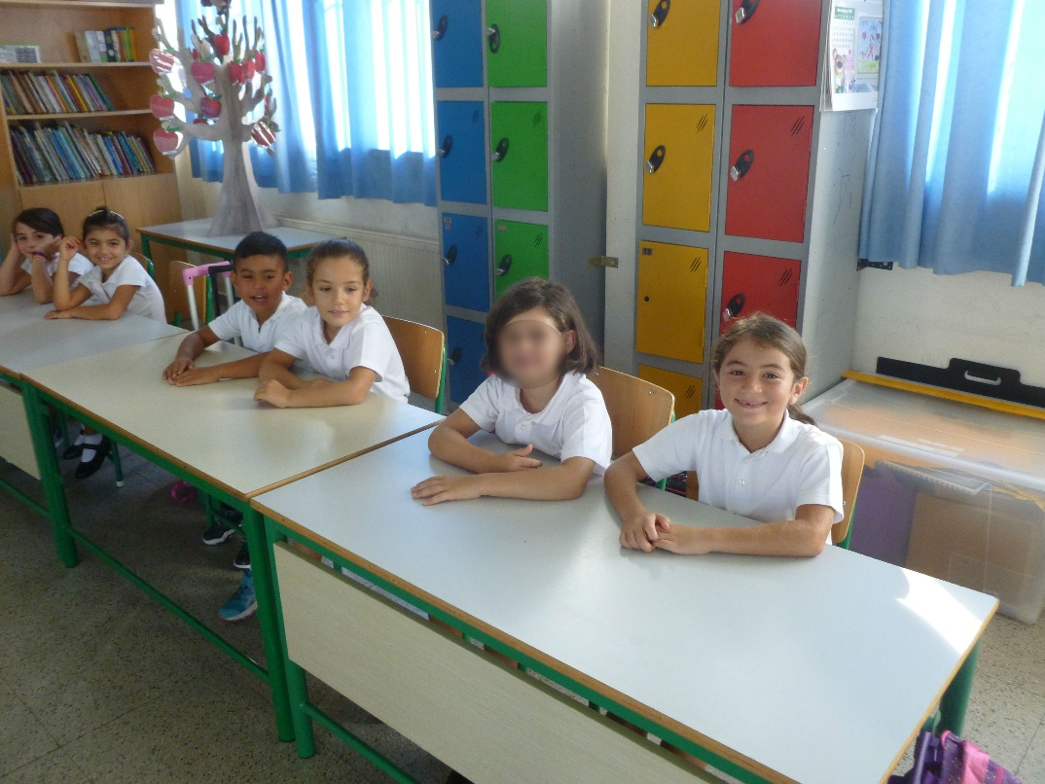
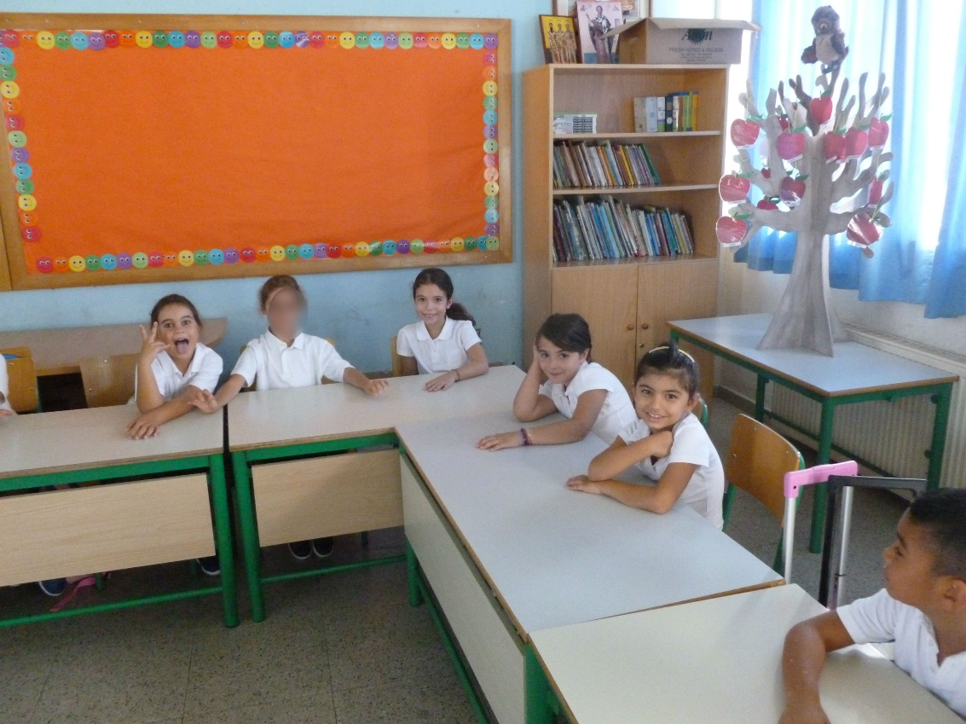
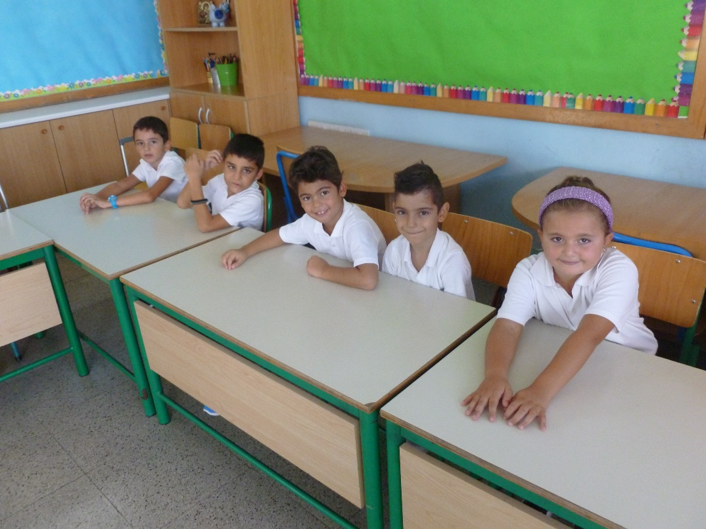
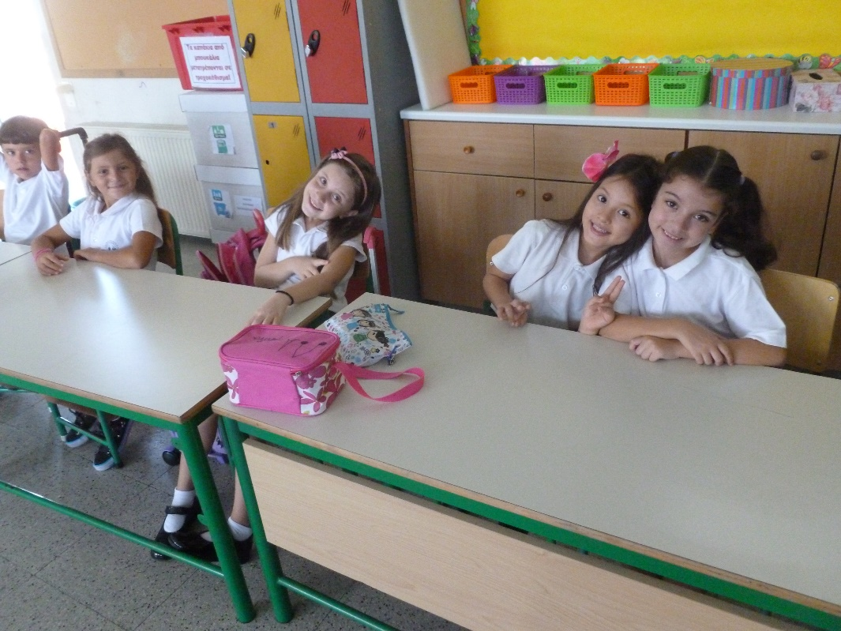
Hello from Cyprus!We love coding!

